Slide 1
Student Interest System
Name: Muqadas Arshad
Roll Number: BITF20M023

Slide 2
Introduction
Web-based application for managing student data on academic interests
Enhances overall efficiency in educational institutions
User Friendly interface

Slide 3
Technology
Frontend: HTML, CSS, JavaScript, and Bootstrap
Backend: Flask, a Python web framework
Database: MySQL Workbench
Visualization: Integration of charting libraries, such as Chart.js, for graphical representation of interest data

Slide 4
Reason of Choosing this Technology
Reasons:
Compatibility
Efficiency
Scalability
Community support
Visual appeal & user-friendliness

Slide 5
Key Features
Log in
Register
Logout
Dashboard
Add Student
All Student List
View Students
Update Students
Delete Students
Charts and Visualizations
Activity Log

Slide 6
Color Scheme
Color Scheme:
Primary: #3498db (Blue)
Secondary: #2ecc71 (Green)
Background: #ecf0f1 (Light Gray)
Accent: #e74c3c (Red)
Text: #34495e (Dark Gray)
Button: #3498db (Blue) for positive actions, #e74c3c (Red) for negative actions

Slide 7
Fonts Design
Font Design:
Headings: Roboto Condensed, bold
Body Text: Open Sans, regular
Buttons: Roboto Condensed, bold, uppercase
General: Maintain a clean and modern aesthetic, with readable font sizes for a user-friendly experience.

Slide 8
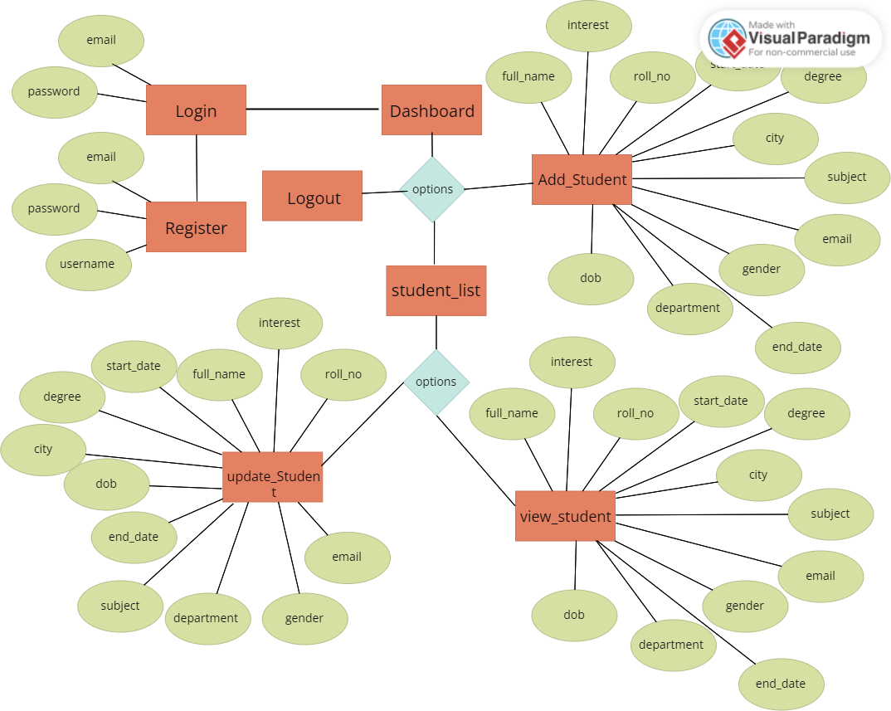
ER Diagram

Slide 9
Application Workflow
User login:
If not registered, self-registration
Redirect to login after successful registration
Redirect to dashboard upon successful login

Slide 10
Application Workflow
Dashboard navigation:
Logout
Student List
Add Student:
Redirect to Add Student page
Create: Redirect to Student List after successful creation
Cancel: Redirect to Student List

Slide 11
Application Workflow
Student List:
View: Redirect to View Student page
Update: Redirect to Update Student page
Delete: Confirmation pop-up, redirect to Student List after successful action

Slide 12
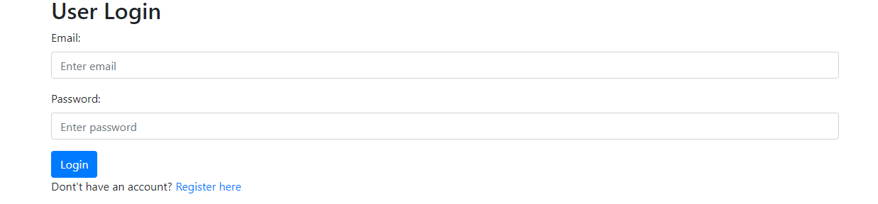
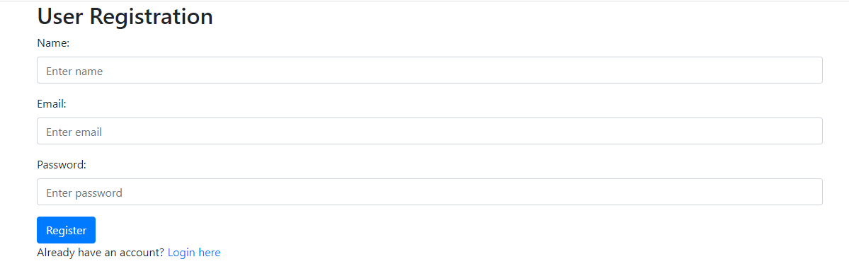
Login and Register Screen

Slide 13
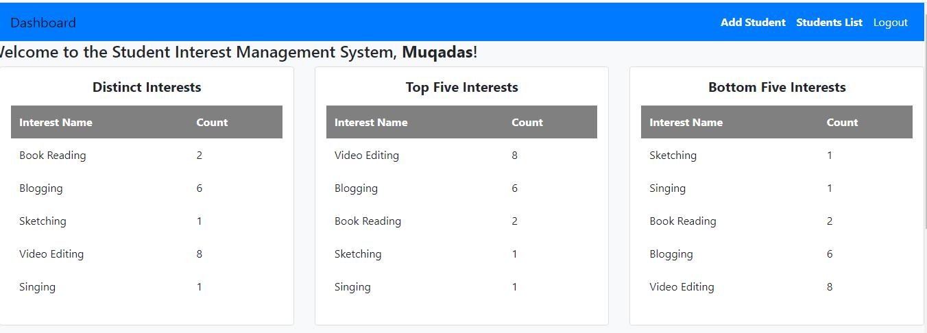
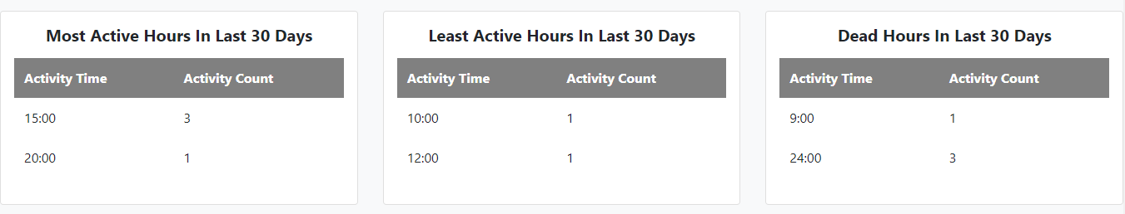
Dashboard Screens

Slide 14
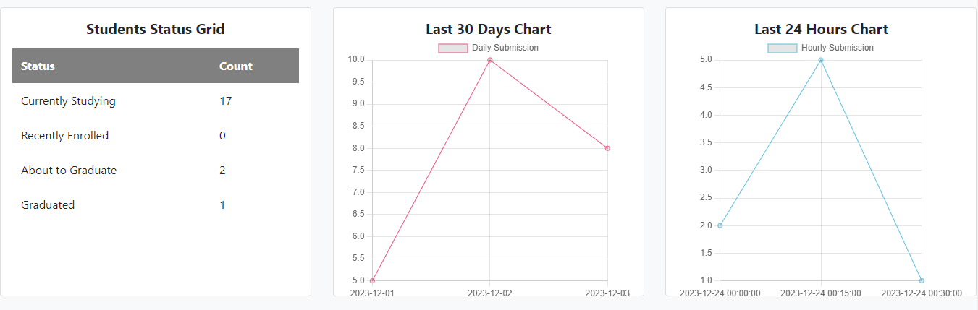
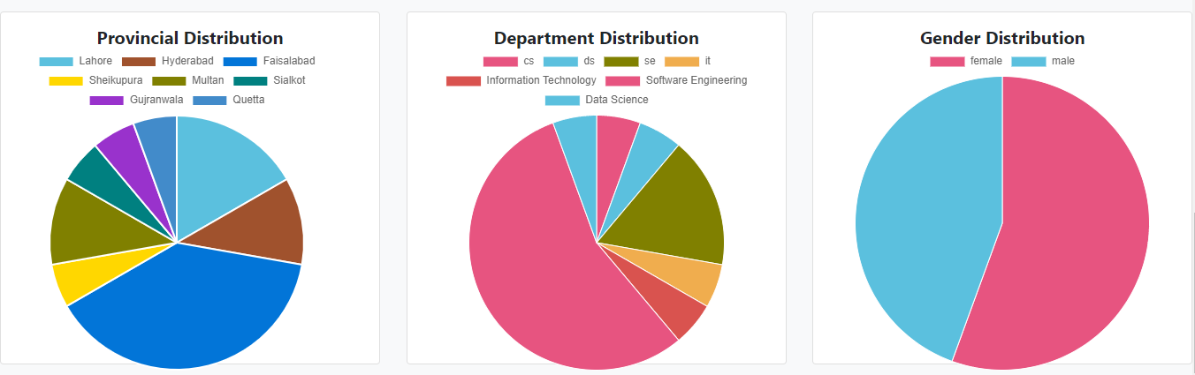
Dashboard Screens

Slide 15
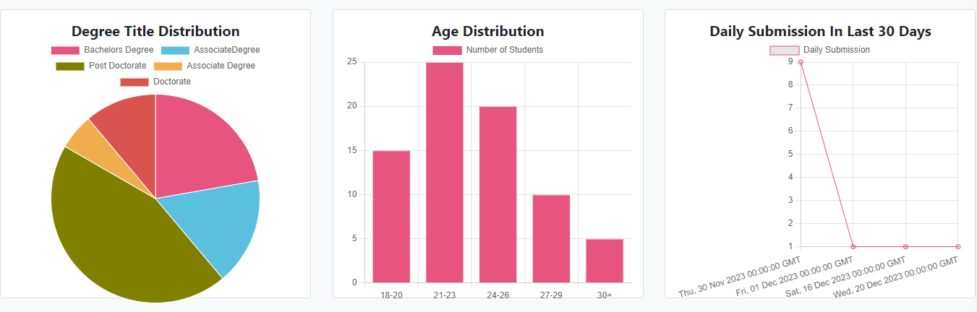
Dashboard Screens

Slide 16
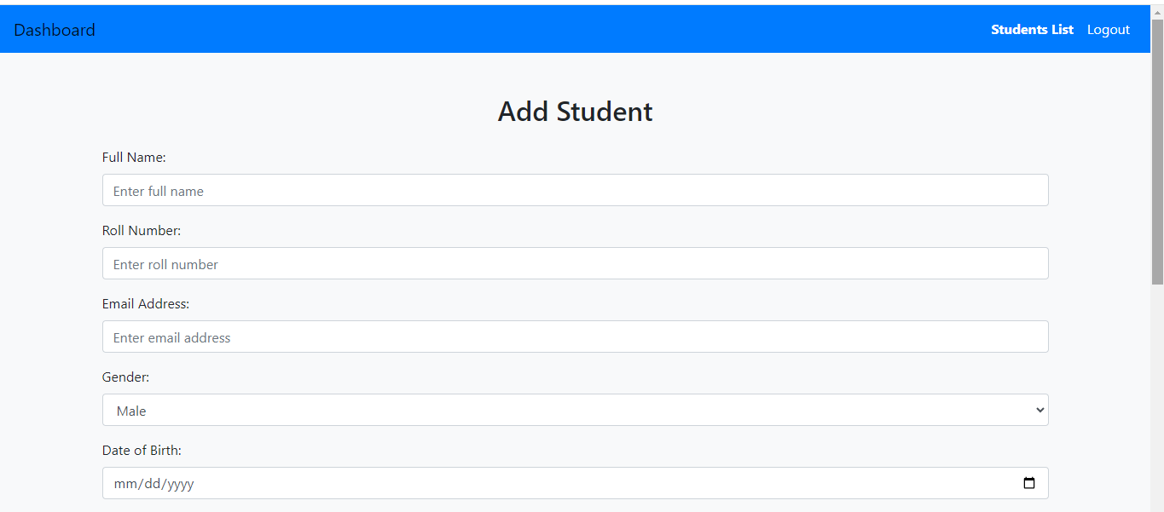
Add Student Screen

Slide 17
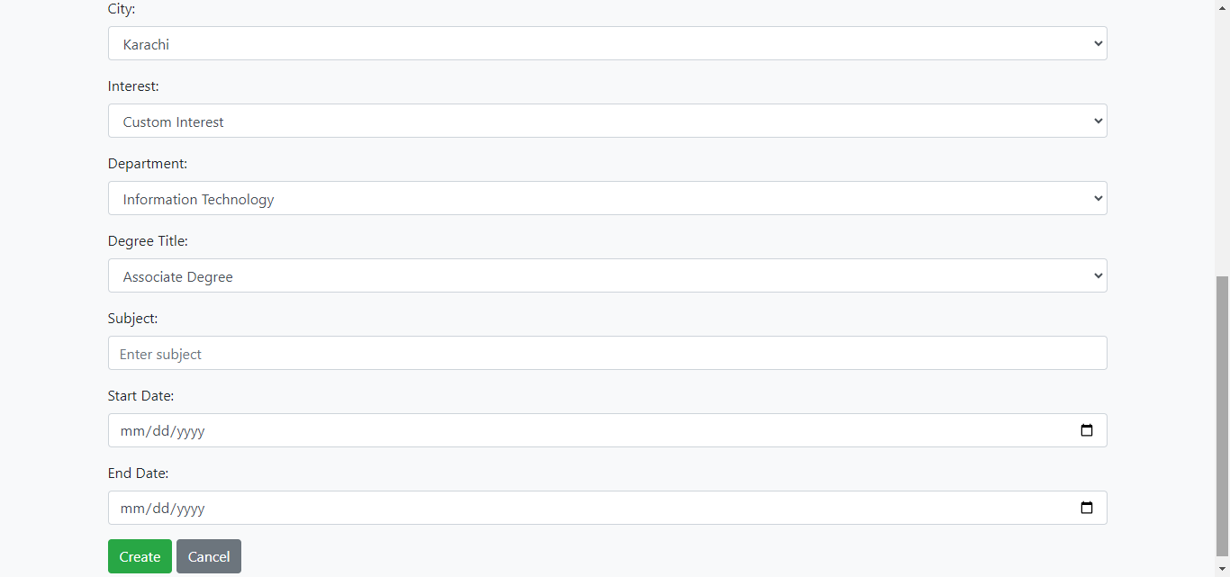
Add Student Screen

Slide 18
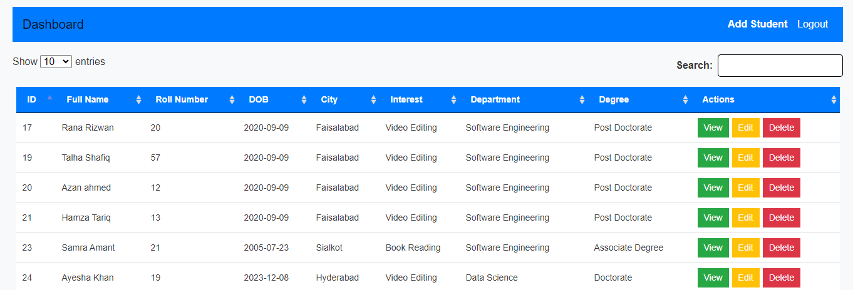
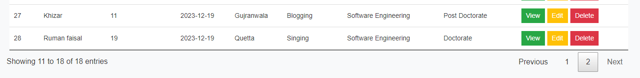
Student List Screen

Slide 19
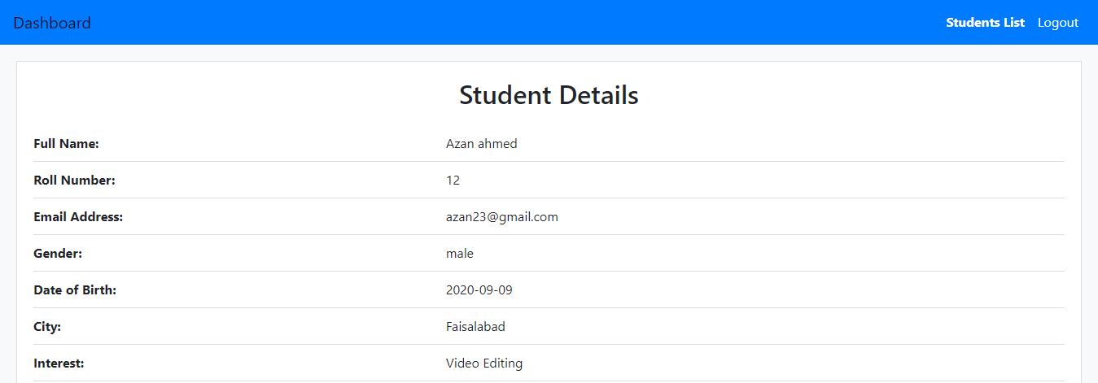
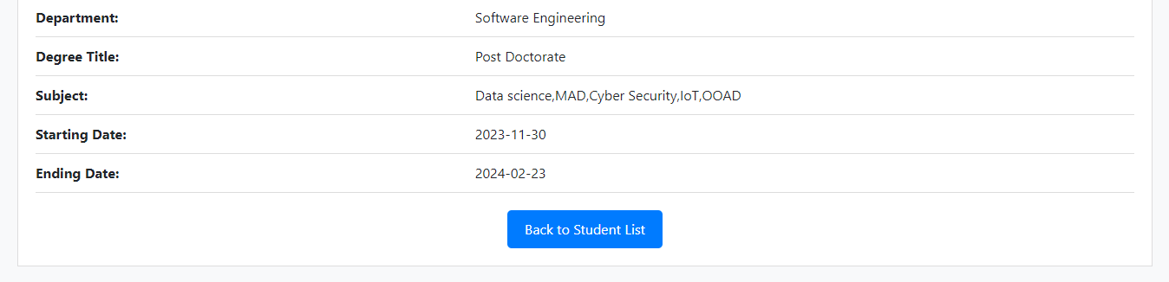
View Student Screen

Slide 20
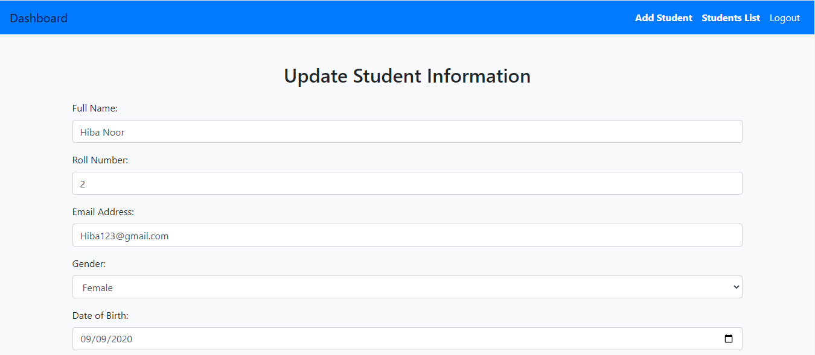
Update Screen

Slide 21
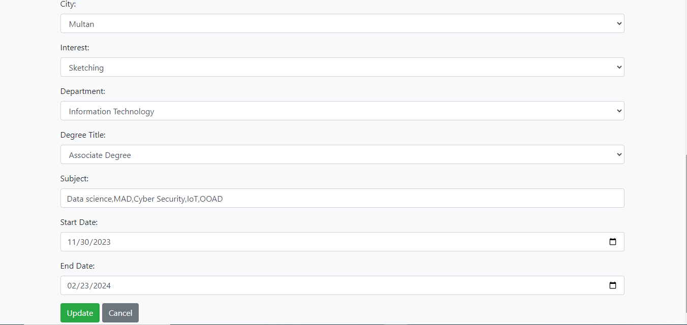
Update Screen

Slide 22
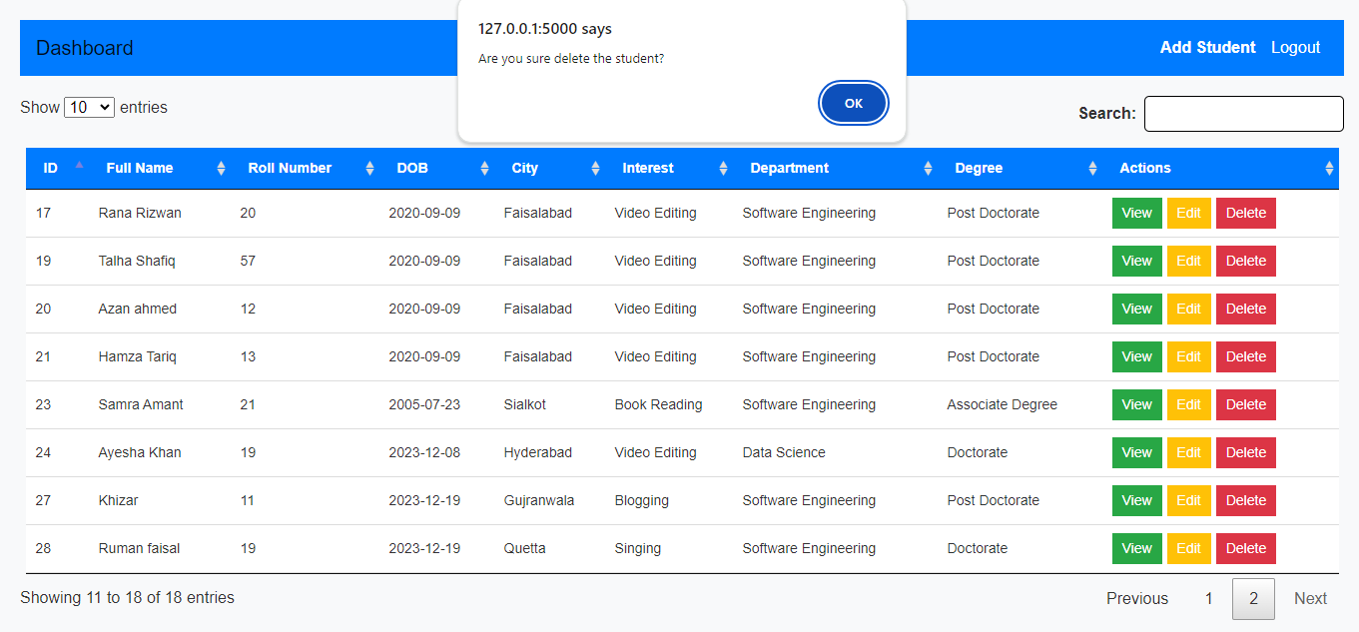
Delete Screen

Slide 23


