Slide 1
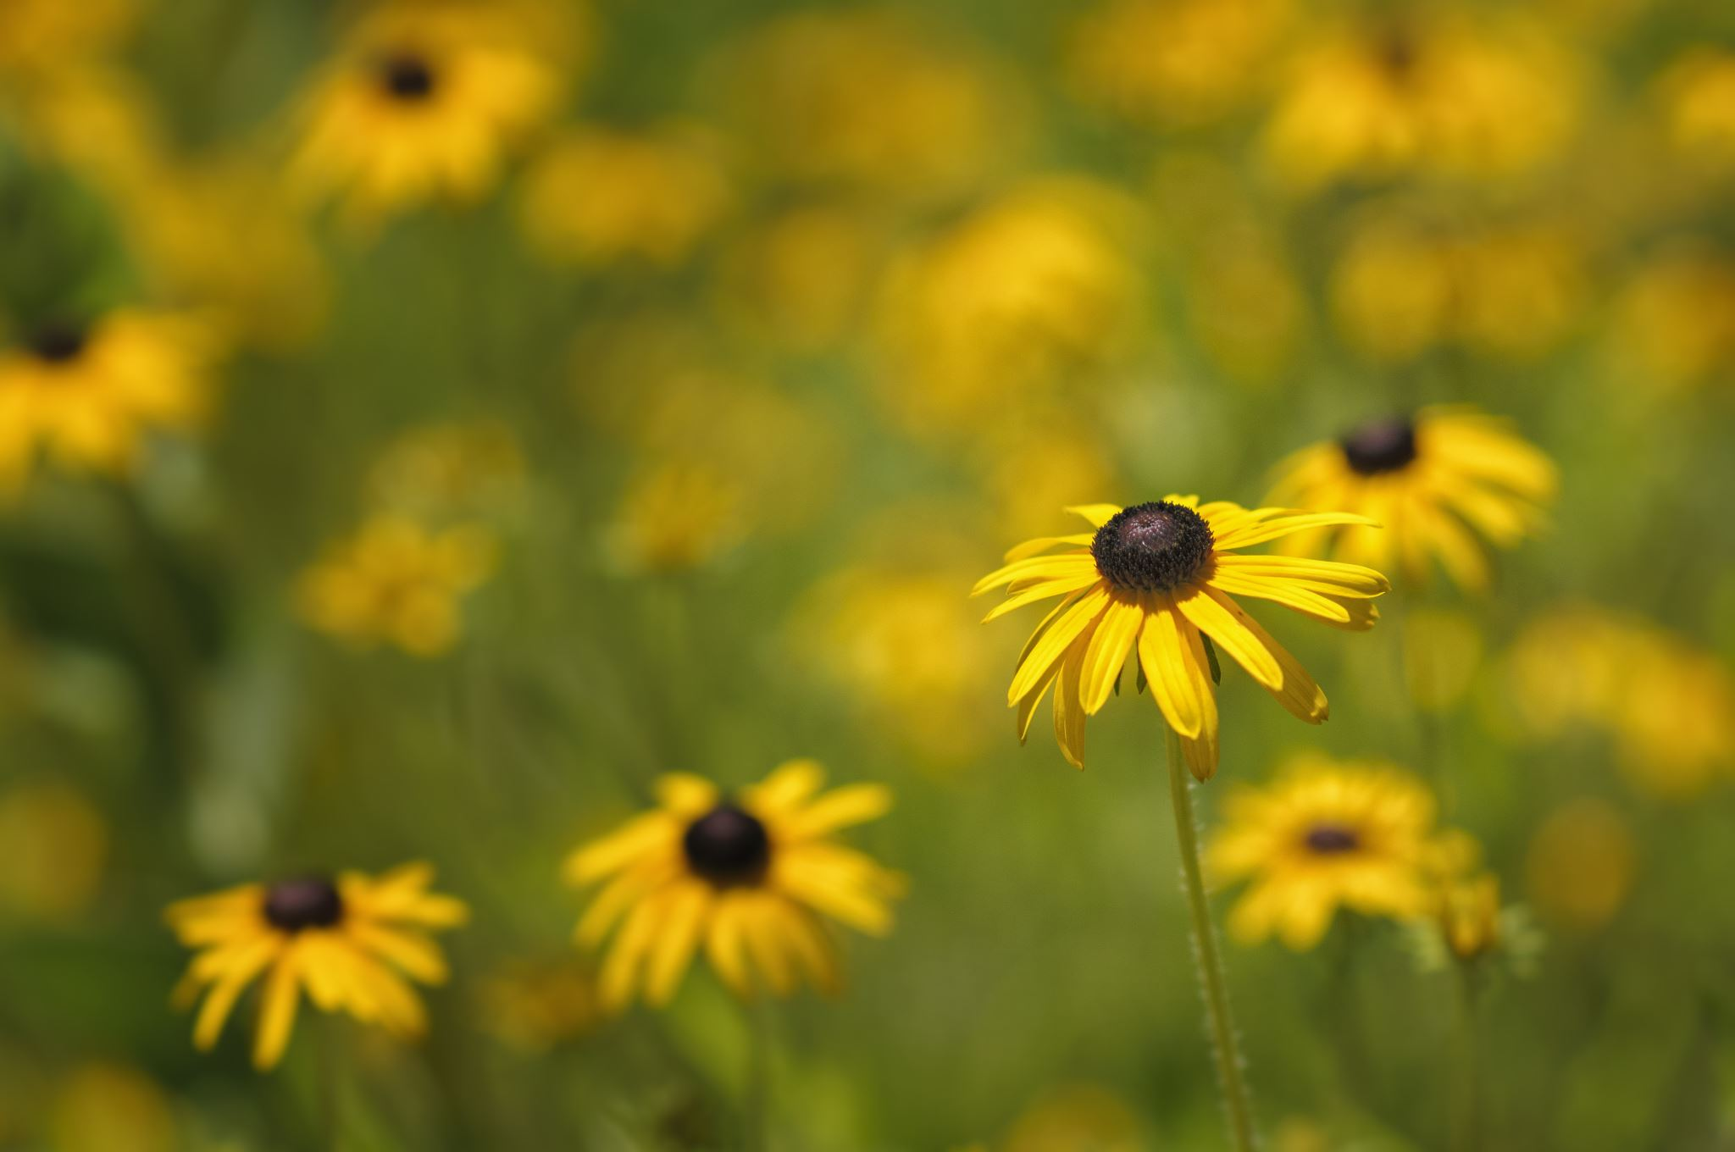
TITLE
FLOWER

Slide 2
CHAPTER #01 FLOWER CYCLE

Slide 3
OUTDOOR PLANTS
The quick brown fox jumps over the lazy dog. The quick brown fox jumps over the lazy dog. The quick brown fox jumps over the lazy dog. The quick brown fox jumps over the lazy dog..

Slide 4
INDOOR PLANTS
The quick brown fox jumps over the lazy dog. The quick brown fox jumps over the lazy dog. The quick brown fox jumps over the lazy dog. The quick brown fox jumps over.

