Slide 1


Slide 2

AV / ADC — 362
COMPLEX ENGINEERING PROBLEM PRESENTATION
Hardware-in-the-Loop Simulation of a UAV Altitude Control System via FM Telemetry Link
Presented By:
• Abdul Muqtadir
• Rehan (23101012 - AC)
• Haroon (23101009 - AC)
• Anas (23101010 - AC)
Total Slides: 21
Department:
Dept. of Avionics Engineering
NUST College of Aeronautical Engineering
Risalpur, Pakistan

Slide 3
Sequence
1. Project Aim & Objectives
2. Introduction & Motivation
3. Literature Review
4. System Architecture & Methodology
5. Results & Performance Analysis
6. Conclusion & Future Scope

Slide 4
Project Aim & Objectives
• Real-Time Flight Emulation: Simulate 2nd-order UAV altitude dynamics and closed-loop autopilot feedback via embedded Python.
• Physical RF Telemetry Link: Transmit real-time flight telemetry over-the-air at 915 MHz using ADALM-Pluto SDR.
• Atmospheric Noise Modeling: Subject telemetry stream to severe Additive White Gaussian Noise (AWGN) to replicate harsh channels.
• DSP Signal Recovery: Implement Quadrature Demodulation and Single-Pole IIR filtering to recover clean control data.

Slide 5
Introduction & Problem Motivation
• Avionics Validation Bottleneck: Physical flight testing of control surfaces and telemetry is cost-prohibitive and presents safety risks.
• Hardware-in-the-Loop (HITL) Role: Bridges the gap between pure software simulations and physical aerospace prototypes.
• Over-The-Air RF Fidelity: Exposes digital telemetry data to real-world propagation characteristics and hardware latency.
• Integrated Digital Twin: Mathematically unifies flight mechanics, RF modulation, and receiver DSP directly in GNU Radio.

Slide 6
Literature Review

Slide 7
Literature Review & Theoretical Background
• Classical PID in Avionics: Remains the industry benchmark for UAV stabilization due to computational efficiency and robust disturbance rejection.
• Software-Defined Radio (SDR): Reconfigures RF modulation chains dynamically, replacing bulky, dedicated analog hardware.
• GNU Radio DSP Pipeline: Enables seamless mathematical coupling of physical plant dynamics directly into the communication pipeline.
• Channel Impairment Mitigation: Quadrature demodulation paired with low-pass IIR filtering effectively rejects atmospheric phase clicks.

Slide 8
System Architecture & Methodology

Slide 9
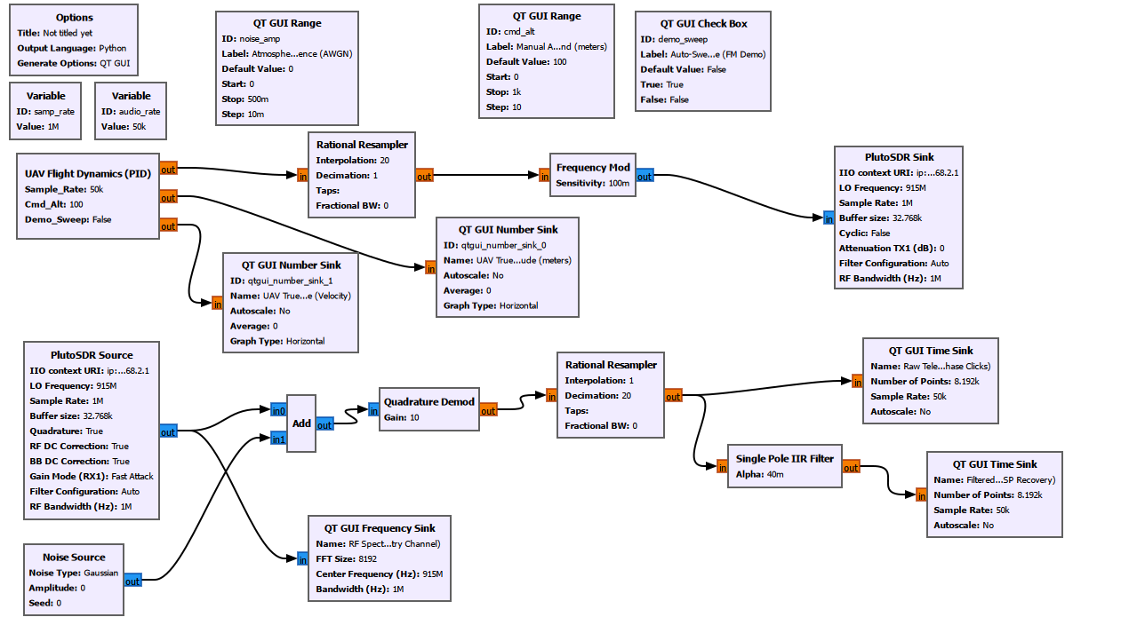
Methodology: System Architecture & Pipeline
• Closed-Loop Transmission Cycle: Complete pipeline: Physics Engine → FM Modulator → 915 MHz SDR TX → RF Channel → SDR RX → DSP Recovery.
• Custom Flight Computer: Embedded Python block computes aerodynamic drag, motor thrust, and telemetry streams.
• Over-The-Air Hardware Loopback: Physical transmission and reception across matched 915 MHz whip antennas.
• Real-Time Ground Station: QT GUI displays live RF spectra, telemetry time scopes, and altitude setpoints.

Slide 10
Methodology: UAV Dynamics & Physics Engine
• Second-Order Dynamic Model: Governs vertical UAV motion incorporating vehicle mass (1.0 kg) and aerodynamic drag (1.1 Ns/m).
• Equation of Motion: Net acceleration computed via a(t) = [u(t) - drag · v(t)] / mass, where u(t) is commanded motor thrust.
• Discrete-Time Integration: Real-time state integration: Velocity v(k+1) = v(k) + a·dt and Altitude h(k+1) = h(k) + v·dt.
• Ground Boundary Clamping: Altitude clamped at h ≥ 0 to model realistic ground contact and avoid unphysical negative altitude.

Slide 11
Methodology: Autopilot PID Control Algorithm
• Altitude Error Tracking: Instantaneous altitude error computed continuously as e(t) = Target Altitude - Current Altitude.
• Three-Term Control Logic: Commanded thrust signal: u(t) = Kp·e(t) + Ki·∫e(t)dt + Kd·[de(t)/dt].
• Integral Anti-Windup Limiting: Cumulative integral error clamped between [-300, 300] to prevent actuator saturation and overshoot.
• Aggressively Tuned Gains: Configured with Kp = 3.0, Ki = 0.08, Kd = 0.9 to yield a distinct underdamped transient response.

Slide 12
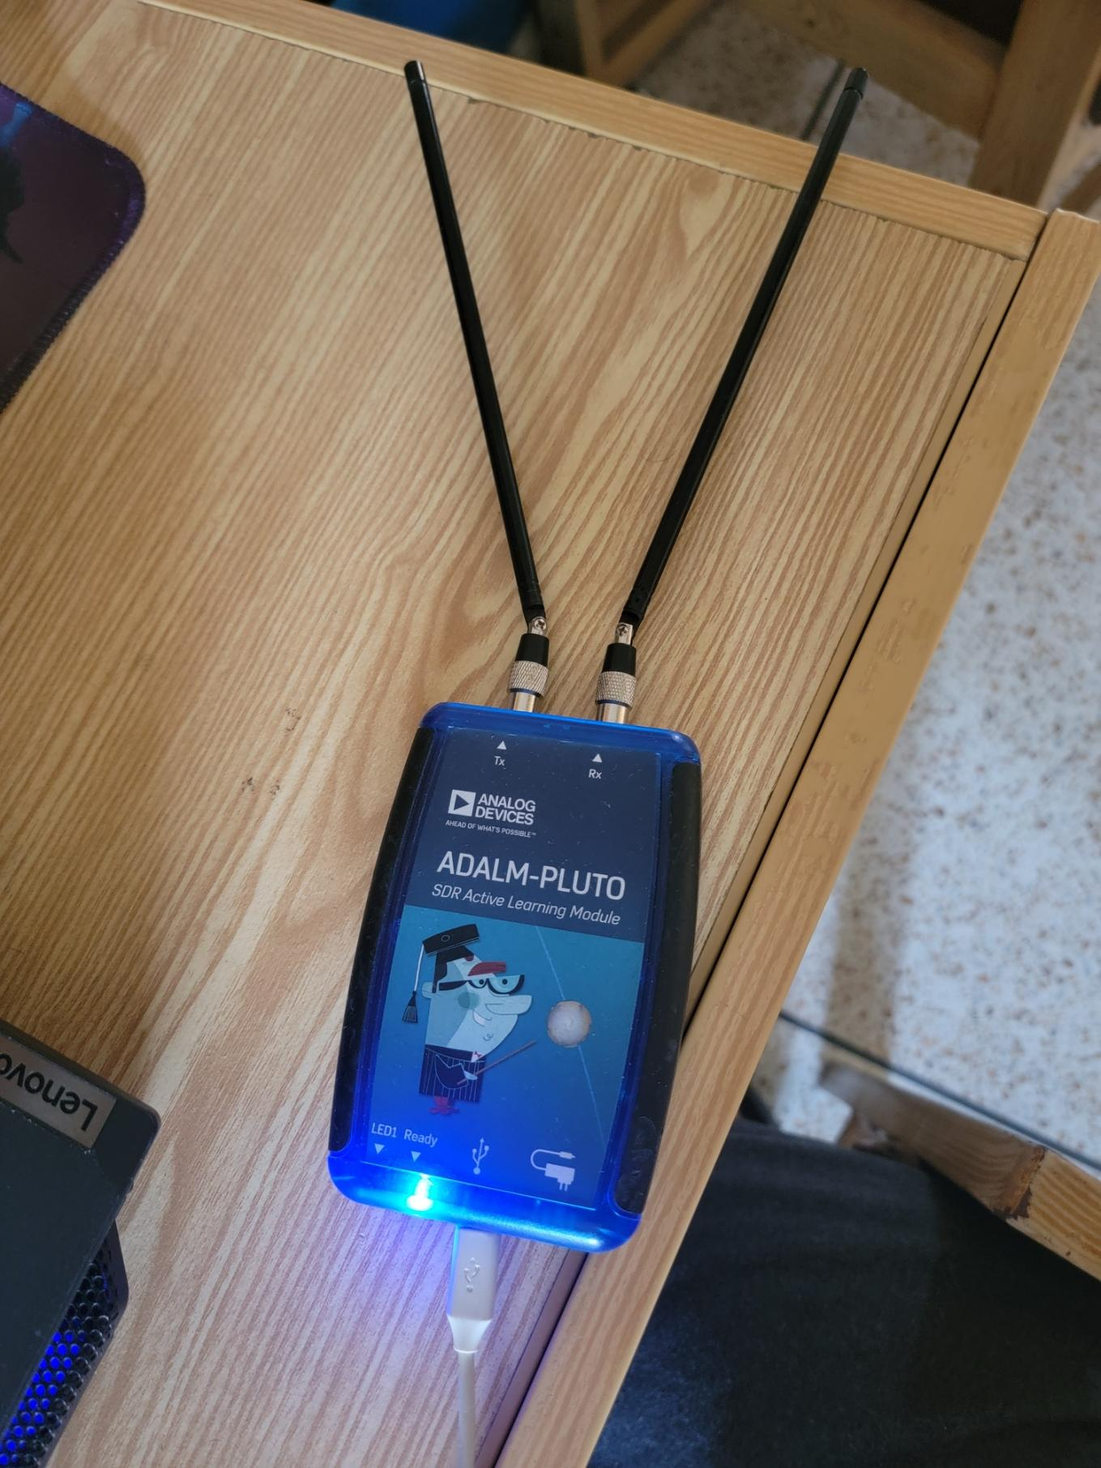
Methodology: FM Telemetry & SDR RF Loopback
• Telemetry Stream Normalization: Flight altitude data mapped to a normalized floating-point baseband signal.
• Direct Frequency Modulation: Continuous FM modulation encoding instantaneous flight altitude into frequency shifts.
• ADALM-Pluto SDR Transceiver: Baseband signal upconverted and transmitted over-the-air at 915 MHz carrier frequency.
• Physical Channel Realism: Over-the-air link exposes telemetry to real analog channel impairments and hardware latency.

Slide 13
Methodology: DSP Recovery & Noise Mitigation
• Synthetic Noise Injection: Additive White Gaussian Noise (AWGN) source mixed into the RF channel to stress-test receiver robustness.
• Quadrature Demodulation: Computes instantaneous phase derivative to extract baseband telemetry from complex I/Q samples.
• Single-Pole IIR Low-Pass Filter: Configured with weighting factor α = 0.04 to eliminate high-frequency phase clicks.
• Signal Reconstruction: Successfully extracts the smooth underlying low-frequency altitude curve required for feedback.

Slide 14
Results & Performance Analysis

Slide 15
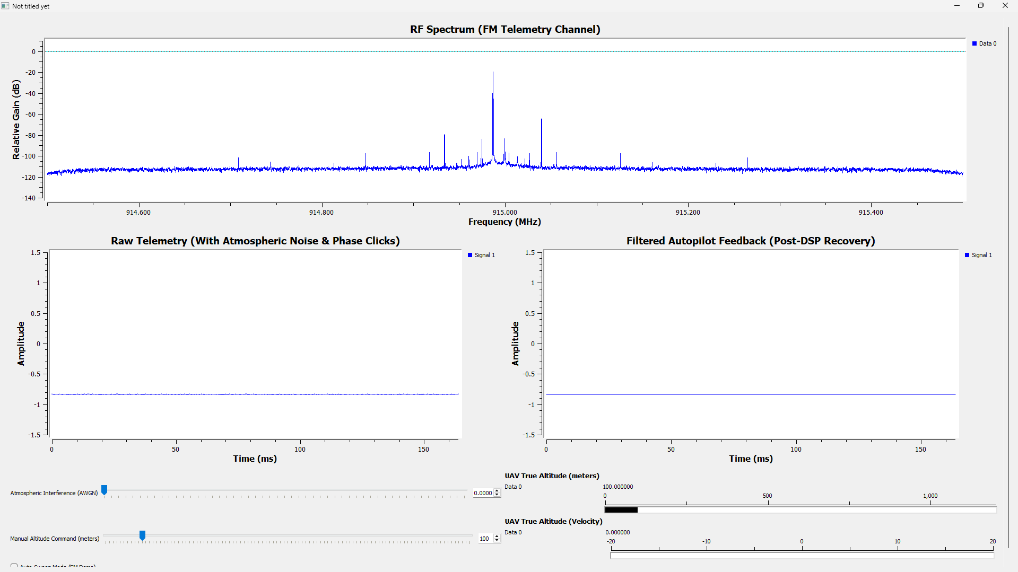
Results: Baseline Steady-State Hover Analysis
• Zero-Noise Benchmark: Evaluated under ideal channel conditions (AWGN = 0) to establish baseline flight dynamics.
• Stable Altitude Lock: Flight computer maintains precise steady-state hover with zero steady-state error.
• Tightly Clustered FM Spectrum: RF energy remains concentrated at carrier frequency during static altitude hold.
• Verified Autopilot Equilibrium: Confirms proper mass-drag-thrust balance and baseline PID loop convergence.

Slide 16
Results: Dynamic Step Response Analysis
• Automated Step Maneuver: Commanded rapid 800-meter vertical climb from 200 m to 1000 m target altitude.
• Underdamped Flight Profile: Exhibits distinct transient overshoot and smooth settling time characteristic of tuned PID gains.
• FM Sideband Expansion: Spectrum analyzer captures noticeable spectral broadening corresponding to maximum climb velocity.
• Closed-Loop Tracking Fidelity: Telemetry stream faithfully tracks rapid physical acceleration without lag or numerical divergence.

Slide 17
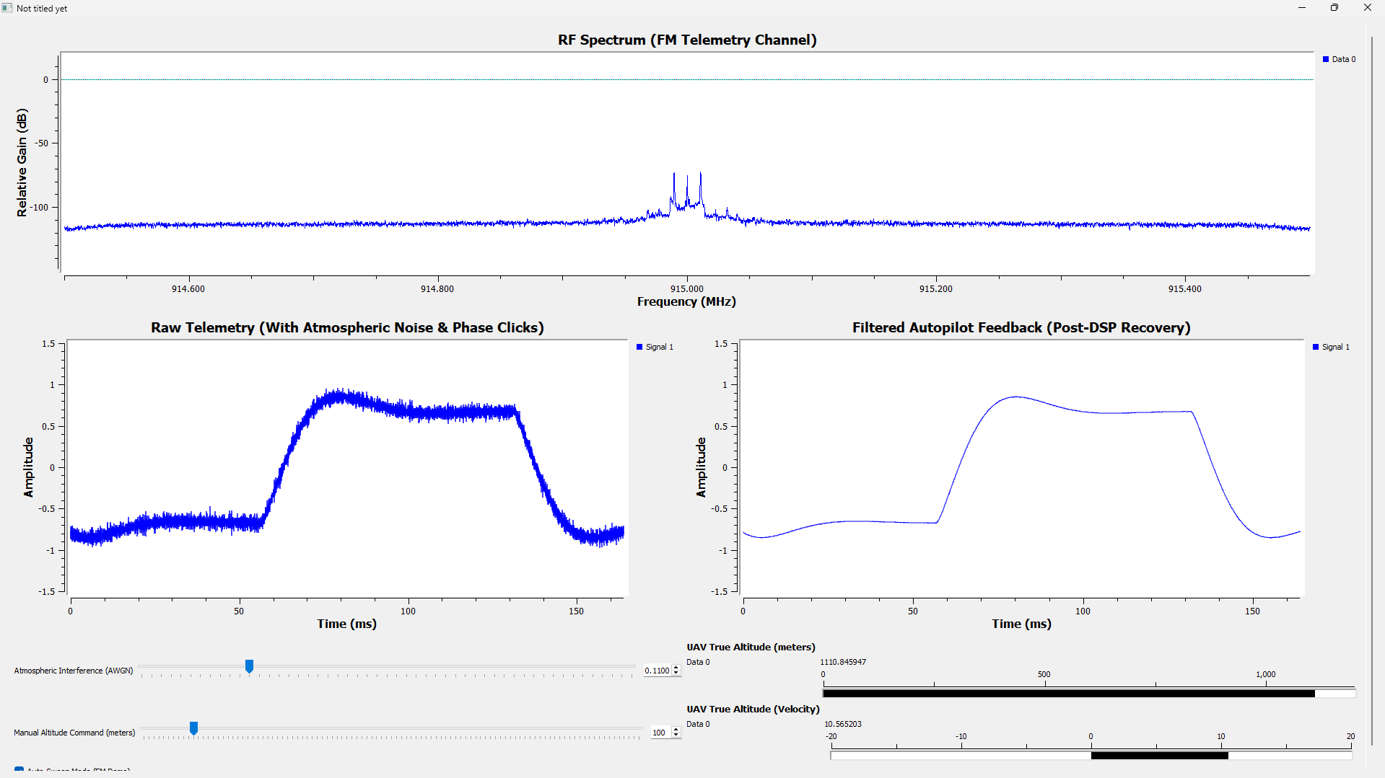
Results: AWGN Noise Rejection & Signal Recovery
• Severe Interference Conditions: Telemetry subjected to high-amplitude AWGN simulating harsh atmospheric interference.
• Raw Telemetry Corruption: Left time scope demonstrates complete signal corruption by channel noise floor and phase clicks.
• DSP Filter Performance: Single-Pole IIR filter (α = 0.04) completely strips high-frequency noise spikes.
• Restored Clean Feedback: Right time scope recovers smooth, continuous underdamped curve suitable for reliable autopilot feedback.

Slide 18
Conclusion & Future Scope

Slide 19
Conclusion: Key Achievements & Findings
• Successful HITL Demonstration: Validated real-time flight physics coupled seamlessly with physical SDR hardware loopback.
• Robust Over-The-Air Link: 915 MHz FM transmission provided reliable real-time telemetry streaming via ADALM-Pluto SDR.
• High Noise Immunity: Quadrature demodulation and IIR filtering successfully recovered critical flight data under heavy AWGN.
• Scalable Avionics Framework: Proves viability of GNU Radio + SDR testbed as a safe, cost-effective aerospace prototyping solution.

Slide 20
THANK YOU

Slide 21
QUESTIONS & DISCUSSION
Presented By: Abdul Muqtadir | Rehan | Haroon | Anas
Dept. of Avionics Engineering, NUST CAE Risalpur
CEP: Hardware-in-the-Loop Simulation of UAV Telemetry

