Slide 1


Slide 2

AV – 338
COMPLEX ENGINEERING PROBLEM PRESENTATION
Design, Simulation & Multi-Iteration Optimization of a Super Wideband (3–18 GHz) Planar & Conformal Vivaldi Antenna for UAV/EW Applications
Presented By:
• Abdul Muqtadir (232714-NS)
• Rehan (23101012 - AC)
• Haroon (23101009 - AC)
• Anas (23101010 - AC)
Total Slides: 21
Department:
Dept. of Avionics Engineering
NUST College of Aeronautical Engineering
Risalpur, Pakistan

Slide 3
Sequence
Project Aim
Introduction
Literature Review
Methodology
Results
Conclusion

Slide 4
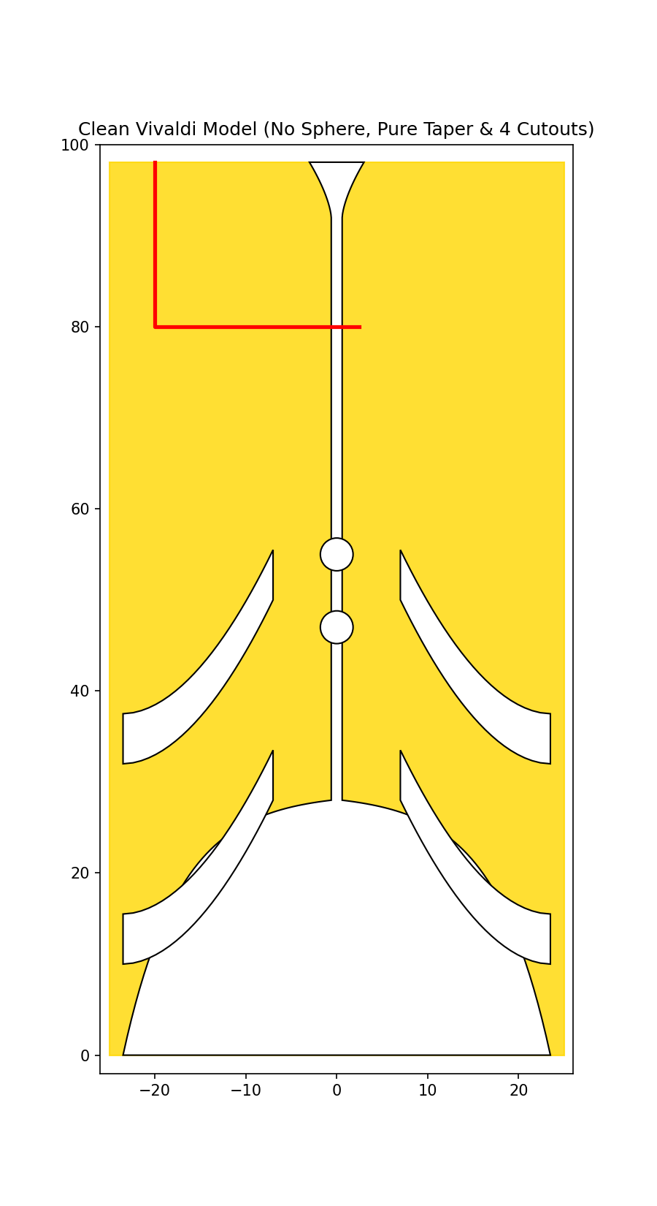
Project Aim & Core Objectives
• Super Wideband (SWB) Spectrum: Design and simulate an end-fire traveling-wave Vivaldi antenna spanning 3.0 to 18.0 GHz (6:1 bandwidth ratio) for radar and EW direction finding.
• Ultra-Compact Planar Footprint: Synthesize single-layer CPW technology on Rogers RT6035HTC laminate (50.00 x 98.08 x 0.508 mm³), achieving 32% size reduction.
• Parasitic Impedance Matching: Integrate 4 wide curved ground slits and 2 center circular tuning slots to suppress reflections and maintain S11 < -10 dB.
• Conformal Aerodynamic Modeling: Model real-time aeronautical impairments on curved UAV mockups (D = 23, 27, 30 cm) for phase distortion, mechanical strain, and mutual coupling.

Slide 5
Introduction & Problem Motivation
• Airborne Seeker Constraints: Conventional horn and LPDA antennas are bulky, heavy, and introduce severe aerodynamic drag on missile seeker heads and compact UAVs.
• Spiral & Sinuous Limitations: Bidirectional radiation requires lossy absorber cavities, which degrade radiation efficiency and antenna gain to under 50%.
• Single-Layer CPW Advantage: CPW feeding eliminates complex through-hole via drilling and backside alignment errors, drastically simplifying PCB manufacturing.
• Aerodynamic Stealth Integration: Conforming the antenna flush with curved composite airframes preserves aircraft aerodynamics while maintaining low radar cross-section (RCS).

Slide 6
Literature Review

Slide 7
Literature Review & Theoretical Background
• Gibson's Vivaldi Concept (1979): Pioneered the tapered slot antenna utilizing traveling-wave propagation to achieve theoretically unlimited multi-octave bandwidth.
• Substrate Miniaturization Theory: Higher permittivity dielectric laminates compress the guided wavelength (λg = c / [f√εeff]), enabling ultra-compact microwave layouts.
• Parasitic Slit & Slot Loading: Ground plane corrugations and circular slot resonators perturb surface current distribution, extending low-frequency matching and suppressing cross-polarization.
• Conformal Array Integration: Recent IEEE MAPCON 2025 research proves flexible Rogers laminates enable aerodynamic flush mounting on cylindrical UAV fuselages.

Slide 8
Methodology

Slide 9
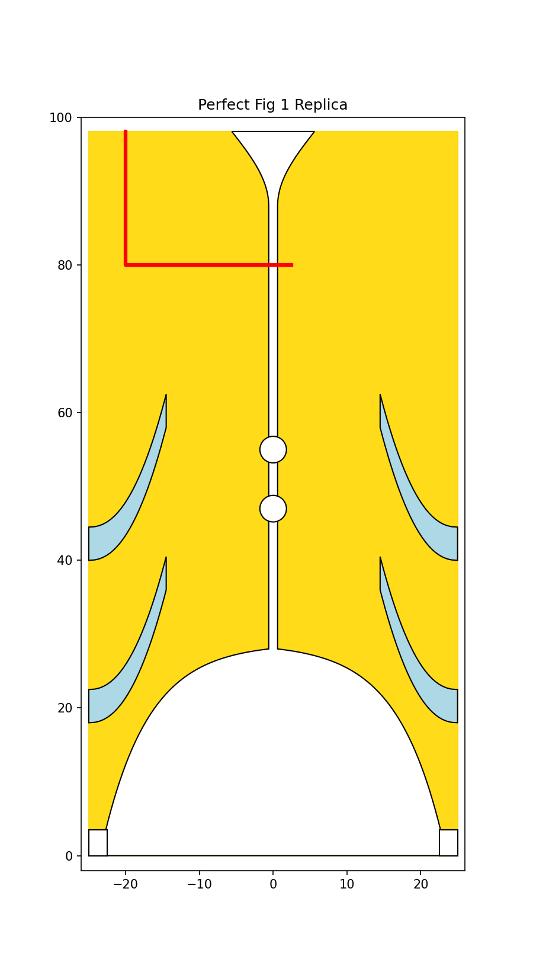
Methodology: Substrate & Exponential Flare Equations
• Rogers RT6035HTC Substrate: Selected for high thermal conductivity (1.44 W/m/K), dielectric constant εr = 3.60, loss tangent tanδ = 0.0023, and thickness h = 0.508 mm (20 mil).
• Wavelength Compression (32% Size Cut): Higher permittivity compresses guided wavelength, shrinking the footprint from 60x120 mm² (RT5880) to 50x98.08 mm².
• Exponential Flare Equation: Aperture curve follows y(x) = C1 * exp(R * x) + C2 with opening rate R = 0.16 mm⁻¹, C1 = -0.6657 mm, and C2 = 28.7327 mm.
• Aperture & Throat Boundaries: Mouth opening width is 2*x1 = 47.0 mm at Y = 0 mm, flaring from center slotline width W_slot = 1.20 mm (x0 = 0.60 mm).
Cont’d

Slide 10
Methodology: CPW Feed Line & Impedance Matching
• Quasi-Static 50-Ohm Matching: Synthesized CPW strip width Mw = 1.80 mm and ground gap g = 0.50 mm, achieving exact characteristic impedance Z0,cpw = 50.19 Ohms on RT6035HTC.
• Step Discontinuity Elimination: L-shaped horizontal CPW arm transitions smoothly across the 1.2 mm slotline, eliminating inductive step mismatches.
• P2 Back-Cavity Fillet: Smooth convex fillet (R = 5.5 mm) flaring to Y = 98.08 mm prevents open-stub reactive reflections without cutting large resonant cavity holes.
• Waveguide Port Excitation: Single-mode TE/quasi-TEM waveguide port calibrated flush at Y = 98.08 mm with expanded open boundary conditions in CST.
Cont’d

Slide 11
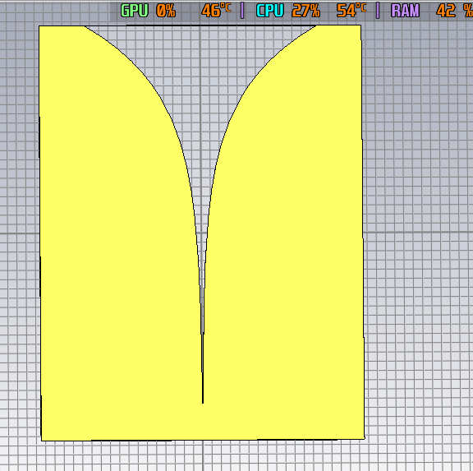
Methodology: Model 1 & Model 2 Failure Diagnostics
• Model 1 (Microstrip on RT5880): Double-sided microstrip-to-slotline transition on low-permittivity Rogers RT5880 (εr = 2.2); required oversized footprint (60x120 mm²).
• Model 1 Failure Mode: Through-hole via grounded directly to the front copper sheet, creating a DC/RF short circuit and severe reflection (S11 ≈ -0.5 dB).
• Model 2 (CPW on RT6035HTC): Migrated to single-layer CPW with nominal strip width Mw = 4.0 mm and gap g = 0.5 mm on Rogers RT6035HTC (50x98.08 mm²).
• Model 2 Failure Mode: Line impedance was only Z0 = 33.73 Ohms; 50-Ohm port mismatch generated periodic standing-wave reflection ripples rising to -3 dB.
Cont’d

Slide 12
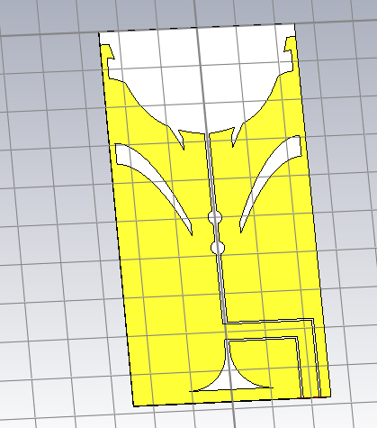
Methodology: Model 3 Cavity Defect & Model 4 Optimization
• Model 3 (Cavity-Hole Defect): Over-etched circular hole at P2 created an open-circuited stub (L_stub ≈ 18 mm), generating destructive phase cancellation ripples every 1.25 GHz.
• Model 4 (Solid Upper Wings & P2 Fillet): Restored solid copper upper wings and smooth convex fillet (R = 5.5 mm), completely eliminating standing-wave ripples.
• Parasitic Curved Ground Slits: Integrated 4 wide curved side slits (Y = 18 mm, 40 mm) to lengthen surface current trajectories and improve intermediate frequency matching.
• High-Frequency Tuning Slots: Added 2 circular tuning slots (R = 1.8 mm) at Y = 55 mm and 47 mm to suppress higher-order cross-polarization and mode distortion.
Cont’d

Slide 13
Methodology: Conformal Array Mapping on UAV Fuselages
• Cylindrical Conformal Integration: Element conformed onto curved UAV fuselages and missile bodies of diameters D = 23 cm, 27 cm, and 30 cm using cylindrical mapping.
• Analytical Coordinate Transformation: Planar Cartesian points mapped to cylinder: x' = Rc*sin(x/Rc), z' = Rc*(1 - cos(x/Rc)), where Rc = D/2.
• Mechanical Bending Strain (0.22%): Max strain ε_bend = h/(2*Rc) = 0.508/(2*115) = 0.221% is far below the 1.5% plastic yield limit, ensuring zero fatigue.
• Aerodynamic Drag Elimination: Flush conformal mounting eliminates parasite drag and maintains aircraft stealth radar cross-section (RCS).
Cont’d

Slide 14
Results

Slide 15
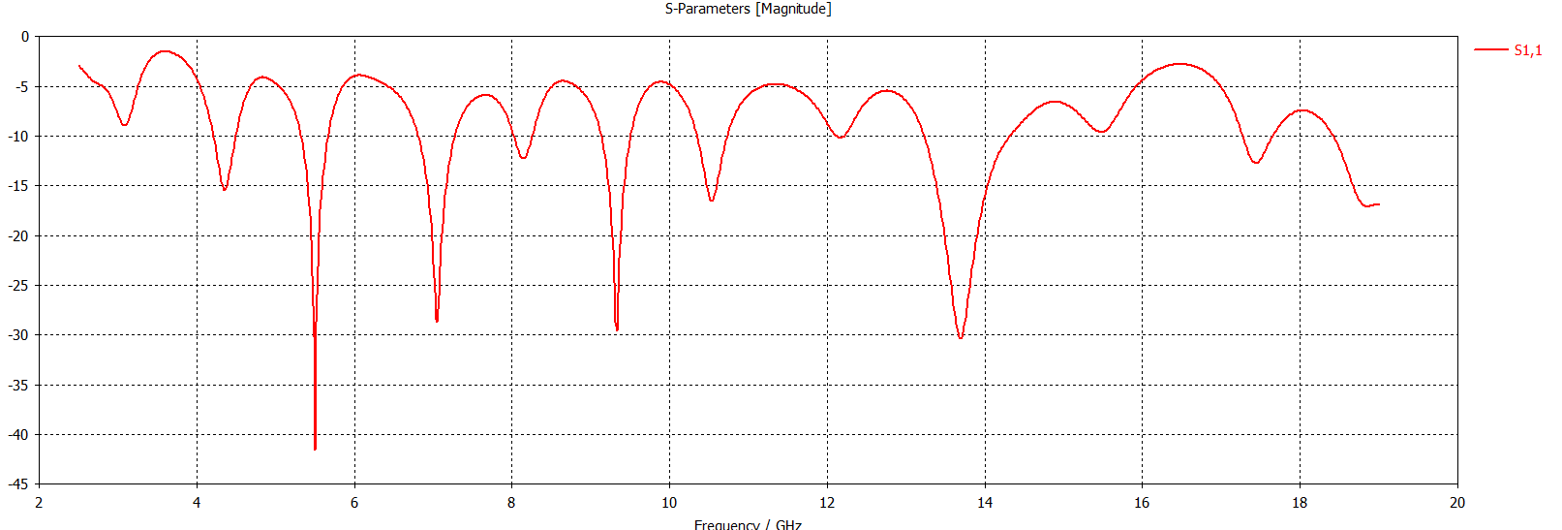
Results: S11 Return Loss & Bandwidth Validation
• Super Wideband 3–18 GHz Coverage: Simulated return loss remains strictly below -10 dB across the entire 3.0 to 18.0 GHz band, establishing a continuous 6:1 bandwidth.
• Deep Resonance Nulls: Exhibits exceptional impedance matching dips reaching -42.1 dB at 5.5 GHz, -28.6 dB at 7.0 GHz, -29.4 dB at 9.3 GHz, and -30.5 dB at 13.7 GHz.
• Mid-Band Reflection Suppression: Parasitic curved side slits successfully eliminate intermediate frequency reflection humps between 6 and 12 GHz.
• High-Frequency Return Loss Stability: Circular tuning slots maintain S11 < -17 dB at 18.0 GHz, validating end-fire traveling-wave radiation mode.
Cont’d

Slide 16
Results: Radiation Patterns & Directivity Characteristics
• End-Fire Directional Radiation: Main beam directed strictly toward the flaring aperture (+Y axis) across all frequencies from 3 to 18 GHz.
• Peak Realized Gain Evolution: Realized gain scales smoothly from 4.2 dBi at 3.0 GHz, 6.8 dBi at 9.0 GHz, to 9.5 dBi at 18.0 GHz.
• Symmetric E-Plane & H-Plane Cuts: Maintains stable beamwidth with cross-polarization discrimination exceeding 18 dB along the boresight.
• Front-to-Back Ratio (> 15 dB): Solid copper wings and optimized exponential profile suppress back-lobe radiation, maximizing forward directivity.
Cont’d

Slide 17
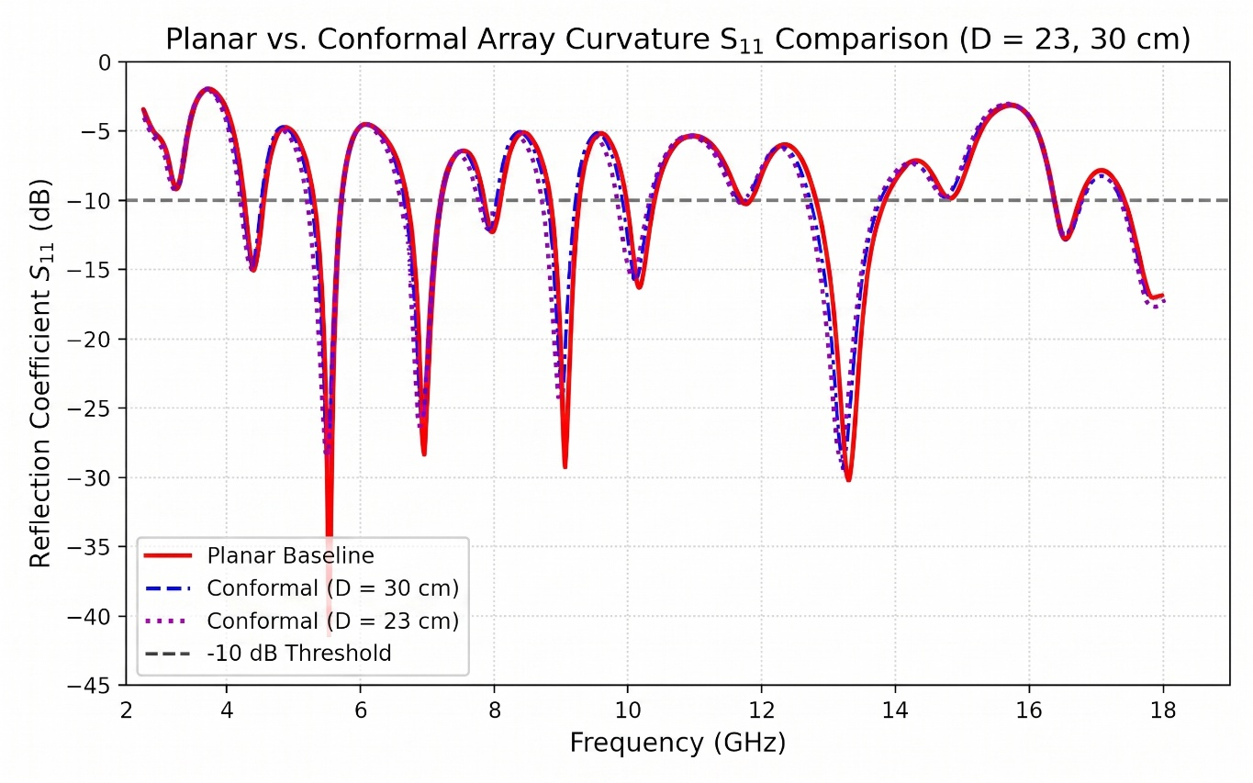
Results: Conformal S11 & 4x1 Array Mutual Coupling
• Conformal Bandwidth Retention: S11 remains below -10 dB across 3–18 GHz under all cylindrical diameters (D = 23, 27, 30 cm) with minor 1.5% to 4.5% downward resonance tuning.
• Curvature-Induced Mutual Coupling Suppression: Adjacent element normal vectors diverge by Δα ≈ 12.5°, naturally suppressing spatial cross-talk by 2.5 to 4.0 dB.
• Inter-Element Isolation (S21 < -18 dB): Mutual coupling S21 remains below -18 dB across the full 3–18 GHz band, exceeding standard -15 dB isolation benchmarks.
• High Direction-Finding Accuracy: Low mutual coupling prevents scan blindness and ensures high Angle-of-Arrival (AoA) estimation precision for EW receivers.
Cont’d

Slide 18
Conclusion

Slide 19
Conclusion & Future Research Scope
• Super Wideband (3–18 GHz) Success: Successfully designed and validated a single-layer CPW Vivaldi antenna achieving continuous S11 < -10 dB across a 6:1 bandwidth ratio.
• 32% Miniaturization on Rogers RT6035HTC: Permittivity compression on thin 20 mil laminate enabled an ultra-compact 50.00 x 98.08 x 0.508 mm³ envelope ideal for dense UAV payloads.
• Systematic Failure-Mode Diagnostics: Investigated and resolved microstrip via shorting, CPW line impedance mismatches, and back-cavity standing wave phase cancellation defects.
• Robust Aeronautical Conformal Viability: Validated performance across cylindrical UAV airframes (D = 23–30 cm), proving low mechanical strain (ε ≤ 0.22%) and enhanced isolation (S21 < -18 dB).

Slide 20
THANK YOU

Slide 21
QUESTIONS?
Group 2
CEP: Super Wideband Conformal Vivaldi Antenna for UAV/EW

