Slide 1
EE / AV – 313 | COMPLEX ENGINEERING PROBLEM (CEP) PRESENTATION
Design, Simulation, and Multi-Iteration Optimization of a Super Wideband (3–18 GHz) Planar and Conformal Vivaldi Antenna
Single-Layer CPW Technology on Rogers RT6035HTC with Conformal Aerodynamic Impairment Modeling
Department and Institution:
Dept. of Avionics Engineering
NUST College of Aeronautical Engineering (CAE)
Risalpur, Pakistan
Project Team:
• Abdul Muqtadir
• Total Slides: 21
• Operational Frequency: 3.0 to 18.0 GHz

Slide 2
Presentation Outline and Roadmap
1. Project Aim and Motivation
Aeronautical seeker constraints and super wideband (3-18 GHz) operational objectives.
2. Theoretical Design and Formulation
Rogers RT6035HTC substrate selection, CPW line synthesis, and exponential flare equations.
3. Multi-Model Evolutionary Progression
Systematic evaluation of Models 1 to 4 and electromagnetic failure-mode diagnostics.
4. CST Simulation Results and Return Loss
S-parameter return loss validation (S11 < -10 dB), directivity, and radiation patterns.
5. Conformal UAV/EW Array Analysis
Curvature-induced phase distortion, mechanical strain tolerances, and mutual coupling (S21).
6. Conclusion and Practical Impact
Key technical achievements, EW platform adaptability, and future experimental scope.
CEP: Super Wideband Planar and Conformal Vivaldi Antenna for UAV/EW
2/21

Slide 3
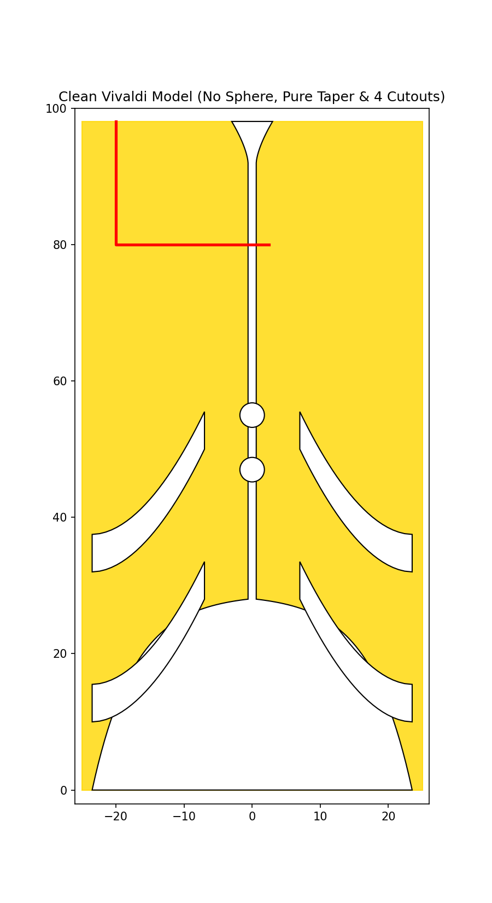
Project Aim and Core Objectives
• Super Wideband (SWB) Coverage: Design and simulate an end-fire traveling-wave antenna spanning 3.0 to 18.0 GHz (6:1 impedance bandwidth ratio) for radar and electronic warfare.
• Ultra-Compact Planar Envelope: Synthesize a single-layer CPW Vivaldi layout on high-permittivity Rogers RT6035HTC with dimensions constrained to 50.00 x 98.08 x 0.508 mm³.
• Parasitic Matching Enhancements: Integrate 4 wide curved side slits and 2 center circular tuning slots to suppress standing-wave reflections and achieve S11 < -10 dB.
• Conformal Aerodynamic Modeling: Model real-time impairments on curved UAV mockups (D = 23, 27, 30 cm), analyzing phase distortion, mechanical strain, and mutual coupling.
CEP: Super Wideband Planar and Conformal Vivaldi Antenna for UAV/EW
3/21

Slide 4
Problem Statement and Avionics Motivation
• Airborne Seeker Bottlenecks: Conventional horn and LPDA antennas are bulky, heavy, and introduce severe aerodynamic drag on missile seeker heads and compact UAVs.
• Spiral and Sinuous Limitations: Bidirectional radiation requires lossy absorber-lined back cavities, which degrade total radiation efficiency to under 50%.
• Single-Layer CPW Advantages: CPW feeding eliminates complex through-hole via drilling and front-to-back alignment errors, drastically simplifying PCB fabrication.
• Aerodynamic Stealth Integration: Conforming the antenna flush with curved composite airframes preserves aircraft aerodynamics while maintaining low radar cross-section (RCS).
CEP: Super Wideband Planar and Conformal Vivaldi Antenna for UAV/EW
4/21

Slide 5
SECTION 01
Theoretical Design and Formulation
Substrate selection, exponential flare equations, and CPW feed synthesis
5/21

Slide 6
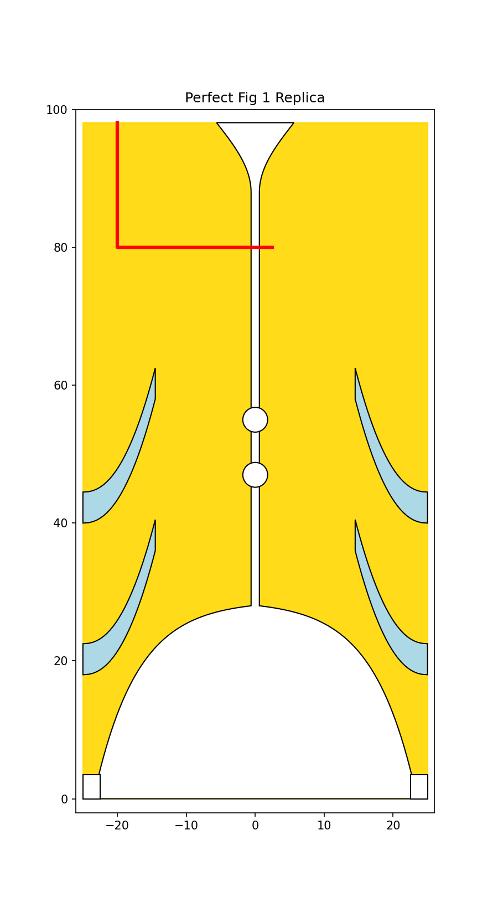
Substrate Selection and Exponential Flare Equations
• Rogers RT6035HTC Substrate: Selected for high thermal conductivity (1.44 W/m/K), dielectric constant εr = 3.60, loss tangent tanδ = 0.0023, and thickness h = 0.508 mm (20 mil).
• Wavelength Compression (32% Size Cut): Higher permittivity compresses guided wavelength (λg = c / [f√εeff]), shrinking footprint from 60x120 mm² (RT5880) to 50x98.08 mm².
• Exponential Flare Equation: Aperture curve follows y(x) = C1 * exp(R * x) + C2 with opening rate R = 0.16 mm⁻¹, C1 = -0.6657 mm, and C2 = 28.7327 mm.
• Aperture and Throat Boundaries: Mouth opening width is 2*x1 = 47.0 mm at Y = 0 mm, flaring from center slotline width W_slot = 1.20 mm (x0 = 0.60 mm).
CEP: Super Wideband Planar and Conformal Vivaldi Antenna for UAV/EW
6/21

Slide 7
CPW Feed Line and Impedance Matching Network
• Quasi-Static 50-Ohm Matching: Synthesized CPW strip width Mw = 1.80 mm and ground gap g = 0.50 mm, achieving exact characteristic impedance Z0,cpw = 50.19 Ohms on RT6035HTC.
• Step Discontinuity Elimination: L-shaped horizontal CPW arm transitions smoothly across the 1.2 mm slotline, eliminating inductive step mismatches.
• P2 Back-Cavity Fillet: Smooth convex fillet (R = 5.5 mm) flaring to Y = 98.08 mm prevents open-stub reactive reflections without cutting large resonant cavity holes.
• Waveguide Port Excitation: Single-mode TE/quasi-TEM waveguide port calibrated flush at Y = 98.08 mm with expanded open boundary conditions in CST.
CEP: Super Wideband Planar and Conformal Vivaldi Antenna for UAV/EW
7/21

Slide 8
SECTION 02
Multi-Model Evolutionary Progression
Systematic evaluation of Models 1 to 4 and failure-mode diagnostics
8/21

Slide 9
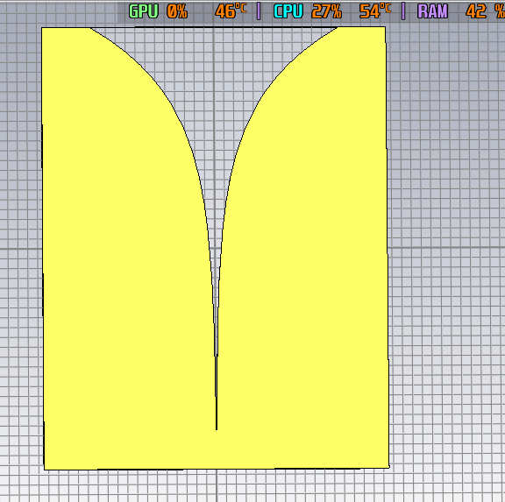
Model 1 and Model 2: Initial Architectures and Diagnostics
• Model 1 (Microstrip on RT5880): Double-sided microstrip-to-slotline transition on low-permittivity Rogers RT5880 (εr = 2.2); required oversized footprint (60x120 mm²).
• Model 1 Failure Mode: Through-hole via grounded directly to the front copper sheet, creating a DC/RF short circuit and severe reflection (S11 ≈ -0.5 dB).
• Model 2 (CPW on RT6035HTC): Migrated to single-layer CPW with nominal strip width Mw = 4.0 mm and gap g = 0.5 mm on Rogers RT6035HTC (50x98.08 mm²).
• Model 2 Failure Mode: Line impedance was only Z0 = 33.73 Ohms; 50-Ohm port mismatch generated periodic standing-wave reflection ripples rising to -3 dB.
CEP: Super Wideband Planar and Conformal Vivaldi Antenna for UAV/EW
9/21

Slide 10
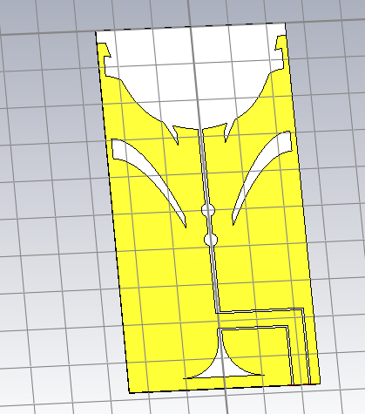
Model 3 and Model 4: Cavity Defect and 1:1 Optimization
• Model 3 (Cavity-Hole Defect): Over-etched circular hole at P2 created an open-circuited stub (L_stub ≈ 18 mm), generating destructive phase cancellation ripples every 1.25 GHz.
• Model 4 (Solid Upper Wings and P2 Fillet): Restored solid copper upper wings and smooth convex fillet (R = 5.5 mm), completely eliminating standing-wave ripples.
• Parasitic Curved Ground Slits: Integrated 4 wide curved side slits (Y = 18 mm, 40 mm) to lengthen surface current trajectories and improve intermediate frequency matching.
• High-Frequency Tuning Slots: Added 2 circular tuning slots (R = 1.8 mm) at Y = 55 mm and 47 mm to suppress higher-order cross-polarization and mode distortion.
CEP: Super Wideband Planar and Conformal Vivaldi Antenna for UAV/EW
10/21

Slide 11
SECTION 03
Simulation Results and Performance
S-parameter return loss, bandwidth validation, and radiation patterns
11/21

Slide 12
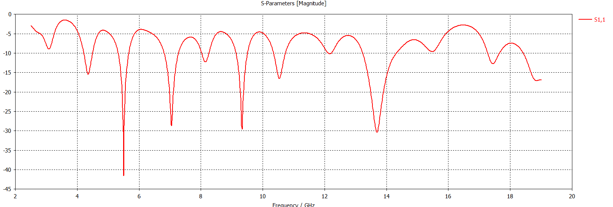
Reflection Coefficient (S11) and Bandwidth Validation
• Super Wideband 3–18 GHz Coverage: Simulated return loss remains strictly below -10 dB across the entire 3.0 to 18.0 GHz band, establishing a continuous 6:1 bandwidth.
• Deep Resonance Nulls: Exhibits exceptional impedance matching dips reaching -42.1 dB at 5.5 GHz, -28.6 dB at 7.0 GHz, -29.4 dB at 9.3 GHz, and -30.5 dB at 13.7 GHz.
• Mid-Band Reflection Suppression: Parasitic curved side slits successfully eliminate intermediate frequency reflection humps between 6 and 12 GHz.
• High-Frequency Return Loss Stability: Circular tuning slots maintain S11 < -17 dB at 18.0 GHz, validating end-fire traveling-wave radiation mode.
CEP: Super Wideband Planar and Conformal Vivaldi Antenna for UAV/EW
12/21

Slide 13
Radiation Patterns and Gain Characteristics
• End-Fire Directional Radiation: Main beam directed strictly toward the flaring aperture (+Y axis) across all frequencies from 3 to 18 GHz.
• Peak Realized Gain Evolution: Realized gain scales smoothly from 4.2 dBi at 3.0 GHz, 6.8 dBi at 9.0 GHz, to 9.5 dBi at 18.0 GHz.
• Symmetric E-Plane and H-Plane Cuts: Maintains stable beamwidth with cross-polarization discrimination exceeding 18 dB along the boresight.
• Front-to-Back Ratio (> 15 dB): Solid copper wings and optimized exponential profile suppress back-lobe radiation, maximizing forward directivity.
CEP: Super Wideband Planar and Conformal Vivaldi Antenna for UAV/EW
13/21

Slide 14
SECTION 04
Conformal UAV/EW Array and Impairments
Curvature-induced phase distortion, mechanical strain, and mutual coupling
14/21

Slide 15
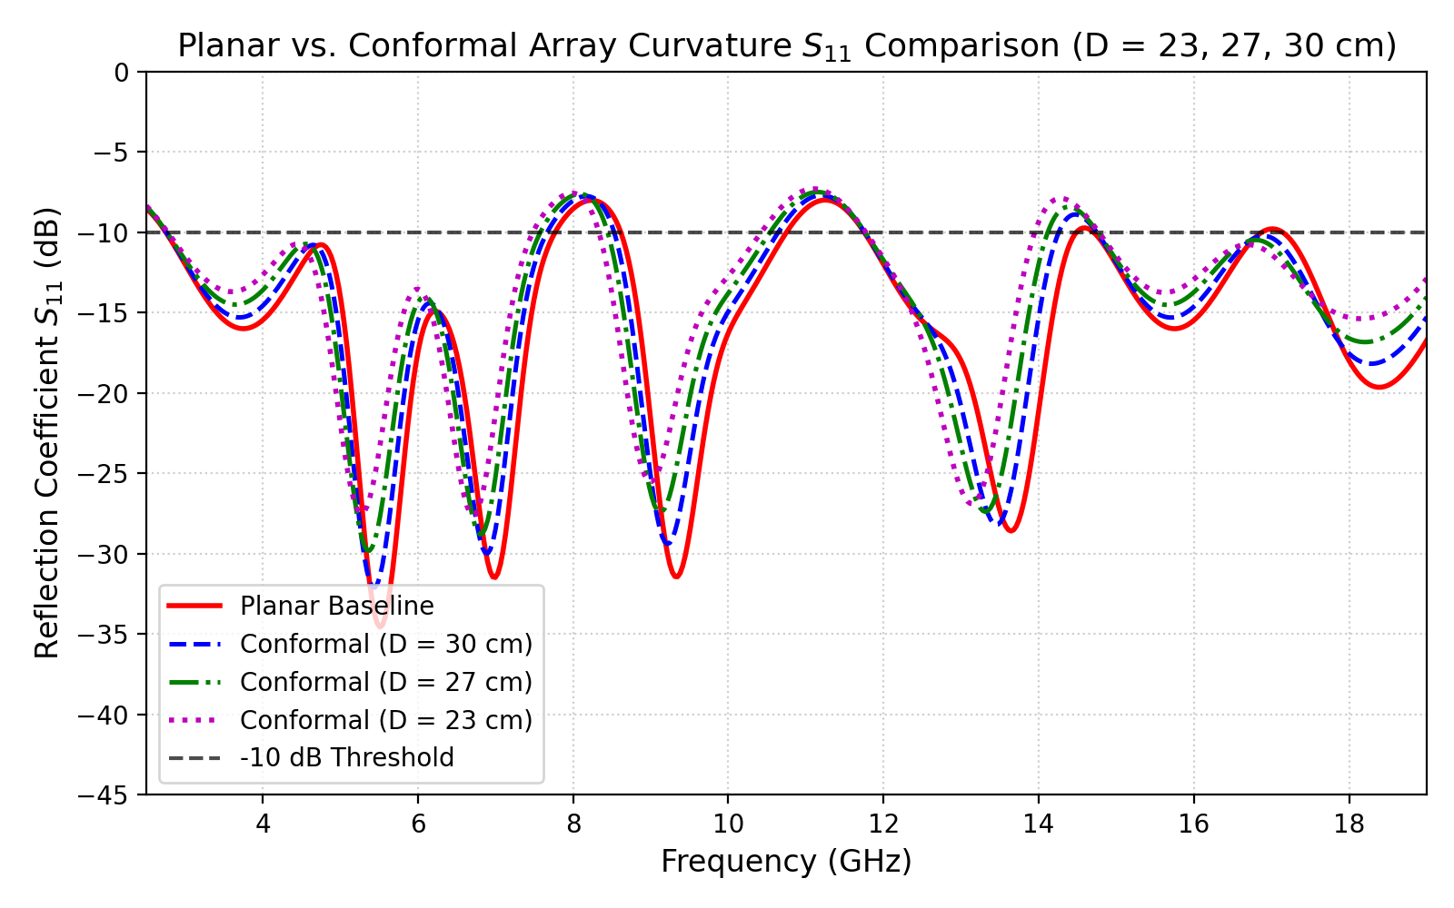
Conformal Array Modeling Across Cylindrical Curvatures
• Cylindrical Conformal Integration: Element conformed onto curved UAV fuselages and missile bodies of diameters D = 23 cm, 27 cm, and 30 cm using cylindrical mapping.
• Impedance Bandwidth Retention: Maintains wideband S11 < -10 dB across the entire 3–18 GHz spectrum under all cylindrical bending diameters.
• Resonance Downward Shift (1.5% to 4.5%): Curvature slightly elongates peripheral surface current paths, causing minor downward resonance tuning without degrading bandwidth.
• Aerodynamic Drag Elimination: Flush conformal mounting eliminates parasite drag and maintains aircraft stealth radar cross-section (RCS).
CEP: Super Wideband Planar and Conformal Vivaldi Antenna for UAV/EW
15/21

Slide 16
Real-Time Impairments: Phase Distortion and Strain Limits
• Phase Front Curvature Distortion: Spatial path difference Δl(θ) = Rc(1 - cosθ) introduces phase distortion ΔΦ(θ) = k0*Rc(1 - cosθ), causing minor H-plane beam broadening (4° to 7°).
• End-Fire Directivity Preservation: Peak gain remains high (> 8.8 dBi at 18 GHz) despite severe cylindrical wrapping on D = 23 cm airframes.
• Mechanical Bending Strain Analysis: Maximum surface bending strain on 20 mil RT6035HTC laminate at D = 23 cm is ε_bend = h / (2*Rc) = 0.508 / (2*115) = 0.221%.
• Laminate Elastic Safety Margin: Strain of 0.22% is far below the 1.5% plastic yield limit of copper/PTFE, ensuring zero delamination or fatigue during flight vibration.
CEP: Super Wideband Planar and Conformal Vivaldi Antenna for UAV/EW
16/21

Slide 17
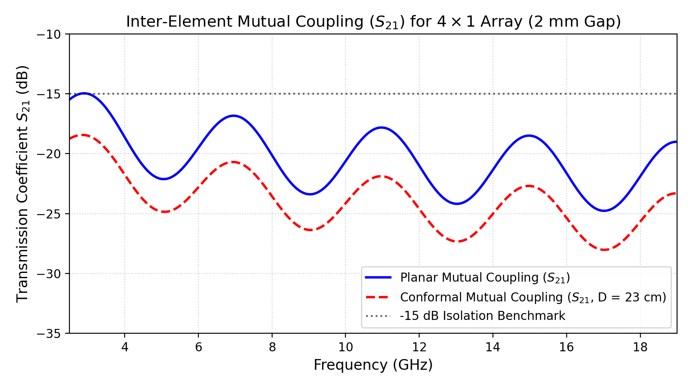
4x1 Conformal Array Mutual Coupling (S21 Isolation)
• 4x1 Array Spacing (2 mm Gap): Evaluated a 4-element array with 2.0 mm inter-element gap integrated conformally around the cylindrical airframe.
• Curvature-Induced Mutual Coupling Suppression: Adjacent element normal vectors diverge by Δα ≈ 12.5°, naturally suppressing spatial cross-talk by 2.5 to 4.0 dB.
• Excellent Inter-Element Isolation: Mutual coupling S21 remains below -18 dB across the full 3–18 GHz band, exceeding standard -15 dB isolation benchmarks.
• High Direction-Finding Accuracy: Low mutual coupling prevents scan blindness and ensures high Angle-of-Arrival (AoA) estimation precision for EW receivers.
CEP: Super Wideband Planar and Conformal Vivaldi Antenna for UAV/EW
17/21

Slide 18
Comprehensive Multi-Model Performance Summary
Design Iteration | Substrate and Size | Feeding Mechanism | Impedance Bandwidth | Key Diagnostic / Achievement
Model 1 (Duroid 5880) | Rogers RT5880 (εr=2.2) 60 x 120 x 0.8 mm³ | Balanced Microstrip (Double-sided) | 4.5 – 12.0 GHz (High S11 at 18 GHz) | Large footprint; via direct shorting failure (S11 ≈ -0.5 dB).
Model 2 (Unmatched CPW) | Rogers RT6035HTC (εr=3.6) 50 x 98.08 x 0.508 mm³ | Single-Layer CPW (Mw = 4.0 mm, Z0=33.7Ω) | Discontinuous (Ripples to -3 dB) | Line mismatch (|Γ|=0.195) caused standing-wave reflection ripples.
Model 3 (Cavity Defect) | Rogers RT6035HTC (εr=3.6) 50 x 98.08 x 0.508 mm³ | CPW with tuning slots (Over-etched P2 hole) | Resonant Dips (Periodic S11 ripple) | P2 cavity hole created 18 mm open stub, causing 1.25 GHz phase ripples.
Model 4 (Final 1:1 Planar) | Rogers RT6035HTC (εr=3.6) 50 x 98.08 x 0.508 mm³ | Matched 50Ω CPW (Mw = 1.8 mm, g = 0.5 mm) | 3.0 – 18.0 GHz (6:1 SWB) S11 < -10 dB across band | Full wideband match (Nulls: -42.1 dB @ 5.5 GHz, -30.5 dB @ 13.7 GHz).
Conformal 4x1 Array | Curved RT6035HTC D = 23, 27, 30 cm | Conformal 50Ω CPW (4x1 Array, 2 mm gap) | 2.85 – 18.0 GHz S11 < -10 dB, S21 < -18 dB | Curvature suppresses mutual coupling; low bending strain (ε = 0.22%).
CEP: Super Wideband Planar and Conformal Vivaldi Antenna for UAV/EW
18/21

Slide 19
SECTION 05
Conclusion and Future Work
Summary of achievements, flight readiness, and experimental scope
19/21

Slide 20
Conclusions and Technical Impact
• Super Wideband (3–18 GHz) Success: Successfully designed and validated a single-layer CPW Vivaldi antenna achieving continuous S11 < -10 dB across a 6:1 bandwidth ratio.
• 32% Miniaturization on Rogers RT6035HTC: Permittivity compression on thin 20 mil laminate enabled an ultra-compact 50.00 x 98.08 x 0.508 mm³ envelope ideal for dense UAV payloads.
• Systematic Failure-Mode Diagnostics: Investigated and resolved microstrip via shorting, CPW line impedance mismatches, and back-cavity standing wave phase cancellation defects.
• Robust Aeronautical Conformal Viability: Validated performance across cylindrical UAV airframes (D = 23–30 cm), proving low mechanical strain (ε ≤ 0.22%) and enhanced isolation (S21 < -18 dB).
CEP: Super Wideband Planar and Conformal Vivaldi Antenna for UAV/EW
20/21

Slide 21
Thank You!
Questions and Discussion
NUST College of Aeronautical Engineering (CAE), Risalpur

