Slide 1


CSE DEPARTMENT
EXPENSE SHARING APP
Front End Development Frameworks for Web Applications
Project Lead
Team Members
Badiya Murali
To be updated

Slide 2



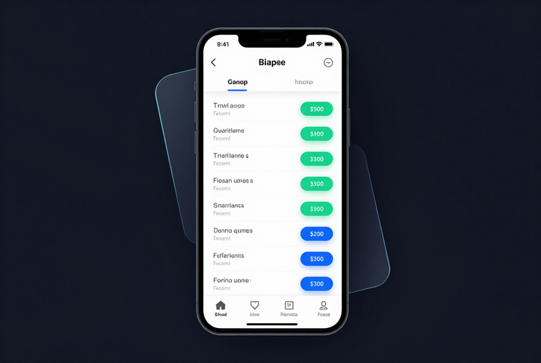
EXPENSE SHARING APP
CHALLENGES
IN SHARED EXPENSES
Manual calculations lead to errors and disputes — splitting bills among friends, roommates or colleagues is tedious and often inaccurate.
PROBLEM
STATEMENT
Unclear payment responsibilities cause awkward follow-ups — no one knows exactly who owes whom, leading to forgotten debts and broken trust.
No centralized tracking means shared expenses are scattered across chats, notes and memory — making reconciliation chaotic and time-consuming.

Slide 3



EXPENSE SHARING APP
SIMPLIFY EXPENSE ENTRY & SPLITTING
Enable users to log shared expenses instantly and split costs equally or by custom ratios — with zero manual calculation required.
PROJECT
OBJECTIVES
VISUAL BALANCE SUMMARY
Provide a clean, real-time dashboard showing who owes whom, with intuitive charts and color-coded balance indicators at a glance.
SMOOTH & ACCESSIBLE WEB EXPERIENCE
Deliver a responsive, fast-loading web application with accessible UI components, consistent design language, and effortless navigation for all users.

Slide 4

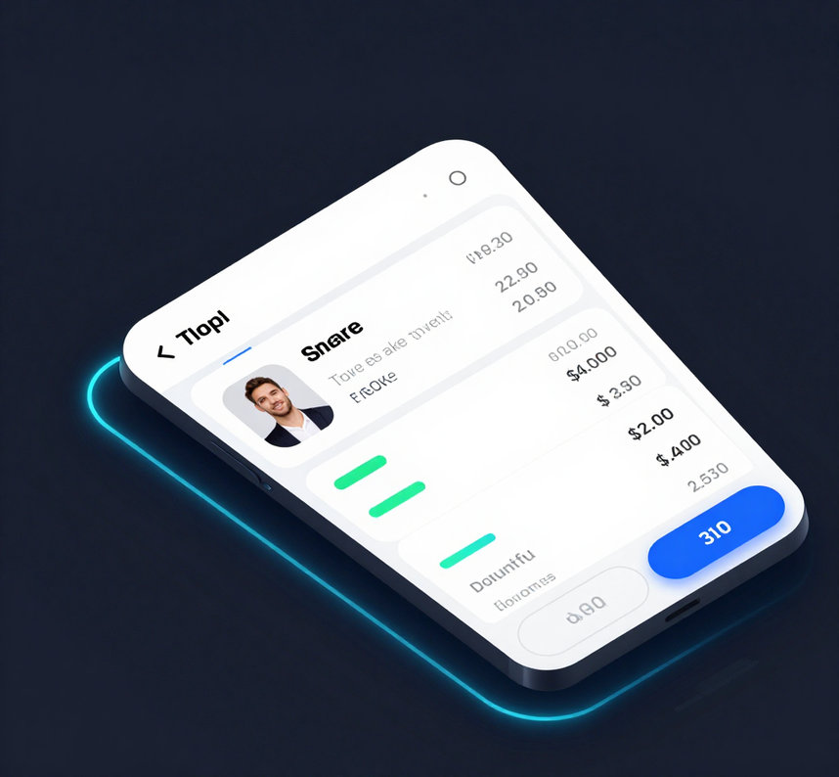

EXPENSE SHARING APP
THE PROPOSED SOLUTION
SMART GROUP EXPENSE MANAGEMENT
A modern web application built with front-end development frameworks that enables groups to record shared expenses, automatically calculate individual splits, and display a clear real-time dashboard of who owes whom — eliminating manual calculations and awkward money conversations.
Instant Split Calculation & Balances
Visual Dashboard: Who Owes Whom

Slide 5
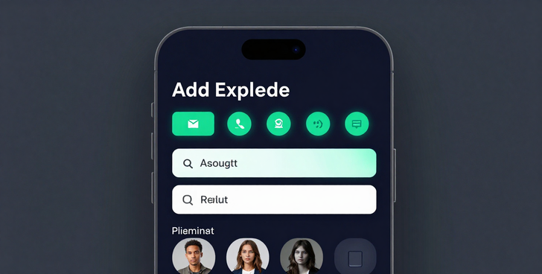
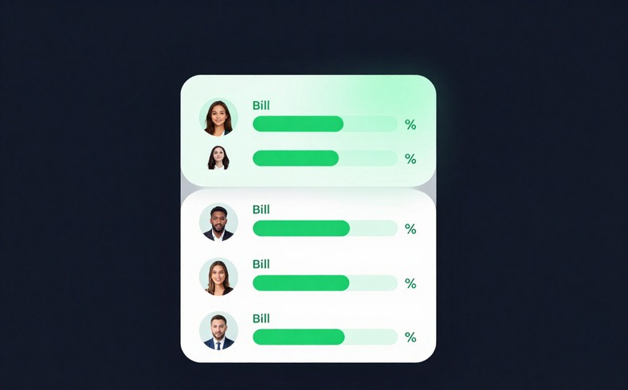

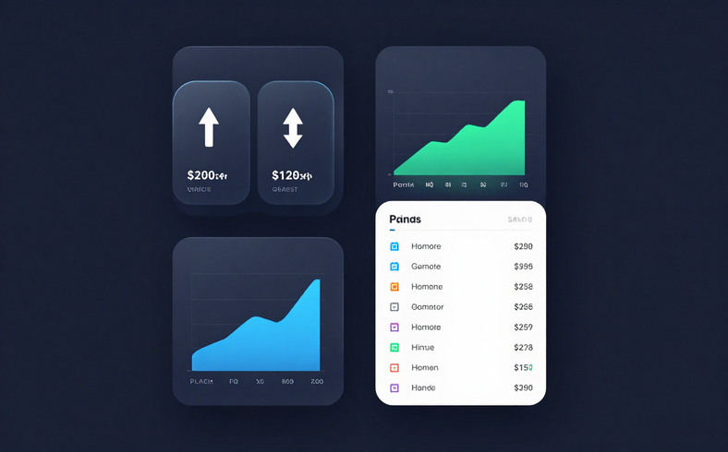
EXPENSE SHARING APP
ADD EXPENSE
SPLIT COSTS
Instantly log any shared expense — enter amount, category, and participants. Clean input forms with real-time validation and smart auto-suggestions.
Automatically divide costs equally or by custom percentage. Visual split cards show each member's share with zero manual calculation needed.
BALANCES & HISTORY
Live balance dashboard shows who owes whom. Full expense history with filters, category tags, and timeline view for complete transparency.
KEY
FEATURES

Slide 6

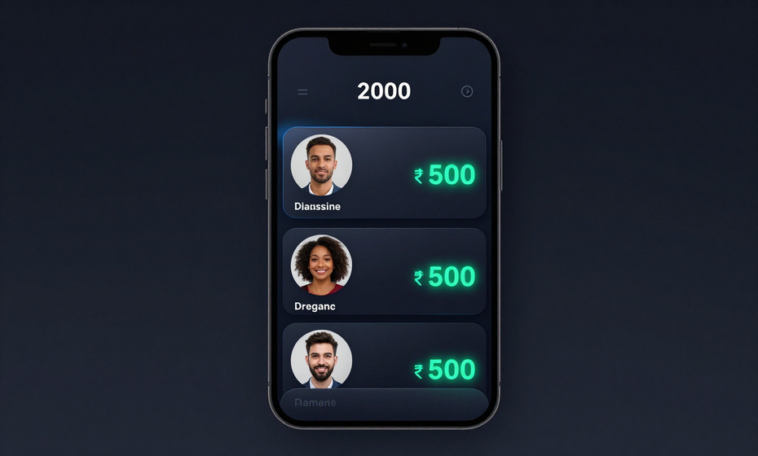
EXPENSE SHARING APP
₹2000 EXPENSE
SPLIT EXAMPLE
A group dinner of ₹2000 is split equally among 4 friends — Arjun, Priya, Ravi & Sneha. Each owes ₹500. Balances update instantly in the app dashboard.
₹500
EQUAL SPLIT — 4 MEMBERS
Arjun paid ₹2000 upfront. The app auto-calculates each share: Priya owes ₹500, Ravi owes ₹500, Sneha owes ₹500. Net balance shown per user in real time.

Slide 7
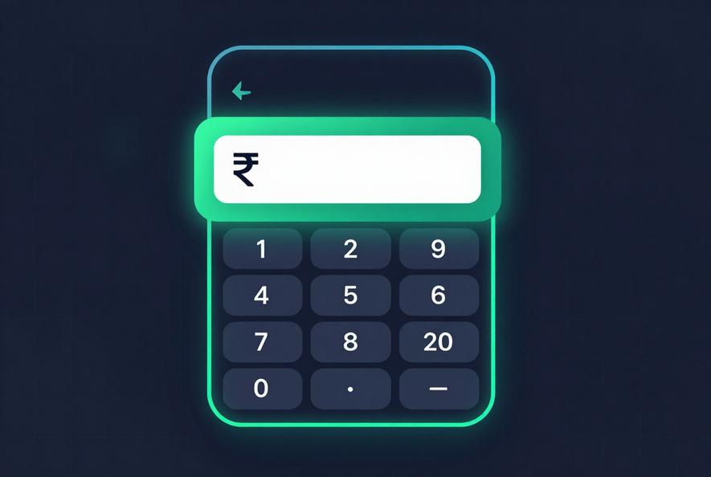

EXPENSE SHARING APP
Three seamless steps guide the user from expense entry to final balance update — designed for speed, clarity and zero confusion.
Step 1: Enter Expense
User inputs the total amount and adds a short description. The app instantly logs the transaction with a timestamp.
Step 2: Select Participants & Split Method
Choose group members involved. Pick equal, percentage, or custom split — the app calculates each share in real time.
Step 3: Review Shares & Balances
A clean summary shows who owes what. Balances update instantly across all participants' dashboards.
USER
FLOW
➤ Enter Amount & Description
➤ Select Members & Split Type
➤ Review Balances & Confirm

Slide 8

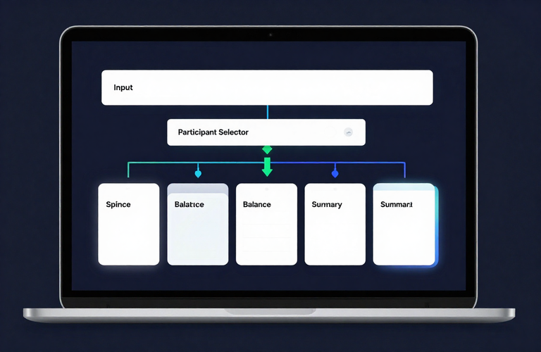
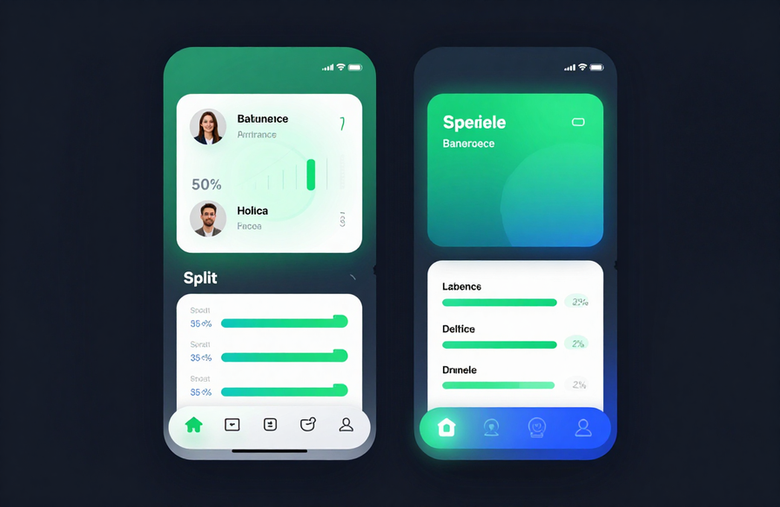
EXPENSE SHARING APP
SLIDE 08
FRONTEND COMPONENTS
& ARCHITECTURE
Component Layers:
● Input & Expense Form — captures amount, category, date
● Participant Selector — dynamic member toggle with avatars
● Split Calculation View — equal / custom split logic display
● Balance Cards — per-user owed / owed-to summary tiles
● Summary Dashboard — grouped totals, visual breakdown charts
All components are modular, reusable, and state-driven for seamless UI updates.

Slide 9
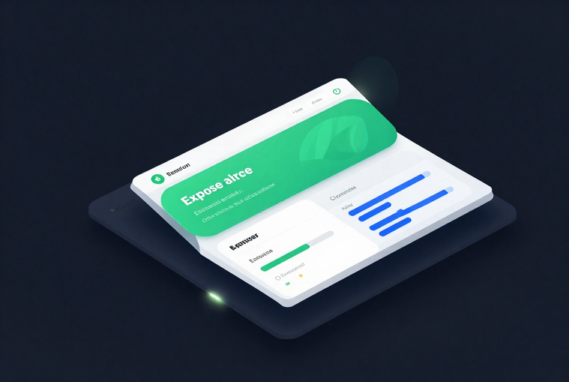
EXPENSE SHARING APP
The project scope has been reviewed and approved. Development is structured around a component-driven frontend approach, with emphasis on responsive layouts, interactive UI elements, and seamless user experience across devices.
APPROVED
SCOPE &
PROGRESS
Interface Planning — Complete
Screen Design — In Progress
Interaction Flow — In Progress
TECHNOLOGY &
PROJECT STATUS
Current phase covers interface planning, screen wireframing, and interaction flow mapping. Each module is being designed for clarity, speed, and visual consistency before implementation begins.

Slide 10

EXPENSE SHARING APP
10 / 10
FUTURE SCOPE & CONCLUSION
Expense sharing made simple, clear, and collaborative.

