Slide 1
Text processing
Emil Inochkin BSCS 2025

Slide 2
Motivation
Creating an AI which will post fun fake news in the telegram channel
Creating an AI which will post fun fake news in the telegram channel
Text sources
Azerbaijani news telegram channels (SputnikAz, APA, DIM)

Slide 3
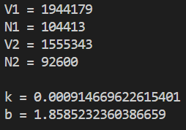


Heaps law
Approximation for v3

Slide 4
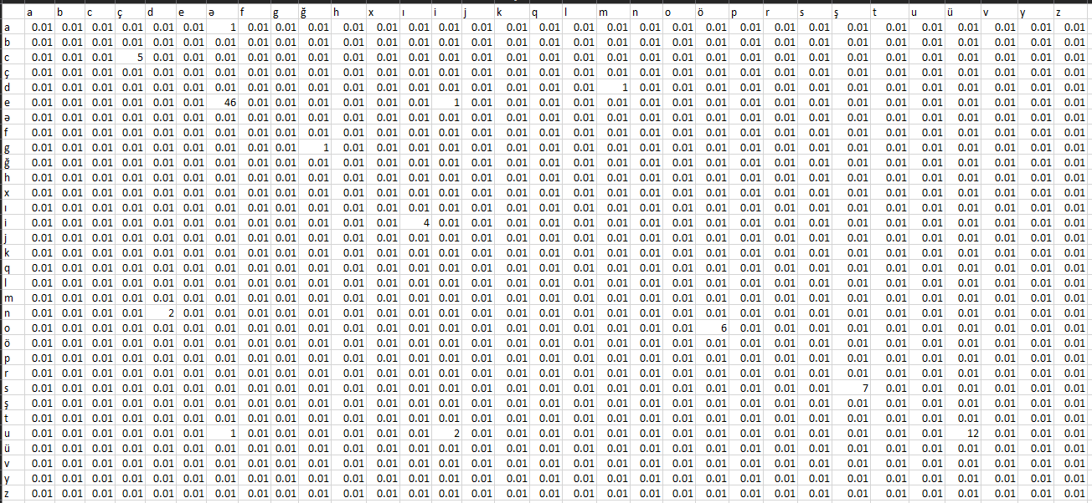
Confusion matrix

