Slide 1
Image Report Generation
Muhammad Murad 21k3064
Hafsa Salman 21k3070
Adeeba Nawaz 21k3105

Slide 2
Problem Statement
Existing models for medical image analysis often lack modularity, scalability, and adaptability. The need for better preprocessing, contrastive loss handling, and multi-modal fusion is critical.

Slide 3
Project Overview
This project improves the XRGEN model for advanced medical image understanding. Key innovations include modular design, enhanced contrastive loss computation, and dynamic fusion strategies for multi-modal data.

Slide 4
Key Changes in Improved Model
Device handling improvements for GPU/CPU flexibility
Modularization of forward pass logic
Enhanced logging for debugging
Refined contrastive loss computation
Flexible multi-modal weighted fusion strategies

Slide 5
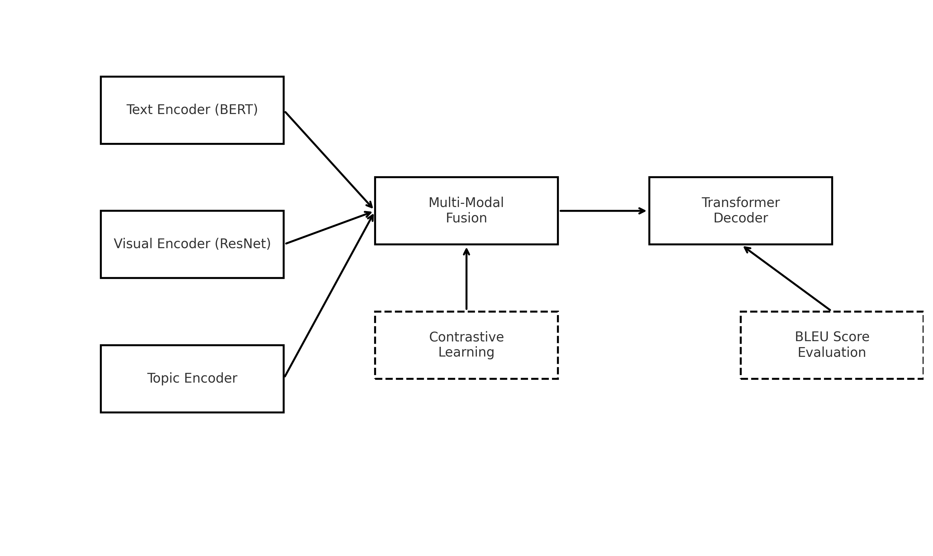
Architecture Diagram

Slide 6
Team Contribution
Murad:
Modularized topic embedding handling
Refactored sequence preparation logic
Hafsa
Enhanced contrastive loss computation
Improved model performance
Adeeba
Tried multiple architectures
Developed Streamlit frontend interface

Slide 7
Results and Impact
Results:
Improved working and modularity of the XRGEN model
Enhanced user interaction with an intuitive frontend
Impact:
Better maintainability and scalability
Effective integration of multi-modal data

Slide 8
Conclusion
The project successfully improved the XRGEN model's modularity, scalability, and usability. Future work includes exploring additional multi-modal data sources and optimizing computational efficiency.

