Slide 1
JavaScript Tips&Tricks ES6 Overview

Slide 2
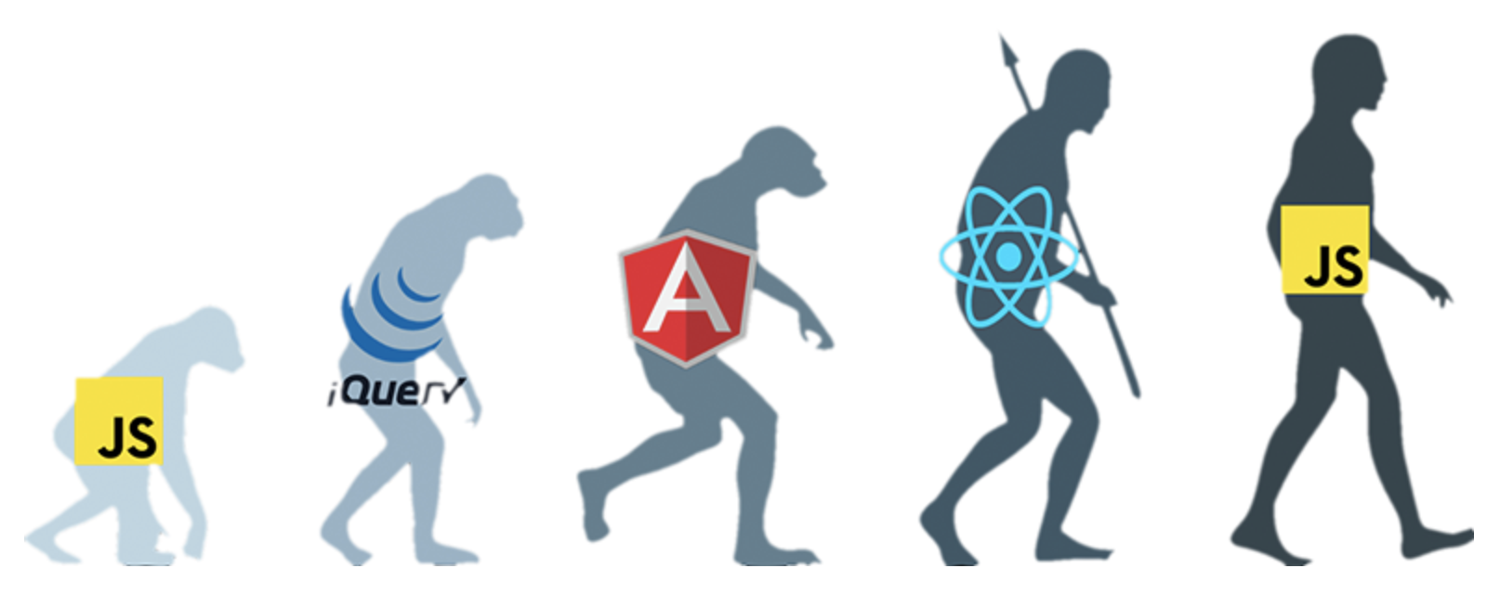
JavaScript is All

Slide 3
Javascript development
Javascript (React, Angular, Vue, etc..)
CSS (SCSS, StyledCSS, SVG, etc..)
HTML (Audio, Video, Canvas, etc..)
NodeJS (HapiJS, ExpressJS, SocketIO, etc..)
Browsers (DOM, DevTools, web optimization)

Slide 4
Tips & Tricks
Javascript Hoisting
Call Stack
IIFE
Scope
Callbacks, async-await
https://ponyfoo.com/articles/es6#introduction
https://learn.javascript.ru/

Slide 5
Trends
Component architecture (bit, storybook, etc.)
ES6 modules (https://medium.com/web-standards/es-modules-cartoon-dive-71f42c1e851a)
State Management (API context, hooks, RXJS)
GraphQL-API or REST-API
WebAssembly (https://webassembly.org/)
Reason (https://reasonml.github.io/)
JS Foundation – (https://habr.com/ru/news/t/313000/)
https://stateofcss.com
https://stateofjs.com

Slide 6
Which framework?
Angular
React (lib)
Vue
etc?
https://www.npmtrends.com/react-vs-@angular/core-vs-vue

