Slide 1
Predicting Insurance Costs with Machine Learning
SmartPremium

Slide 2
Project Overview
The objective of this project is to develop a Machine Learning regression model that predicts insurance premium amounts based on customer characteristics and policy information.

Slide 3
Data Exploration and Analysis (EDA)
Examined dataset dimensions and feature types.
Identified numerical and categorical variables.
Checked missing values.
Analyzed feature distributions.
Investigated relationships between variables.

Slide 4
Data Preprocessing
Numerical Missing values were imputed using Median
Categorical Missing values were imputed using Mode
The original date column was converted into:
1. Policy Year
2. Policy Month
3. Policy Day
Categorical variables were transformed using One-Hot Encoding
Numerical features were standardized using StandardScaler
The dataset was divided into:
Training Set : 80 (960000, 41)
Test set : 20 (240000, 41)

Slide 5
Models
Linear Regression
K-Nearest Neighbors Regressor
Support Vector Regressor (SVR)
Decision Tree Regressor
Random Forest Regressor
XGBoost Regressor

Slide 6
Model Results
Model | MAE | RMSE | R²
Linear Regression | 667.27 | 863.27 | 0.0027
KNN | 719.82 | 939.62 | -0.1815
SVR | 639.23 | 896.00 | -0.0743
Decision Tree | 897.99 | 1232.90 | -1.0341
Random Forest | 655.93 | 852.55 | 0.0274
XGBoost | 642.42 | 844.84 | 0.0449

Slide 7
Hyperparameter Tuning
To improve model performance, hyperparameter optimization was performed using RandomizedSearchCV
Tuned Models
Random Forest Regressor
XGBoost Regressor
Tuned Model Results
Model | MAE | RMSE | R²
Tuned Random Forest | 639.97 | 845.39 | 0.0436
Tuned XGBoost | 648.00 | 847.87 | 0.0380

Slide 8
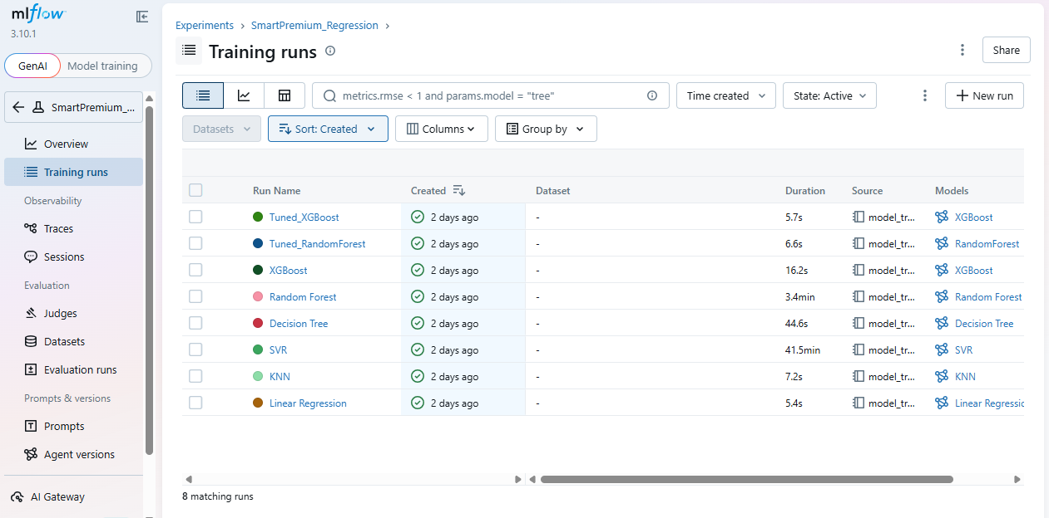
ML Flow Tracking
Link : http://127.0.0.1:5000/#/experiments/1/runs?searchFilter=&orderByKey=attributes.start_time&orderByAsc=false&startTime=ALL&lifecycleFilter=Active&modelVersionFilter=All+Runs&datasetsFilter=W10%3D

Slide 9
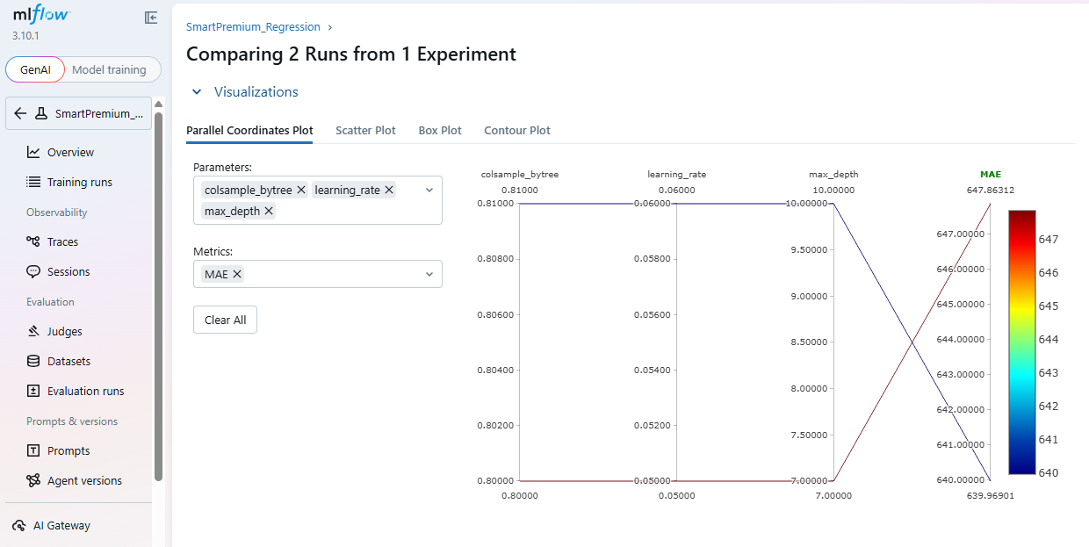

Slide 10
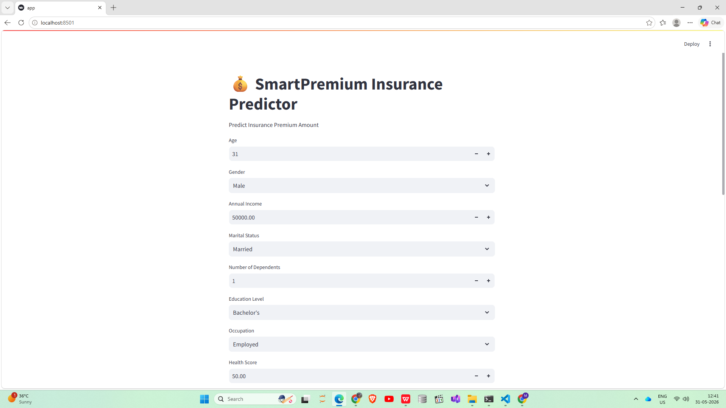
Streamlit App
单击此处编辑母版文本样式
二级
三级
四级
五级

Slide 11
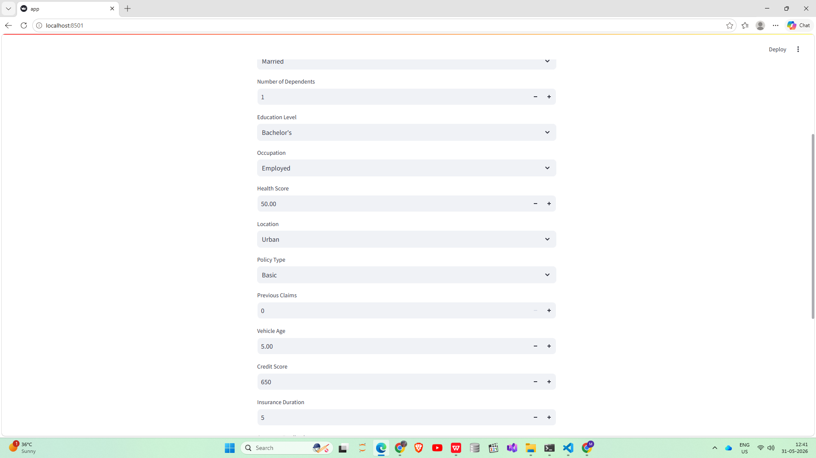

Slide 12
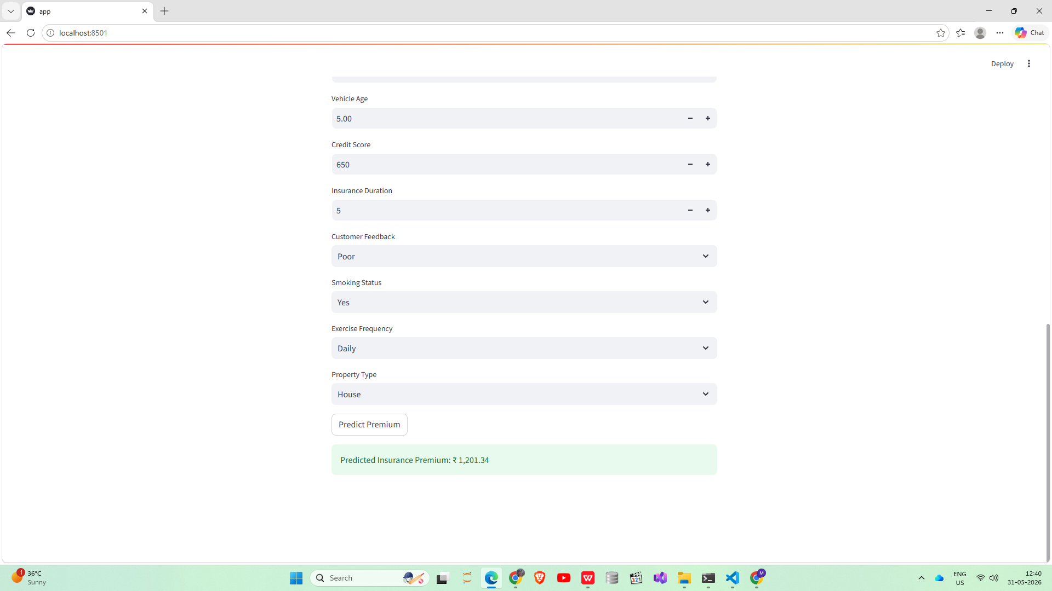

Slide 13
Conclusion
Among the evaluated models, the Tuned Random Forest Regressor achieved the best overall performance and was selected for deployment. MLflow was utilized for experiment tracking, while Streamlit provided an interactive interface for real-time premium estimation.

