Slide 1
Placement Eligibility Streamlit Application
Interactive Dashboard for Student Placement Readiness
By: Murali Duraisami

Slide 2
Project Overview
An interactive web app for student placement readiness analysis
Consolidate Academic, Programming, Soft skills & Placement data
Helps placement coordinators evaluate student readiness

Slide 3
Tech Stack
Python
Streamlit - Web UI
SQLite - Relational database
Pandas - Data handling
Faker - Synthetic data generation

Slide 4
Database Schema
Four interconnected tables with foreign keys(student_id):
Students
Programming
SoftSkills
Placements

Slide 5
Key Features
✅ Search Student by Name to display a unified student profile
✅ Dynamic placement filters based on Skills
✅ Real-time SQL JOIN queries
✅ Secure parameterized queries
✅ Placement Insights to identify placement Ready students
✅ Interactive Dashboard

Slide 6
Project Workflow
️⃣ Data Generation → Faker generates dummy data
️⃣ Database Setup → SQLite stores relational data
️⃣ Streamlit UI → Sidebar filters & text input
️⃣ SQL Queries → Fetch joined data dynamically
️⃣ Visualization → Display as DataFrame

Slide 7
Ex: Student Search Query
Fetches details from all 4 tables using SQL JOIN
Returns academic, programming, soft skills & placement data
Uses parameterized query to avoid SQL injection

Slide 8
Insights & Learnings
Designed a normalized relational schema
Learned SQL joins for multi-table queries
Integrated SQLite with Streamlit
Implemented OOP-based data generation
Handled empty query results

Slide 9
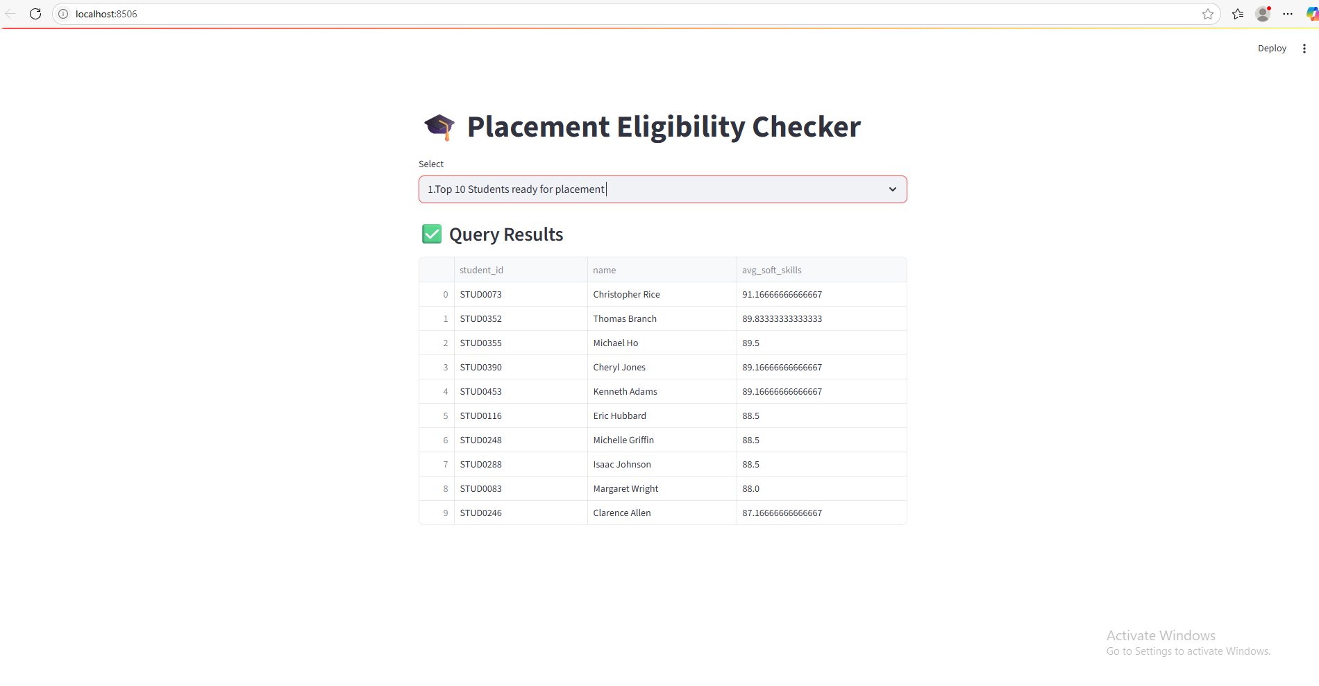
UI Screenshot

Slide 10
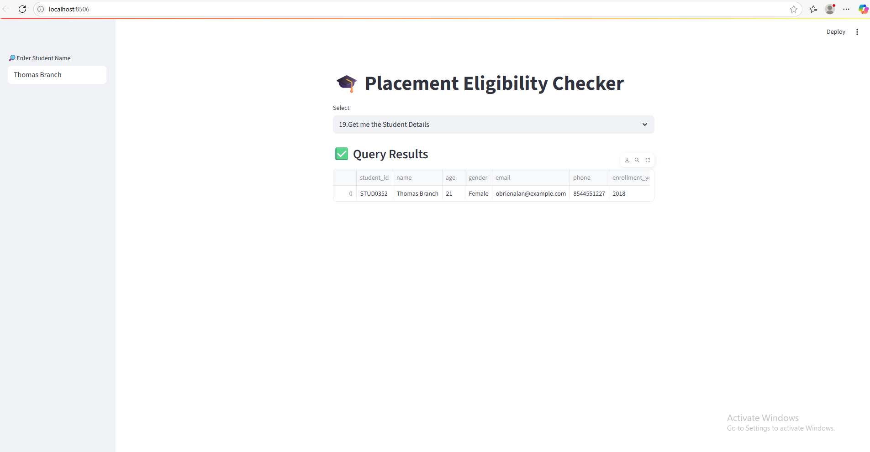
UI Screenshot

