Slide 1
Graphics
Data Types & Plot Types

Slide 2
Your Opinions
HW 1 reasonable?
Yes, Easy, Hard
More Live Code?
Yes, No, ?, OK

Slide 3
Why is graphics in this course?
Good graphics today requires the computer
Visualization enters every step of the data analysis cycle
Data cleaning – are there anomalies?
Exploration
Model checking
Reporting results
Plots can uncover structure in data that can’t be detected with numerical summaries
Important communication skill

Slide 4
Keep in Mind
Meta Data: The source of information and the selection process for the observations
Are these data representative of the population that you are trying to generalize to?
What is a clear and informative way to present the data so that insights are readily discernable?

Slide 5
Review ggplot Components
The plot object
Aesthetic mappings
Layers of Geometric shapes and Statistical summaries – they are paired
Scales for the aesthetics
Themes for the other stuff (non data)

Slide 6
Know your data types
The appropriate graphical techniques depend on the kind of data that you are working with
Quantitative
continuous – e.g., height, weight
discrete – numeric data with few values, e.g., number of children in family
Qualitative
ordered – categories with an order but no meaningful distance between, e.g., number of stars for a movie rating
nominal - categories have no meaningful order, e.g., gender, race
Notes:
Don’t confuse discrete with measurement limitations
Some variables could fall into more than one type, e.g., number of years of education (quantitative) vs complete high school, some college, etc. (ordinal)

Slide 7
Data Type can depend on
Units of measurement
What constitutes a record in the data
These concepts are connected

Slide 8
What type of data is handedness?
A. Quantitative
B. Qualitative – nominal
C. Qualitative – ordinal
D. Possibly A or B
E. Possibly A or C
What type of data is income?
Quantitative
Qualitative – nominal
Qualitative – ordinal
Possibly A or B
Possibly A or C

Slide 9
Individual report the activities performed with left hand (write, eat, bat, sweep, etc.) and these are counted
What type of data is handedness?
Quantitative – discrete
Quantitative – contin
Qualitative – nominal
Qualitative – ordinal
Family income reported in a survey, choose from brackets, e.g. < $30,000, $30,000 - $45,000, etc
What type of data is income?
Quantitative – discrete
Quantitative - contin
Qualitative – nominal
Qualitative – ordinal

Slide 10
Consider sex as reported in the DAWN survey
What type of data?
A. Quantitative
B. Qualitative – nominal
C. Qualitative – ordinal
Consider sex as reported in World Bank Data on Countries
What type of data?
Quantitative
Qualitative – nominal
Qualitative – ordinal

Slide 11
Different Plots for Different Data Types
load(url("http://www.stat.berkeley.edu/users/nolan/data/babiesLab133.rda"))

Slide 12
Kaiser Study
Oakland Kaiser mothers
1960s
Measure the babies weight (in ounces) at birth
All babies:
Male
Single births (no twins, etc.)
Survived 28 days

Slide 13
Information collected on mother’s and their babies
Birth weight (ounces)
Gestation (weeks)
Parity - total number of previous pregnancies
Mother’s height and weight
Mother’s smoking status
Mother’s age, race, education level, income
Father’s information and more…

Slide 14
One Quantitative Variable

Slide 15
Histogram – Mother’s weight
Y-scale is count
Y-scale is density
Right Tail Truncated
What is the difference between these 2 histograms?

Slide 16
Density curve
Band width is small so see fluctuations in individual values
Rug plot thickness matches these little peaks

Slide 17
Quantile Plot
Compare the distribution to a theoretical one
Upward curve for small values indicates a short left tail
Upward curve for large values indicates a long right tail

Slide 18
Bar plot - Education Level
Bar Width – has no meaning
What’s the difference between these 2 plots?
Notes:
Bar chart – width of bar has no meaning
Bar chart – often prefer proportions or percentages over counts

Slide 19
Pie chart - Education Level
Easier to compare heights of bars than angles
Notes:
Pie chart – areas are hard to compare
Bar chart – width of bar has no meaning

Slide 20
Dot Chart - Education Level
Width of bars in a bar plot have no meaning
Dot plot (aka Cleveland) focus on comparison of the values
Notes:
Dot

Slide 21
Discrete Quantitative Variable can sometimes look like a Qualitative Variable

Slide 22
Parity: Number of siblings
This quantitative variable is different from birth weight – there are only a few possible values, i.e., it’s not possible to have 2.3 siblings, and it’s highly unlikely to have 17
> table(infants$parity)
0 1 2 3 4 5 6 7 8 9 10 11 13
315 310 238 168 83 52 32 16 8 7 4 2 1

Slide 23
Number of Previous Pregnancies
Bar plot – height not area is the proportion
What’s the difference between these 2 plots?

Slide 24
Method of Comparison
Often, we not only want to better understand a distribution, but we want to compare the distribution for subgroups or to compare against another population or standard
How do you think the birth weight distribution might vary with smoking status?

Slide 25
One Quantitative Variable and One Qualitative Variable

Slide 26
Super-posed Density Plots – one per level

Slide 27
Multiple histograms on 1 plot
Stacked Bars
Overlaid bars
What the difference between these 2 plots?

Slide 28
Quantile – Quantile Plot

Slide 29
Side-by-side Boxplots & Violin Plots

Slide 30
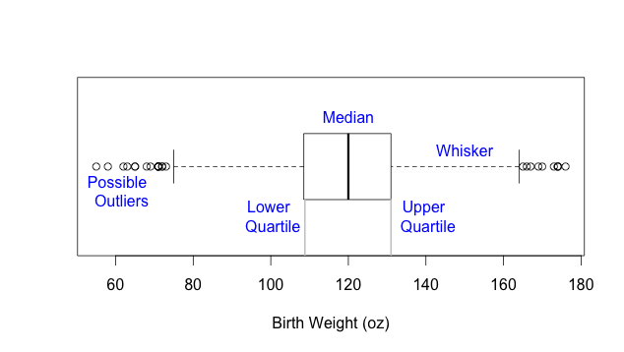
Boxplot Definition

Slide 31
Two Qualitative Variables

Slide 32
Mosaic Plot - Education and Income
Notes:
Need a decent ggplot version

Slide 33
Side-by-side Bar Plot
Smoking status normalized within Education level
What’s the difference between these 2 plots?

Slide 34
Interaction Plot
Smoking status normalized within Education level

Slide 35
Two Quantitative Variables

Slide 36
Scatter Plot and Smooths
This smooth is a linear fit
Gray bands give a sense of accuracy of linear fit

Slide 37
Relationships between more than 2 variables
Qualitative information can be conveyed in plots through color, plotting symbol, juxtaposed panels

Slide 38
2 Quant + 1 Qual
Overlap in Gray bands says lines for each group are similar

Slide 39
Summary of graph relationships between two variables
Two Qualitative variables
Mosaic plot, side-by-side barplots (watch normalization), interaction plot
One Quantitative and one Qualitative
Side-by-side boxplots, violin plots, dotcharts, super-posed density curves, qq-plot
Two Quantitative variables
Scatter plot, line plot (time), smooths

Slide 40
Check the code posted to Lecture Code on bcourses to see how these plots were made

