Slide 1
Advanced Variational Auto-Encoders
STAT540
Dolzodmaa Davaasuren

Slide 2
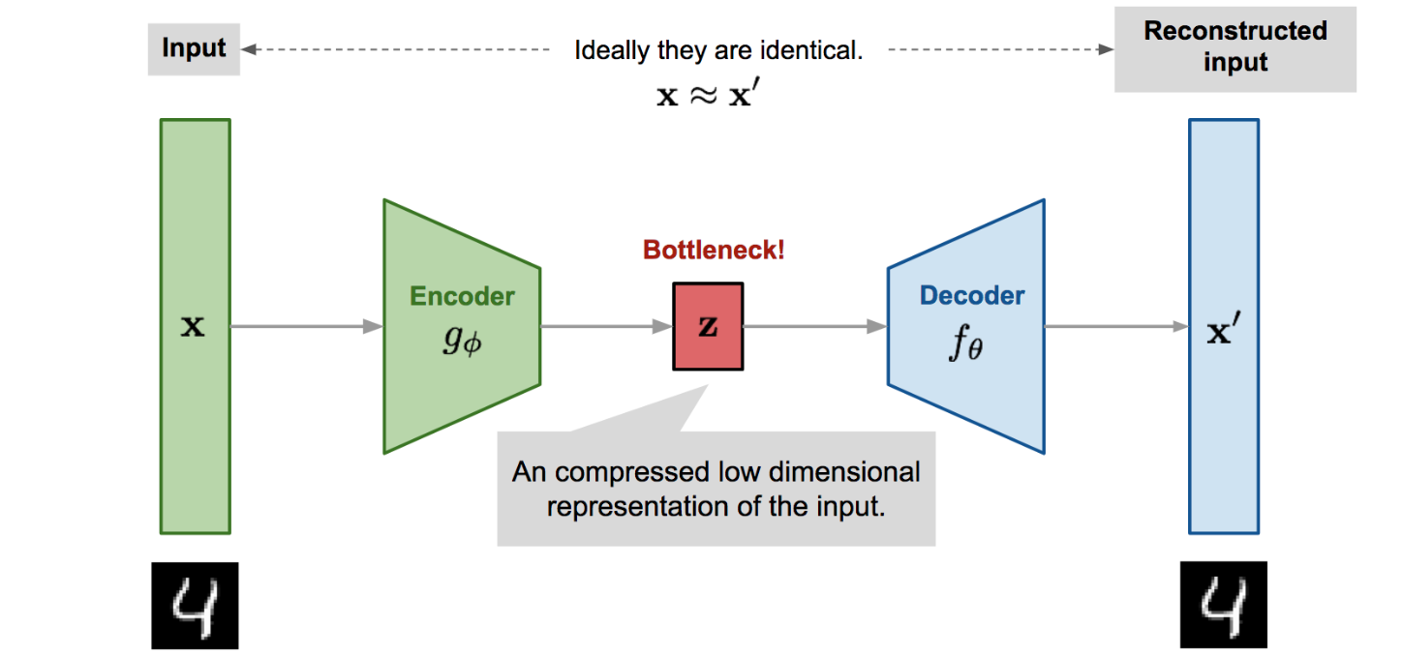
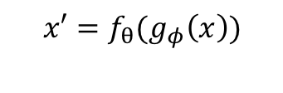
What is Auto-Encoder?
Train such that features can be used to reconstruct data
$$x′=f_{θ}(g_{φ}\left(x\right))$$
Can Auto-Encoder generate new data?
Dimension Reduction

Slide 3
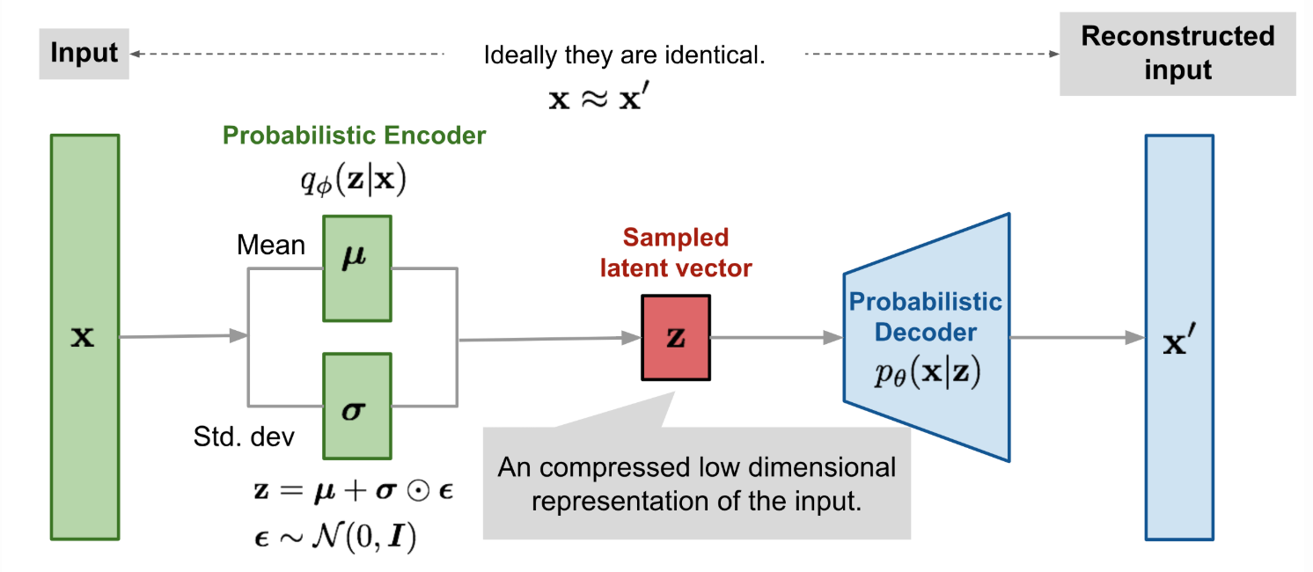

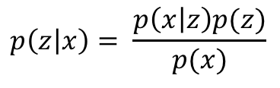
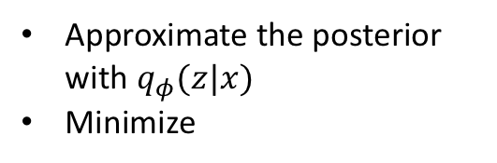
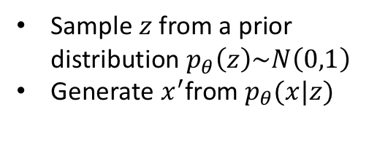
Variational Auto-Encoder (VAE), (Kingma & Welling, 2014),
Sample $z$from a prior distribution $p_{θ}\left(z\right)\sim N\left(0,1\right)$
Generate $x^{′}$from $p_{θ}(x|z)$
$$p\left(z | x\right)= \frac{p\left(x | z\right)p(z)}{p(x)}$$
Approximate the posterior with $q_{φ}(z|x)$
Minimize
Reparameterization Trick
-ELBO(q)
Regularizer
Reconstruction Loss

Slide 4
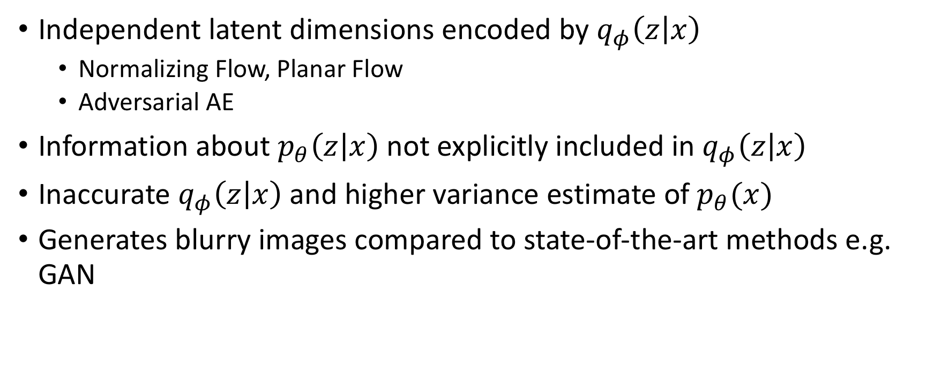
Issues with VAE
Independent latent dimensions encoded by $q_{φ}\left(z | x\right)$
Normalizing Flow, Planar Flow
Adversarial AE
Information about $p_{θ}\left(z | x\right)$ not explicitly included in $q_{φ}\left(z | x\right)$
Inaccurate $q_{φ}\left(z | x\right)$ and higher variance estimate of $p_{θ}(x)$
Generates blurry images compared to state-of-the-art methods e.g. GAN

Slide 5
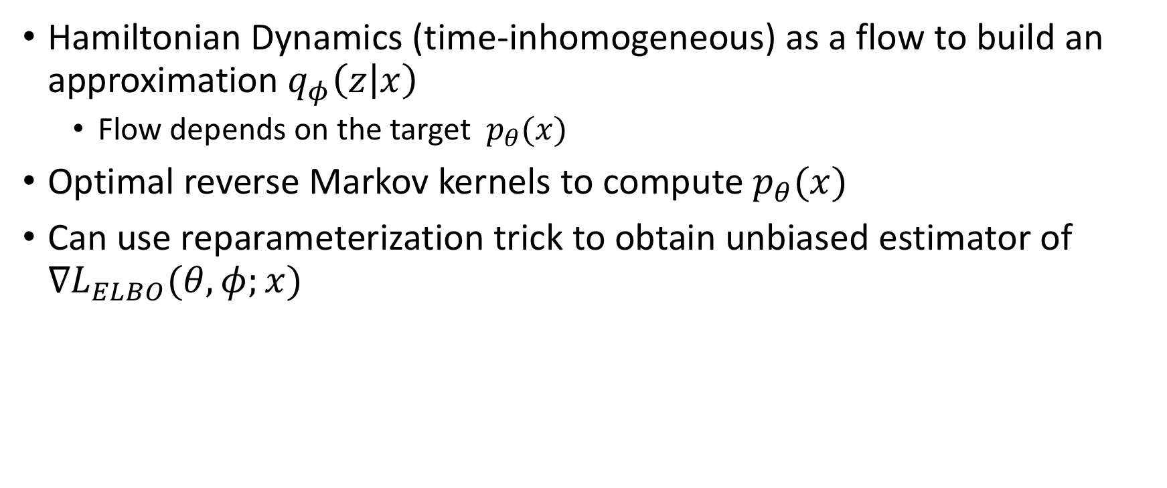
Hamiltonian Variational Auto-Encoder (HVAE) (Anthony L. Caterini 2018)
Hamiltonian Dynamics (time-inhomogeneous) as a flow to build an approximation $q_{φ}\left(z | x\right)$
Flow depends on the target $p_{θ}(x)$
Optimal reverse Markov kernels to compute $p_{θ}(x)$
Can use reparameterization trick to obtain unbiased estimator of $∇L_{ELBO}(θ,φ;x)$

Slide 6
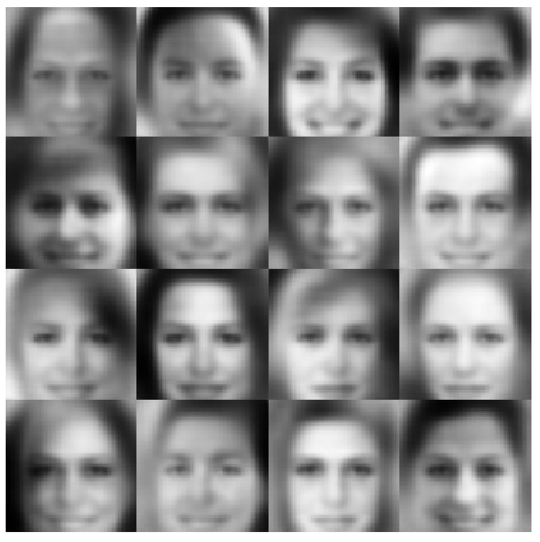
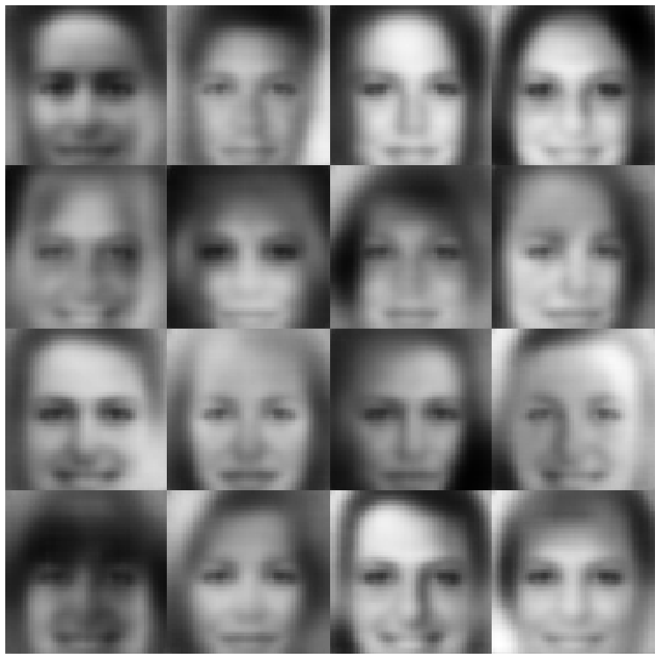
Comparison of HVAE vs VAE
NLL comparison: VAE - 83.20 HAVE – 82.62
Qualitative comparison on CelebA Face Dataset
HVAE
VAE

Slide 7
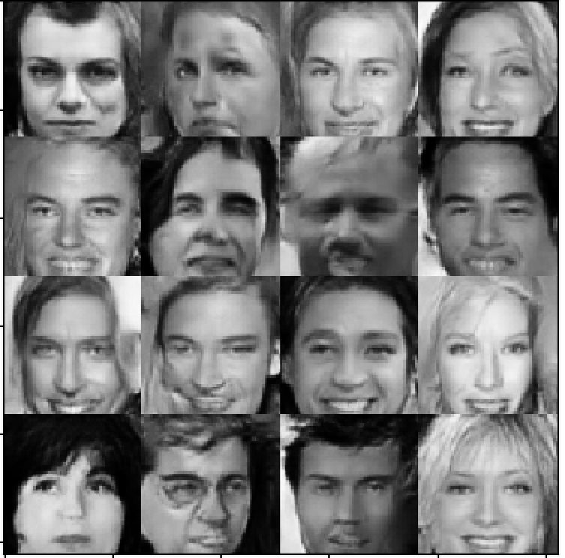
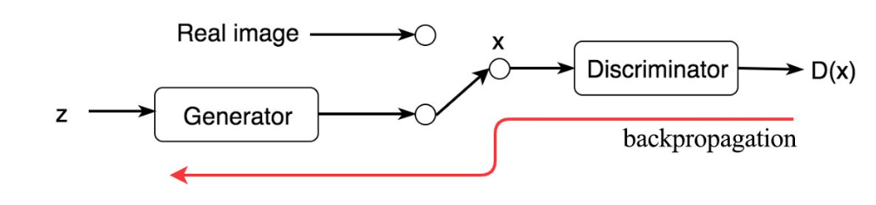
General Adversarial Network (GAN) Ian Goodfellow (2014)
What is General Adversarial Network?
Discriminator output for real data
Discriminator output for fake data

Slide 8
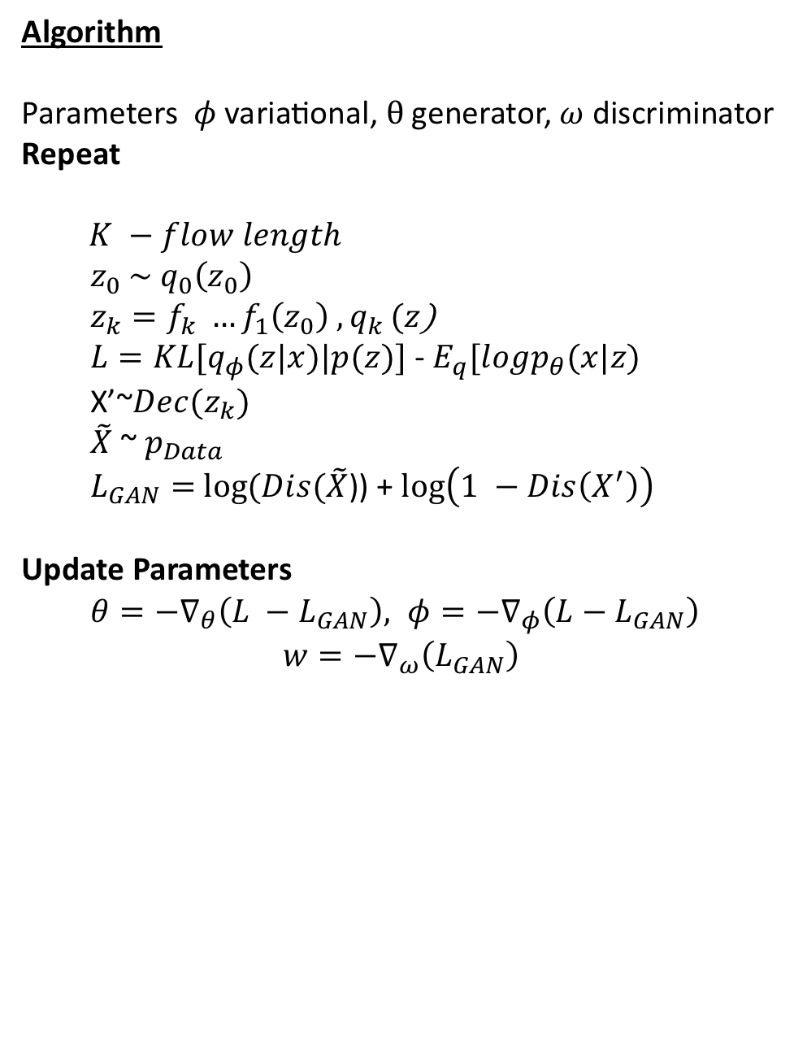

VAE with flow + GAN
Algorithm
Parameters $φ$variational, $θ$generator, $ω$discriminator
Repeat
$K −flow length$
$z_{0} \sim q_{0}\left(z_{0}\right)$
$z_{k}=f_{k} …f_{1}\left(z_{0}\right)$ ${, q}_{k}(z$)
$L=KL[q_{φ}(z|x)|p(z)]$ - $E_{q}[logp_{θ}(x|z)$
X’~$Dec(z_{k})$
$\tilde{X}$ ~ $p_{Data}$
$L_{GAN}=$ $log⁡(Dis(\tilde{X}$)) + $\log\left(1 −Dis\left(X^{′}\right)\right)$
Update Parameters
$θ=−∇_{θ}\left(L −L_{GAN}\right), φ=−∇_{φ}\left(L−L_{GAN}\right)$
$$w=−∇_{ω}\left(L_{GAN}\right)$$
$$X −random mini batch$$

Slide 9
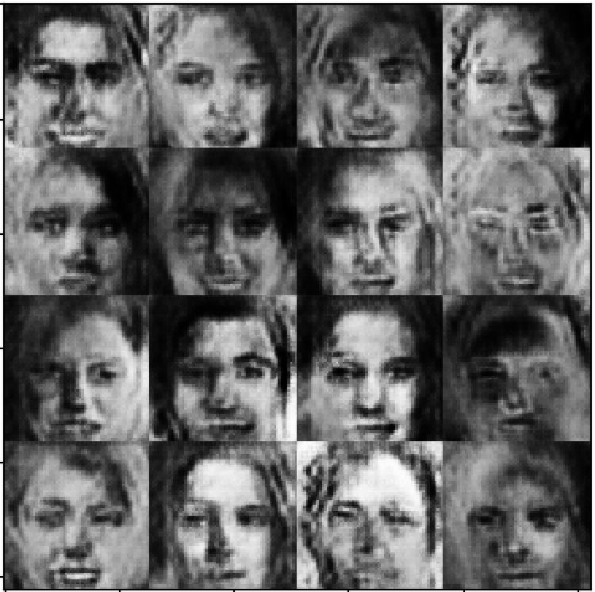
Preliminary Result
More Results Coming Soon…

Slide 10
References
Goodfellow, Ian, et al. "Generative adversarial nets." Advances in neural information processing systems. 2014.
Caterini, Anthony L., Arnaud Doucet, and Dino Sejdinovic. "Hamiltonian variational auto-encoder." Advances in Neural Information Processing Systems. 2018.
Rezende, Danilo Jimenez, and Shakir Mohamed. "Variational inference with normalizing flows." arXiv preprint arXiv:1505.05770 (2015).
Kingma, Diederik P., and Max Welling. "Auto-encoding variational bayes." arXiv preprint arXiv:1312.6114 (2013).

