Slide 1
Expediting Computation for Partial Dependence Plots
Mudong Zeng
Department of Statistics

Slide 2
Outline
Motivation
Challenges of PDP
Uncertainty issue
Computation issue
Solution to quantify uncertainty
bootstrapping
Solution to reduce computation time
Parallel computing
Subsampling bootstrap
Discussion
Conclusion
2/10

Slide 3

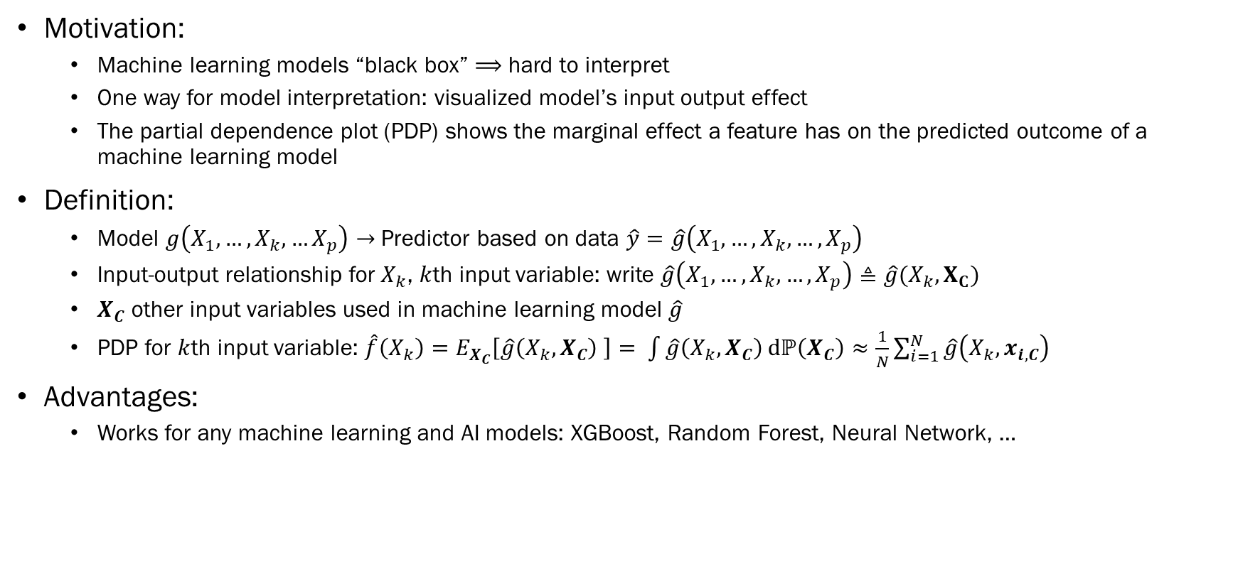

Partial Dependence Plot （PDP）
Motivation:
Machine learning models “black box” $⟹$ hard to interpret
One way for model interpretation: visualized model’s input output effect
The partial dependence plot (PDP) shows the marginal effect a feature has on the predicted outcome of a machine learning model
Definition:
Model $g\left(X_{1}, …, X_{k},…X_{p}\right)→$ Predictor based on data $\hat{y}=\hat{g}\left(X_{1}, …, X_{k},…,X_{p}\right)$
Input-output relationship for $X_{k}$, $k$th input variable: write $\hat{g}\left(X_{1}, …, X_{k},…,X_{p}\right)≜\hat{g}(X_{k},X_{C})$
$X_{C}$ other input variables used in machine learning model $\hat{g}$
PDP for $k$th input variable: $\hat{f}\left(X_{k}\right)=E_{X_{C}}\left[\hat{g}\left(X_{k}, X_{C}\right) \right]= \int{\hat{g}\left(X_{k},X_{C}\right)}dℙ\left(X_{C}\right)≈\frac{1}{N}\sum_{i=1}^{N}{\hat{g}\left(X_{k}, x_{i,C}\right)}$
Advantages:
Works for any machine learning and AI models: XGBoost, Random Forest, Neural Network, …
$$X$$
Black Box
$$Y$$
3/10

Slide 4
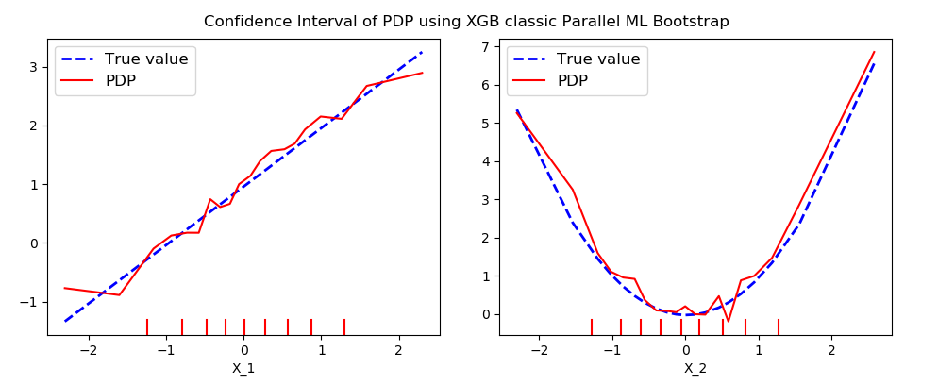
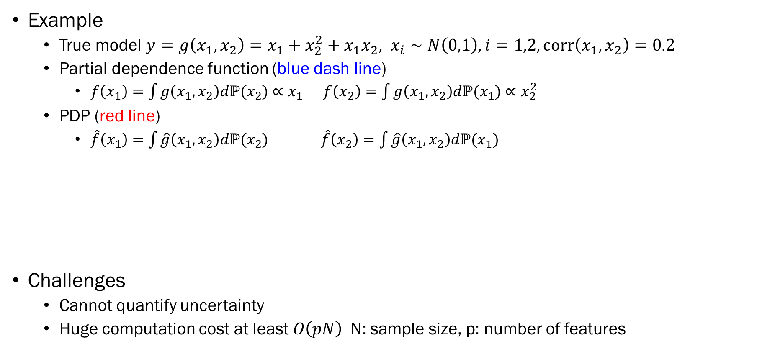
Partial Dependence Plot (PDP)
Example
True model $y=g\left(x_{1},x_{2}\right)=x_{1}+x_{2}^{2}+x_{1}x_{2}, x_{i}∼N\left(0,1\right), i=1,2,corr\left(x_{1},x_{2}\right)=0.2$
Partial dependence function (blue dash line)
$f\left(x_{1}\right)=\int{g\left(x_{1},x_{2}\right)dℙ(x_{2})}∝x_{1}$ $f\left(x_{2}\right)=\int{g\left(x_{1},x_{2}\right)dℙ(x_{1})}∝x_{2}^{2}$
PDP (red line)
$\hat{f}\left(x_{1}\right)=\int{\hat{g}\left(x_{1},x_{2}\right)dℙ(x_{2})}$ $\hat{f}\left(x_{2}\right)=\int{\hat{g}\left(x_{1},x_{2}\right)dℙ(x_{1})}$
Challenges
Cannot quantify uncertainty
Huge computation cost at least $O\left(pN\right)$N: sample size, p: number of features
4/10

Slide 5
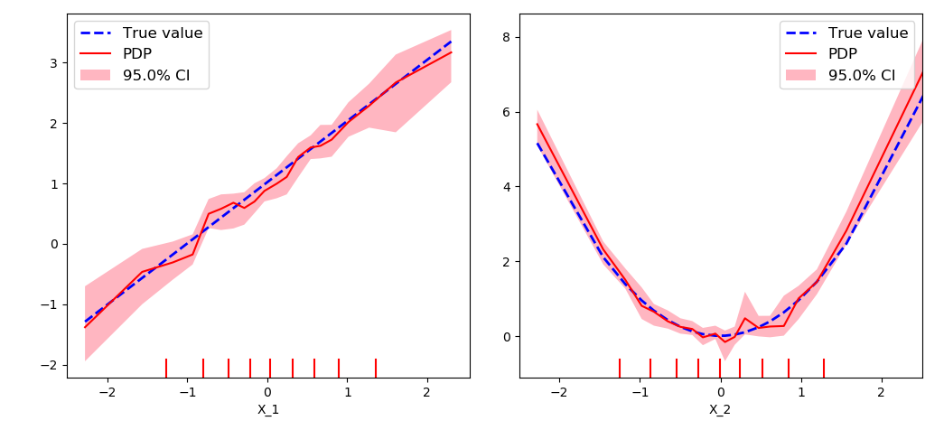
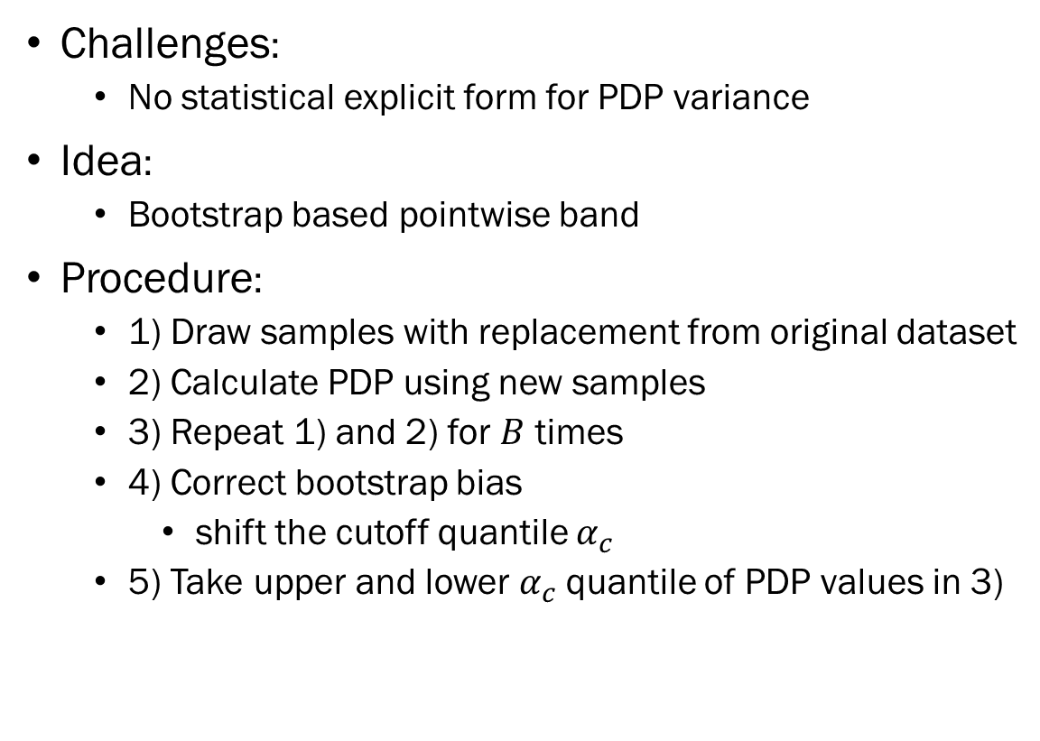
Quantify uncertainty of PDP
Challenges:
No statistical explicit form for PDP variance
Idea:
Bootstrap based pointwise band
Procedure:
1) Draw samples with replacement from original dataset
2) Calculate PDP using new samples
3) Repeat 1) and 2) for $B$ times
4) Correct bootstrap bias
shift the cutoff quantile $α_{c}$
5) Take upper and lower $α_{c}$quantile of PDP values in 3)
5/10

Slide 6
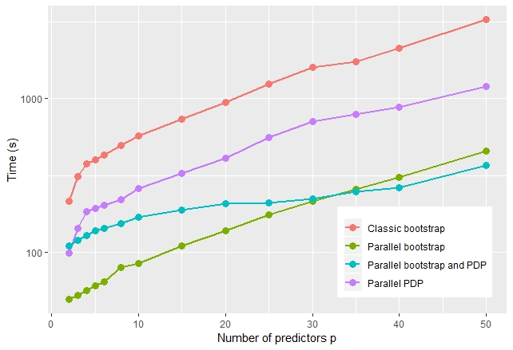

Expediate computation for PDP with confidence band Parallel Computing
Idea:
Separate the program processes to execute tasks concurrently on separate CPUs
Processes can be separated
Fitting machine learning model
Calculating PDP
Bootstrapping for confidence interval
Parallel computing in Python
Loky
Multiprocessing
Threading
Simulation settings:
Sample size $N = 10,000$
Number of predictors $p = 2 \sim 50$
Model: XGBoost
Real model contains: linear, quadratic, exp, sin, log, interaction …
6/10

Slide 7
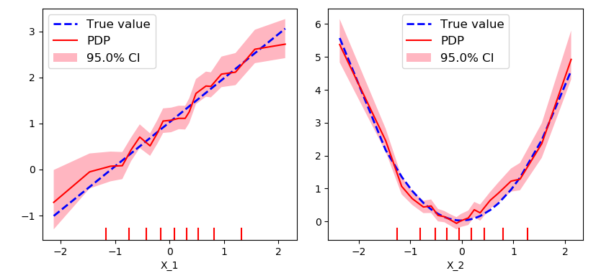
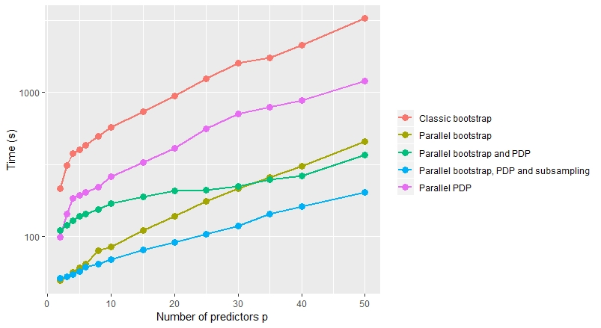
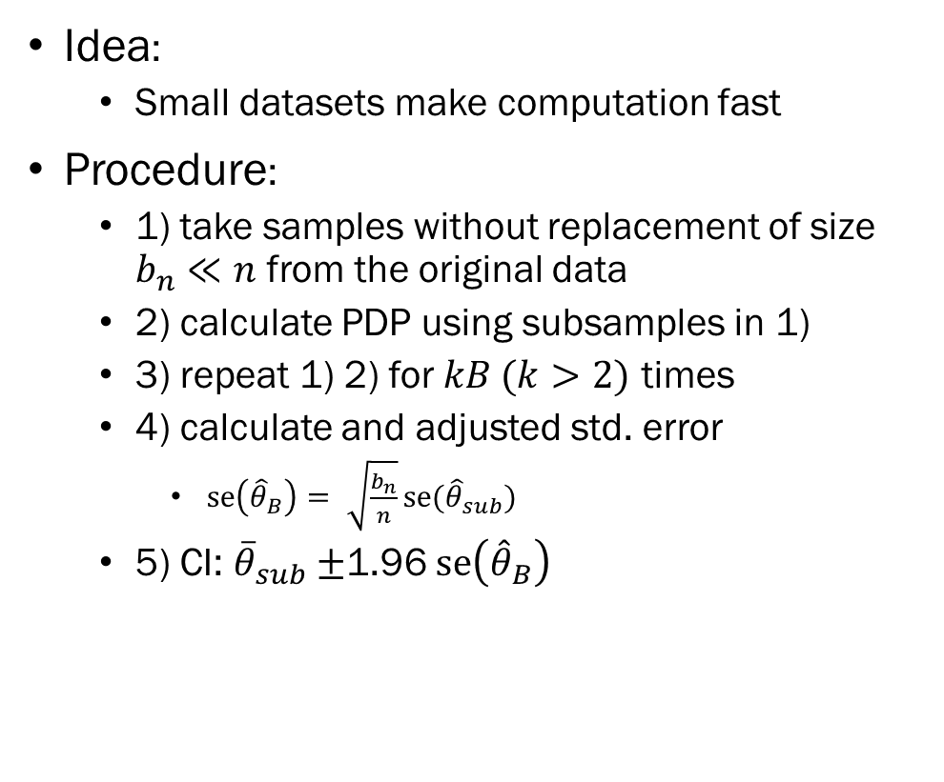
Expediate computation for PDP with confidence band Subsampling bootstrap*
Idea:
Small datasets make computation fast
Procedure:
1) take samples without replacement of size $b_{n}≪n$ from the original data
2) calculate PDP using subsamples in 1)
3) repeat 1) 2) for $kB (k>2)$ times
4) calculate and adjusted std. error
$se\left({\hat{θ}}_{B}\right)= \sqrt{\frac{b_{n}}{n}}se({\hat{θ}}_{sub})$
5) CI: ${\overline{θ}}_{sub}±$1.96 $se\left({\hat{θ}}_{B}\right)$
* Politis, Dimitris N., Joseph P. Romano, and Michael Wolf. Subsampling. Springer Science & Business Media, 1999.
7/10
Notes:
takes samples without replacement of size $b_{n}$ from the original sample of size n

Slide 8
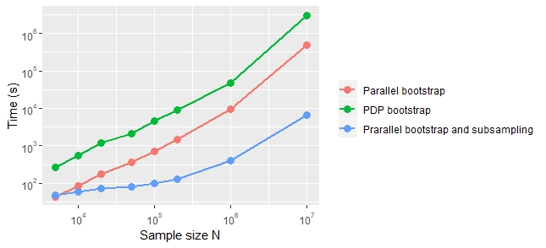

Simulation on sample size
Settings:
Number of input variables $p = 5$, sample size $N$ from 5000 to ${10}^{7}$
$g\left(x\right)=x_{1}+x_{2}^{2}+x_{1}x_{2}+e^{x_{3}}+\sin\left(\frac{x_{4}}{2}\right)+\cos^{2}{(x_{5})}$
Model: XGBoost( n_estimators = 500, max_depth = 4 )
Bootstrap: $B = 200$
Subsampling: $kB = 1000, b_{n}=\sqrt{N}$
8/10

Slide 9
Discussion
Parallel computing
Advantages:
Easy for one layer parallel
Straightforward
Disadvantages:
Hard for nested parallel
Overhead cost (loky > multiprocessing > threading)
Computation time depends on the business of the server
Subsampling bootstrap
Advantages:
Fundamentally reduce computation complexity
Efficient for large sample size
Disadvantages:
Require normality assumption
Unstable for imbalance class dataset (improve local-case control)
9/10

Slide 10
Conclusion
PDP is efficient when the number of predictors or sample size is small
PDP computation cost increases exponentially as the number of predictors increases
Ways to expediate the computation for PDP:
Variable selection to reduce the number of input variables
Apply two nested parallels: parallel PDP under bootstrapping
Use subsampling to further expediate the computation
10/10

