Slide 1
Computationally Efficient Methods for Stochastic Generator Expansion Planning
Vijay Kumar
Industrial Engineering Department
The Pennsylvania State University

Slide 2
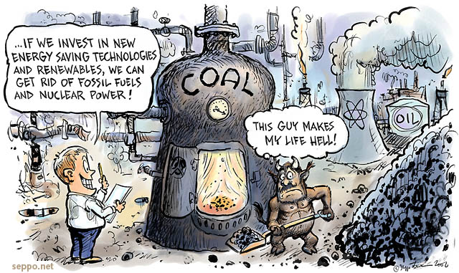
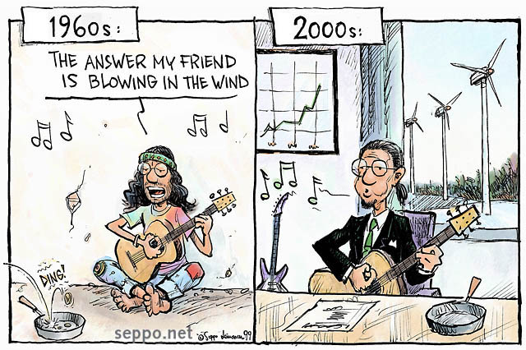
What is Generator Expansion Planning?
Problem Statement
Minimize Net Present Value
Subject to
Demand Constraints
Environment Constraints
Variables
Investment (New Capacity of each technology)
Generation (Generation level of each technology)
Notes:
The main question for energy utilities and Independent system operators was to determine the amount of renewable energy integration into the power grid. This motivates the question of what generator types to build in the future?

Slide 3
Problem Framing
Stage 1:
Choose investment
mix & operate for 10 yrs
Stage 2:
Choose investment
mix & operate for 10 yrs
Stage 3:
Choose investment
mix & operate for 30 yrs
Observe Fuel Prices,
Technology Costs,
& Policy Discussions
Observe Cumulative
Carbon Cap, fuel prices,
technology costs
Technologies:
Nuclear
Coal
NG-CCGT
NG-CT
Coal-CCS*
Wind*
Solar (PV)*
Uncertainties:
Cumulative Carbon Cap at end of Stage 3
Natural Gas Price
Nuclear Capital Costs
Wind Capital Costs
Solar Capital Costs
Coal-CCS Capital Costs
Notes:
The stochastic dynamic program solution has been present Bellamn invented in 1960

Slide 4
Classic Dynamic Programming Solution Methods
Objective of the Stochastic Problem
Choose RE(t) to maximize Bellman Value (Total Reward) in each time period:
V_{t}*(S_{t}) = max(C_{t}(S_{t}, RE_{t}) + E[V_{t+1}(S_{t+1})|S_{t}, RE_{t}])
Algorithmic Framework
Decision
State
Loop over time t / iterations n
Loop over states S
Loop over decisions X
μ(t)
Loop over random shocks W
Decision
State
Decision
State
Suffers from Curse of
Dimensionality
T=1
T=2
T=3

Slide 5
What is the solution? ADP
Don’t visit ALL states exhaustively
Sample states
Don’t test EVERY exogenous information signal
Sample the information
MAX E{f(x)} is hard
Break into two steps:
Deterministic Optimization: Best action for a sample state, sample signal, and estimate of the value function
Stochastic Simulation: Get a better estimate of the expected value for a sample state and it’s best action
Challenges
Obtain a good low dimensional form of the value function
How to Sample efficiently ?

Slide 6
Double Pass ADP Algorithm
Step 0: Initialize V_{t}⁰, n, S₀¹
Step 1: Choose sample path w^{n}
Step 2: loop over t=0 to T
Step 2a: Solve:
Step 2b: Update States
Step 3: Loop over t=T, T-1, …, 1
Step 3a: Compute v_{t}^{n} using x_{t}^{n} from forward pass
Step 3b: Update value function approximations
Step 4: n=n+1; if n<=N go to Step 1
Step5 : Return Value functions V_{t}^{n}

Slide 7

How to Sample efficiently? Exploration-Exploitation tradeoff
Objective: Gather enough information to make best decisions overall.
Exploitation: should I stick with what I know and find a good policy w.r.t. this knowledge?
at risk of missing out on a better reward somewhere
Exploration: should I look for states w/ more reward?
at risk of wasting time & getting some negative reward
Another Idea : Obtain a set of samples using modified version of accept reject with acceptance ratio as

Slide 8
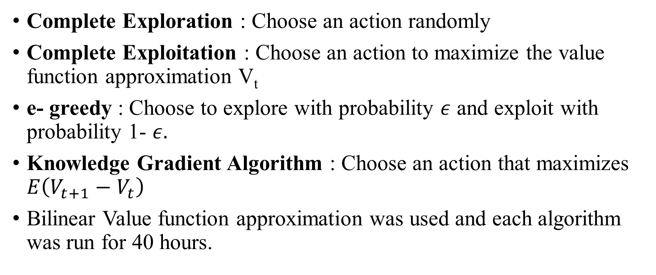
Comparison to other algorithms
Complete Exploration : Choose an action randomly
Complete Exploitation : Choose an action to maximize the value function approximation V_{t}
e- greedy : Choose to explore with probability $ε$ and exploit with probability 1- $ε.$
Knowledge Gradient Algorithm : Choose an action that maximizes $E\left(V_{t+1}−V_{t}\right)$
Bilinear Value function approximation was used and each algorithm was run for 40 hours.

Slide 9
Test Problem and Results
Test Problem : 3 Time Periods in increments of 20 years, 4 Technologies and 2 uncertainties in Fuel Prices and Cost of Carbon.
Conclusion and Future Work
Comparison of the solution to Exact Dynamic
Programming or Stochastic Optimization solution.
Testing of this methodology to other ADP
frameworks such as Inventory, Cart Pole or Chess.

