Slide 1
Professor Jayaram Sethuraman
Career Highlights

Slide 2
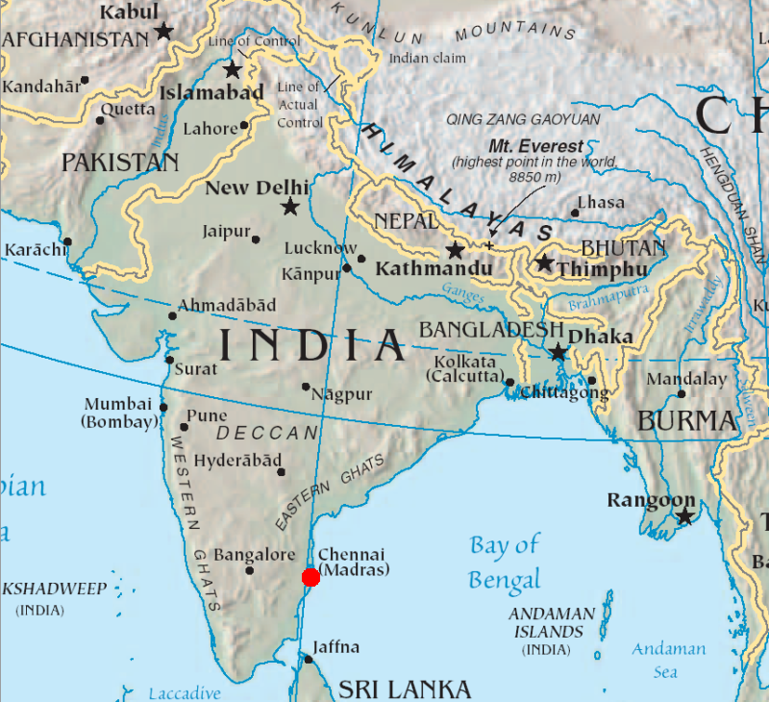

Slide 3
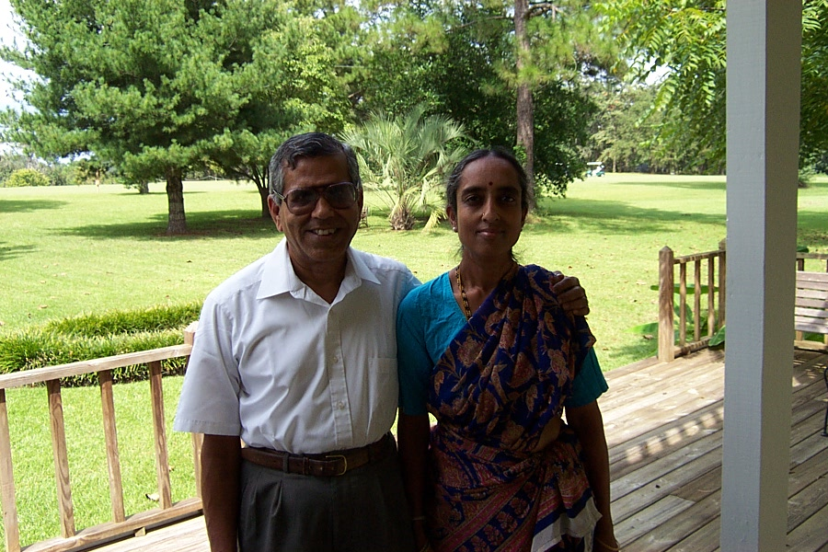

Slide 4
Academic History
B.SC. Madras University , 1957
M.A. Madras University, 1958
Ph.D. Indian Statistical Institute, 1962
Dissertation: Some results concerning asymptotic distributions and their applications
Major Professor: R.R. Bahadur

Slide 5
Awards and Honors
President’s Cont. Education Award, FSU, 2002
ASA Service Award, 2001
Professorial Excellence Award, FSU, 1996
Teaching Incentive Program Award, FSU, 1995
Fulbright Sr. Researcher, Teaching Fellow,1995-6
R.A. Bradley Lecturer, Univ. of Georgia, 1995
US Army S.S. Wilks Award, 1994
Sr. NSF/ASAS/NIST Fellow, 1994-95
Robert O.Lawton Distinguished Professor Award, FSU, 1993
Fellow, IMS, 1968
Fellow, ASA, 1971
Elected Member, ISI, 1972

Slide 6
Ph.D. Students
A.R. Padmanabhan
R. Natarajan
J. E. Conroy
R.E. Taylor
R.E. Sielken
G.G. Gregory
R.P. Clickner
D.H. Jones
E. El-Neweihi
J. Lynch
S.E. Nevius
J.C. Conlon
J.W. Jeon
L.Barker
R.C. Tiwari
N.R. Rao
W.T. Chan
B. Presnell
T.R. Young
T.V. Kurien
D. C. Herge
C. A. Dorado
S. Wu

Slide 7
Some Research Highlights
1961 Sankhya: Sethu developed a criterion for the convergence of joint distributions from convergence of the marginal and conditional distributions.
1965 Sankhya: In two papers with H.Rubin,
Sethu gave important approximations for
probabilities of moderate deviations and
uses these results to calculate Bayes risk
efficiencies.

Slide 8
Research Highlights (continued)
Sethu’s 1964 Ann. Math. Stat. On large
deviations is seminal, and this and additional papers by Sethu proved extremely valuable in solving problems of convergence of stochastic processes.
Sethu and I.Richard Savage made important contributions (cf. 1966 Ann. Math. Stat.) to
nonparametric sequential rank tests.

Slide 9
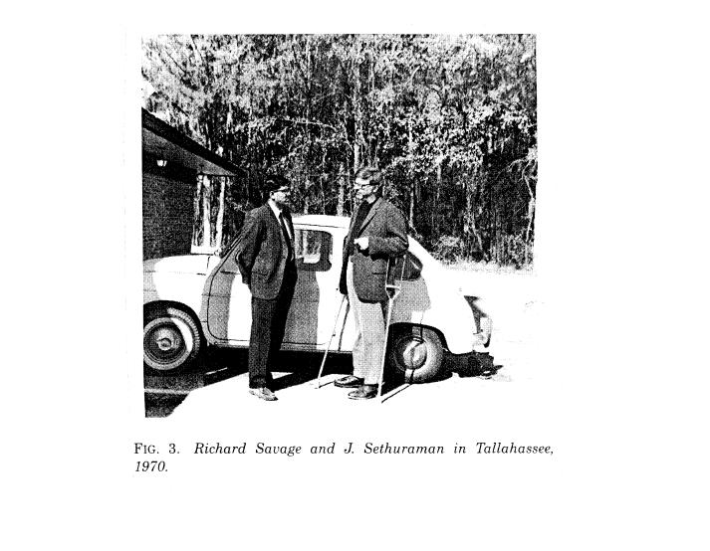

Slide 10
Research Highlights (continued)
Sethu’s elegant constructive definition of the Dirichlet process ( published in Stat. Sinica 1994 but cited earlier in joint research with Ram Tiwari)
is well known and used by researchers in
Bayesian nonparametrics . Bruce Lindsay’s
(1983) handwritten notes of Sethu’s NSF-CBMS lectures at Penn State have been widely disseminated.

Slide 11
Research Highlights (continued)
Sethu pioneered in the areas of stochastic
comparisons among life distributions. His 1977 Ann. Stat. introducing the notion of functions decreasing in transpositon (DT) (joint with Proschan and Hollander) , later termed arrangements increasing by Marshall and Olkin, has been very valuable in reliability analysis, ranking problems, and other areas of statistics.

Slide 12
Research Highlights (continued)
Sethu paper with K. Athreya and H. Doss (Ann. Statist. 1996) gave useful and rigorous conditions for convergence
in Markov chain Monte Carlo simulation
and was extremely important as one of the earlier theorems in this area was incorrect).

Slide 13
Research Highlights (continued)
Sethu has been teaching image
analysis and doing research in this important area and having interactions with Ulf
Grenander, the group at Brown University,
and Anuj Srivastava. See, for example,
Sethu’s paper with Grenander in the 1994
J. Mult. Anal.

Slide 14
Research Grants
U.S. Army Research Office: 1972-2000
Research and Engineering Apprentice Program (REAP) supported by the Academy of Applied Science: 1981-present: A hands on
research/study apprentice program in
the area of probability and statistics for high
seniors in the Tallahassee area. In 24 summer terms, Sethu has personally mentored 68 students.

Slide 15
Teaching
Sethu derives all results from scratch
Infectious enthusiasm
Unselfish with ideas
Lectures with a sense of humor
His ideas inspire research and dissertation topics
Winner: Teaching Incentive Program Award, 1995

