Slide 1
HyperText Transfer Protocol
HTTP

Slide 2
HTTP
Protocol that web browsers and web servers use to communicate with each other
It is a request-response protocol between a client and a server

Slide 3
Example: Browsing the Web
Client machine (your computer) is the one to initiate a request for a web page
The request is sent to the Web server (hosts Web site(s) and provides HTML files )
The server receives the request and sends back the desired information along with a status report

Slide 4
HTTP Request Pieces: First Line
First line contains:
a method, e.g., GET or POST (ones we will cover)
a URL or path to the document
The protocol and its version
For example:
GET /RCurl/index.html HTTP/1.1

Slide 5
HTTP Request Pieces: Header
Provides auxiliary information about the request via key:value pairs, e.g.
User-Agent: R version 2.15.0 (2012-03-30)
Host: www.omegahat.org
Accept: */*
Authorization: xxx
From: login@mail.com
X-Do-Not-Track: 1
Blank line
Blank Line
Indicates end of header

Slide 6
HTTP Request Pieces: Body
Optional body for the request
Contains the data characterizing the request
Used for a POST method of request, not for GET

Slide 7
HTTP Response Pieces
First Line
Status of the request
Remaining Header
key:value pairs about the content of the response, e.g., character encoding, type of content (image, HTML document, …).
Body: typically what we want, e.g., the HTML document.

Slide 8
GET Method
Request a document from a server
Request has no side effect.
Example, type a URL in a browser
http://www. omegahat.org/RCurl/index.html
Produces the following HTTP request:
GET /RCurl/index.html HTTP/1.1
Host: www.omegahat.org
Blank line

Slide 9
Server’s Response: Header
Status 200 indicates success
HTTP/1.1 200 OK
Date: Fri, 01 Jun 2012 22:56:46 GMT
Server: Apache/2.2.14 (Ubuntu)
Last-Modified: Wed, 01 Feb 2012 04:08:30 GMT
ETag: "3262089-10bf-4b7df3b75ab80"
Accept-Ranges: bytes
Content-Length: 4287
Vary: Accept-Encoding
Content-Type: text/html
Blank line

Slide 10
Status Codes
100 Informational – Communication continuing, more input expected from client or server
200 Success - e.g., 200 - general success;
300 Redirection or Conditional Action – requested URL is located somewhere else.
400 Client Error – e.g., 404 indicates the document was not found
500 Internal Server Error or Broken Request – error on the server side

Slide 11
Visit Wikipedia Page
pageContents = getURLContent(wikiURL,
verbose = TRUE)
* Trying 2620:0:863:ed1a::1...
* Connected to en.wikipedia.org (2620:0:863:ed1a::1) port 443 (#0)
* TLS 1.2 connection using TLS_ECDHE_ECDSA_WITH_AES_128_CBC_SHA
* Server certificate: *.wikipedia.org
* Server certificate: GlobalSign Organization Validation CA - SHA256 - G2
* Server certificate: GlobalSign
> GET /wiki/United_States_presidential_election_in_Virginia,_2004 HTTP/1.1
Host: en.wikipedia.org
Accept: */*

Slide 12
Response Header
< HTTP/1.1 200 OK
< Date: Mon, 28 Nov 2016 18:08:55 GMT
< Content-Type: text/html; charset=UTF-8
< Content-Length: 164960
< Connection: keep-alive
< Server: mw1272.eqiad.wmnet
< X-Powered-By: HHVM/3.12.7
< Vary: Accept-Encoding,Cookie,Authorization
< X-UA-Compatible: IE=Edge
< Content-language: en
…

Slide 13
Example: Other Status Codes
India stock exchange
uIn = "http://www.nseindia.com/archives/nsccl/volt/CMVOLT_07062012.CSV"
data = read.csv(url(uIn))
Error in open.connection(file, "rt") : cannot open the connection
In addition: Warning message:
In open.connection(file, "rt") :
cannot open URL 'http://www.nseindia.com/archives/nsccl/volt/CMVOLT_07062012.CSV':
HTTP status was '403 Forbidden'

Slide 14
Try Verbose option of getURL
d = getURL(uIn, verbose = TRUE)
* Trying 23.7.66.103...
* Connected to www.nseindia.com (127.0.0.1) port 80 (#0)
> GET /archives/nsccl/volt/CMVOLT_07062012.CSV HTTP/1.1
Host: www.nseindia.com
Accept: */*
< HTTP/1.1 403 Forbidden
< Server: AkamaiGHost
< Mime-Version: 1.0
< Content-Type: text/html
< Content-Length: 325
< Expires: Mon, 28 Nov 2016 16:31:32 GMT
< Date: Mon, 28 Nov 2016 16:31:32 GMT
< Connection: close
<
* Closing connection 0
Error: Forbidden
Need Some Expertise in HTTP status codes –
We need to supply a User-Agent key-value pair

Slide 15
What is a 403 error?
403 status code indicates that the server understood the request but refuses to authorize it.
Curious: We can paste the url in the browser and download the data. No special login or permission is needed to do this
The server can make public the reason for forbidding the request

Slide 16
Contents of the Response

Slide 17
What are the terms of use?
https://www.nseindia.com/global/content/termsofuse.htm
You may not conduct any systematic or automated data collection activities (including scraping, data mining, data extraction and data harvesting) on or in relation to our site without our express written consent.

Slide 18
Possible Work Around
Set a browser-like user agent string so the site thinks your request is from a browser
Specify
User-Agent: string

Slide 19
Try Again with User-Agent
d = getURL(uIn, useragent = "R", verbose = TRUE)
* Trying 23.7.66.103...
* Connected to www.nseindia.com (127.0.0.1) port 80 (#0)
> GET /archives/nsccl/volt/CMVOLT_07062012.CSV HTTP/1.1
Host: www.nseindia.com
User-Agent: R
Accept: */*
< HTTP/1.1 302 Moved Temporarily
< Server: AkamaiGHost
< Content-Length: 0
< Location: https://www.nseindia.com/archives/nsccl/volt/CMVOLT_07062012.CSV
< Date: Mon, 28 Nov 2016 16:33:23 GMT
< Connection: keep-alive
<
* Connection #0 to host www.nseindia.com left intact
New Status Code indicates the resource has been moved.

Slide 20
d = getURL(uIn, useragent = "R”,
followlocation = TRUE, verbose = TRUE)
* Trying 23.192.90.148...
* Connected to www.nseindia.com (127.0.0.1) port 80 (#0)
> GET /archives/nsccl/volt/CMVOLT_07062012.CSV HTTP/1.1
Host: www.nseindia.com
User-Agent: R
Accept: */*
< HTTP/1.1 302 Moved Temporarily
< Server: AkamaiGHost
< Content-Length: 0 …
* Found bundle for host www.nseindia.com: 0x10ac74540
* Trying 23.192.90.148...
> GET /archives/nsccl/volt/CMVOLT_07062012.CSV HTTP/1.1
Host: www.nseindia.com
User-Agent: R
Accept: */*
< HTTP/1.1 200 OK
< Server: -
< Content-Length: 96219
It’s a good idea to always set the follow location option to TRUE

Slide 21
Now we have the text
head(read.csv(textConnection(d)))
Date Symbol Underlying.Close.Price..A. …
1 07-JUN-2012 20MICRONS 87.30
2 07-JUN-2012 3IINFOTECH 11.45
3 07-JUN-2012 3MINDIA 3664.20
4 07-JUN-2012 A2ZMES 103.30
5 07-JUN-2012 AANJANEYA 489.45
6 07-JUN-2012 AARTIDRUGS 102.60

Slide 22
A GET Example with a Form

Slide 23
One of the “simplest” forms

Slide 24
View the Source (pared down)
<form action="/search" id="f" method="get">
<div class="init" id="fkbx">
<div id="fkbx-text">
Search Google or type URL
</div>
<input id="q" aria-hidden="true"
autocomplete="off" name="q"
tabindex="-1" type="url"
jsaction="mousedown:ntp.fkbxclk">
</div>
</form>

Slide 25
17 only truly random number

Slide 26
URL for the Google Search Results
https://www.google.com/search?q=17%20only%20truly%20random%20number&sourceid=chrome-instant&ion=1&ie=UTF-8&rct=j
The URL contains the inputs from the form
? Separates url from the inputs
q = our query
With %20 instead of blanks
& separates inputs

Slide 27
We can perform Google Searches programatically
queryURL =
"https://www.google.com/search?q=17+only+truly+random+number&sourceid=chrome-instant&ion=1&espv=2&ie=UTF-8”
get17Query = getURL(queryURL)
OR
get17Info =
getForm("https://www.google.com/search",
q = "17+only+truly+random+number",
sourceid = "chrome-instant",
ion = "1", espv = "2",ie = "UTF-8")

Slide 28
An Example: GET and PUT

Slide 29
Table of Gas Prices

Slide 30
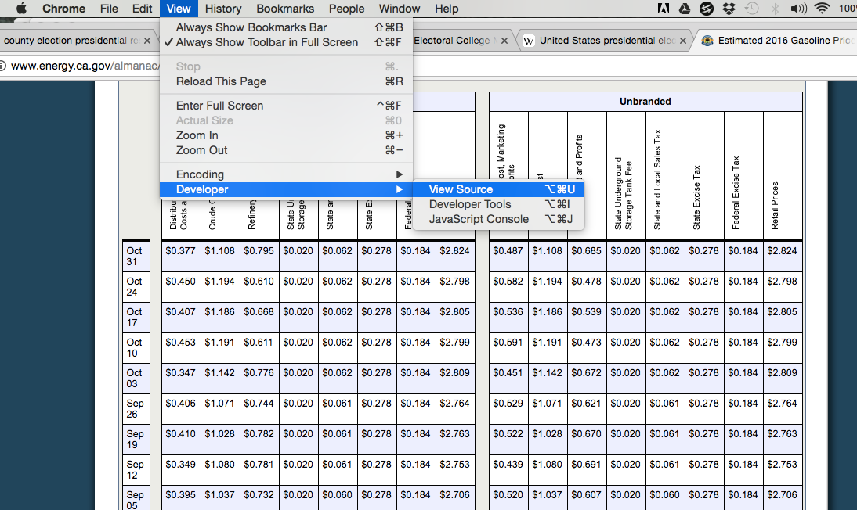
View the HTML Source

Slide 32
> gasURL =
"http://www.energy.ca.gov/almanac/transportation_data/gasoline/margins/"
> tbl =
readHTMLTable(gasURL, which = 1,
stringsAsFactors = FALSE)
> dim(tbl)
[1] 47 19

Slide 33
Want Data for Additional Years

Slide 34
View Source
POST method
We have a
<select> widget
And an
<input> widget which is a Submit button

Slide 35
POST Method
Requests the server to accept the entity enclosed in the body of the request
For example, the information in a web form to a data handling process

Slide 36
View Source
year is the name of this input
2013 is its value
newYear is the name of this input
'Get different year' is its value

Slide 37
txt = postForm(gasURL,
year = "2013",
newYear = 'Get different year')
gas13 = readHTMLTable(txt, which = 1,
stringsAsFactors = FALSE)

Slide 38
Authentication

Slide 39
OAuth
Authentication protocol that allows
you (User)
to approve one application (consumer)
to interact with another app (service provider) on your behalf
User’s password to service provider is not shared with the consumer application

Slide 40
Scenario
User: Joe
Consumer: Bitly
Service provider: Twitter
Joe wants to allow bitly to post shortened links to his Twitter stream
See https://blog.varonis.com/introduction-to-oauth/

Slide 41
Series of Exchanges
User shows intent (Joe asks bitly to do it)
Consumer gets permission from provider (bitly contacts twitter and gets consumer key & secret)
User goes to Provider and approves consumer access (shows consumer key and user password)
Consumer obtains access from provider (twitter gives bitly access token and secret (bitly provides consumer secret to get it))
Consumer can now access User’s stuff from service provider (with access token)

Slide 42
Pulling tweets for analysis in R
Who is the User?
my twitter acct
twitteR function
me
Twitter

Slide 43
Twitter scraping from within R
We have a User account with Twitter
Tell Twitter we are setting up an app. We get its consumer key and secret.
We verify the app with twitter and get an access token and secret
R package twitteR – has a function searchTwitter() which we use as the consumer and as the user

Slide 44
Pull tweets
library(twitteR)
consumer_key = "7P5a…….uSR"
consumer_secret = "Uyc….Q0c"
access_token = "3684….d6x"
access_secret = "7LpQ….T3e”
setup_twitter_oauth(consumer_key,
consumer_secret,
access_token,
access_secret)
trumpTwts = userTimeline("realDonaldTrump”)

Slide 45
Before you scrape:
Check to see if CSV, JSON, or XML version of an HTML page are available – better to use those
Check to see if there is an R package that provides structured access (e.g., twitteR)
Check that you have permission to scrape

Slide 46
If you do scrape:
Be careful to not to overburden the site with your requests
Test code on small requests
Use try() so that you don’t lose your results when one request triggers an error
Save the results of each request so you don’t have to repeat the request unnecessarily

