Slide 1
Text Mining

Slide 3
How can we analyze text?
Unsupervised –
The documents are not labeled or classified
Look for clusters/groups of like documents
Supervised –
The documents are labeled
Develop prediction method to predict label from text (and possibly other information)
Both approaches require us to transform the text into a quantitative form that we can analyze

Slide 4
Modified Tweets
Get Out to VOTE - and we will win! Poll
We are winning and the press is refusing to report it
Media in the tank for Clinton but Trump will win!
Dems are making phony polls to suppress the Trump. We are going to WIN!

Slide 5
Drop Stop Words (the, in, and, is, are..)
Get Out to VOTE - and we will win! Poll
We are winning and the press is refusing to report it
Media in the tank for Clinton but Trump will win!
Dems are making phony polls to suppress the Trump. We are going to WIN!

Slide 6
Drop Stop Words (the, in, and, is, are..)
Get Out VOTE - we win! Poll
We winning press refusing report
Media tank Clinton Trump win!
Dems making phony polls suppress Trump. We going WIN!

Slide 7
Stem Words (winning to win; polls to poll; are to is)
Get Out VOTE - we win! Poll
We winning press refusing report
Media tank Clinton Trump win!
Dems making phony polls suppress Trump. We going WIN!

Slide 8
Stem Words (winning to win; polls to poll; are to is)
Get Out VOTE - we win! Poll
We win press refus report
Media tank Clinton Trump win!
Dems mak phony poll suppress Trump. We go WIN!

Slide 9
Drop Punctuation Convert to lower case
Get Out VOTE - we win! Poll
We win press refus report
Media tank Clinton Trump win!
Dems mak phony poll suppress Trump. We go WIN!

Slide 10
Drop Punctuation Convert to lower case
get out vote we win poll
we win press refus report
media tank clinton trump win
dems mak phony poll suppress trump we go win

Slide 11
Bag of words
Unique words across all documents
clinton dems get go mak media out phony poll press refus report suppress tank trump vote we win

Slide 12
Each Document is a word vector
 | A | B | C | D | NumDocs
clinton | 0 | 0 | 1 | 0 | 1
dems | 0 | 0 | 0 | 1 | 1
get | 1 | 0 | 0 | 0 | 1
go | 0 | 0 | 0 | 1 | 1
…
trump | 0 | 0 | 1 | 1 | 2
vote | 1 | 0 | 0 | 1 | 2
we | 1 | 1 | 0 | 1 | 3
win | 1 | 1 | 1 | 1 | 4
TOTAL | 6 | 5 | 5 | 9

Slide 13
What information do we lose with Word Vectors?
Placement / juxtaposition of words
E.g., “damn” alone is typically a negative word, but “damn good” is a positive phrase; bigrams can help
Meaning through punctuation –
use of exclamation point can distinguish between authors
Small words
Some analyses focus on small words to identify authors

Slide 14
Similarity between documents
Do documents use the same terms?
Don’t care about common terms
Want to control for the length of the document

Slide 15
Similarity between documents
Term frequency: number of the words in a document are this term (nt of n)
Document frequency: number of the documents that contain this term (Nd of N)
Normalized vector:
V = nt/n * N/Nd) (term freq - inverse doc freq)
Or
V = nt/n * log((1+N)/ Nd)

Slide 16
 | A | B | C | D | InvDocFrq
clinton | 0 | 0 | 1/5 | 0 | 4
dems | 0 | 0 | 0 | 1/9 | 4
get | 1/6 | 0 | 0 | 0 | 4
go | 0 | 0 | 0 | 1/9 | 4
…
trump | 0 | 0 | 2/5 | 1/9 | 2
vote | 1/6 | 0 | 0 | 1/9 | 2
we | 1/6 | 1/5 | 0 | 1/9 | 4/3
win | 1/6 | 1/5 | 1/5 | 1/9 | 1
TOTAL | 6 | 5 | 5 | 9

Slide 17
tf-idf (log2)
 | A | B | C | D | Log(idf)
clinton | 0 | 0 | 2/5 | 0 | 4 -> 2
dems | 0 | 0 | 0 | 2/9 | 4 -> 2
get | 2/6 | 0 | 0 | 0 | 4 -> 2
go | 0 | 0 | 0 | 2/9 | 4 -> 2
…
trump | 0 | 0 | 2/5 | 1/9 | 2 -> 1
vote | 1/6 | 0 | 0 | 1/9 | 2 -> 1
we | 2/30 | 2/25 | 0 | 2/45 | 4/3 -> 0.4
win | 1/20 | 3/50 | 3/50 | 1/30 | 1 -> 0.3
TOTAL | 6 | 5 | 5 | 9

Slide 18
Distance between documents
Dist(V, W) = ½( KL(V, AVG) + KL(W, AVG))
where: KL stands for Kulback-Leibler measure
KL(V, AVG) = sum( log(V/AVG) * AVG)
and V = TF* IDF

Slide 19
Dissimilarity Matrix
 | A | B | C | D
A | 0 | 1.80 | 2.10 | 1.44
B | 1.80 | 0 | 1.65 | 1.30
C | 2.10 | 1.65 | 0 | 1.61
D | 1.44 | 1.30 | 1.61 | 0

Slide 20
Multi-dimensional Scaling
Information visualization technique for high-dimensional data.
Consider the matrix of dis-similarities above for the four documents.
Assign locations in 2 dimensions so that the distances between documents is roughly preserved.

Slide 21
Example
 | A | B | C
A | 0 | 3 | 4
B | 3 | 0 | 5
C | 4 | 5 | 0
Could represent as a triangle in two dimensions

Slide 22
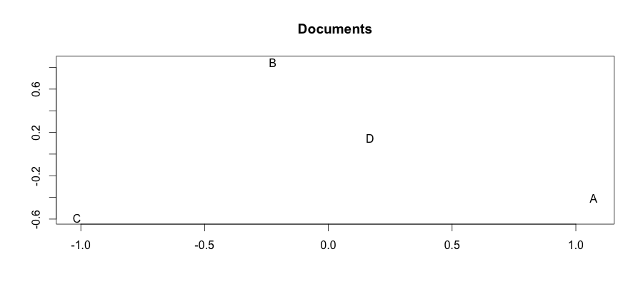
Our Documents

Slide 23
MDS
Doesn’t produce unique representations of the data,
Does give you the opportunity to compare objects (documents in our case)
Look for clusters and gaps

Slide 24
Hierarchical clustering
Build a binary tree that successively merges similar groups.
This implies that we need a metric or measure of similarity between groups of points.
There are various algorithms that can be used to create the binary tree.

Slide 25
Agglomerative Clustering
1. Start with each point in its own group.
2. Merge the two most similar groups.
3. Repeat step 2 until all groups have been merged into one
Note that the similarity between two groups being merged at any stage must, by design, be decreasing because we merge less and less similar groups.

Slide 26
Measure of similarity between groups
Single linkage: smallest distance between any point in one group and a point in the other group.
Complete linkage: largest distance between any point in one group and a point in the other group.
Average linkage: average distance between each point in one group and every point in the other group

Slide 27
Single linkage tends to result in chaining, where you successively add on one point to a group
Complete linkage tends not to merge close groups when one point in one group is far from the other group.

Slide 28
Dendrogram
Useful visualization of the clustering process.
Typically the tree is drawn such that the heights of the branches proportional to the dissimilarity between the two groups.
This visual helps you see where a good place to “cut” the tree might be and create clusters

Slide 29
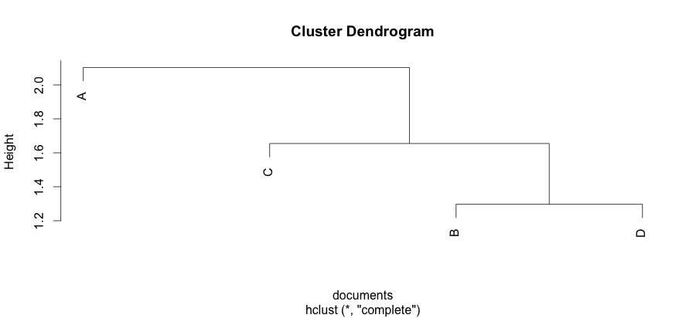
Complete linkage

Slide 30
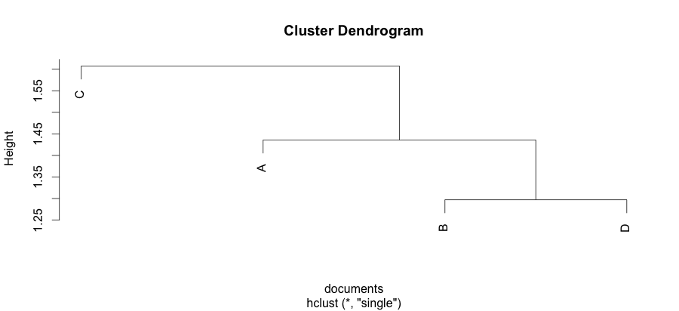
Single linkage

Slide 31
Dendrogram
Different definitions of similarity can give very different trees.
The algorithm imposes a hierarchy on a set of data, even if there isn’t one.

Slide 32
Your Turn
State of the Union addresses

Slide 33
State of the union speeches
Use readLines() to read in the speeches
Return value: character vector with one element/character string per line in the file
Regular expressions to find ***
Use *** to identify the date of the speech
Use regular expressions to extract the year
Use regular expressions to extract the month
Use *** to extract the name of the president

Slide 34
State of the union speeches
Chop the speeches up into a list there is one element for each speech.
Each element is a character vector.
Each element of the vector is a character string corresponding to a sentence in the speech

Slide 35
Word Vectors
Eliminate apostrophes, numbers, and the phrase: (Applause.) from the text.
Make all the characters lower case.
Split the sentences up where there are blanks and punctuation
Drop any empty words that resulted from this split
Load the library Rstem and use the function wordStem() to stem words

Slide 36
Find the bag of words
Create a word vector for each speech
Normalize the word vectors to get term frequencies

Slide 37
Analysis
Exploratory analysis of the data:
Number of sentences, long words, political party
Multidimensional scaling
Hierarchical clustering

