Slide 1
Topics
Data
JSON
XML, XPath
SQL and SELECT statement
Analysis
Naïve Bayes
Bootstrap and Bagging
Cross-validation

Slide 2
Data Analysis Issues
Model selection: How to choose the k in K-NN, the complexity parameter in recursive partitioning, the threshold in Naïve Bayes?
Variability: How accurate is our predictor?
Generalizability: What can our data and findings say about other situations?

Slide 3
Structured Plain-text Data

Slide 4
Recall
Delimited data, e.g.,
comma separated values
Tab-delimited
Fixed-width format data
Key:value pairs

Slide 5
Data Available on the Web
HTML
HTML Table
plain text formats (e.g., delimited)
Other Formats:
JSON
XML

Slide 6
JSON
JavaScript Object Notation

Slide 7
Text format
Lightweight data-interchange
Easy for humans to read and write.
Easy for machines to parse and generate

Slide 8
JSON Primitive Data Types
Number
like numeric in R
no NaN, NA, Inf
String (in double quotes)
Boolean (true or false)
These are scalars
null – empty object (like NULL in R)

Slide 9
JSON Structures: Array
Unnamed
Ordered
Comma-separated
Square brackets
Possibly heterogeneous
[value, value, value, …]

Slide 10
JSON Structures: Object
Named
Unordered
Comma-separated
Curly brackets
Possibly heterogeneous
AKA: Associative array
{"key": value, "key": value, "key": value, …}

Slide 11
Example
{"lender_id":"matt",
"loan_count":23,
"status":[2, 1, 3],
"sponsored": false, "sponsor_name": null,
"lender_dem":{"sex":"m","age":77 }
}

Slide 12
Example
Object
String
{"lender_id":"matt",
"loan_count":23,
"status":[2, 1, 3],
"sponsored": false, "sponsor_name": null,
"lender_dem":{"sex":"m","age":77 }
}
Number
Array
Boolean
Object

Slide 13
Twitter

Slide 14
One Abbreviated Tweet
[
{
"favorite_count": 11495,
"favorited": false,
"user": {"verified": true, "profile_sidebar_fill_color": "C5CEC0", … }
"id_str": "786204978629185536",
"text": "Crooked Hillary Clinton likes to talk about the things she will do but she has been there for 30 years - why didn't she do them?”,
"id": 7.862e+17,
"source": "<a href='http://twitter.com/download/iphone' rel='nofollow'>Twitter for iPhone</a>",
"lang": "en",
"geo": null,
"created_at": "Wed Oct 12 14:00:48 +0000 2016",
"place":{"full_name": "Florida, USA", … }, … ]

Slide 15
Translate into a Structure in R
> length(tweetList)
[1] 3243
> class(tweetList[[1]])
[1] "list”
> names(tweetList[[1]])
[1] "favorite_count" "favorited" "user"
[4] "id_str" "text" "id"
[7] "source" "lang" "geo"
[10] "created_at" "place"

Slide 16
Translate into a Structure in R
> length(tweetList[[1]]$user)
[1] 41
> tweetList[[1]]$text
[1] "PAY TO PLAY POLITICS. \n#CrookedHillary https://t.co/wjsl8ITVvk"
> tweetList[[1]]$created_at
[1] "Wed Oct 12 14:00:48 +0000 2016"

Slide 17
Translate into a Structure in R
Unnamed list of 3243 tweets
Each tweet is a named list of 11 elements (this is an abbreviated file)
Most of these elements are vectors of length 1 or NULL vectors
Two are named lists with 41 (user) and 10 (place) elements. These elements are a mix of vectors and lists

Slide 18
XML
eXtensible Markup Language

Slide 19
XML is a standard for semantic, hierarchical representation of data
<catalog>
<plant>
<common>Bloodroot</common>
<botanical>Sanguinaria canadensis</botanical>
<zone>4</zone>
<light>Mostly Shady</light>
<price>2.44</price>
<availability>03/15/2006</availability>
<indoor>true</indoor>
</plant>
…
</catalog>
Notes:
anything in brackets is markup; only 4 pieces of information

Slide 20
Examples of XML

Slide 22
<lender>
<lender_id>matt</lender_id>
<name>Matt</name>
<image>
<id>12829</id>
<template_id>1</template_id>
</image>
<whereabouts>San Francisco CA</whereabouts>
<country_code>US</country_code>
<uid>matt</uid>
<member_since>2006-01-01T09:01:01Z</member_since>
<personal_url>www.socialedge.org/blogs/kiva-chronicles
</personal_url>
<occupation>Entrepreneur</occupation>
<loan_because>I love the stories. </loan_because>
<occupational_info>I co-founded a startup nonprofit (this one!)
and I work with an amazing group of people dreaming up ways to
alleviate poverty through personal lending.
</occupational_info>
<loan_count>89</loan_count>
<invitee_count>23</invitee_count>
</lender>
Snippet of Kiva Data for one lender

Slide 24
Snippet of exchange data
<Cube>
<Cube time="2008-04-21">
<Cube currency="USD" rate="1.5898"/>
<Cube currency="JPY" rate="164.43"/>
<Cube currency="BGN" rate="1.9558"/>
<Cube currency="CZK" rate="25.091"/>
</Cube>
<Cube time="2008-04-17">
<Cube currency="USD" rate="1.5872"/>
<Cube currency="JPY" rate="162.74"/>
<Cube currency="BGN" rate="1.9558"/>
<Cube currency="CZK" rate="24.975"/>
</Cube>
</Cube>

Slide 26
<event id="00068404" network-code="ak"
time-stamp="2008/09/16_22:17:31 " version="2">
<param name="year" value="2008"/>
<param name="month" value="09"/>
<param name="day" value="14"/>
<param name="hour" value="00"/>
<param name="minute" value="59"/>
<param name="second" value="04.0"/>
<param name="latitude" value="51.8106"/>
<param name="longitude" value="-175.9250"/>
<param name="depth" value="146.0"/>
<param name="magnitude" value="3.8"/>
<param name="num-stations" value="10"/>
<param name="num-phases" value="15"/>
<param name="dist-first-station" value="126.1"/>
<param name="azimuthal-gap" value="53"/>
<param name="magnitude-type" value="L"/>
<param name="magnitude-type-ext"
value="Ml = local magnitude (synthetic Wood-Anderson)"/>
<param name="location-method" value="a"/>
<param name="location-method-ext"
value="Auryn (Confirmed by human review)"/>
</event>
<event>
Snippet of USGS earthquake catalog data (quakeml)

Slide 28
<actions>
<action datetime="2009-01-26">
<text>Referred to the Committee on Appropriations, and in addition
to the Committee on the Budget, for a period to be
subsequently determined by the Speaker, in each case for
consideration of such provisions as fall within the
jurisdiction of the committee concerned.
</text>
</action>
<action datetime="2009-01-26">
<text>Referred to House Appropriations</text>
</action>
</actions>
..
<relatedbills>
<bill relation="rule" session="111" type="hr" number="88" />
</relatedbills>
Snippet of US Congress data

Slide 30
<Placemark id="217">
<name>8.2</name>
<description>
Date: 2008-9-15
Magnitude: 1.5
Depth: 8.2 km
</description>
<styleUrl>#ball1-2</styleUrl>
<Point>
<coordinates>-147.426, 60.929, 0</coordinates>
</Point>
</Placemark>
Snippet of KML for one earthquake placemark

Slide 31
XML Syntax

Slide 32
Syntax
The basic unit of XML code is called an “element” or “node”
Each Node has a start tag and end tag
<zone>4</zone>
Start tag
End tag
Content

Slide 33
Syntax
A node may have other other nodes (children) in it in addition to plain text content.
<plant>
<zone>4</zone>
<light>Mostly Shady</light>
</plant>
Start tag
Content consists of
two nodes
Indentation is simply to show the nesting
End tag

Slide 34
Syntax
Nodes may be empty
<plant>
<zone></zone>
<light/>
</plant>
These two nodes
are empty
Both formats are
acceptable

Slide 35
Syntax
Nodes may have attributes (and attribute values)
<plant type=“indoor”>
<zone></zone>
<light source=“2” class=“new”/>
</plant>
The attribute named type
has a value of “indoor”
This empty node
has two attributes

Slide 36
Syntax
Comments can appear anywhere
<plant>
<!–- elem with content -->
<zone>4 <!–- a second comment --></zone>
<light>Mostly Shady</light>
</plant>
Two comments

Slide 37
Well-formed XML
An element must have both an open and closing tag unless it is empty. If empty, it can be of the form <tagname/>.
Tags must nest properly. (Inner tags must close before outer ones.)
Tag names are case-sensitive; start and end tags must match exactly.
No spaces are allowed between < and tag name.
Tag names must begin with a letter and contain only alphanumeric characters.

Slide 38
Well-formed XML ctd.:
All attributes must appear in quotes in the format:
name = "value"
Isolated markup characters must be specified via entity references. < is specified by &lt; and > is specified by &gt;.
All XML documents must have one root node that contains all the other nodes.

Slide 39
<?xml version="1.0" encoding="ISO-8859-1"?>
<!-- Edited with XML Spy v2006 (http://www.altova.com) -->
<catalog>
<plant>
<common>Bloodroot</common>
<botanical>Sanguinaria canadensis</botanical>
<zone>4</zone>
<light>Mostly Shady</light>
<price>$2.44</price>
<availability>031599</availability>
</plant>
<plant>
<common>Columbine</common>
<botanical>Aquilegia canadensis</botanical>
<zone>3</zone>
<light>Mostly Shady</light>
<price>$9.37</PRICE>
<availability>030699</availability>
</plant>
…</catalog>
XML declaration and processing instructions
Note how indentation makes it easier to check that the tags are correctly nested.

Slide 40
Tree Representation

Slide 41
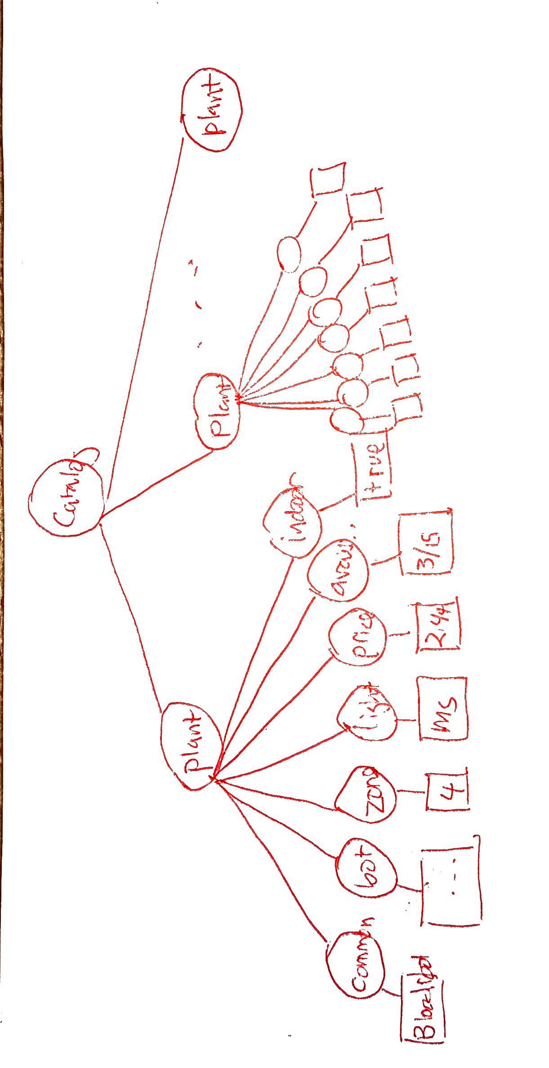
<catalog>
<plant>
<common>Bloodroot</common>
<botanical>Sanguinaria canadensis</botanical>
<zone>4</zone>
<light>Mostly Shady</light>
<price>$2.44</price>
<availability>031599</availability>
</plant>
…
</catalog>

Slide 42
Tree terminology
There is only one root or document node in the tree, and all the other nodes are contained within it.
We think of these other nodes as being descendants of the root node.
We use the language of a family tree to refer to relationships between nodes. Parents, children, siblings, ancestors, descendants
The terminal nodes in a tree are also known as leaf nodes. Content always falls in a leaf node.

Slide 43
<A>
<B>
<D>xxx</D>
<E/>
</B>
<B>
<D> yyy </D>
</B>
<C>
ABC
<D> ZZZZ </D>
</C>
</A>
Which statement is TRUE?
A. All B nodes are siblings
B. E’s parent is a B node
C. All D nodes are siblings
D. A and B
E. A, B, and C

Slide 44
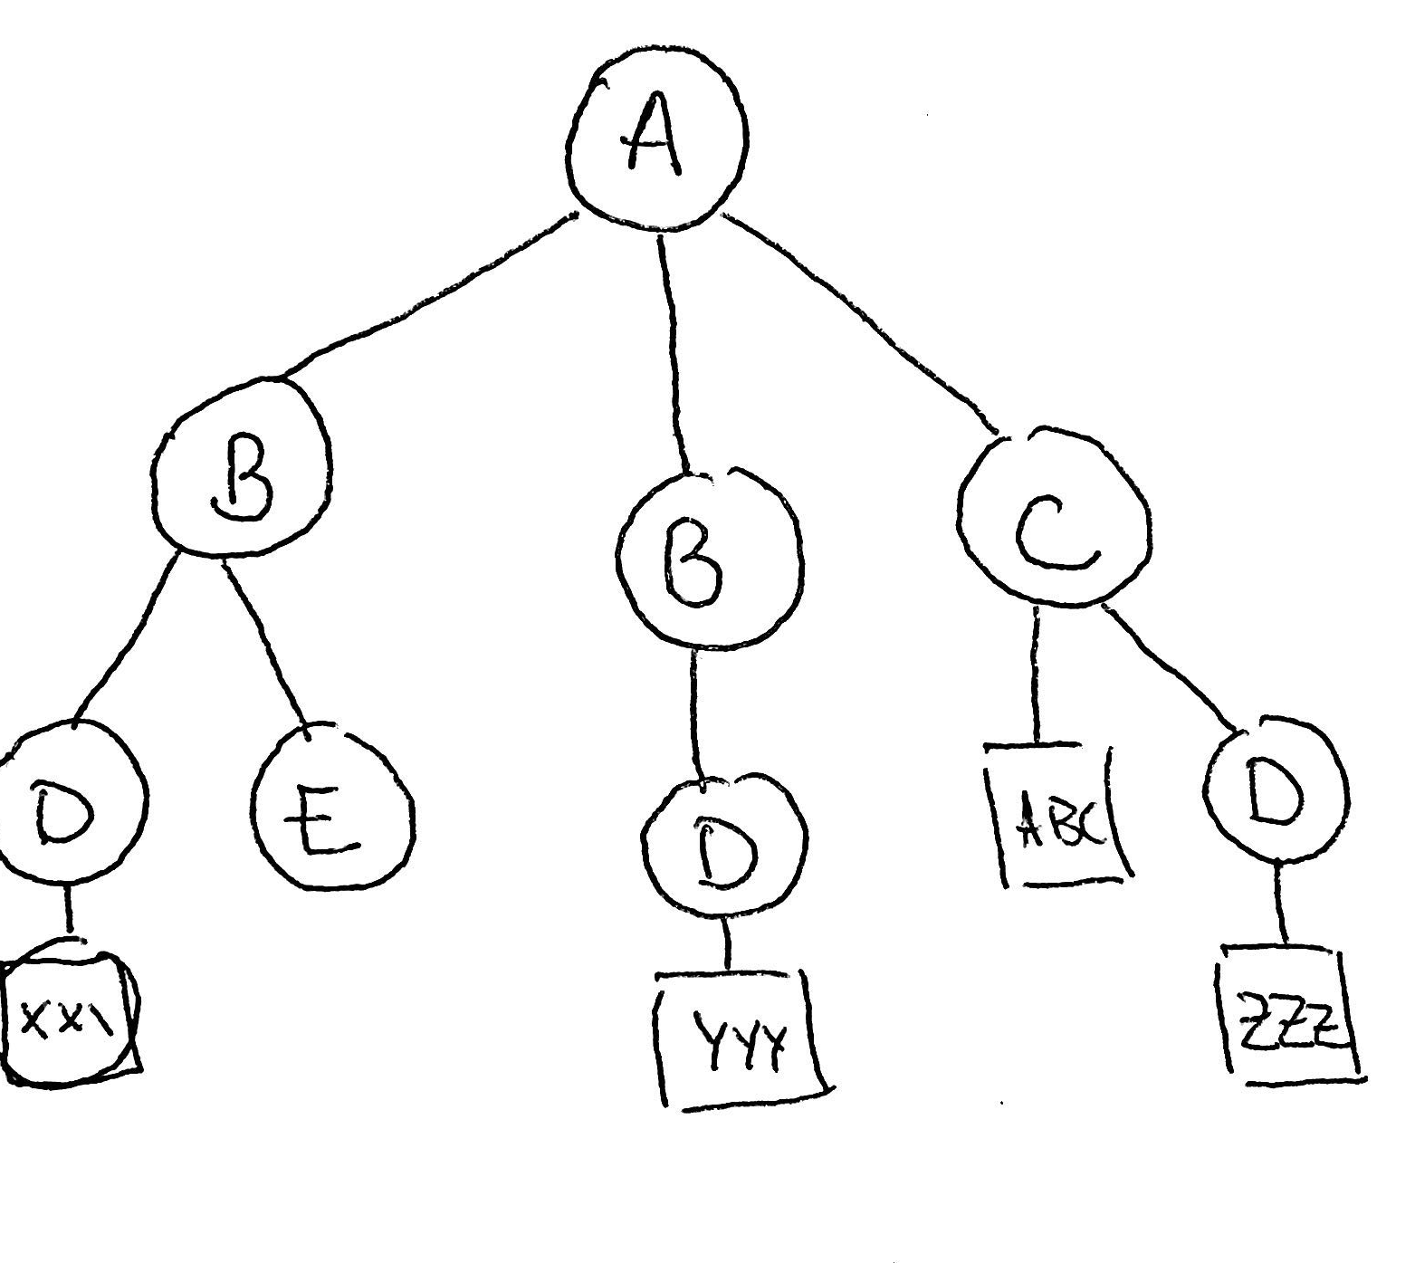
Which statement is TRUE?
A. All B nodes are siblings
B. E’s parent is a B node
C. All D nodes are siblings
D. A and B
E. A, B, and C
<A>
<B>
<D>xxx</D>
<E/>
</B>
<B>
<D> yyy </D>
</B>
<C>
ABC
<D> ZZZZ </D>
</C>
</A>

Slide 45
Working with XML in R

Slide 46
XML package
Handy functions for parsing XML
xmlParse: read an XML file into R
xmlValue: retrieve text content of a node (including content of all child nodes)
xmlSize: return the number of child nodes
xmlName: return the tag name of a node
xmlGetAttr: return the attribute value of the specified attribute

Slide 47
To read an XML file into R, use xmlParse
doc = xmlParse("plant.xml")
and extract the root node using xmlRoot.
catalog = xmlRoot(doc)
class(catalog)
[1] "XMLNode"
To illustrate how we manipulate an XML object in R, we take this data and reformat it into a data frame with one row for each plant.

Slide 48
The XML document is a special object in R.
It is similar to a list, but we need special functions to extract content

Slide 49
xmlParse implements what is called the DOM (Document Object Model) parser.
We don’t have time to cover it, but you should be aware of another parsing model called SAX (Simple API for XML). It reads the document incrementally and is more memory efficient, but it is trickier to use.
The tree structure is represented in R as a list of lists.
We can access an element within a node (i.e., a child), using the usual [[ ]] indexing for lists.

Slide 50
XML versions of lapply and sapply, named xmlApply xmlSApply. Each takes an XMLNode object as its primary argument. They iterate over the node’s children nodes, invoking the given function.
Like lapply, xmlApply returns a list. Like sapply, xmlSApply returns a simpler data structure if possible.

Slide 51
Look at the first plant node
> oneplant = catalog[[1]]
> class(oneplant)
[1] "XMLNode"
> oneplant
<plant>
<common>Bloodroot</common>
<botanical>Sanguinaria canadensis</botanical>
<zone>4</zone>
<light>Mostly Shady</light>
<price>$2.44</price>
<availability>031599</availability>
</plant>
Here is a leaf node
It contains the content
"Bloodroot"

Slide 52
We can drill down further into the list:
> oneplant[[’common’]]
<common>Bloodroot</common>
Note that this doesn’t remove the markup.
To do this, use the function xmlValue
> xmlValue(oneplant[['common']])
[1] "Bloodroot"
> xmlValue(oneplant[['botanical']])
[1] "Sanguinaria canadensis"

Slide 53
TASK: Create a vector of common names:
common = xmlSApply(catalog, function(el){
xmlValue(el[['common']])})
head(common)
plant plant plant
"Bloodroot" "Columbine" "Marsh Marigold"
plant plant plant
"Cowslip" "Dutchman's-Breeches" "Ginger, Wild"
The elements of the root node are all plant nodes, like oneplant.

Slide 54
Pros
data is self-describing
format separates content from structure
data can be easily merged and exchanged
file is human-readable
file is also easily machine-generated
standards are widely adopted

Slide 55
Cons
XML documents can be very verbose
It’s so general that it can be difficult to develop tools for all cases
Files can be quite large due to high amount of redundancy

Slide 56
Comparison JSON & XML
JSON is simpler
JSON is not as rich – no attributes, no schema for describing acceptable format
Compressed JSON and XML not much different in size

