Slide 1
Reading and Writing Data Files

Slide 2
Unstructured vs Structured Plain-text Data

Slide 3
State of the Union Speeches
***
State of the Union Address
George Washington
December 8, 1790
Fellow-Citizens of the Senate and House of Representatives:
In meeting you again I feel much satisfaction in being able to repeat my
congratulations on the favorable prospects which continue to distinguish
our public affairs. The abundant fruits of another year have blessed our
country with plenty and with the means of a flourishing commerce.

Slide 4
Web Log Entries
169.237.46.168 -- [26/Jan/2004:10:47:58 -0800]
"GET /stat141/Winter04 HTTP/1.1" 301 328
"http://anson.ucdavis.edu/courses/"
"Mozilla/4.0 (compatible; MSIE 6.0; Windows NT 5.0; .NET CLR 1.1.4322) "
169.237.46.168 -- [26/Jan/2004:10:47:58 -0800]
"GET /stat141/Winter04/ HTTP/1.1" 200 2585
"http://anson.ucdavis.edu/courses/"
"Mozilla/4.0 (compatible; MSIE 6.0; Windows NT 5.0; .NET CLR 1.1.4322)"

Slide 5
Web Log Entries – extract & omit
169.237.46.168 -- [26/Jan/2004:10:47:58 -0800]
"GET /stat141/Winter04 HTTP/1.1" 301 328
"http://anson.ucdavis.edu/courses/"
"Mozilla/4.0 (compatible; MSIE 6.0; Windows NT 5.0; .NET CLR 1.1.4322) "
169.237.46.168 -- [26/Jan/2004:10:47:58 -0800]
"GET /stat141/Winter04/ HTTP/1.1" 200 2585
"http://anson.ucdavis.edu/courses/"
"Mozilla/4.0 (compatible; MSIE 6.0; Windows NT 5.0; .NET CLR 1.1.4322)"

Slide 6
readLines()
The readLines() function reads each line of text in a file and creates a character vector with one element per line
We can then use regular expressions to extract the data we want.

Slide 7
SPLIT on either
blank" or
blank--blank[ or
"blank
wlist = strsplit(wl, " \"| -- \\[|\" ")
wlist[[1]]
[1] "169.237.46.168"
[2] "26/Jan/2004:10:47:58 -0800]"
[3] "GET /stat141/Winter04 HTTP/1.1"
[4] "301 328"
[5] "http://anson.ucdavis.edu/courses/"
[6] "\"Mozilla/4.0 (compatible; MSIE 6.0; Windows NT 5.0; .NET CLR 1.1.4322)\""

Slide 8
> wlist[[1]][3]
[1] "GET /stat141/Winter04 HTTP/1.1”
Eliminate the unwanted characters in the third element
> sapply(wlist,
function(x) gsub(" .*$", "", x[3]))
[1] "GET" "GET"

Slide 9
Fixed-width formats

Slide 10
read.fwf()
The read.fwf() function is handy if the pieces of information are always the same width
“fwf” stands for fixed-width-format
The web log data is close to a fwf

Slide 11
123456789012345678901234567890123456789…
ip is 1-14 | skip| |
169.237.46.168 -- [26/Jan/2004:10:47:58…
read.fwf(fileLoc,
widths = c(14,5,2,1,3,1,4,18,3))
V1 V2 V3 V4 V5 V6 V7 … 1 169.237.46.168 -- [ 26 / Jan / 2004 …
2 169.237.46.168 -- [ 26 / Jan / 2004 …

Slide 12
Delimited data

Slide 13
Reading data into R
Many data sets are stored in text files.
The easiest way to read these into R is using either the read.table or read.csv function, both of which return a data frame.
Consider the data at the following site
fileLoc = "http://www-958.ibm.com/software/data/cognos/manyeyes/datasets/olympic2012withgdp/versions/1.txt"

Slide 14
The data
ISO Gold/medals Silver/medals Bronze/medals …
ABW 0 0 0 0 0 2,456,000,000.00 108,000…
AFG 0 0 1 1 1 20,343,461,030.00 34,385,000 …
AGO 0 0 0 0 0 100,990,000,000.00 …
ALB 0 0 0 0 0 12,959,563,902.00 3,205,000 …
These data are tab delimited
The variable names have slashes in them
The numbers have commas in them

Slide 15
read.table() or read.csv()
These functions are useful for reading delimited plain text files
They have quite a few options. Some of the important ones are:
file - name or URL
header - are column names at the top of the file?
sep - what divides elements of the table
na.strings - symbol for missing values, like 9999
skip - number of lines at the top of the file to ignore

Slide 16
> ctry = read.csv(
fileLoc, skip = 1, sep = "\t", header = FALSE,
colClasses = c("character", rep("numeric", 5),
rep("character", 3)))
> head(ctry)
V1 V2 V3 V4 V5 V6 V7 V8 V9
1 ABW 0 0 0 0 0 2,456,000,000.00 108,000 22740.7407
2 AFG 0 0 1 1 1 20,343,461,030.00 34,385,000 591.6377
3 AGO 0 0 0 0 0 100,990,000,000.00 19,082,000 5292.4222
4 ALB 0 0 0 0 0 12,959,563,902.00 3,205,000 4043.5457
5 AND 0 0 0 0 0 3,491,000,000.00 84,864 41136.4065
6 ARE 0 0 0 0 0 360,245,000,000.00 7,512,000 47955.9372
Note we skipped the first row because the names would be problematic
Next we need to:
Clean up the GDP and POP by removing ,s and converting character strings to numeric

Slide 17
> head(data$V7)
[1] "2,456,000,000.00" "20,343,461,030.00" "100,990,000,000.00"
[4] "12,959,563,902.00" "3,491,000,000.00" "360,245,000,000.00"
> fix7 = as.numeric(
gsub(",", "", data$V7))
> head(fix7)
[1] 2456000000 20343461030 100990000000
[4] 12959563902 3491000000 360245000000

Slide 18
Data Available on the Web
HTML
Table (e.g., your simulation results)
plain text format (e.g., the ManyEyes data)
Other Format:
JSON
XML

Slide 19
HTML

Slide 20
Scraping data from a Web page
Means to write code to automatically extract data from one or more web pages.
HTML is like XML – We can use parsing capabilities in the XML package. htmlParse() can create a tree structure from ill-formed HTML.
The information is all in text and we may need to use regular expressions to extract the relevant pieces

Slide 21
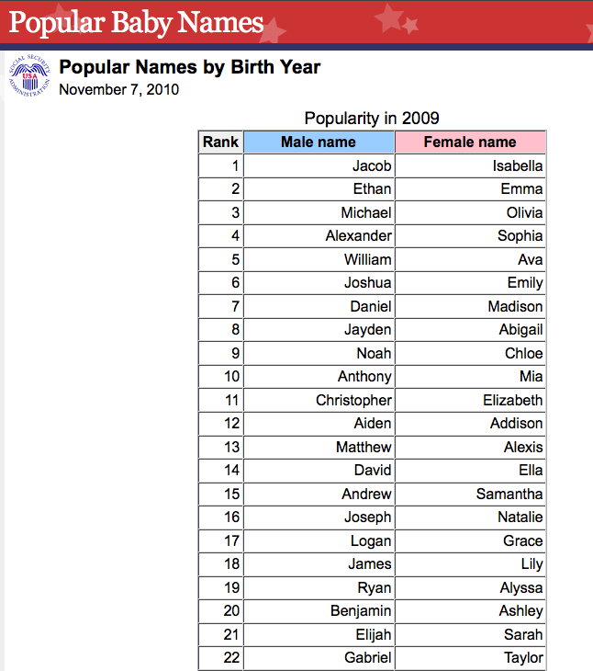
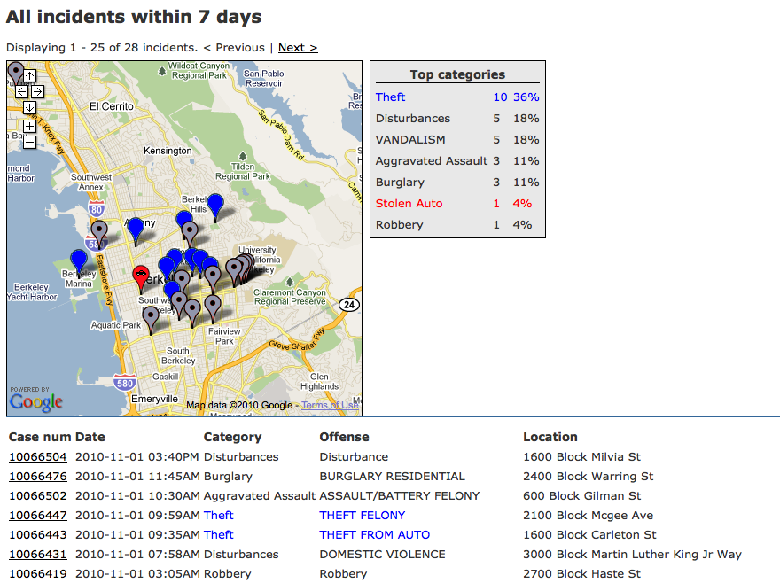
Much of the data available on the web is not provided as a separate downloadable file; it’s embedded in the website itself.

Slide 22
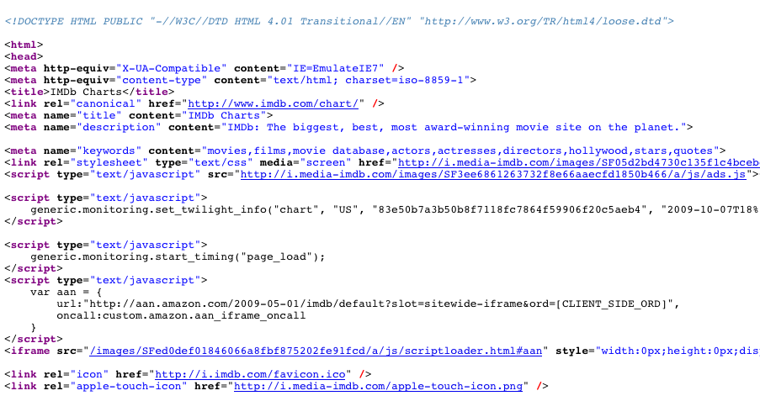
Web pages are created when your browser software represents or “renders” a specially formatted (HTML) text file. Most browsers allow you to see this file under something like View > Page Source.

Slide 23
Our goal: Extract this information and
put it in a dataframe

Slide 24
JSON
JavaScript Object Notation

Slide 25
Text format
Lightweight data-interchange
Easy for humans to read and write.
Easy for machines to parse and generate

Slide 26
JSON Structure
JSON is built on two structures:
An unordered collection of comma-separated name:value pairs
{“lender_id”:”matt”, “loan_count”:23}
An ordered array of values
[1, [true, false, true], [1, 2, 10, 20], {“lender_id”:”skylar”, “loan_count”:1}]

Slide 27
Comparison to XML
JSON is simpler
Not as rich – no attributes, unordered, no schema for describing acceptable format
Compressed JSON and XML not much different in size

Slide 29
{"header":{"total":"576803","page":1,"date":"2010-01-29T20:00:23Z","page_size":1000},
"lenders":[
{"lender_id":"matt",
"name":"Matt",
"image":{"id":12829,"template_id"1}, "whereabouts":"San Francisco CA",
"country_code":"US",
"uid":"matt",
"member_since":"2006-01-01T09:01:01Z",
"personal_url":"www.socialedge.org\/blogs\/kiva-chronicles",
"occupation":"Entrepreneur",
"loan_because":"I love the stories. ",
"occupational_info":"I co-founded a startup nonprofit (this one!) and I work with an amazing group of people dreaming up ways to alleviate poverty through personal lending. ",
"loan_count":89,
"invitee_count":23},
{"lender_id":"jessica",
"name":"Jessica",
"image":{"id":197292,
"template_id":1}, …

Slide 30
XML
eXtensible Markup Language

Slide 31
Most of the data sets we have seen have been in the form of ASCII tables.
Date Time Lat Lon Depth Mag
1968/01/12 22:19:10.35 36.6453 -121.2497 6.84 3.00
1968/02/09 13:42:37.05 37.1527 -121.5448 8.49 3.00
1968/02/21 14:39:48.10 37.1783 -121.5780 6.95 3.80
1968/03/02 04:25:53.94 36.8343 -121.5447 5.35 3.00
1968/03/17 15:07:02.12 37.3088 -121.6615 4.39 3.00
1968/03/21 21:54:59.94 37.0378 -121.7407 11.86 4.30
Advantages:
easy to read, write, and process
in standard cases, don’t need a lot of extra information
But these advantages can quickly disappear....

Slide 32
XML is a standard for semantic, hierarchical representation of data
<state>
<gml:name abbreviation="AL”> ALABAMA </gml:name>
<county>
<gml:name> Autauga County </gml:name>
<gml:location>
<gml:coord>
<gml:X> -86641472</gml:X>
<gml:Y> 32542207</gml:Y>
</gml:coord>
</gml:location>
</county>
Relationships between pieces of data reflect relationships in the real world.
Notes:
anything in brackets is markup; only 4 pieces of information

Slide 33
Pros
data is self-describing
format separates content from structure
data can be easily merged and exchanged
file is human-readable
file is also easily machine-generated
standards are widely adopted

Slide 34
Cons
XML documents can be very verbose and hard to read
It’s so general that it’s hard to develop tools for all cases
Files can be quite large due to high amount of redundancy

Slide 35
XML is has become quite popular in many scientific fields, and it is standard in many web applications for the exchange and visualization of data.
Well learn how to
create it and
read/process it.
Well do both of these things from within R, but first let’s start with an overview of what XML documents look like.
Notes:
first look at Google earth examples

Slide 37
<lender>
<lender_id>matt</lender_id>
<name>Matt</name>
<image>
<id>12829</id>
<template_id>1</template_id>
</image>
<whereabouts>San Francisco CA</whereabouts>
<country_code>US</country_code>
<uid>matt</uid>
<member_since>2006-01-01T09:01:01Z</member_since>
<personal_url>www.socialedge.org/blogs/kiva-chronicles
</personal_url>
<occupation>Entrepreneur</occupation>
<loan_because>I love the stories. </loan_because>
<occupational_info>I co-founded a startup nonprofit (this one!)
and I work with an amazing group of people dreaming up ways to
alleviate poverty through personal lending.
</occupational_info>
<loan_count>89</loan_count>
<invitee_count>23</invitee_count>
</lender>
Snippet of Kiva Data for one lender

Slide 39
Snippet of exchange data
<Cube>
<Cube time="2008-04-21">
<Cube currency="USD" rate="1.5898"/>
<Cube currency="JPY" rate="164.43"/>
<Cube currency="BGN" rate="1.9558"/>
<Cube currency="CZK" rate="25.091"/>
</Cube>
<Cube time="2008-04-17">
<Cube currency="USD" rate="1.5872"/>
<Cube currency="JPY" rate="162.74"/>
<Cube currency="BGN" rate="1.9558"/>
<Cube currency="CZK" rate="24.975"/>
</Cube>
</Cube>

Slide 41
<event id="00068404" network-code="ak"
time-stamp="2008/09/16_22:17:31 " version="2">
<param name="year" value="2008"/>
<param name="month" value="09"/>
<param name="day" value="14"/>
<param name="hour" value="00"/>
<param name="minute" value="59"/>
<param name="second" value="04.0"/>
<param name="latitude" value="51.8106"/>
<param name="longitude" value="-175.9250"/>
<param name="depth" value="146.0"/>
<param name="magnitude" value="3.8"/>
<param name="num-stations" value="10"/>
<param name="num-phases" value="15"/>
<param name="dist-first-station" value="126.1"/>
<param name="azimuthal-gap" value="53"/>
<param name="magnitude-type" value="L"/>
<param name="magnitude-type-ext"
value="Ml = local magnitude (synthetic Wood-Anderson)"/>
<param name="location-method" value="a"/>
<param name="location-method-ext"
value="Auryn (Confirmed by human review)"/>
</event>
<event>
Snippet of USGS earthquake catalog data

Slide 43
<actions>
<action datetime="2009-01-26">
<text>Referred to the Committee on Appropriations, and in addition
to the Committee on the Budget, for a period to be
subsequently determined by the Speaker, in each case for
consideration of such provisions as fall within the
jurisdiction of the committee concerned.
</text>
</action>
<action datetime="2009-01-26">
<text>Referred to House Appropriations</text>
</action>
</actions>
..
<relatedbills>
<bill relation="rule" session="111" type="hr" number="88" />
</relatedbills>
Snippet of US Congress data

Slide 45
<Placemark id="217">
<name>8.2</name>
<description>
Date: 2008-9-15
Magnitude: 1.5
Depth: 8.2 km
</description>
<styleUrl>#ball1-2</styleUrl>
<Point>
<coordinates>-147.426, 60.929, 0</coordinates>
</Point>
</Placemark>
Snippet of KML for one earthquake

Slide 46
XML Syntax

Slide 47
Syntax
The basic unit of XML code is called an “element” or “node.” It is made up of both markup and content. Markup consists of tags, attributes, and comments.
<CYL> 6 </CYL> <!–- elem with content 6 -->
<CYL> </CYL>
<CYL type=“numeric”/>
<CYL size=”2”> 6 </CYL>
Start tag
Content
Comment - can go anywhere
End tag
Elements with no content
An attribute

Slide 48
Well-formed
Tag names are case-sensitive; start and end tags must match exactly.
No spaces are allowed between the < and the tag name.
Tag names must begin with a letter and contain only alphanumeric characters.
An element must have both an open and closing tag unless it is empty.
An empty element that does not have a closing tag must be of the form <tagname/>.
Tags must nest properly. (Inner tags must close before outer ones.)

Slide 49
<?xml version="1.0" encoding="ISO-8859-1"?>
<!-- Edited with XML Spy v2006 (http://www.altova.com) -->
<CATALOG>
<PLANT>
<COMMON>Bloodroot</COMMON>
<BOTANICAL>Sanguinaria canadensis</BOTANICAL>
<ZONE>4</ZONE>
<LIGHT>Mostly Shady</LIGHT>
<PRICE>$2.44</PRICE>
<AVAILABILITY>031599</AVAILABILITY>
</PLANT>
<PLANT>
<COMMON>Columbine</COMMON>
<BOTANICAL>Aquilegia canadensis</BOTANICAL>
<ZONE>3</ZONE>
<LIGHT>Mostly Shady</LIGHT>
<PRICE>$9.37</PRICE>
<AVAILABILITY>030699</AVAILABILITY>
</PLANT>
<PLANT>
<COMMON>Marsh Marigold</COMMON>
<BOTANICAL>Caltha palustris</BOTANICAL>
<ZONE>4</ZONE>
<LIGHT>Mostly Sunny</LIGHT>
<PRICE>$6.81</PRICE>
<AVAILABILITY>051799</AVAILABILITY>
</PLANT>
</CATALOG>
XML declaration and processing instructions
Note how indentation makes it easier to check that the tags are correctly nested.

Slide 50
Well formed XML ctd.:
All attributes must appear in quotes in the format:
name = “value”
Isolated markup characters must be specified via entity references. < is specified by &lt; and > is specified by &gt;.
All XML documents must contain a root node containing all the other nodes.

Slide 51
Tree Representation

Slide 52
<Envelope>
<subject>Reference rates</subject>
<Sender>
<name>European Central Bank</name>
</Sender>
<Cube>
<Cube time="2008-04-21">
<Cube currency="USD" rate="1.5898"/>
<Cube currency="JPY" rate="164.43"/>
<Cube currency="BGN" rate="1.9558"/>
<Cube currency="CZK" rate="25.091"/>
</Cube>
<Cube time="2008-04-17">
<Cube currency="USD" rate="1.5872"/>
<Cube currency="JPY" rate="162.74"/>
<Cube currency="BGN" rate="1.9558"/>
<Cube currency="CZK" rate="24.975"/>
</Cube>
</Cube>
</Envelope>

Slide 53
Tree terminology
There is only one root or document node in the tree, and all the other nodes are contained within it.
We think of these other nodes as being descendants of the root node.
We use the language of a family tree to refer to relationships between nodes. Parents, children, siblings, ancestors, descendants
The terminal nodes in a tree are also known as leaf nodes. Content always falls in a leaf node.

Slide 54
Note:
We’ll learn to create and process XML documents from within R, but always keep in mind that R and XML are two separate things.
In particular, it will be helpful to have in your mind the structure of the XML document before you do anything in R, especially when you’re creating a new XML document.

