Slide 1
Writing functions

Slide 2
So far we have relied on the built-in functionality of R to carry out our analyses. In the next several lectures, we cover:
How to write your own functions
How to use control flow
Debugging your code when something goes wrong
The meaning of environments and variable scope
Timing and writing efficient code

Slide 3
Steps In Writing a Function
Explain: Describe the task in words
Concrete: Write code for a specific example
Abstract: Identify the variables and decide if they are required or have defaults
Encapsulate: Wrap the code into a function where the parameters are the general variables
Test: Check the function works as expected with your original data AND try the function on test cases with other data

Slide 4
Writing your own functions in R
The code we have been writing so far in R has been
made up of a sequence of commands, one after another
specific to the particular dataset we are working with.
Functions allow us to
organize our code into tasks
reuse the same code on different datasets by making the data an argument to the function.

Slide 5
Function Signature:
Required arguments
Default arguments
Function Name
calcRainSize = function (x, traceAmt = 0) {
mean(x[x> traceAmt])
}
Typically we assign the function to a particular name. This should describe what the function does. Using a VERB in the name is a good idea.
Assign Function
to this Name
Function Body
Between { }

Slide 6
function ( arguments ) body
The keyword function just tells R that you want to create a function.
Recall that the parameters to a function are its inputs, which may have default values.
> args(median)
function (x, na.rm = FALSE)
Here, if we do not explicitly specify na.rm when we call median, it will be assigned the default value of FALSE.

Slide 7
A few notes on specifying the arguments:
When you’re writing your own function, it’s good practice to put the most important arguments first. Often these will not have default values.
This allows the user of your function to easily specify the arguments by position, eg.
calcRainSize(xvec)
rather than
calcRainSize(x = xvec)

Slide 8
Next we have the body of the function, which typically consists of expressions surrounded by curly brackets. Think of these as performing some operations on the input values given by the arguments.
{
expression 1
expression 2
return(value)
}
The return expression hands control back to the caller of the function and returns a given value
If the function returns more than one thing, this is done using a named list, for example:
return(list(total = sum(x), avg = mean(x)))

Slide 9
In the absence of a return expression, a function will return the last evaluated expression. This is particularly common if the function is short.
That is the case for our simple function:
calcRainSize = function(x) mean(x[x>0])
Here we don’t need brackets {}, since there is only one expression in the function.
A return expression anywhere in the function will cause the function to return control to the user immediately, without evaluating the rest of the function.

Slide 10
Considerations when writing a function:
What will the function do?
What should we call it? (Relate the name to what it does)
What will be the arguments?
Which arguments have default values and what are they?
What (if anything) should the function return?

Slide 11
Anonymous functions

Slide 12
Apply calcRainSize to rain
sapply(rain, calcRainSize)
We don’t actually have to go through the hassle of writing a function definition.
We can use an anonymous function:
sapply(rain, function(station) { mean(station[station > 0])
}
)

Slide 13
Multiple Inputs and Apply
We can specify the value for traceAmt as an additional argument to sapply
sapply(rain, calcRainSize,
traceAmt = 5)
What if we want to specify a different value of traceAmt for each weather station?
mapply(calcRainSize, rain,
traceAmt = c(0, 1, 5, 10, 0))

Slide 14
Multiple Inputs and Apply
Recall another version of function was:
calcRainSize =
function(x, tA = 0, sumFun = mean)
{
sumFun(x[x > tA])
}
What if we want to specify a different value of traceAmt for each weather station and use the median function?
mapply(calcRainSize, rain,
traceAmt = c(0, 1, 5, 10, 0),
MoreArgs = list(sumFun = median))

Slide 15
Roulette Wheel Study
This function used for a Monte Carlo study: Use a computer to simulate random variables (a random experiment). Use the simulations to learn about properties of the random process

Slide 16
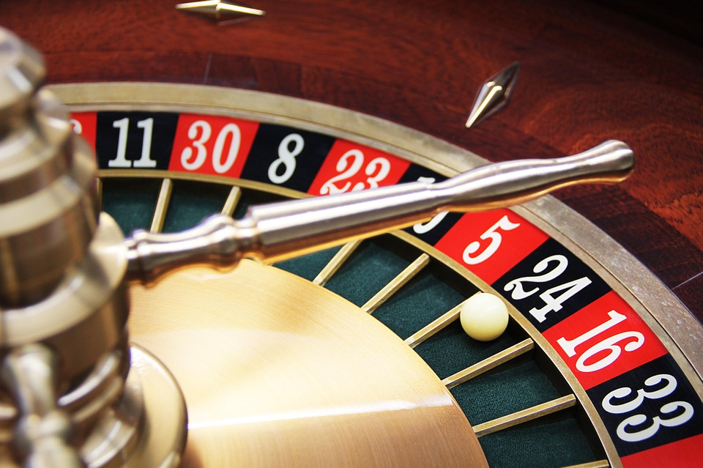
The Wheel

Slide 17
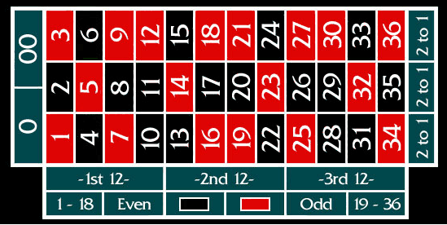
The Table

Slide 18
Outside Bets
Even Odds (PAY 1 to 1)
Place $1 bet,
If win keep your $1 and get $1 more
If lose, house gets your $1
Red or Black
Even or Odd
Low or High
1st, 2nd, or 3rd dozen
1st, 2nd, or 3rd column
PAY 2 to 1)
Place $1 bet,
If win keep your $1 and get $2 more
If lose, house gets your $1

Slide 19
Inside Bets
Straight up (single number )
Split (2 numbers)
Street (3 numbers)
Corner (4 numbers)
Pays 35 to 1
Pays 17 to 1
Pays 11 to 1
Pays 8 to 1

Slide 20
How do winnings from 100 bets of $1 on Red compare to 1 bet of $100 one Red?

Slide 21
Let’s write a function that can simulate these two situations – 100 $1 bets 1 $100 bet

Slide 22
Explain
Simulate the spins from a roulette wheel and track the winnings for a specified number of bets for a specified bet size

Slide 23
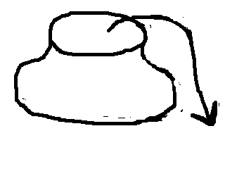
Explain
Spins from a roulette wheel behave like draws from an urn
18 Red Balls
18 Black Balls
2 Green Balls
Draw 1 ball
Win if it’s Red
Replace ball in urn
Ready to play again

Slide 24
Code an example
wheel = rep(c("red”,"black”,"green"),
c(18, 18, 2))
spins = sample(wheel, 100,
replace = TRUE)
winnings = numeric(100)
winnings[spins == "red"] = 1
winnings[spins != "red"] = -1
totalWinnings = sum(winnings)
Can we work with 1 and -1 instead of red, black and green?

Slide 25
Simplify Code
wheel = rep(c(1, -1), c(18, 20))
wins = sample(wheel, 100,
replace = TRUE)
totalWinnings = sum(wins)
How would this code change for the other betting scenario?

Slide 26
Code for Other Scenario
wheel = rep(c(1, -1), c(18, 20))
wins = sample(wheel, 1,
replace = TRUE)
totalWinnings = sum(wins * 100)
How do these 2 scenarios compare?
To answer this question we want to evaluate our code many times

Slide 27
Generalize
What are the inputs?
Number of spins
Size of bet
Number of +1s and -1s
A & B
A, B, & C

Slide 28
Generalize
What are reasonable default values?
Number of spins
Size of bet
Number of +1s and -1s
1 spin
$1 bet
18 +1s and 20 -1s

Slide 29
Encapsulate
betRed =
function(numBets,betAmt = 1) {
wheel = rep(c(1, -1), c(20, 18))
wins = sample(wheel, numBets,
replace = TRUE)
totWinnings = sum(wins * betAmt)
return(totWinnings)
}

Slide 30
Try out
> betRed(1, 100)
[1] -100
> betRed(1, 100)
[1] 100
> betRed(1, 100)
[1] 100
> betRed(1, 100)
[1] -100
> betRed(1, 100)
[1] -100
> betRed(1, 100)
[1] -100
> betRed(1, 100)
[1] -100
> betRed(100, 1)
[1] 8
> betRed(100, 1)
[1] -8
> betRed(100, 1)
[1] 10
> betRed(100, 1)
[1] -8
> betRed(100, 1)
[1] -20
> betRed(100, 1)
[1] -2
> betRed(100, 1)
[1] -4
The winnings look different, but if we could play the game over and over again, how would they compare?

Slide 31
Call function many times
red100B.1D = sapply(rep(100, 10000),
betRed, betAmt = 1)
red1B.100D = sapply(rep(1, 10000),
betRed, betAmt = 100)
Notice that the calls to betRed do not depend on the input – shortcut
replicate(10000, betRed(100, 1))

Slide 32
What next?
We have the results from 10000 roulette spins for each scenario.
Mean
-5.23 and -5.06
Spread
10.1 and 99.9
-

Slide 33
Your Turn!
In your next HW you will carry out a study of several betting strategies
You will also examine the efficiency of code written in a vectorized fashion compared to code written using loops

