Slide 1
Files – plain text and others

Slide 2
Last time we saw how the computer represents plain text
Glyph | ASCII | Unicode
# | 0010 0011 | 0000 0000 0010 0011
$ | 0010 0100 | 0000 0000 0010 0100
A | 0100 0001 | 0000 0000 0100 0001
a | 0110 0001 | 0000 0000 0100 0001
ASCII and Unicode mappings are compatible for the 2^7 = 128 ASCII characters. The bottom 4 characters do not have encodings in ASCII

Slide 3
Text data is organized in files
Plain text – or .txt file
Comma Separated Values – .csv
Tells us to expect commas as delimiters
Rmd files are plain text - .Rmd or .rmd
Tells us to expect code chunks delimited by ```
HTML files are plain text too - .html or .htm
Tells us to expect tags such as <head>

Slide 4
CSV files
example.csv
1,2,3
12,10,100
In this file, the number 3 is not stored in double-precision floating point, but simply as that UTF character 3: 0011 0011
And the 100 is stored as the character 1 followed by the two characters for 0:
0011 0001 0011 0000 0011 0000

Slide 5
File Naming Convention
BaseFileName.fileTypeExtension
The extension, e.g., .txt .csv .Rmd .htm, indicate what kind of data/information is in the file
These extensions are simply conventions. You don’t have to use them, but that can make things difficult for programs to use your data

Slide 6
HTML File - example.html
<html>
<head>
<title>Example of HTML</title>
</head>
<body>
<h1>Example of HTML</h1>
<p>This is my first paragraph. </p>
</body>
</html>
When we view this HTML file in a browser, the <tag>s are used as instructions for rendering

Slide 7
example.html rendered in the browser

Slide 8
Other file formats
Portable Network Graphics - .png
Portable Document Format - .PDF
Microsoft Word Document - .doc
These file formats are not plain text
They are NOT intended to be read as text
The file contains a signature, aka a magic number, to identify its type

Slide 9
When viewed as plain text:
My example.png file begins:
<89>PNG
^Z
My example.pdf file begins:
%PDF-1.4
%<81><E2><81><E3><81>ρ<D3>\r
1 0 obj
<<
BUT: We can’t really see the contents because the binary isn’t/can’t be properly represented as plain text

Slide 10
R file extension conventions
.R – plain text file of R code only
.Rmd – plain text file that contains R code and markdown instructions for knitting the report
.Rhtml – plain text file that contains R code (in chunks) and html for rendering
.Rda OR .RData - NOT plain text, stores R objects that can be loaded into your workspace

Slide 11
How to save your R objects
> x = 1:10
> y = rnorm(17)
> myList = list(a = letters, b = 3:5)
> save(y, myList, file = "myStuff.rda")
> rm(list = ls())
> load(“myStuff.rda”)
> ls()
[1] "y" "myList"

Slide 12
Pairs Trading
Simulation Study

Slide 13
Pairs Trading Project Components
A .R file with the code for the 12 functions
A .R file that runs your simulation and saves output in a .rda file (see below)
A .Rhtml file with report
Code chunks for empirical analysis
Code chunks to analyze the simulation results from the stored data in the .rda file
A PDF file printed from the knitted html file
Knit the Rhtml file, open the html file in a browser, print the page to a PDF file
The .rda file containing your simulation results

Slide 14
Pairs Trading Report
Sections: Intro (1 para); Background (1 para); Findings from empirical study (2 paras plus plots); Simulation study (2 paras plus plots); Discussion (1 para); Conclusion (1 para)
.Rhtml – Template will be posted on weekend
Tuesday – more about HTML
Monday – how to run your simulation remotely in batch mode on the Stat Dept Computers

Slide 15
How Does our Computer Organize Files?
Trees

Slide 16
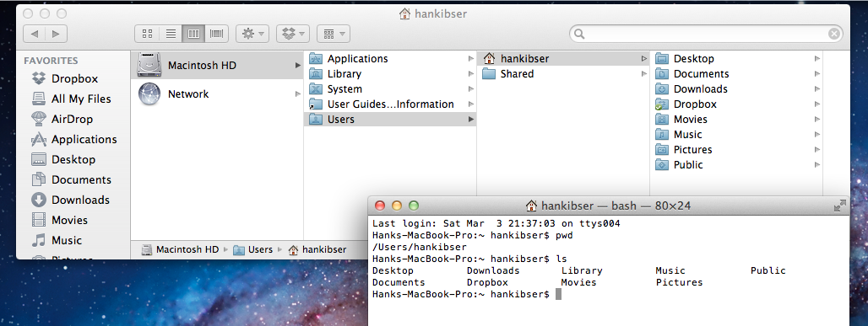
The computer organizes files within directories.
It can be easier to think of directories as you would folders on Windows or Mac OS.
Notes:
two ways of looking at the same thing

Slide 17
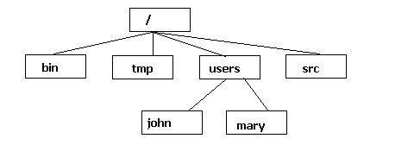
Directories are organized in a tree structure.
There are two “special” directories: The top level directory, named “/”, is called the root directory.
Your home directory, named “~”, contains all your files. For mary, “~” and “/users/mary” mean the same thing.
Notes:
notice how I specified the directories - absolute path name

Slide 18
Tree Hierarchy
One root node
Root node has child nodes and each of these can have child nodes and so on
Any node must have one and only one parent

Slide 19
Full path name: path from the top level directory, “/”, to the file or directory of interest.
For mary the full pathname is /users/mary
Notes:
notice how I specified the directories - absolute path name

Slide 20
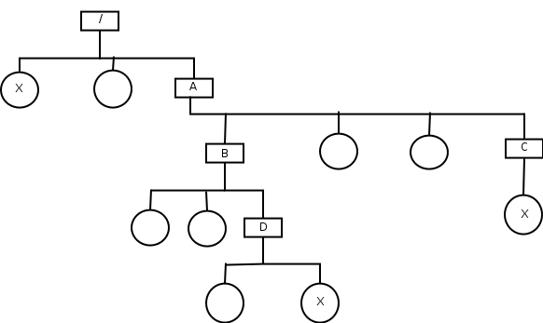
Circle: File
Rectangle: Directory
Full path name: path from the top level directory to the file or directory of interest.
Full path to D: /A/B/D

Slide 21
Circle: File
Rectangle: Directory
Relative path name: path from the current directory to the file or directory of interest.
Relative path to D from within A: B/D
Or: ./B/D where “.” refers to current directory

Slide 22
Circle: File
Rectangle: Directory
Relative path to D from within C: ../B/D
Here “..” refers to the parent directory

Slide 23
Circle: File
Rectangle: Directory
A) ../A/x
B) ../../x
C) ../x
D) /x
Relative path to x at the top from within C:

Slide 24
Circle: File
Rectangle: Directory
../D/x
B) ../B/D/x
C) ../../A/B/D/x
D) /A/B/D/x
Relative path to x in D from within C:

Slide 26
Where do we use this representation?
In R: read.csv(“full path name”)
In UNIX: cd ../B/D/

Slide 27
UNIX

Slide 28
Operating systems
An operating system (OS) is a piece of software that controls the hardware and other pieces of software on your computer.
The most popular OS today, Microsoft Windows, uses a graphical user interface (GUI) for you to interact with the OS. This is easy to learn but not very powerful.
UNIX, on the other hand, is hard at first to learn, but it allows you vastly more control over what your computer can do. There are actually many different “flavors” of UNIX, but what we will cover applies to almost all of them.

Slide 29
Aside: Mac OS is built on top of the UNIX kernel, so everything we do here you can also do on the lab computers.
To get to a window with a UNIX command line (called a terminal), go to Applications > Utilities > Terminal.
If you are on a Windows machine, there are programs to “emulate” what a UNIX machine would do, such as Cygwin and VirtualBox. Another option would be to connect remotely to one of the lab machines, which we discuss how to do.
Notes:
main reason I use Mac: need UNIX facilities
advantage of the first one: can use even when not online
advantage of the second: need to learn how to do this anyway

Slide 30
The differences between, say, Windows and UNIX stem from an underlying philosophy about what software should do.
Windows: Programs are large, multi-functional. Example: Microsoft Word.
UNIX: Many small programs, which can be combined to get the job done. A “toolbox approach.” Example: Take all processes that I’m running which start with /App and save them in a file called AppsRunning:
ps -u nolan | grep "[0-9] /App" > AppsRunning
Notes:
details aren’t important: notice vertical bars, called “pipes”
output from one program becomes input to next program

Slide 31
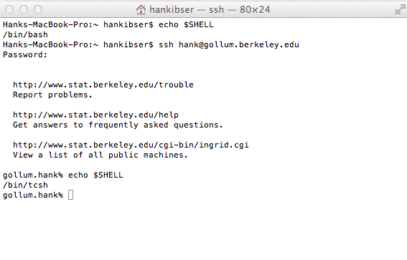
The UNIX kernel is the part of the OS that actually carries out basic tasks.
The UNIX shell is the user interface to the kernel. Like flavors of UNIX, there are also many different shells. For this course, it
doesn’t matter
which one you
use. The default
on the lab
computers is
called tcsh.
the prompt – yours will differ
Notes:
to find out your shell, type echo $SHELL
show connecting to lab computers

Slide 32
cd Means “change directory”.
$ pwd
/Users/nolan
$ cd Desktop/BMLHW
$ ls
BMLcode BMLreport Stat133HW6.pdf
$ ls -a
. BMLcode Stat133HW6.pdf
.. BMLreport
ls -a means to show all files, including the hidden files starting with a dot (“.”).
The two hidden files here are special and exist in every directory. “.” refers to the current directory, and “..” refers to the directory above it. The “$” is the UNIX prompt on my machine.
Notes:
many commands work like this - have arguments listed after
allows us to work with relative path names
cd without any arguments takes you back home

Slide 33
This brings us to the distinction between relative and absolute path names. (Think of a path like an address in UNIX, telling you where you are in the directory tree.)
You may have noticed that I typed cd Desktop/BMLHW, rather than cd /Users/nolan/Desktop/BMLHW.
The first is the relative path; the second is the absolute path.
To refer to a file, you need to refer to it using a relative or absolute path name.
Notes:
do some examples
cd -

Slide 34
Example:
$ pwd
/Users/nolan/Desktop/BMLHW
$ ls BMLcode/
analyze.R genCars.R moveCars.R runSim.R
$ head -3 BMLcode/genCars.R
myFunc = function(r, c) {
sample(1:(r*c), 6, replace = FALSE)
}

Slide 35
Example:
$ cd ..
$ head -3 BMLcode/genCars.R
head: BMLcode/genCars.R: No such file or directory
$ head -3 BMLHW/BMLcode/genCars.R
myFunc = function(r, c) {
sample(1:(r*c), 6, replace = FALSE)
}
Note that file names must be unique within a particular directory, but having,
/Users/nolan/Desktop/genCars.R and
/Users/nolan/Desktop/BMLHW/BMLcode/genCars.R is OK.

Slide 36
Shell Command Syntax
command -options arg1 arg2
Blanks and “–” are delimiters
The number of arguments may vary.
An argument comes at the end of the command line.
It’s usually the name of a file or some text.
Many commands have default argument and so the syntax is $ command
Notes:
do some examples with mv

Slide 37
Shell Command Syntax
Example: move or rename a file.
$ mv test.txt newname.txt
This command has two arguments.
It moves the file test.txt to newname.txt
Notes:
do some examples with mv

Slide 38
Options
Options come between the command and the arguments.
They tell the command to do something other than its default. They are usually prefaced with one or two hyphens.
$ rmdir unixexamples
rmdir: unixexamples: Directory not empty
$ rm -r unixexamples
Notes:
another example ls -a

Slide 39
Getting Help
To look at the syntax of a UNIX command, type man (for “manual”) and then the name of the command.
The two most important parts the SYNOPSIS and DESCRIPTION. These are very much like the “Usage” and “Arguments” in R’s help pages.
SYNOPSIS shows you the syntax for a particular command. Bracketed arguments are optional.
DESCRIPTION tells you what all the options do.
Press the space bar to scroll forward through the man page, “b” to go backward, and “q” to exit.
Notes:
try with ls; point out -a, -l,

Slide 40
Here are a few more handy ones:
wc -l - count the number of lines in a file
head -x - look at the first x lines of a file (default n=10)
tail - like head, but look at the end of the file;
cp - copy a file
$ cp unixexamples/Bing.xt .
cat - print the contents of a file

Slide 41
Summary of Commands
pwd | present working directory
ls | list contents of current directory
ls -a | list contents, include hidden files
ls -l | list contents, include information about file size, etc.
mkdir dname | create a new directory called dname
cd dname | change directory to dname
cd .. | change to parent directory
cd | change to home directory
Notes:
SKIP to slide 16 if near end of lecture, make sure to show them how to run a batch

Slide 42
Summary of Commands
cp file1 file2 | make a copy of file1 and call it file2
scp file1 file2 | secure copy file1 to file2 (the file name(s) will include the location of the machine
mv file1 file2 | move file1 to file2 (like rename)
rm | remove a file (CAUTION)
rm -r | remove all lower-level files
more file | Cat the contents of the file to the screen one page at a time
tail -3 file | Cat the last 3 lines of file to screen
head file | Cat the first 10 lines of file to screen
Notes:
SKIP to slide 16 if near end of lecture, make sure to show them how to run a batch

Slide 43
Wildcards

Slide 44
The * Wildcard
You can refer to multiple files at once using wildcards. The most common one is the asterisk (*). It stands in for anything (including nothing at all).
$ ls
AGing.txt Bing.xt Gagging.text Going.nxt ing.ext
$ ls G*
Gagging.text Going.nxt
$ ls *.xt
Bing.xt

Slide 45
The ? Wildcard
The question mark (?) is similar, except it can only represent a single character.
$ ls
AGing.txt Bing.xt Gagging.text Going.nxt ing.ext
$ ls ?ing.xt
Bing.xt

Slide 46
The [] Wildcards
Finally, square brackets can be replaced by whatever characters are within those brackets.
$ ls
AGing.txt Bing.xt Gagging.text Going.nxt ing.ext
$ ls [A-G]ing.*
Bing.xt
The wildcards can also be combined.
$ ls *G*
AGing.txt Gagging.text Going.nxt
$ ls *i*.*e*
Gagging.text ing.ext

Slide 47
AGing.txt Bing.xt Going.nxt ing.ext
All files
Bing.xt
All but Bing.xt
No such file
*ing.*xt
?ing.*xt
?ing.?xt
?ing.xt
*ing.?xt
All
Bing.xt
No such file or directory
Bing.xt
AGing.txt Going.nxt ing.ext

