Slide 1
Modeling Extreme Storm Surges
Kira White, Rob Ceres, Chris Forest, Murali Haran
Long-term goals:
  Determine the best methods for modeling extreme surge events.
  Study the application of these methods to hourly tide gauge data from various locations (follow-up on Grinsted et al. (2011,2012)).
  Policy implications.
Short-term goals:
  Study tide gauge data over 100 years from 5 different sites.
  Study if there have been any significant changes in surge events over time.

Slide 2
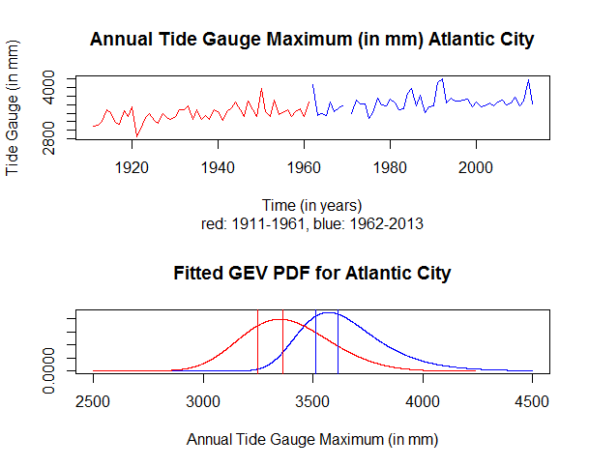
Annual Maxima
4 out of 5 stations indicate a significant increase in the average between the two time periods.
Red: distribution and 95% CI for 1911-1961 (3250, 3362)
Blue: distribution and 95% CI for 1962-2013 (3512, 3612)
Maximum likelihood estimation (R statistics package ismev)

Slide 3
Challenges
De-noising the data to recover the signal:
Purely statistical: use the observations to learn about seasonality at various scales. Apply various kinds of smoothing (approach adopted by Grinsted et al., 2012).
Model-based: use separate predicted tidal information to accomplish the same goals (ongoing work led by Rob Ceres).
Working with extremes: usual trade-offs between data quality (by aggregation, smoothing etc.) versus large sample size

Slide 4
Summary
Policy relevance: Increasing severity of extreme tide events in recent years will affect coastal infastructure.
Big picture in statistical terms: want to learn about the future distribution of tide events, particularly the tail (extremes) of the distribution.
General techniques: Methods of processing and modeling tide gauge data can be applied, in principle, to any station.

