Slide 1

UE24CS352A – ML Mini-Project Review
Project Title
:
Application of Artificial Neural Network in Streamflow Forecasting (Problem 11)
Team Number
:
20
Project Guide
Prof. Prema
:
Project Team
:
R Muralidharan – PES2UG24CS387
Nikhil K R – PES2UG24CS815
Notes:
Introduce the project, the team and the guide. Fill in the team number and guide name before presenting.

Slide 2
Outline
1
Problem Statement
5
Experimental Setup
2
Reference Paper and Background
6
Results
3
Dataset
7
Differences from the Reference
4
Proposed Approach
8
Conclusion and Future Work
Notes:
Flow of the talk: problem, reference paper, data, method, setup, results, conclusion.

Slide 3
Problem Statement
Streamflow forecasting supports flood warning and water resources planning. Streamflow depends on rainfall, past flow and many other factors, so it is hard to predict accurately.
1. Physical models are complex
Conceptual models represent the runoff mechanism explicitly and need many inputs and calibration.
2. Empirical models rest on assumptions
Their accuracy depends on the assumed form, which may fail under extreme conditions.
3. Peak flows are hard to predict
Errors concentrate at peaks, yet under-estimating a peak is the costly mistake for flood preparation.
Objective: Build a feed-forward ANN that predicts daily streamflow Q(t) at USGS 02472000 (Leaf River near Collins, MS) from past rainfall and past streamflow, and compare it with a persistence baseline and linear regression using a leak-free chronological evaluation.
Notes:
Physical models are complex, empirical models rest on assumptions, and peaks are the hardest part. We forecast tomorrow's flow from past rainfall and past flow only.

Slide 4
Reference Paper and Background
0.23%
2.43%
1.65%
Standard ANN: overall RMSE relative to max flow
LSTM: overall RMSE relative to max flow, worse at peaks
RMSE relative to max flow reported by Hsu et al.
Xiao & You, CS229 (2020)
Xiao & You, CS229 (2020)
Hsu, Gupta & Sorooshian (1995)
Reference model
Xiao & You, “Application of Artificial Neural Network in Streamflow Forecasting”, Stanford CS229, Spring 2020
Model form: Q(t) = f(R(t−1..t−m), Q(t−1..t−n)); 3-layer network, sigmoid hidden layer, linear output
Inputs normalised by dividing by the maximum; best model chosen by RMSE; peak threshold 1500 cfs
Notes:
Numbers are as reported in the Stanford CS229 paper by Xiao and You (2020). Standard ANN did better than LSTM, mainly because LSTM was unstable at peaks.

Slide 5
Dataset
Item | Source
Streamflow | USGS NWIS daily mean discharge (parameter 00060, cfs), site 02472000
Rainfall | Daymet v4 daily precipitation (mm/day), grid cell at the gauge (31.7069, −89.4069)
Period | 2003-01-01 to 2012-12-31 (same years as the reference)
Resolution | Daily, one row per calendar day
Data handling: dates parsed and sorted, duplicates dropped, reindexed to a full daily calendar, negative values set to missing. Daymet has no 31 Dec in leap years (2004, 2008, 2012), so those days are gaps. Rows whose lag window touches a gap are dropped.
Notes:
Streamflow from USGS NWIS, rainfall from Daymet, 2003 to 2012, daily. Rainfall is gridded, not a gauge record. Gaps are never interpolated.

Slide 6
Proposed Approach
Clean data
Full daily calendar, no interpolation
Lag features
R(t−1..t−m), Q(t−1..t−n)
Chronological split
Train / validation / test, no shuffling
Scale
Divide by train max
Train ANN
MLP, early stopping
Evaluate
Test years, once
Model
Sigmoid hidden layer(s), linear output
Adam, MSE loss, learning rate 0.005, batch 32
Early stopping on validation MSE (max 200 epochs, patience 25)
Baselines: persistence and linear regression
Features and scaling
m rainfall lags and n flow lags; output is Q(t)
Rainfall and flow scaled separately by training maxima
Scaler fitted on training data only (no leakage)
Hyper-parameters chosen on validation years only
Notes:
Six stages. Everything is fitted on training data; the test years are used once at the end.

Slide 7
Experimental Setup
Set | Years | Purpose
Train | 2003–2006 | Fit the weights
Validation | 2007 | Grid search and early stopping
Test | 2008–2012 | Final evaluation, used once
Hyper-parameter grid
Rainfall lags m: 2, 3, 5
Flow lags n: 2, 4, 6
Hidden layers: (8), (12), (16), (16, 8)
Protocol
Grid scored on validation RMSE (3 seeds)
Final model reported over 5 seeds
Peak day: observed flow above 1500 cfs
Notes:
Test years 2008 to 2012 are never used for any model choice.

Slide 8
Results – Test Set (2008–2012)
Model | MAE | RMSE | R² (NSE) | RMSE peak | RMSE non-peak
Persistence Q(t) = Q(t−1) | 278.9 | 854.8 | 0.768 | 2366 | 213.8
Linear regression | 291.5 | 600.8 | 0.886 | 1452 | 339.5
ANN (best seed) | 237.7 | 587.0 | 0.891 | 1528 | 253.8
ANN (mean of 5 seeds) | 272.0±22.6 | 587.2±10.9 | 0.891±0.004 | 1495±65 | 278.9±28.0
Units: MAE and RMSE in cfs; R² equals Nash–Sutcliffe Efficiency. Peak = observed flow above 1500 cfs.
Best configuration: m = 3, n = 2, hidden = (16,8), best epoch =200.
Notes:
Fill each __ from results/metrics/metrics_summary.csv and best_config.json after running pipeline.py.

Slide 9
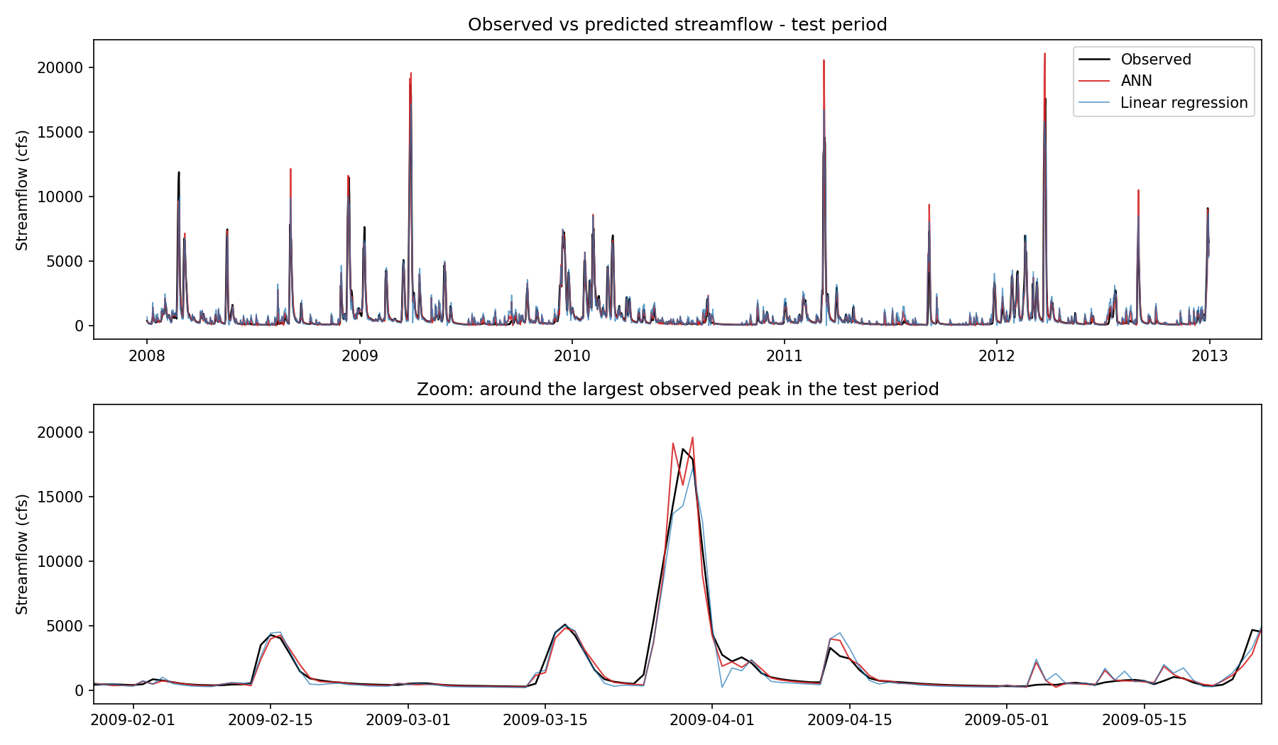
Observed vs Predicted
Insert hydrograph_comparison.png
Notes:
Insert results/figures/hydrograph_comparison.png (and optionally scatter_obs_vs_pred.png).

Slide 10
Differences from the Reference
Aspect | Reference (Xiao & You) | Our work
Split | Train 2003–2007; best model picked on 2008–2012 | Train 2003–2006, validation 2007, untouched test 2008–2012
Rainfall | “At Collins”, source not stated | Daymet v4 gridded precipitation at the gauge
Gaps | Invalid values cleaned | Left missing; affected lag rows dropped
Baselines | Standard ANN vs LSTM | ANN vs persistence and linear regression
Location | Stated as Collins, LA | USGS 02472000 is in Covington County, Mississippi
Notes:
We kept the test years untouched; the reference tuned and reported on the same years.

Slide 11
Conclusion and Future Work
Conclusion
A simple ANN forecasts daily streamflow from past rainfall and flow alone
Evaluation is leak-free: chronological split, train-only scaling, test years used once
Compared against persistence and linear regression baselines
Errors are expected to be largest at peak flows (as in the reference)
Future Work
More stations and basins
Extra inputs such as temperature and soil moisture
Other architectures (LSTM, deeper networks)
Safety factor or asymmetric loss to avoid under-predicting peaks
Notes:
Close by summarising and handing over to questions.

