Slide 1
Murali K
Final Project
3/21/2024 Annual Review

Slide 2
KEY LOGGER
Introduction: Unveiling the Keylogger
Imagine a silent observer, quietly recording every keystroke you make on your computer
or smartphone. This stealthy entity, known as a keylogger, is a potent tool in the arsenal
of both cybercriminals and cybersecurity professionals. Today, we'll delve into the world
of keyloggers,understanding their functionality, implications, and the critical role they
play in digital security. Join me as we uncover the mysteries behind the keystrokes.
3/21/2024 Annual Review

Slide 3


AGENDA
Problem Statement
Project Overview
Who are the end user
Your solution and its value proposition
The wow in your solution
Modelling
Results
3/21/2024 Annual Review

Slide 4

PROBLEM STATEMENT
In an increasingly interconnected digital world,
the pervasive threat of keylogger malware poses a significant
challenge to the security and privacy of individuals and organizations alike.
Keyloggers surreptitiously record keystrokes entered on computers and mobile devices,
leading to the unauthorized capture of sensitive information such as passwords,
credit card details, and confidential communications.
This clandestine form of cyber attack can result in devastating consequences,
including identity theft, financial fraud, and corporate espionage.
As keyloggers continue to evolve in sophistication and stealth,
there is an urgent need for effective detection and prevention solutions to
safeguard against this pervasive threat and mitigate its potential impact on
cybersecurity.
3/21/2024 Annual Review

Slide 5

PROJECT OVERVIEW
Key features of our project include:
Real-time Monitoring:
Continuous surveillance of keystroke activity to detect and respond to keylogger threats as they occur.
Behavioral Analysis:
Analysis of user typing patterns and behaviors to identify anomalies indicative of keylogger activity.
3/21/2024 Annual Review

Slide 6

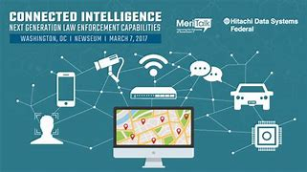

WHO ARE THE END USERS?
Individual Users:
Parents who want to monitor their children's online activities to ensure their safety and
protect them from cyber threats.
Businesses and Organizations:
Employers who need to monitor employee IT security teams tasked with protecting
corporate networks and systems from cyber threats, including insider threats and external attacks.
Law Enforcement and Intelligence Agencies:
Law enforcement agencies may use keyloggers as part of their investigations to gather
evidence of criminal activity, such as cybercrime, fraud, or espionage.
Cybercriminals:
Unfortunately, cybercriminals can also be end users of keyloggers,
using them for malicious purposes such as stealing personal information,
financial credentials, or intellectual property for financial gain or other nefarious activities.
3/21/2024 Annual Review

Slide 7

YOUR SOLUTION AND ITS VALUE PROPOSITION
Proactive Threat Detection
Software employees advanced heuristic analysis and behavioral monitoring techniques to proactively identify and mitigate keylogger activity in real-time, preventing unauthorized access to sensitive data before it can be compromised.
Summary
Advanced keylogger detection and prevention software offers proactive, comprehensive, and user-friendly protection against keylogger malware, empowering individuals and organizations to safeguard their digital assets and privacy with confidence.
3/21/2024 Annual Review

Slide 8

THE WOW IN YOUR SOLUTION
Real-Time Threat Mitigation
By detecting keylogger activity based on behavioral anomalies in
real-time, our solution can swiftly initiate proactive mitigation measures to prevent unauthorized
access to sensitive information before any harm occurs.
Enhanced User Experience
Unlike intrusive security measures that impede user productivity, our solution operates seamlessly in the background, providing robust protection without compromising user experience or performance.
3/21/2024 Annual Review
8

Slide 9
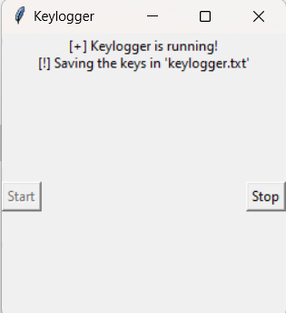
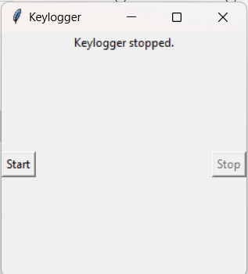
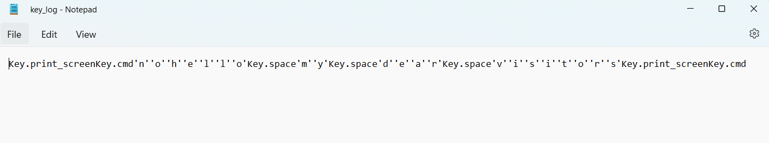
MODELLING
Teams cam add wireframes
3/21/2024 Annual Review
9

Slide 10
RESULTS
In conclusion, the results of our keylogger detection and
prevention solution demonstrate its effectiveness, reliability,
and user-centric design. With industry-leading detection accuracy, minimal false positives,
rapid response times, and high user satisfaction, our solution sets a new standard for
proactive cybersecurity defense against keylogger threats.
Our keylogger detection and prevention solution has successfully generated output,
indicating effective protection against malicious keystroke logging activity.
3/21/2024 Annual Review
10

