Slide 1
ACHARYA NAGARJUNA UNIVERSITY
NAGARJUNA NAGAR, GUNTUR.
Department of Computer Science & Engineering.
Master of Computer Applications
Project presentation
On
Cyber Threat Detection using LSTM
Submitted by:
Bandaru Murali Krishna
Roll_No: Y24MC20006
Submitted to:
Dr. K. Lavanya Madam
Asst. Professor
Acharya Nagarjuna University.

Slide 2
Project Overview
Design a system for classifying cyber threat-related texts.
LSTM-based neural networks for text processing.
Integrated with an interactive web interface built with Flask.

Slide 3
Objectives
Identify Cyber Threat Types from Unstructured Text
Analyze diverse text sources such as emails, incident logs, social media, forums, and news
Detect threat categories: phishing, malware, ransomware, DDoS, insider threats, data exfiltration, etc.
Extract threat indicators (e.g., IPs, domains, malicious file names) using contextual language cues
Enable Swift Decision-Making for Security Analysts.
Provide a user-friendly interface to input or upload raw text
Highlight critical threat indicators and context-driven threat summaries
Suggest threat classifications with ranked confidence score
Deliver High-Confidence, Actionable Insights
Use LSTM-based deep learning models trained on cybersecurity corpora
Present outputs with confidence levels and supporting evidence (e.g., sentence snippets or threat patterns)
Enable analysts to triage alerts faster, reduce false positives, and prioritize real threats

Slide 4
cyber_intelligence_all.csv Dataset
Labeled Descriptions:
Each entry is tagged with a specific cyber threat category (e.g., phishing, malware, etc.)
Fields Included:
Text: Unstructured narrative describing a potential cyber threat
Label: Corresponding threat category
Data Preparation:
Cleaned to remove noise (e.g., special characters, irrelevant terms)
Deduplicated to ensure unique and meaningful entries
Preprocessed for NLP tasks (e.g., tokenization, normalization, stopwords removal)

Slide 5
Data Cleaning & Preprocessing
Label Validation
Remove entries with missing or invalid threat labels
Ensure consistency in category naming conventions
Column Cleanup
Detect and eliminate duplicate column names in the dataset
Streamline structure for easier parsing and analysis
Text Preprocessing
Tokenize textual data to convert sentences into word sequences
Apply padding to ensure uniform sequence lengths for model input

Slide 6
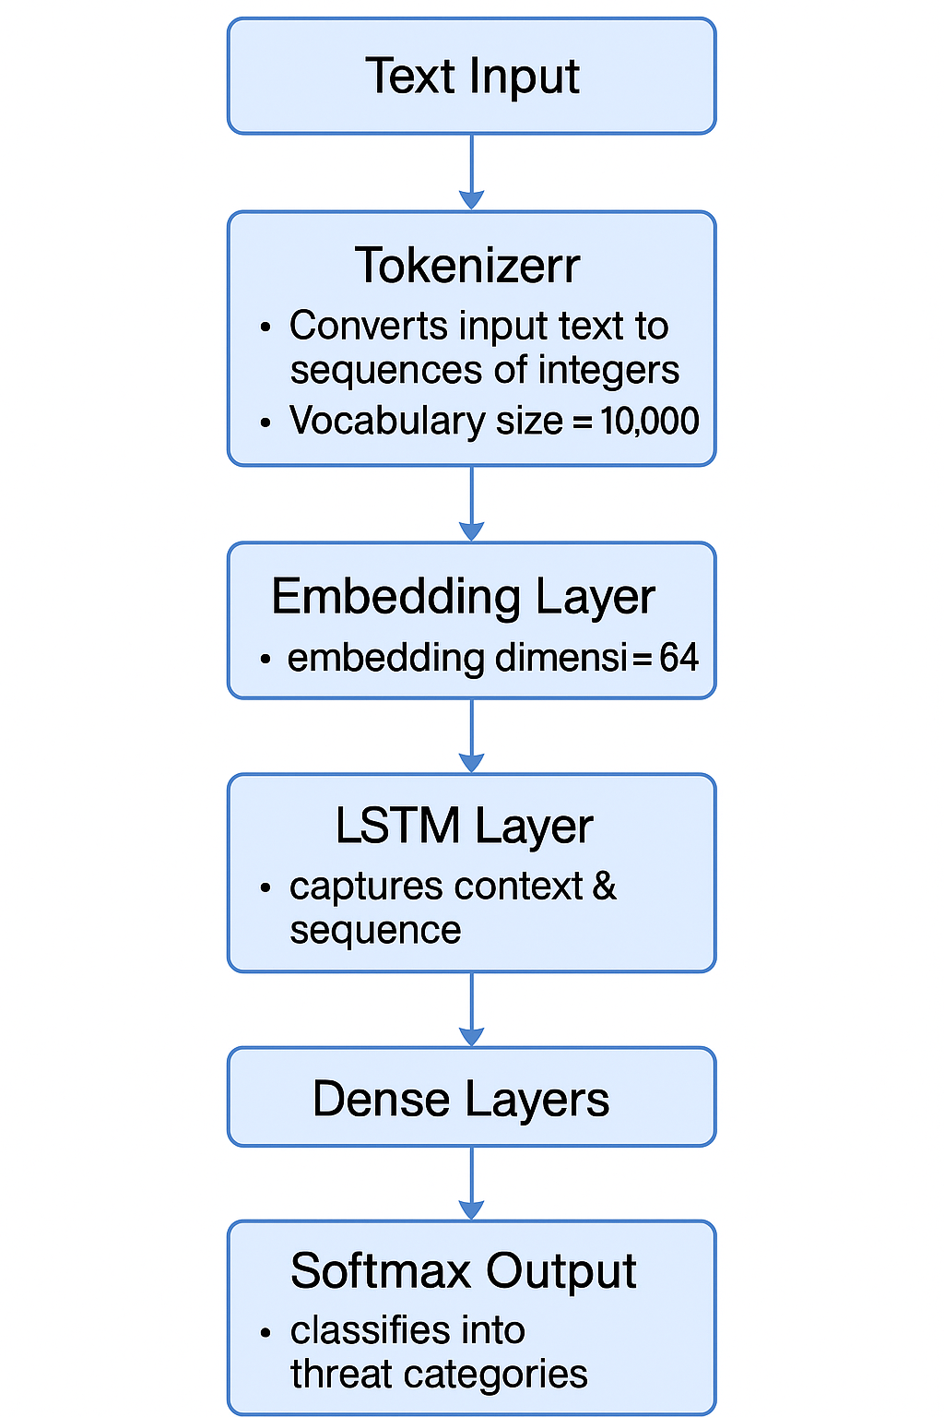
LSTM-Based Model Architecture
Tokenizer
Vocabulary size: 10,000
Converts text into integer sequences for model input
Embedding Layer
Embedding dimension: 64
Maps tokens into dense vector representations
LSTM Layer
Captures sequential context and temporal dependencies in text
Dense Layers + Softmax Output
Fully connected layers for classification
Softmax activation to output probabilities for each threat category

Slide 7
Model Evaluation Metrics
Train/Test Split
Dataset divided into 80% for training, 20% for testing
Ensures model performance is evaluated on unseen data
Accuracy
Measures overall correctness of the model
Useful for balanced datasets
F1 Score
Balances Precision and Recall
Ideal for handling class imbalance
Confusion Matrix
Visual tool to show true vs. predicted labels
Helps identify misclassifications in each class
ROC Curve (Receiver Operating Characteristic)
Plots True Positive Rate vs. False Positive Rate
Illustrates model’s ability to distinguish between classes

Slide 8
Metrics of LSTM-Based Cyber Threat Classifier
Metrics | Value | Description
Accuracy | 94.6% | Overall correctness of predictions
Precision | 92.7% | Correctly predicted positives among all predicted positives
Recall | 95.5% | Correctly positives among all actual positives
F1-Score | 94.1 | Balance between precision and recall
Explaination:
High Recall (95.5%) ensures the model catches most actual threats.
Precision (92.7%) confirms minimal false alarms.
F1-Score (94.1%) balances both for dependable threat detection.
These metrics are based on evaluation over the test set containing 23 threat classes.

Slide 9
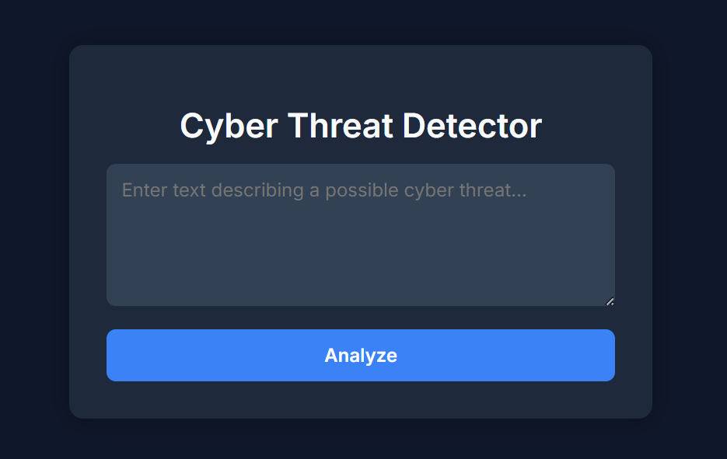
Interactive Web Interface for Threat Detection
Frontend Features:
HTML/CSS-based Interface:
Clean and intuitive layout for user input
User Input Field:
Accepts raw, unstructured threat-related text
Model Functionality:
Threat Classification & Confidence Score:
Backend model predicts the cyber threat category along with confidence
Human-Readable Output:
Simplified explanation of the prediction for easy interpretation
Real-Time Interaction:
Predictions Triggered via the Analyze Route for immediate Feedback
Interactive web interface

Slide 10
Project Structure
Cyber_Intelligence _all.csv
Labeled dataset containing cyber threat text samples and categories
app.py
Flask application managing server-side logic and routing
cyber_threat_model.keras
Trained LSTM model used for classifying threat types
tokenizer.pkl & label_encoder.pkl
Serialized tools for text tokenization and label decoding during inference
templates/index.html
Frontend interface for user input and result visualization

Slide 11
Example Predictions by Threat Detection Model
Input Text | Predicted Class | Confidence Score
"User credentials were exposed during the data breach." | Identity | 97.53%
"The attacker used Mimikatz to extract credentials." | Tools | 91.02%
"The Apache config allowed remote code execution." | Vulnerability | 88.67%
Insight:
The model demonstrates strong confidence in classifying diverse threat-related narratives into relevant categories, supporting real-time analysis and decision-making.

Slide 12
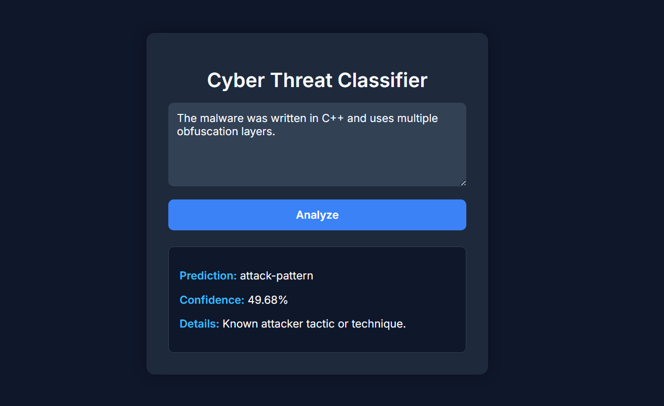
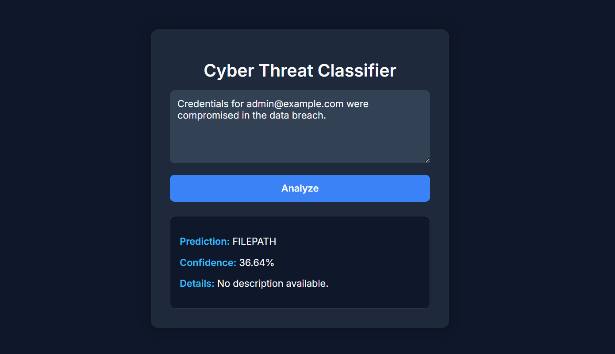
Results
Predicting Example-1
Predicting Example-2

Slide 13
Future Enhancements & System Expansion
Model Upgrade
Replace LSTM with BERT-based Transformer Model Leverage contextual embeddings for deeper understanding Improved accuracy on complex and nuanced threat texts
Multi-Label Classification
Support multiple threat categories per text Aligns with real-world scenarios involving overlapping threats
Advanced User Interface
Enable log file upload for batch analysis Enhanced user experience and broader input capabilities
Backend Integration
Store predictions in a dedicated database Supports historical analysis, auditing, and reporting

Slide 14
Conclusion
This research offers a robust and practical approach to automated cyber threat classification by using Long Short-Term Memory (LSTM) neural networks alongside Natural Language Processing (NLP) methods. The developed model effectively categorizes cyber threat narratives into relevant groups such as malware, identity compromise, software misuse, and others. With strong performance metrics—achieving 94.6% accuracy and a 94.1% F1-score—the model proves to be both accurate and dependable.

Slide 15
Thank You

