Slide 1
Employee Data Analysis using Excel
STUDENT NAME:MURALI KRISHNAN.R
REGISTERNO:312204497, 6BDD666E635D020BCD744D5AEC56A0BB
DEPARTMENT:COMMERCE
COLLEGE: K.C.S. KASI NADAR COLLAGE OF ARTS & SCEINCE

Slide 2
PROJECT TITLE
Employee Management

Slide 3


AGENDA
Problem Statement
Project Overview
End Users
Our Solution and Proposition
Dataset Description
Modelling Approach
Results and Discussion
Conclusion
3/21/2024 Annual Review

Slide 4

PROBLEM STATEMENT
THE PROBLEM IS EMPLOYEE MANAGEMENT ANALYSIS ACCORDING THEIR :
Employee ID
Full Name
Department
Designation
Hire Date
Annual Salary

Slide 5

PROJECT OVERVIEW
In this analysis I am going to ease the process of identify the employees rating using excel, with the help of below mentioned tools in excel.
Tables.
Slicers.
Pivot chart(line chart, pie chart & bar chart).

Slide 6

WHO ARE THE END USERS?
Human Resources (HR) Department
Finance Department
Compensation and Benefits Specialists
Operational Managers
IT and Data Management Teams

Slide 7

OUR SOLUTION AND ITS VALUE PROPOSITION
User-Friendly Interface:
Accessibility
Ease of Use
Comprehensive Data Management:
Data Organization
Data Integration
Advanced Analytical Tools:
Formulas and Functions
PivotTables
Visual Representation:
Charts and Graphs
Scenario Analysis:
Used to analyse different situation

Slide 8
Dataset Description
Data Overview:
The dataset contains information about employees within an organization. This data is used to calculate and analyse the project progress metrics.
Data Fields:
Employee ID
Full Name
Department
Designation
Hire Date
Annual Salary

Slide 9

THE "WOW" IN OUR SOLUTION
Dynamic Dashboards
Advanced Data Visualization
Segmentation Analysis
Comparative Analysis
Interactive Reports
Slicers
3/21/2024 Annual Review
9

Slide 10
MODELLING
Data cleaning.
Creating table.
Creating pivot chart.
Creating dashboard.
Inserting pivot chart in dashboard.
Creating interactive dashboard by putting all together elements.
10

Slide 11

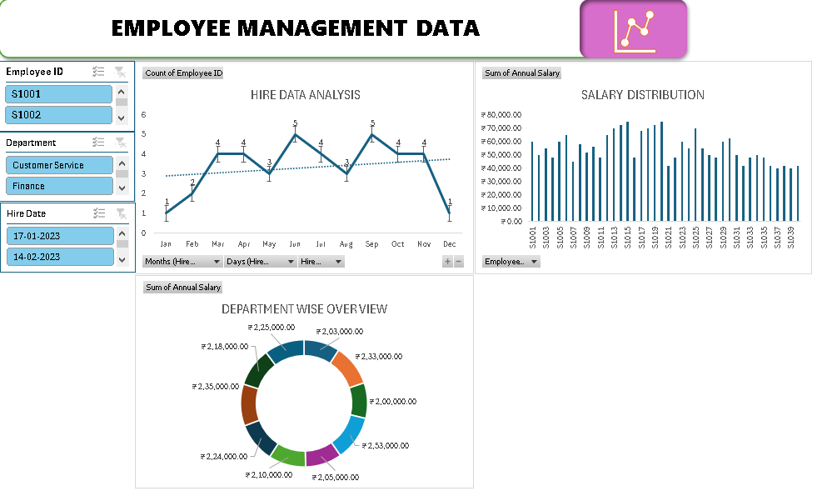
RESULTS
(click to open file)
11

Slide 12
conclusion
“The employee management analysis offers valuable insights into how well management practices are supporting employee performance and satisfaction. By addressing identified issues and leveraging strengths, the organization can improve its management practices, enhance employee engagement, and ultimately achieve better organizational performance”

