Slide 1
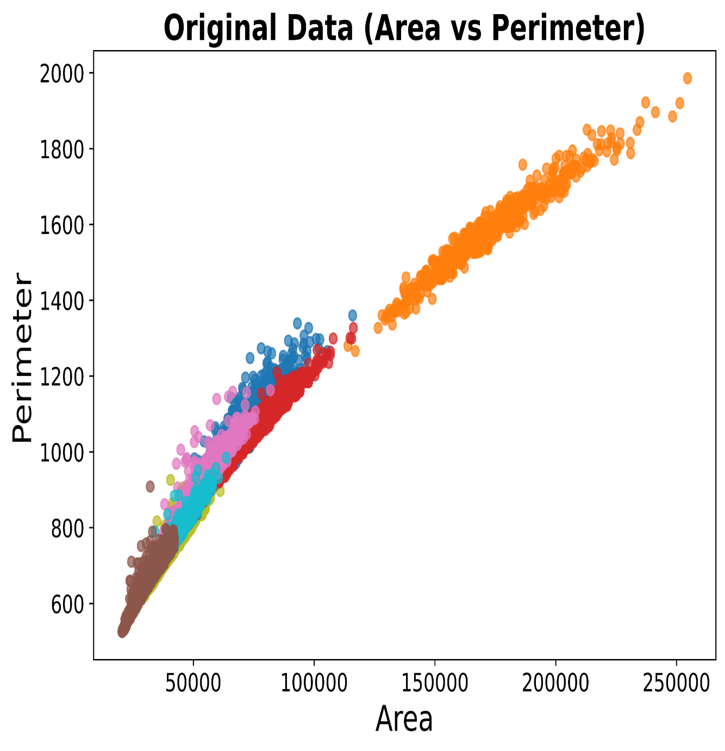
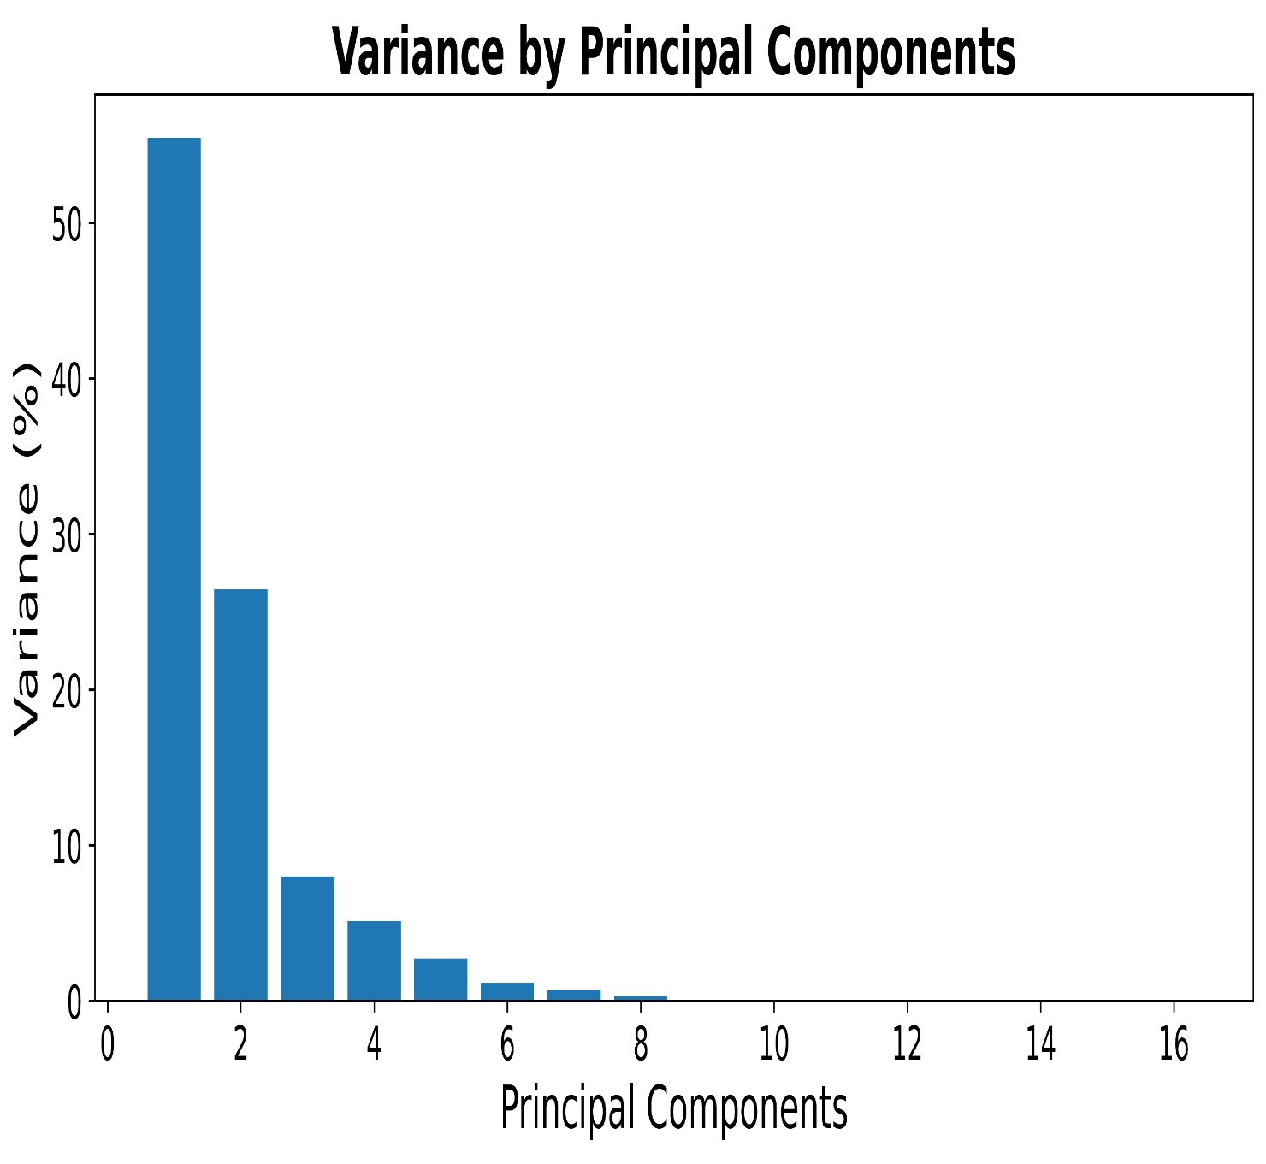

Slide 2
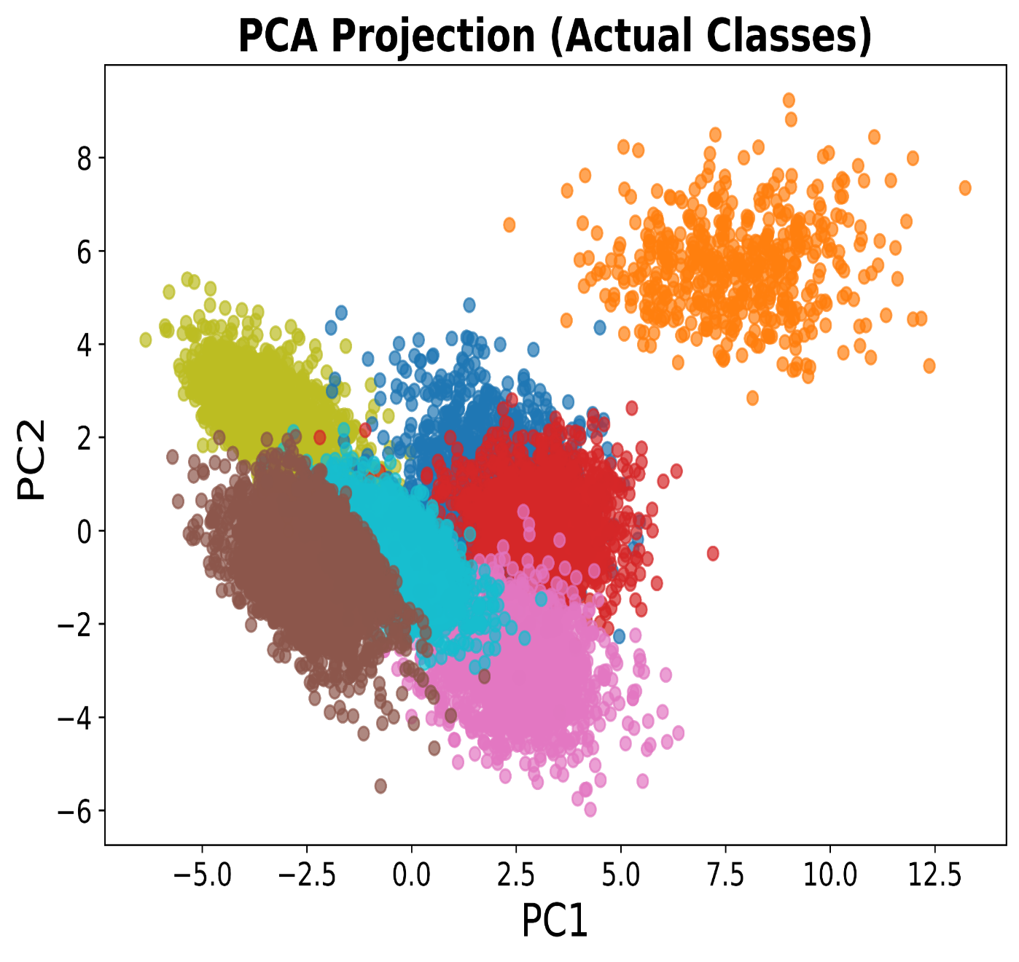
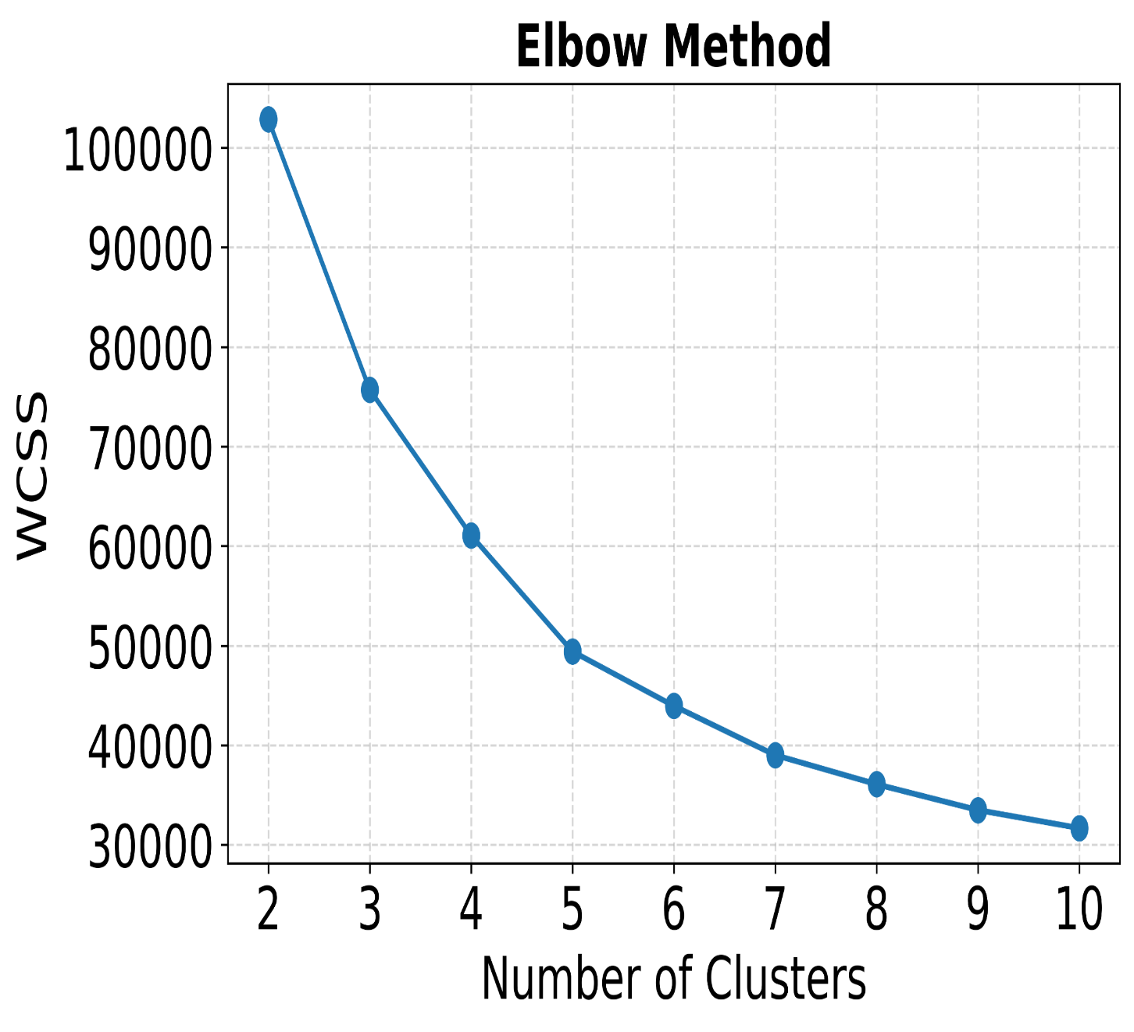

Slide 3
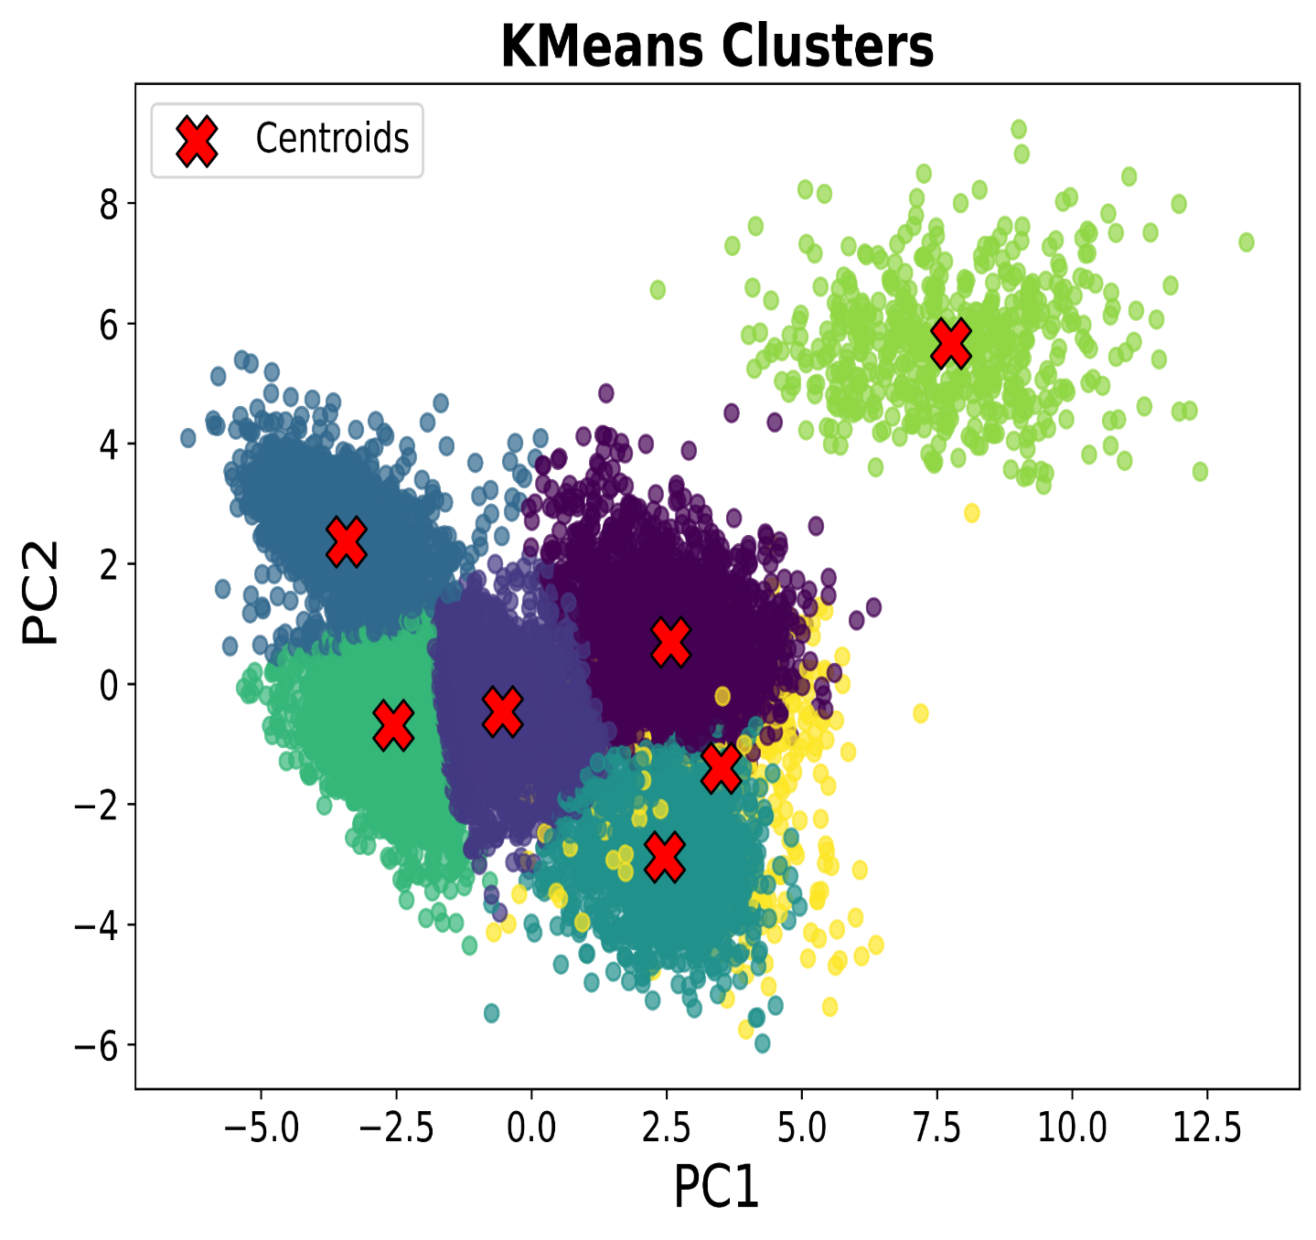
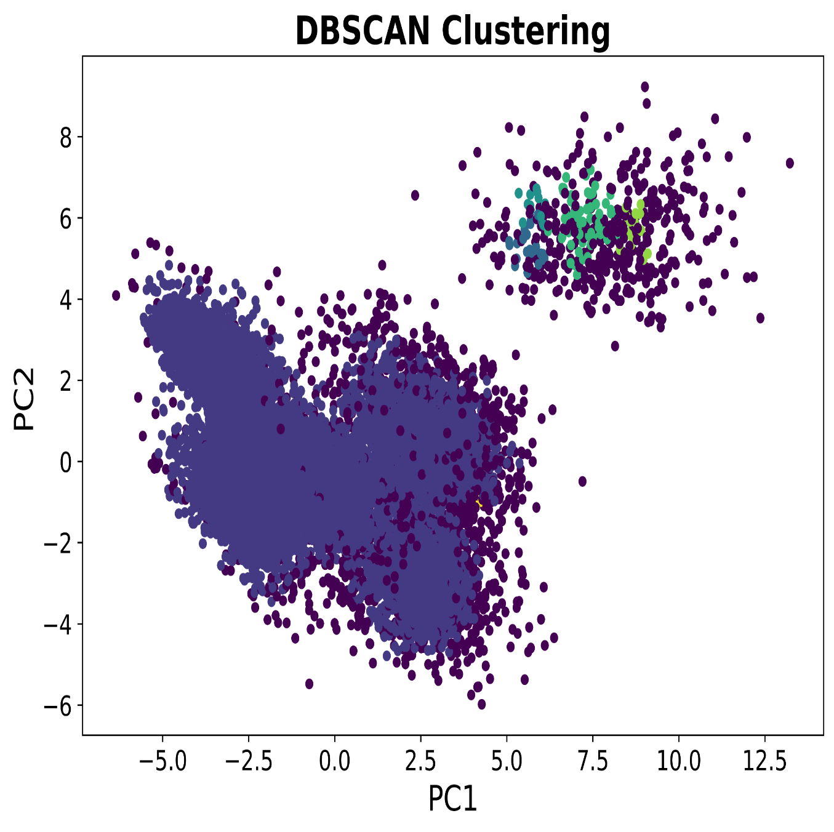

Slide 4
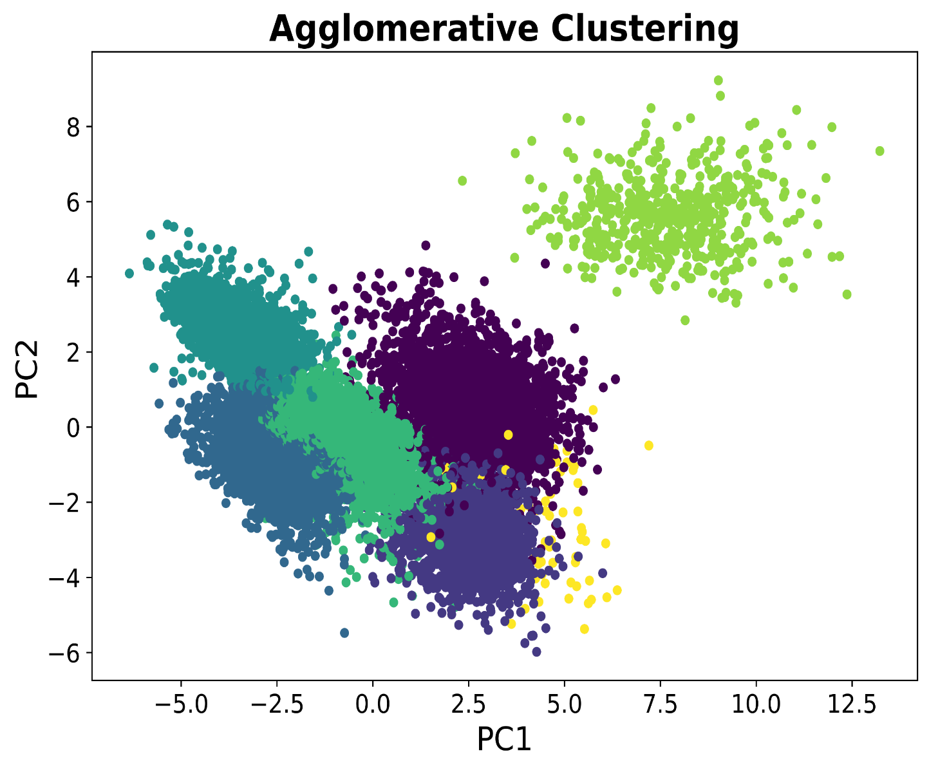
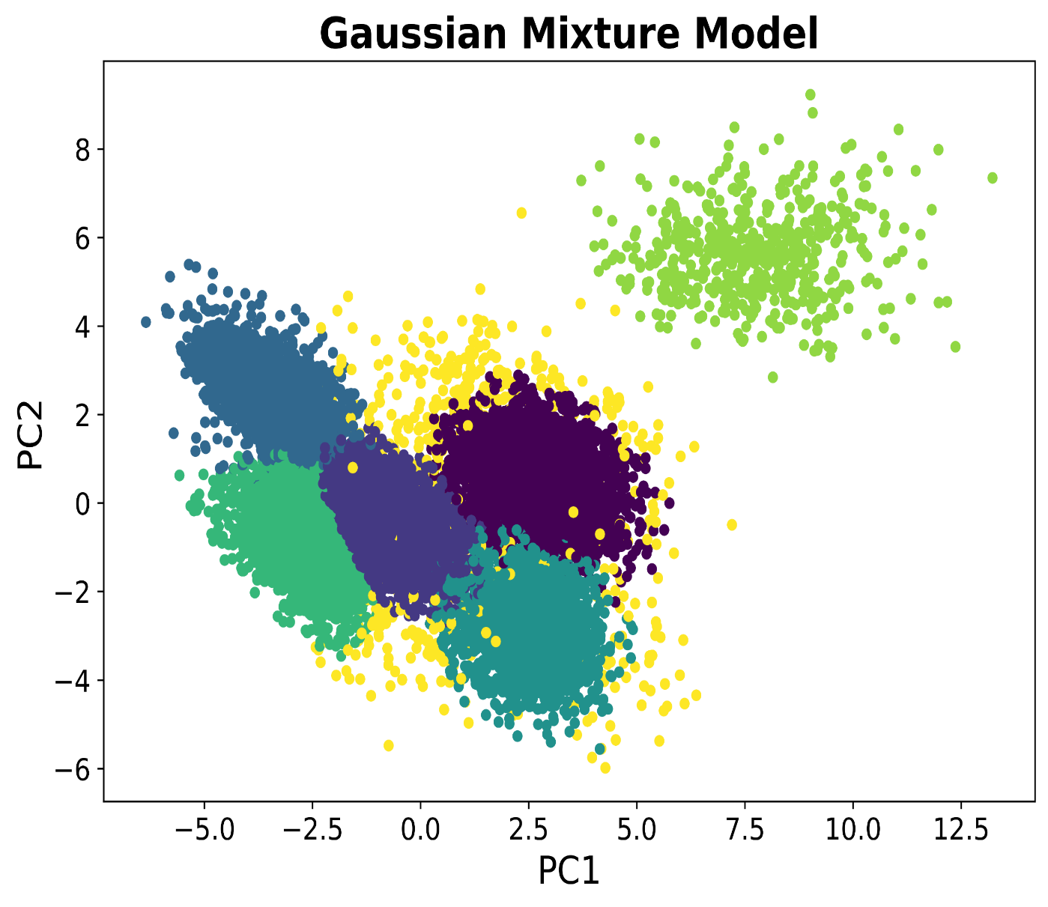

Slide 5
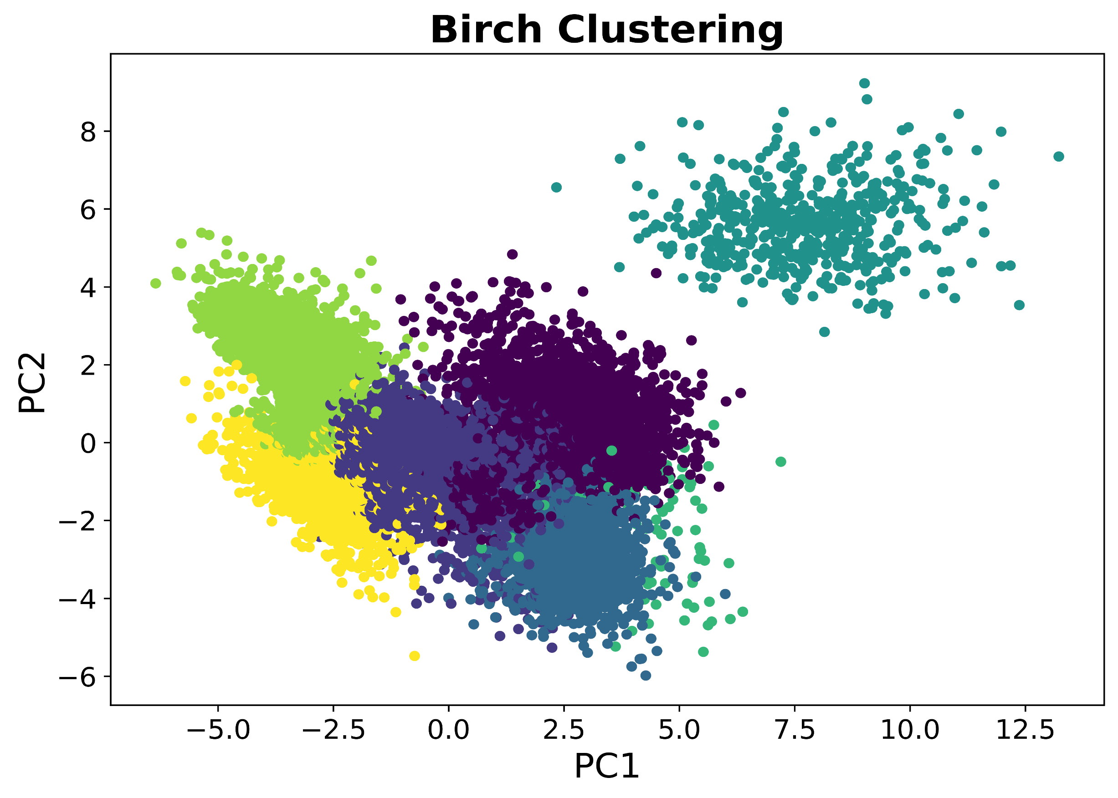

Slide 6
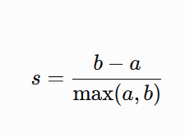
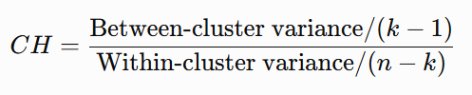
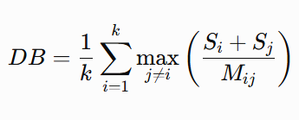
Clustering Evaluation Metrics
Silhouette Score
Range: -1 to +1
Higher is better
Measures cluster cohesion and separation
Calinski–Harabasz Index
Range: 0 to ∞
Higher is better
Ratio of between-cluster to within-cluster variance
Davies–Bouldin Index
Range: 0 to ∞
Lower is better
Measures cluster similarity and overlap

Slide 7
Comparative Evaluation
Model | Silhouette Score ↑ | Calinski– Harabasz Index ↑ | Davies– Bouldin Index ↓
K-Means | 0.309 | 6219.92 | 1.0994
Agglomerative | 0.2622 | 5562.25 | 1.2477
DBSCAN | 0.1481 | 858.78 | 1.3306
Birch | 0.3224 | 5277.53 | 1.1150
GMM | 0.2897 | 5107.09 | 1.6652

Slide 8
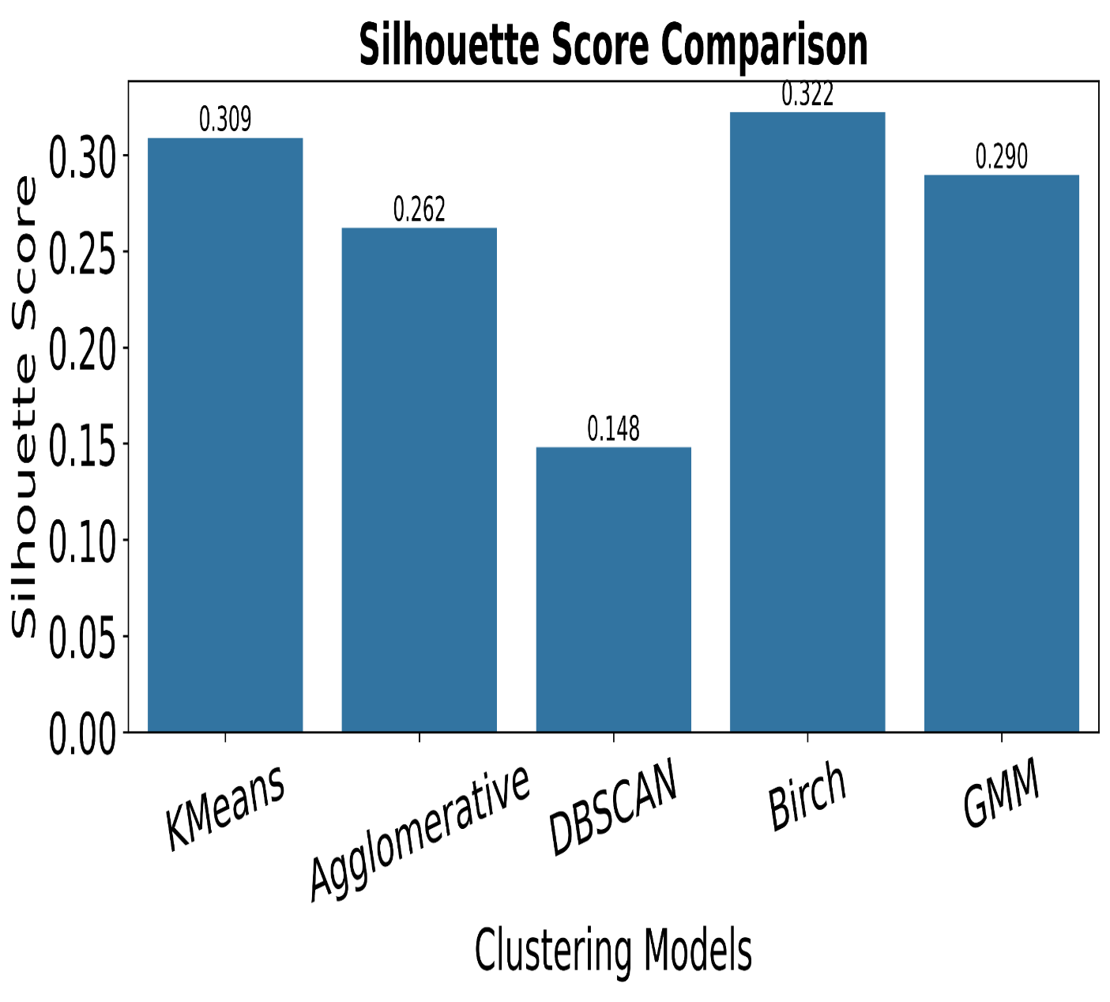
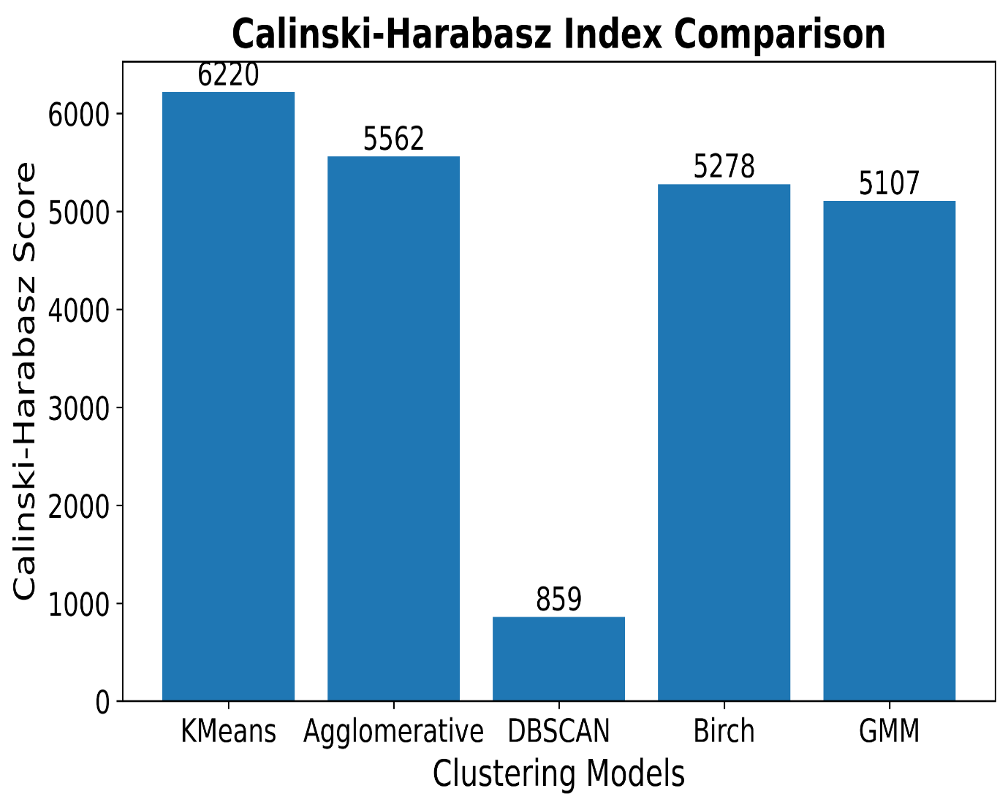

Slide 9
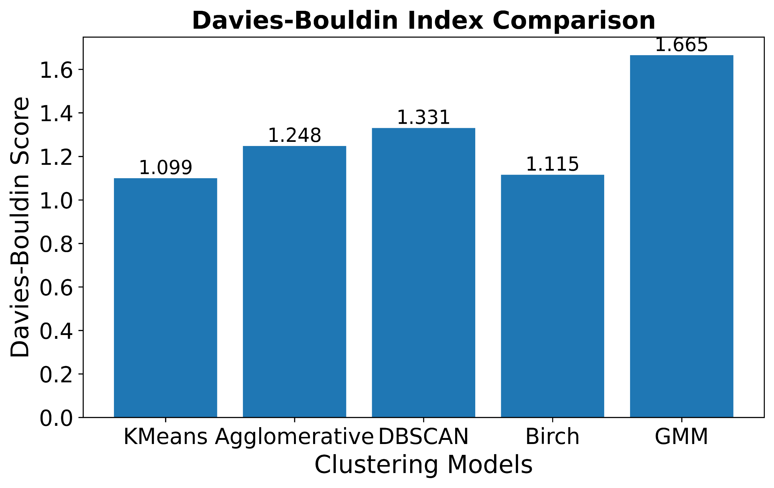

Slide 10
Conclusion
PCA effectively reduced dimensionality, preserving the most significant variance and enabling clear visualization of the bean dataset.
K-Means and Birch achieved the best clustering performance, with K-Means obtaining the highest Calinski–Harabasz Index (6219.92) and lowest Davies– Bouldin Index (1.0994), while Birch achieved the highest Silhouette Score (0.3224).
The combination of PCA and clustering successfully identified natural groupings in the dataset, demonstrating its effectiveness for unsupervised pattern and data analysis.

