Slide 1
VitalGuard AI
Real-Time IoMT Health Monitoring System
Intelligent Healthcare Monitoring at the Speed of Light

Slide 2

Healthcare Monitoring Revolution
Continuous Intelligent Patient Monitoring Through Advanced AI

Slide 3
🚀 Key Features
📡 Real-Time Simulation: Generates vital sign data for 50+ virtual devices
🤖 Tri-Model AI Architecture: Edge, Forecasting & Medical Imaging
⚡ High Performance: FastAPI for low-latency inference
📊 Interactive Dashboard: Modern, responsive monitoring UI
🛡️ Secure & Modular: Anonymized data with easy model upgrades

Slide 4
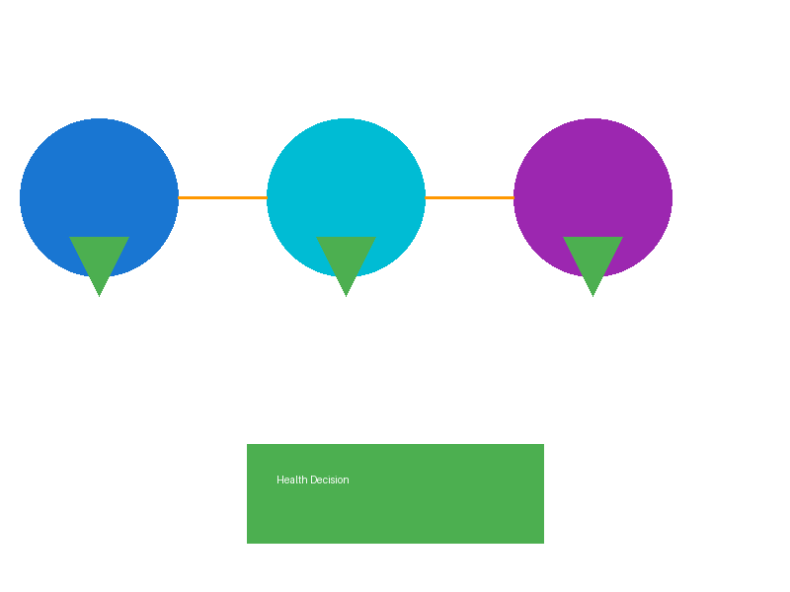
AI/ML Tri-Model System
Edge Intelligence + Temporal Forecasting + Medical Imaging = Comprehensive Health Analysis

Slide 5
System Architecture
📊 Data Flow Pipeline
🏗️ System Layers
1️⃣ Sensors: Real-time vital collection
2️⃣ Edge Layer: Instant anomaly detection
3️⃣ Forecasting: Trend prediction (TFT)
4️⃣ Imaging: Medical image analysis (CNN)
5️⃣ Aggregation: Final health decision
Data Layer: IoT sensor streams
Service Layer: AI orchestration
Inference Engine: Model aggregation
Presentation: Real-time dashboard
Output: Normal/Anomaly Status

Slide 6
The Tri-Model Intelligence System
⚡ Edge Model
🔮 TFT Model
🖼️ CNN Model
Isolation Forest
Instant Detection
Low-Latency
Vital Anomalies
Temporal Fusion
Trend Forecasting
Future Prediction
Health Trends
ResNet50 Network
X-ray Analysis
Image Anomalies
Medical Imaging

Slide 7
Modern Technology Stack
🔧 Backend
🎨 Frontend & Data
Python 3.10+
FastAPI Framework
Uvicorn (ASGI)
PyTorch for ML
Scikit-learn
HTML5 & CSS3
Vanilla JavaScript
Real-time Polling
CSV Datasets
Joblib & Pickle

Slide 8
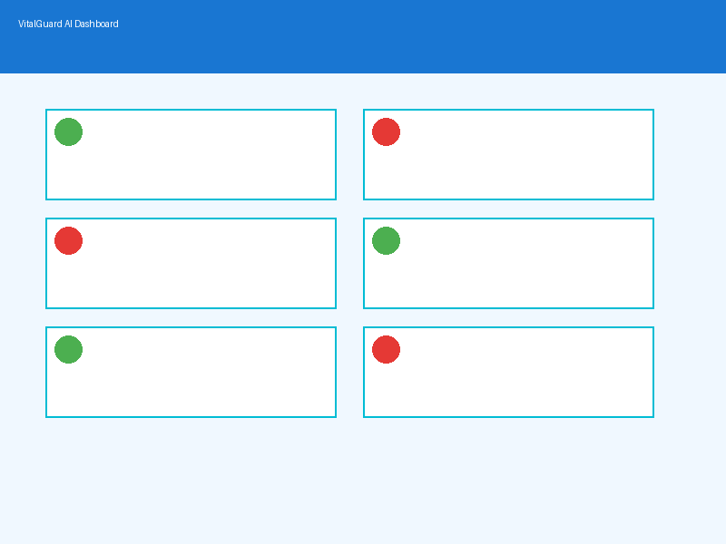
Live Monitoring Dashboard
Real-Time Device Status • Color-Coded Health Indicators • Instant Alerts • 3-Second Refresh Rate

Slide 9
📡 Data Flow & Processing
🔄 Simulator generates 50 virtual devices with realistic vital patterns
🎯 FastAPI orchestrates simulation lifecycle and exposes REST endpoints
📲 Frontend polls /devices endpoint every 3 seconds for live updates
🧠 Each request: vitals → Edge service → TFT service → CNN service
✅ Backend aggregates outputs into Final Health Decision (Normal/Anomaly)

Slide 10
Getting Started & Future Vision
🚀 Quick Start
🌟 Future Roadmap
1. Clone repository
2. Create virtual env
3. pip install -r requirements.txt
4. python backend/main.py
5. Open dashboard!
🔗 Real IoT device integration
📱 Mobile app version
🌐 Edge computing deployment
🔔 Predictive alert system
📈 Enhanced model training

Slide 11
🛡️ Security, Benefits & Impact
🔐 Security: Data anonymization, modular design, easy security updates
✨ Benefits: Real-time monitoring, multi-model redundancy, high scalability
💡 Innovation: Continuous model improvement, expanded vital parameters
🏥 Healthcare Impact: Enhanced patient safety, improved clinical decisions
🌍 Vision: Transform healthcare through intelligent, accessible monitoring

