Slide 1
MCTR PROGRAM Gaining User Access

Slide 2
General Process
1) Click on Access Section of the MCTR Web Page sub link ‘How to Get MCTR Access’ to open the User Access Form
2) Click the yellow box on the window form that pops up
3) A electronic form should pop up
4) Fill out the form by tabbing thru all fields (you do have to click on some fields i.e. The MCTR Focal link which will take you to the Accounting Admin Focal list by ABU).
5) Complete Form, press send on form to route to your manager for approval
6) Your manager should open form, sign electronically & send to the YOUR MCTR BU FOCAL electronically
7) The appropriate MCTR BU FOCAL accounting administrator sets up or modifies access based on the approved form, signs form and routes back notifying “you have access to the MCTR program”.
Please e-mail inquiries about access to YOUR MCTR BU FOCAL.

Slide 3
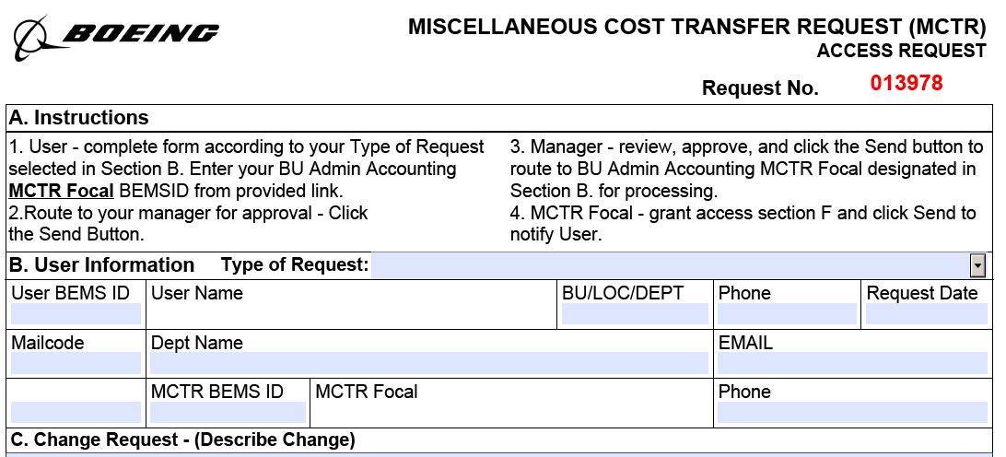
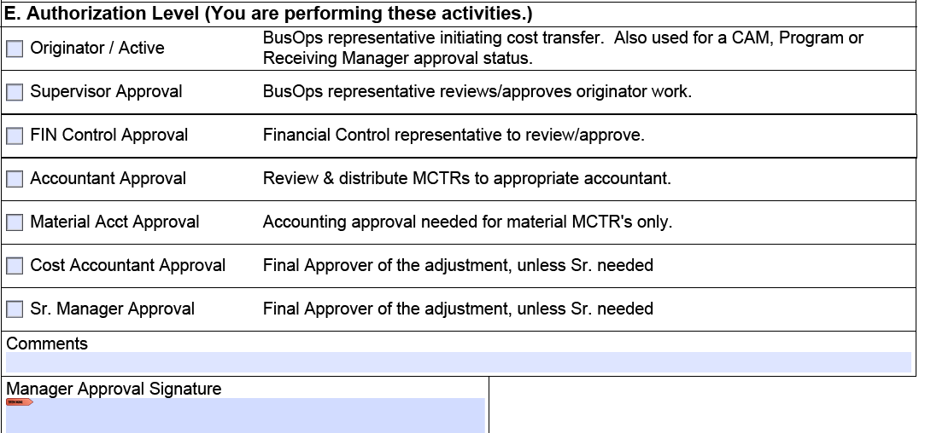
AccessForm

