Slide 1
MCTR – Work Flow & Definitions

Slide 2
MCTR Work Flow

Slide 3
Work Flow Status Definition
When a MCTR is created, the first Status it is placed in is OA – Originator Actions. This status allows the originator to enter the detailed lines of the transfer.
The transfer must be put back in OA status in order to make any modifications to the transfer.

Slide 4
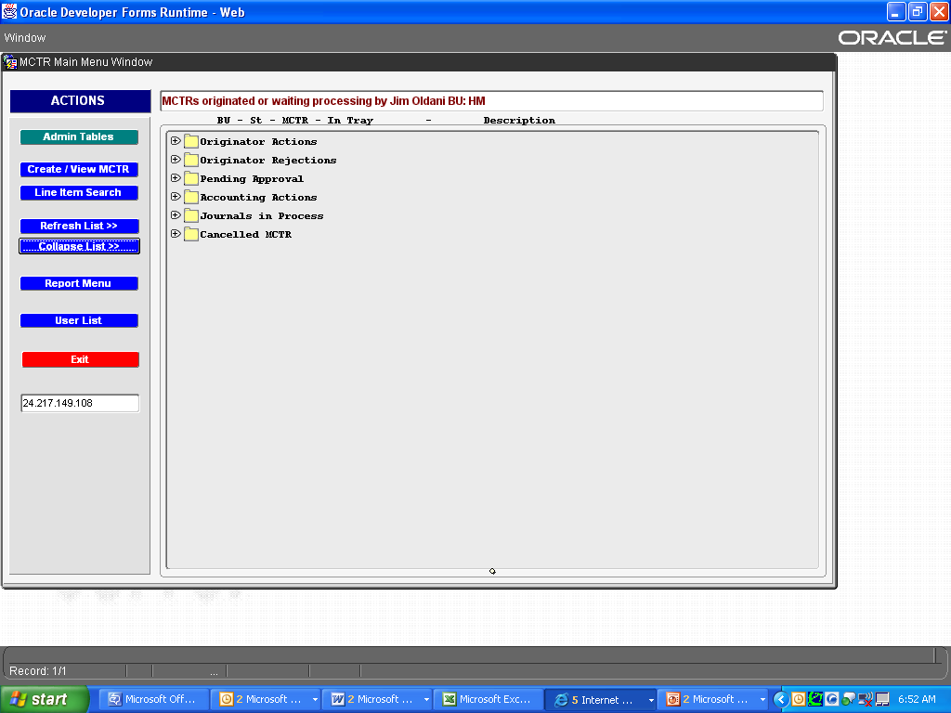
Work Flow Screen
Status = OA
Reset Approvals
Status = OR
Status = SA, LA, FA,
AA,MA,CA,SR,JA,IP
No Archive
Currently in Place
Status = IP becomes
99= Complete
Weekly (Thurs)
Evening

Slide 5
Originator Work Flow Functions
Originator (OA Status)
Edit Mode (Create New/Modify/Cancel) – keys From/To lines
Adds Corrective Justification/Attachments/Comments
Assigns Supervisor/Financial Control/Optional Approvers
MCTR stays in work flow (start to finish)
Submit MCTR (button on header)
Cancel (button on header)
Reset Approvals ( button on header) Appears after approval rejection and re-open of a cancelled MCTR
Re-Open (button on header)
Originator Rejection (OR Status)
Occurs from a downstream Approval ‘not’ approving MCTR
Originator must reset approvals back to OA status for editing

Slide 6
Required Approvers (Bus Ops/Program)
Supervisor (SA Status)
1st required approver (receives email notification after originator submits MCTR)
Approves/Rejects MCTR
Can add comments/attachments
MCTR leaves work flow once approved/rejected
Optional Approver (LA Status) - ***Not Required, but Bus Ops enters/selects
Can approve entire MCTR or line by line. Receives email notification after supervisor submits approval
Financial Control (FA Status)
2nd required approver
Occurs after Supervisor (SA) approval or after Optional Approver (receives email notification)
Last approval before Accounting
Approves/Rejects MCTR
Can add comments/attachments
MCTR leaves work flow once approved/rejected

Slide 7
MCTR Accounting Work Flow Roles
Accountant Approval (work code = AA)
Only work flow that does not receive email notification. Accounting users with access must review and assign themselves.
1st Approval in Accounting after MCTR leaves Bus Ops.
Reviews MCTR and assigns remaining downstream Accounting approvals.
Approvals – changes status to next downstream approval. Notifies next approval by email and updates their work flow.
Rejections – changes status to (OR – originator rejections), sends back to originator work flow and notifies by email.
Visibility is lost in this roles work flow once MCTR is approved or rejected.
Can recall MCTR back to AA status if MCTR is in any downstream approval status (MA, CA, SR) which is prior to the journal/completion process (JA, IP, 99). Rejections will always go back to the Originator.
Downstream Accounting approvers when they reject the MCTR will go back to the AA role as well than this user will need to decide on rejecting it back to Originator. Emails are sent during a rejection.

Slide 8
MCTR Accounting Work Flow Roles
Labor Accountant Approval
(work code = LB)
Receives email notification after Accountant approval.
Work flow visibility up to approval or rejection.
Typically only approves LABOR related cost transfers.
Reviews MCTR based on business unit requirements.
Approvals – changes status to next downstream approval. Notifies next approval by email and updates their work flow.
Rejections – changes status to (OR – originator rejections), sends back to Accountant work flow and notifies by email.

Slide 9
MCTR Accounting Work Flow Roles
Material Accountant Approval
(work code = MA)
Receives email notification after Accountant approval.
Work flow visibility up to approval or rejection.
Typically only approves material related cost transfers.
Reviews MCTR based on ABU requirements.
Approvals – changes status to next downstream approval. Notifies next approval by email and updates their work flow.
Rejections – changes status to (OR – originator rejections), sends back to Accountant work flow and notifies by email.
.

Slide 10
MCTR Accounting Work Flow Roles
Material Accountant Approval
(work code = MA)
Receives email notification after Accountant approval.
Work flow visibility up to approval or rejection.
Typically only approves material related cost transfers.
Reviews MCTR based on ABU requirements.
Approvals – changes status to next downstream approval. Notifies next approval by email and updates their work flow.
Rejections – changes status to (OR – originator rejections), sends back to Accountant work flow and notifies by email.

Slide 11
MCTR Accounting Work Flow Roles
Cost Accountant Approval (work code = CA)
Receives email notification after Accountant or Material approval.
Work flow visibility up to approval or rejection.
Typically reviews the majority of cost transfers. Primary review responsibility currently resides with this approver.
Review process includes an overview (2nd look) at the class codes and Justification/Corrective Action.
Primarily reviews the hours and amounts being transferred.
Approvals – changes status to next downstream approval. Notifies next approval by email and updates their work flow.
Rejections – changes status to (OR – originator rejections), sends back to Accountant work flow and notifies by email.
Fills in the Appl Jrnl ID & JV Item Code fields in header of MCTR

Slide 12
MCTR Accounting Work Flow Roles
Journal Approval (work code = SR)
Receives email notification after Cost Accountant approval.
Work flow visibility up to approval or rejection.
Reviews MCTR for reasonableness and are the final approver.
Approvals – changes status to Journal Actions (JA).
Submits Journal using ‘Journal’ button in the header of the MCTR that appears once Journal Actions (JA) status is achieved.
Rejections – changes status to (OR – originator rejections), sends back to Accountant work flow and notifies by email.

Slide 13
MCTR Work Flows
Journal Actions (JA)
Accounting is responsible for pressing Journal button to move MCTR in preparation for weekly EAS Staging.
Journal In Process (IP)
Once MCTR is in this workflow it is ready to be sent to EAS. The weekly EAS staging is COB each Thursday.
Completed (99)
Once MCTR is sent to EAS, system changes to complete.
User Cancelled (XX)
The originator cancels the MCTR.
System Cancelled (XS)
System cancels outstanding MCTRs after a period of time when they are not processed or user cancelled.

Slide 14
MCTR Accounting Work Flow Roles
MCTR BU FOCAL Administrator Role
Typically primary and backup support at business segment level
Primary source for daily support questions
Supports system testing
Security Access
Includes fulfilling requests for user access per an electronic form.
Maintaining forms.
Reviewing/working automated emails.
Supporting Sox audits (includes running oracle discover reports that tie to MCTR tables – report writer tool).

