Slide 1


Bank of Baroda Hackathon - 2022
Technology Partner
Team Name :GRYFFINDOR

Slide 2
Problem Statement?
Why did you decide to solve this Problem statement?
An efficient call center that is managed better, helps banks to get more new customers and also to retain existing customers. We all might have experienced some inconvenience when calling call centers. The call center representatives find it difficult to handle large number of calls from people with varying moods and needs. Proper analysis of these calls can help in improving the user experience. We have used Python in our solution to analyze the transcripts that we have generated to classify the data according to various checkpoints.

Slide 3
User Segment & Pain Points
Which user /advertiser segment would be early adopter of your product & why?
Using the data analysis provided by our solution, we can find that the target audience can be segmented into two groups, i.e. geographically and behaviorally. The data from the transcripts that are generated from the calls are used to analyze the callers based on the region, pin code, toll free numbers etc.
Behavioral attributes can also be taken from the data generated. These can be the behavior of customers while calling, frequency of calls made by them and many more. These data points help in segmentation.

Slide 4
Pre-Requisite
What are the alternatives/competitive products for the problem you are solving?
DeepCall
CloudTalk
Salesforce
Aircall

Slide 5
Azure tools or resources
Azure tools or resources which are likely to be used by you for the prototype, if your idea gets selected. Azure Speech Service Text Analytics Power BI

Slide 6
Any Supporting Functional Documents
Present your solution, talk about methodology, architecture & scalability
Transcripts are generated from the call recordings using the Azure Speech Service resource. It is used to convert speech to text in various Indian languages in real-time. The generated transcripts now act as the base dataset. The data is then analyzed and classified based on cumulative indicators using Text Analytics tool.
Sentiment analysis is used to monitor customer feedback and to understand the needs of the customer. These indicators are essential in extracting patterns among the data and help in grouping the calls in a better way. All this processed data is then visually represented through charts and graphs using Power BI. Reports are created in centralized dashboard and occasionally shared across the teams.

Slide 7
AZURE SPEECH SERVICE
The Speech service provides speech-to-text and text-to-speech capabilities with an Azure Speech resource. You can transcribe speech to text with high accuracy, produce natural-sounding text-to-speech voices, translate spoken audio, and use speaker recognition during conversations.
We use speech-to-text to transcribe audio into text, either in real time or asynchronously.
Convert audio to text from a range of sources, including microphones, audio files, and blob storage.

Slide 8
AZURE TEXT ANALYTICS
Text Analytics is used to extract insights from unstructured clinical documents. Recognize, classify, and determine relationships between data.
Additionally, Text analytics can be used to analyze positive and negative sentiment in social media, customer reviews, and other sources to get a pulse on your brand. Use opinion mining to explore customers' perception of specific attributes of products or services in text.

Slide 9
MICROSOFT POWER BI
Power BI provides cloud-based BI (business intelligence) services, known as "Power BI Services“.
It offers data warehouse capabilities including data preparation, data discovery, interactive dashboards and has the ability to load custom visualizations.

Slide 10
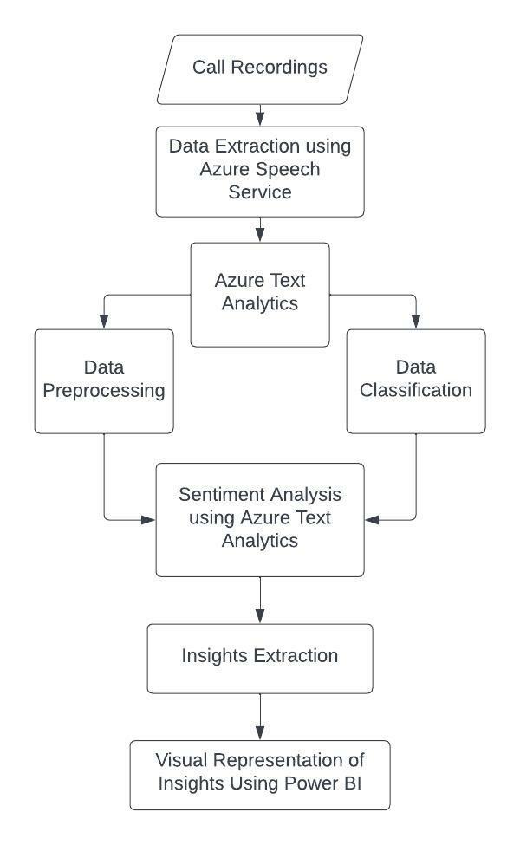
ARCHITECTURE

Slide 11
Key Differentiators & Adoption Plan
How is your solution better than alternatives and how do you plan to build adoption?
Compared to other existing softwares our product has the ability to perform sentiment analysis
on the transcripts generated from call recordings, irrespective of languages and classify users with respect to the analysis result.
The analysis result is then projected in a KPI dashboard, to help companies to understand user sentiments more efficiently.

Slide 12
GitHub Repository Link & supporting diagrams, screenshots, if any
How far it can go?
https://github.com/MuralidarRR/Team-Gryffindor---BOB-Havkathon.git

Slide 13
Thank You
Team member names
Muralidar R R (Team Lead)
Mukunthan S
Pavithraa G
Priya Dharshini R

