Slide 1
GIT HUB
www.hindujatech.com

Slide 2
Agenda
Introduction to Axure
Application Windows
Masters and Dynamic Panels
Dynamic Web pages
Global variables
Team Project
How to Run and Publish an axure Project
Reference

Slide 3
Introduction to GIT
Git allows groups of people to work on the same documents (often code) at the same time, and without stepping on each other's toes.
It's a distributed Version Control System(VCS).
Git is a command line tool

Slide 4
Introduction to Git Hub
Git hub is git repository web-based hosting service.
It offers distributed revision control and source code management functionality of git
Git hub provides a web-based graphical interface
It also provides features like access control,wikis, task management and bug tracking and feature request for every project.

Slide 5
History of Git hub
Development started in 1 Oct 2007 and was officially launched in April 2008 by Tom Preston – Werner, Chris Wanstrath, and PF Hyett
Git hub can be accessed and manipulated using standard git command-lin interface

Slide 6
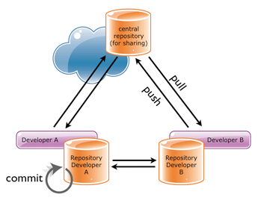
Application Window

Slide 7
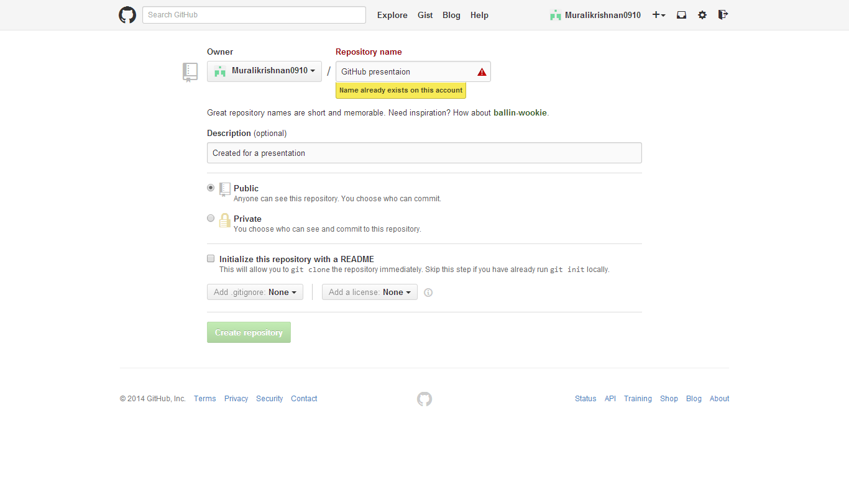

Slide 8
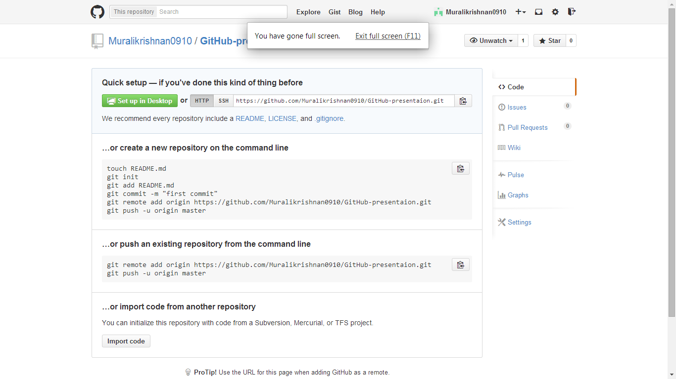

Slide 9
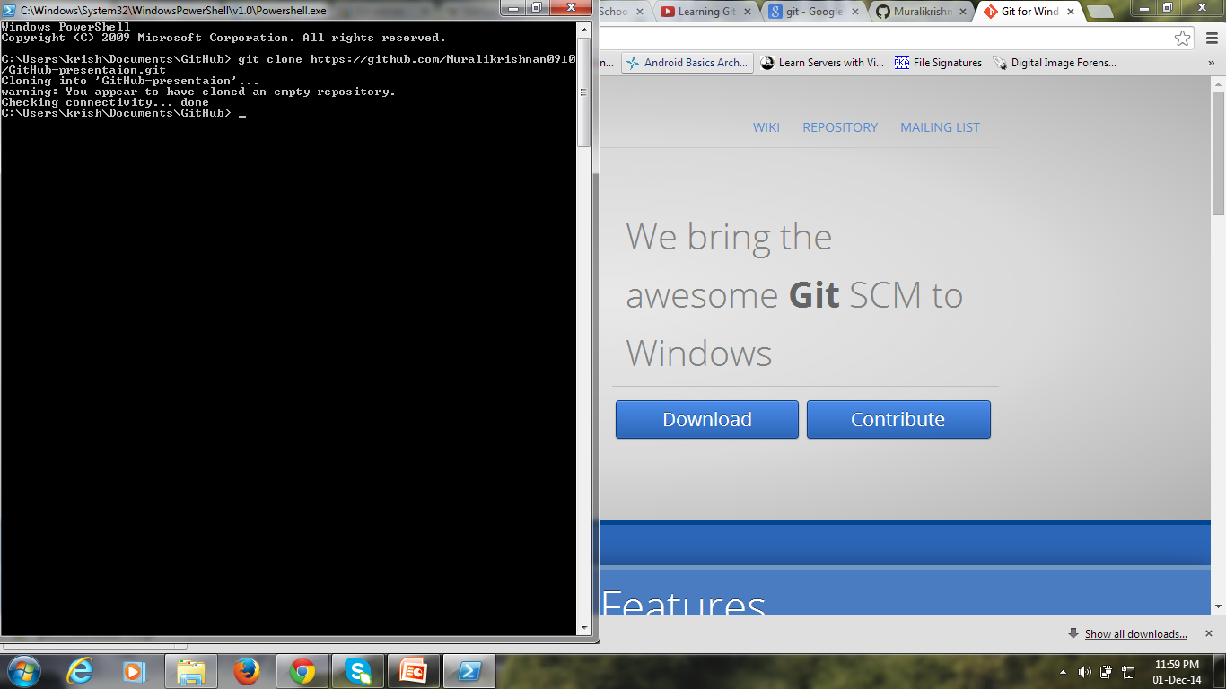

Slide 10
Download link of Git for windows
http://msysgit.github.io/

Slide 11
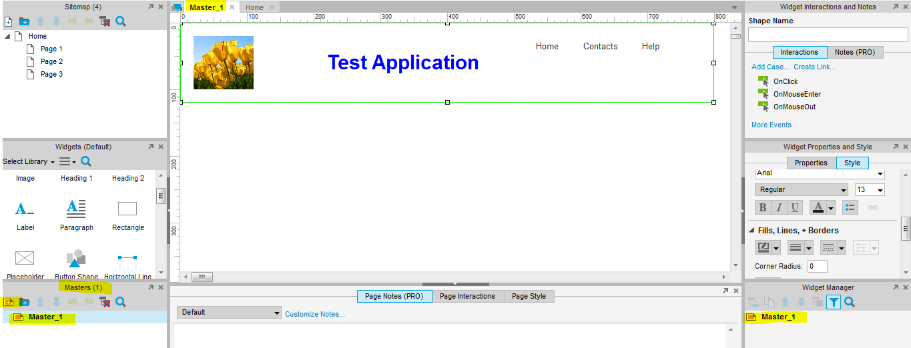
Masters
After you have created the master, you can drag and drop it in any page. It will set to the location specified in the master page.
Any changes in the master will automatically reflect in all the pages which contain the master.

Slide 12
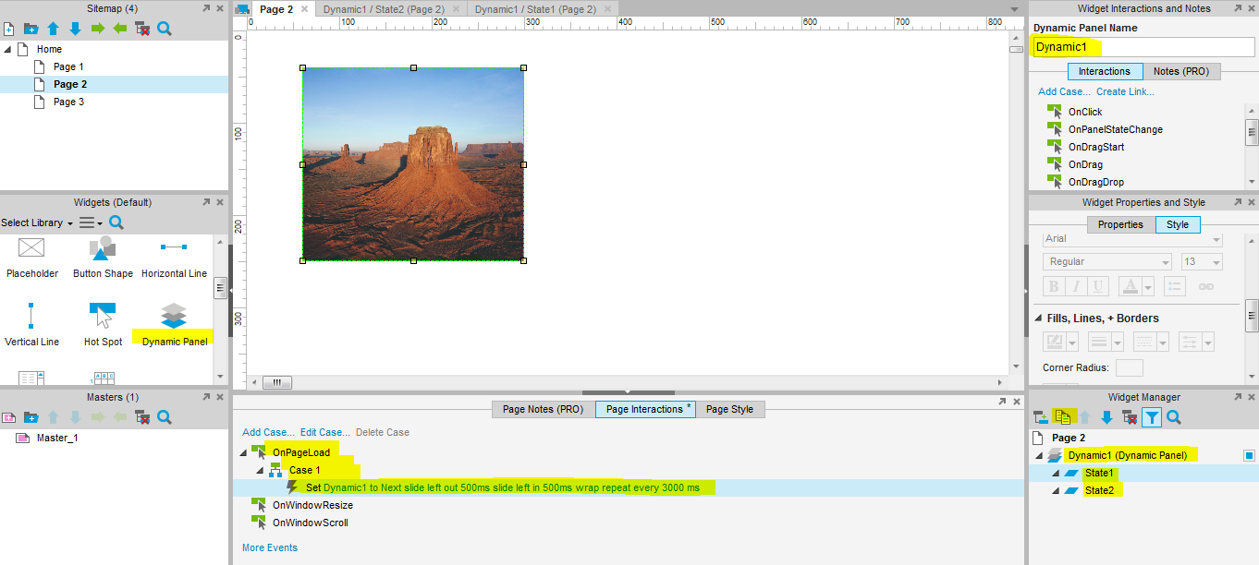
Dynamic Panels
Select a Image or any widget for which you wish to create a dynamic panel.
Cover that widget with the dynamic panel.
The interactions can also be provided for widgets.

Slide 13
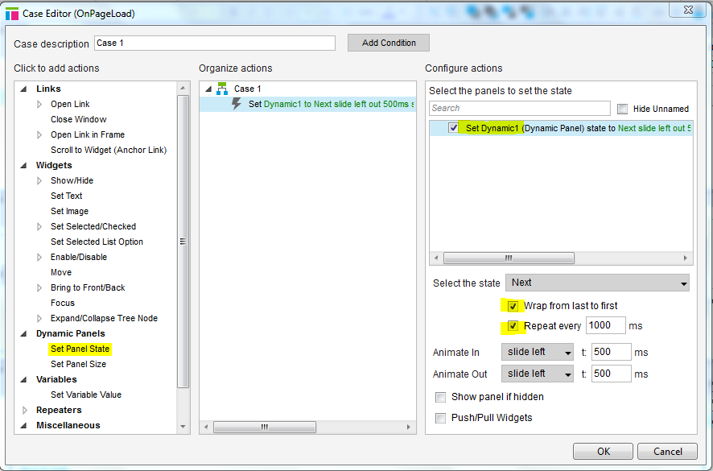
Page Interactions for Dynamic panel

Slide 14
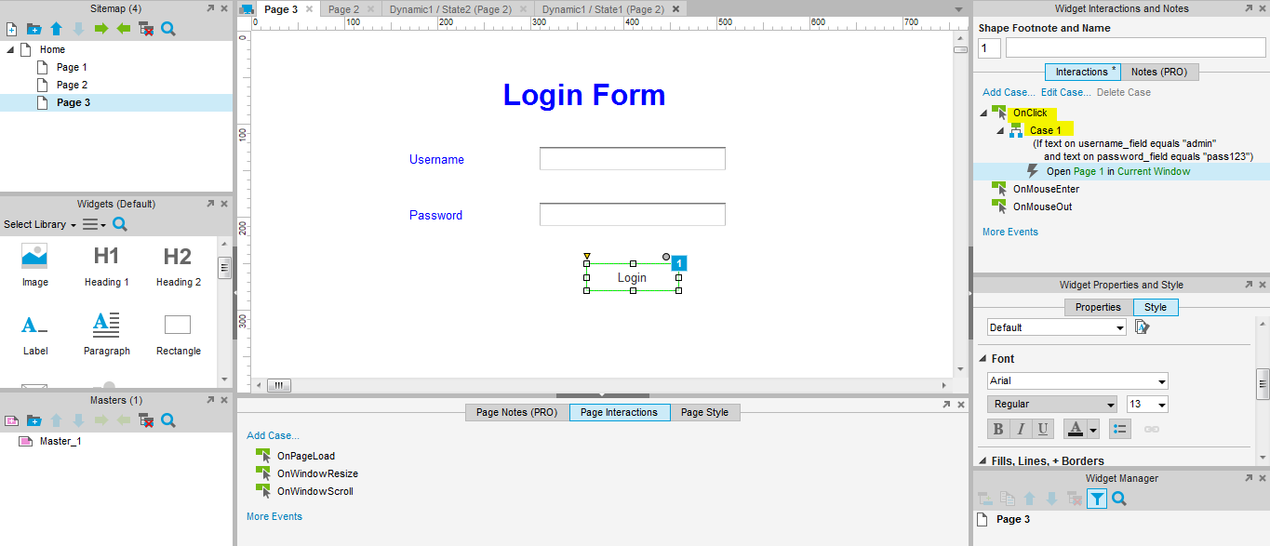
Dynamic Web Pages
Consider a basic login page with username and password authentication and then redirect to page 1

Slide 15
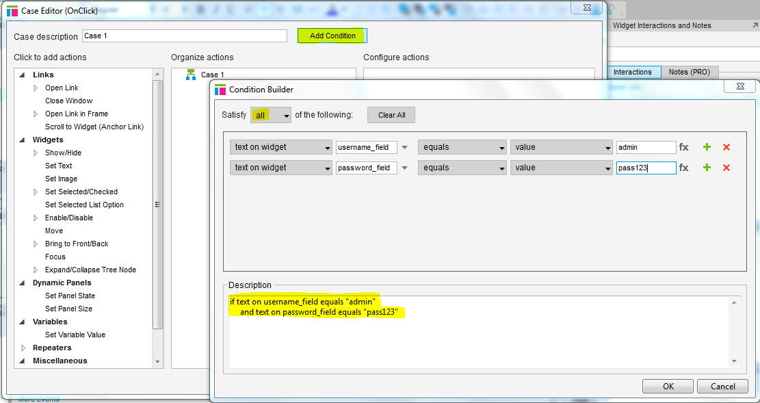
Widget Interaction

Slide 16
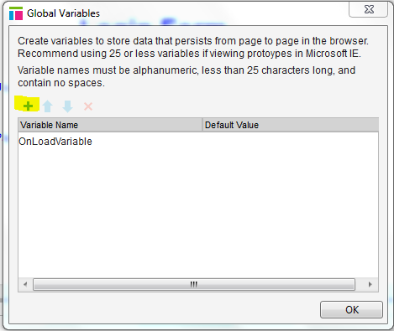
Global Variables
Global variables allows to store value in a variable and use it as and when required in some other page or in the same page.
Under “Projects” tab, Select “Global variables”

Slide 17
Team Project
Under Team (pro) tab, you can either create a new team project or get an team project created by another person.
This is similar to SVN.
We have a team directory which contains the main project and a local copy which is for our work. we can “check out” the pages which we wish to work and then “check in” to apply all changes to our main project.

Slide 18
Run and Publish Project
Under “Publish” tab, “preview” option allows to view the project created.
To publish the project to “Axure Share”, select “publish to axure share”.
If you have an “AxShare” account , then you can provide it and you will receive an URL for your project.
Else you can create an account and then generate a url for your project.
This url can shared with others and your work can be viewed by them.

Slide 19
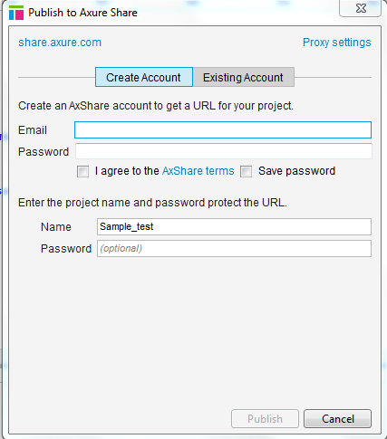
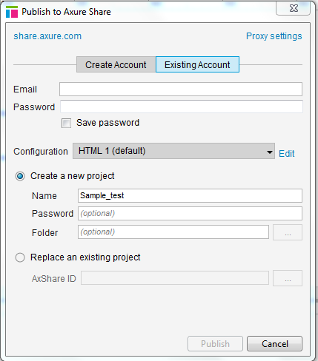
Publish to Axure Share

Slide 20
REFERENCES
https://try.github.io/levels/1/challenges/4

Slide 21

Questions???
1 December 2014
Notes:
JAXL

Slide 22

1 December 2014

