Slide 1
C Sharp

Slide 2
Making method parameters optional by specifying parameter defaults

Slide 3
Optional Parameters
public static void AddNumbers(int firstNumber, int secondNumber, int[] restOfTheNumbers = null)
{
int result = firstNumber + secondNumber;
if (restOfTheNumbers != null)
{
foreach (int i in restOfTheNumbers)
{
result += i;
}
}
Console WriteLine ("Total = " + result.ToString());
}
Optional parameters must appear after all required parameters.

Slide 4
Named Parameters
In the following method, parameters "b" & "c" are optional.
public static void Test(int a, int b = 10, int c = 20)
{
Console WriteLine("a = “ + a);
Console WriteLine("b = “ + b);
Console WriteLine("c = “ + с);
}

Slide 5
Named Parameters
When we invoke this method as shown below, "1" is passed as the argument for parameter "a" and "2" is passed as the argument for parameter "b" by default.
Test (1, 2);
My intention is to pass "2" as the argument for parameter "c". To achieve this we can make use of named parameters, as shown below. Notice that, I have specified the name of the parameter for which value "2" is being passed.
Test(1, c: 2);

Slide 6
Making method parameters optional by using Optional Attribute

Slide 7
Optional Parameters
public static void AddNumbers(int firstNumber, int secondNumber, int[] restOfTheNumbers = null)
{
int result = firstNumber + secondNumber;
if (restOfTheNumbers != null)
{
foreach (int i in restOfTheNumbers)
{
result += i;
}
}
Console WriteLine ("Total = " + result.ToString());
}

Slide 8
Code Snippets in Visual Studio

Slide 9
Code Snippets in Visual Studio
Code snippets are ready made snippets of code you can quickly insert into your code.
Keyboard shortcut: CTRL K + X
Right click and select "Insert Snippet..", from the context menu
Click on Edit – Intel license- Insert Snippet
Use code snippets short cut. For example to use "for loop" code snippet, type "for" and press TAB key twice

Slide 10
Code Snippets in Visual Studio
Once a code snippet is inserted, the editable fields are highlighted in yellow, and the first editable field is selected automatically. Upon changing the first editable field, press TAB to move to the next editable field. To come to the previous editable field use SHIFT +TAB. Press ENTER or ESC keys to cancel field editing and return the Code Editor to normal.
Code Snippet Types:
Expansion: These snippets allows the code snippet to be inserted at the cursor.
Surrounds With: These snippets allows the code snippet to be placed around a selected piece of code.
Refactoring: These snippets are used during code refactoring.

Slide 11
Surround-with Code Snippets
Surround-with snippets surrounds the selected code, with the code snippets code.
Select the code to surround, and use keyboard shortcut CTRL K + S
Select the code to surround, right click and select "Surround with.." option from the context menu
Select the code to surround, then click on Edit menu, select "IntelliSense" and then select the "Surround With" command.

Slide 12
Surround-with Code Snippets
Code snippets can be used with any type of applications that you create with visual studio. For example, you can use them with
Console applications
ASP.NET web applications
ASP.NETMVC applications etc..

Slide 13
Surround-with Code Snippets
Code snippets are available for the following languages.
C#
Visual Basic
XML
HTML
Jscript
SQL

Slide 14
Code Snippet Manager
Code Snippet Manager can be used to Add or remove code snippets. You can also find the following information about a code snippet
Description
Shortcut
Snippet Type
Author
To access code snippet manager, click on "Tools" and then select "Code Snippet Manager". Code snippets are xml files and have snippet extension.

Slide 15
What is dictionary in c#

Slide 16
dictionary in C#
A dictionary is a collection of (key, value) pairs.
Dictionary class is present in System.Collections.Generic namespace.
When creating a dictionary, we need to specify the type for key and value.
Dictionary provides fast lookups for values using keys.
Keys in the dictionary must be unique.

Slide 17
dictionary in C#
Dictionary<int, Custom> dictionaryCustomers = new Dictionary<int, Customr>();
Customr customel = new Customr () { ID = 101, Name = "Mark", Salary = 5000 };
Customr custome2 = new Customr () { ID = 102, Name = "Pam", Salary = 7000 };
Customr custome3 = new Custom () { ID = 104, Name = "Rob", Salary = 5500 };
dictionaryCustomers.Add(customr1.ID, customr1);
dictionaryCustomers.Add(customr2.ID, customr2);
dictionaryCustomers.Add(customr3.ID, customr3);
Customr customer101 = dictionaryCustomers [101];
Console WriteLine("ID = (0}, Name = {1}, Salary = (2)",
customer101. ID, customer101. Name, customer101. Salary);
foreach (KeyValuePair<int, Customr > customerKeyValuePair in dictionaryCustomers)
{
Console WriteLine("Key = " + customerKeyValuePair.Key);
Customr cust = customerKeyValuePair.Value;
Console WriteLine("ID = (0}, Name = (1}, Salary = (2)", cust.ID, cust.Name, cust.Salary);
}

Slide 18
What is dictionary in c# continued

Slide 19
dictionary in C#
TryGetValue()
Count()
Remove()
Clear()
Using LINQ extension methods with Dictionary
Different ways to convert an array into a dictionary

Slide 20
List collection class in C#

Slide 21
List collection class in C#
List is one of the generic collection classes present in System. Collections. Generic namespace. There are several generic collection classes in System. Collections.
Generic namespace as listed below.
Dictionary
List
Stack
Queue etc.

Slide 22
List collection class in C#
A List class can be used to create a collection of any type.
For example, we can create a list of Integers, Strings and even complex types.
The objects stored in the list can be accessed by index.
Unlike arrays, lists can grow in size automatically.
This class also provides methods to search, sort, and manipulate lists.

Slide 23
List collection class in C# Continued

Slide 24
List collection class in C#
Contains() function - Checks if an item exists in the list. This method returns true if the items exists, else false
Exists() function - Checks if an item exists in the list based on a condition. This method returns true if the items exists, else false
Find() function - Searches for an element that matches the conditions defined by the specified lambda expression and returns the first matching item from the list

Slide 25
List collection class in C#
FindLast() function - Searches for an element that matches the conditions defined by the specified lambda expression and returns the Last matching item from the list
FindAll() function - Returns all the items from the list that match the conditions specified by the lambda expression

Slide 26
List collection class in C#
Findindex() function - Returns the index of the first item, that matches the condition specified by the lambda expression. There are 2 other overloads of this method which allows us to specify the range of elements to search, with in the list.
FindLastindex() function - Returns the index of the last item, that matches the condition specified by the lambda expression. There are 2 other overloads of this method which allows us to specify the range of elements to search, with in the list.

Slide 27
List collection class in C#
Convert an array to a List - Use ToList() method
Convert a list to an array - Use ToArray() method
Convert a List to a Dictionary - Use ToDictionary() method

Slide 28
Working With Generic list class and ranges

Slide 29
Working With Generic list class and ranges
AddRange() - Add method allows you to add one item at a time to the end of the list, where as AddRange() allows you to add another list of items, to the end of the list.
GetRange() - Using an item index, we can retrieve only one item at a time from the list, if you want to get a list of items from the list, then use GetRange() function. This function expects 2 parameters, i.e. the start index in the list and the number of elements to return.

Slide 30
Working With Generic list class and ranges
InsertRange() – Insert() method allows you to insert a single item into the list at a specificed index, where as InsertRange() allows you, to insert another list of items to your list at the specified index.
Remove Range() – Remove() function removes only the first matching item from the list. RemoveAt() function, removes the item at the specified index in the list. RemoveAll function removes all the items that matches the specified condition. RemoveRangel() method removes a range of elements from the list. This function expects 2 parameters, i.e. the start index in the list and the number of elements to remove. If you want to remove all the elements from the list without specifying any condition, then use Clear()function.

Slide 31
Sort a list of simple types in c#

Slide 32
Sort a list of simple types
Sorting a list of simple types like int, string, char etc, is straight forward. Just invoke the sort() method on the list instance and the data will be automatically sorted in ascending order.
List<int> numbers = new List‹int› { 1, 8, 7, 5, 2, 3, 4, 9, 6 };
numbers.Sort();
If you want the data to be retrieved in descending order, use Reverse) method on the list instance.
numbers.Reverse();

Slide 33
Sort a list of simple types
However, when you do the same thing on a complex type like Customer, we get a runtime invalid operation exception - Failed to compare 2 elements in the array. This because, -NET runtime does not know, how to sort complex types. We have to tell the way we want data to be sorted in the list by implementing Comparable interface.

Slide 34
Sort a list of simple types
How is the sort functionality working for simple types like int, string, char etc.?
That is because these types (int, string, decimal, char etc.) have implemented Comparable interface already.

Slide 35
Sort a list of complex types in c#

Slide 36
Sort a list of complex types
To sort a list of complex types without using LINQ, the complex type has to implement Comparable interface and provide implementation for Compare To() method. Compare To() method returns an integer, and the meaning of the return value is shown below. RETURN VALUE is
Greater than ZERO- The current instance is greater than the object being compared with.
Less than ZERO - The current instance is less than the object being compared with.
is ZERO - The current instance is equal to the object being compared with.

Slide 37
Sort a list of complex types
Alternatively you can also invoke CompareTo() method. Salary property of the Customer object is int. CompareTo() method is already implemented on integer type, so we can invoke this method and return it's value.

Slide 38
Sort a list of complex types
public class Customer : Icomparable<Customer>
{
public int ID { get; set; }
public string Name { get; set; }
public int Salary & get; set; }
public int CompareTo(Customer obj)
{
//if (this.Salary › obj.Salary)
//return 1;
//else if (this.Salary ‹ obj.Salary)
// return -1;
//else
//return 0;
return this.Salary.CompareTo(obj.Salary);
}
}

Slide 39
Sort a list of complex types
If you prefer not to use the Sort functionality provided by the class, then you can provide your own, by implementing Comparer interface. For example, if I want the customers to sorted by name instead of salary.
Step 1: Implement Comparer interface
public class SortByName : IComparer<Customer>
{
public int Compare(Customer X, Customer y)
{
return x.Name. CompareTo(y.Name);
}
}

Slide 40
Sort a list of complex types
Step 2: Pass an instance of the class that implements Comparer interface, as an argument to the Sort method.
SortByName sortByName = new SortByName();
listCutomers.Sort(sortByName);

Slide 41
Sort a list of complex types using Comparison delegate

Slide 42
Using Comparison delegate with List <T>
(One of the overloads of the Sort) method in List class expects Comparison delegate to be passed as an argument.
public void Sort(Comparison<T > comparison);

Slide 43
Using Comparison delegate with List <T>
Approach 1:
Step 1: Create a function whose signature matches the signature of System.Comparison delegate. This is the method where we need to write the logic to compare 2 customer objects.
private static int CompareCustomers(Customer c1, Customer c2)
return c1. ID. CompareTo(c2.ID);

Slide 44
Step 2: Create an instance of System.Comparison delegate, and then pass the name of the function created in Step as the argument. So, at this point "Comparison" delegate is pointing to our function that contains the logic to compare 2 customer objects.
Comparison<Customer › customerComparer = new Comparison<Customer >(CompareCustomers);

Slide 45
Step 3: Pass the delegate instance as an argument, to Sort) function.
listCutomers.Sort(customerComparer);

Slide 46
Sort a list of complex types
Approach 2:
In Approcah1 this is what we have done
Created a private function that contains the logicto compare customers
Created an instance of Comparison delegate, and then passed the name of the private function to the delegate.
Finally passed the delegate instance to the Sort method.

Slide 47
Sort a list of complex types
Do we really have to follow all these steps. Isn't there any other way?
The above code can be simplified using delegate keyword as shown below.
listCutomers.Sort(delegate(Customer c1, Customer c2)
{
return (c1. ID.CompareTo(c2.ID));
});

Slide 48
Sort a list of complex types
Approach 3:
The code in Approach 2, can be further simplified using lambda expression as shown below.
listCutomers.Sort((cl, c2) => c1. ID.CompareTo(c2. ID));

Slide 49
Some useful methods of List collection class

Slide 50
Using Comparison delegate with List <T>
TrueForAll() - Returns true or false depending on whether if every element in the list matches the conditions defined by the specified predicate.
AsReadOnly() - Returns a read only wrapper for the current collection. Use this method, if you don't want the client code to modify the collection i.e. add or remove any elements from the collection. The ReadOnlyCollection will not have methods to add or remove items from the collection. You can only read items from this collection.

Slide 51
Using Comparison delegate with List <T>
TrimExcess() - Sets the capacity to the actual number of elements in the List, if that number is less than a threshold value.

Slide 52
Using Comparison delegate with List <T>
According to MSDN:
This method can be used to minimize a collection's memory overhead if no new elements will be added to the collection. The cost of reallocating and copying a large List<T> can be considerable. So the Trim Excess method does nothing if the list is at more than 90 percent of capacity. This avoids incurring a large reallocation cost for a relatively small gain. The current threshold is 90 percent, but this could change in the future.

Slide 53
When to use a dictionary over list in c#

Slide 54
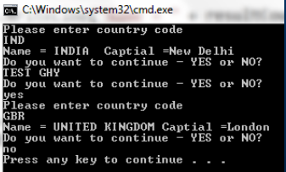
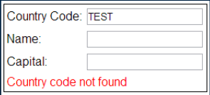
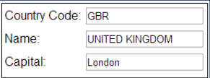
When to use a dictionary over list
Find method of the List class loops thru each object in the list until a match is found. So, if you want to lookup a value using a key dictionary is better for performance over list. So, use dictionary when you know the collection will be primarily used for lookups.

Slide 55
Generic queue collection class

Slide 56
When to use a dictionary over list
Queue is a generic FIFO (First In First Out) collection class that is present in System.Collections. Generic namespace.
The Queue collection class is analogous to a queue at the ATM machine to withdraw money. The order in which people queue up, will be the order in which they will be able to get out of the queue and withdraw money from the ATM. The Queue collection class operates in a similar fashion. The first item to be added (enqueued) to the queue, will be the first item to be removed (dequeued) from the Queue.

Slide 57
When to use a dictionary over list
To add items to the end of the queue, use Enqueue() method.
To remove an item that is present at the beginning of the queue, use Dequeue() method.
A foreach loop iterates thru the items in the queue, but will not remove them from the queue.
To check if an item, exists in the queue, use Contains() method.

Slide 58
When to use a dictionary over list
What is the difference between Dequeue and Peek() methods?
Dequeue() method removes and returns the item at the beginning of the queue, where as Peek() returns the item at the beginning of the queue, without removing it.

Slide 59
Generic stack collection class

Slide 60
Generic stack collection class
Stack is a generic LIFO (Last In First Out) collection class that is present in System.Collections. Generic namespace.
The Stack collection class is analogous toa stack of plates. If you want to add a new plate to the stack of plates, you place it on top of all the already existing plates. If you want to remove a plate from the stack, you will first remove the one that you have last added. The stack collection class also operates in a similar fashion. The last item to be added (pushed) to the stack, will be the first item to be removed (popped) from the stack.

Slide 61
Generic stack collection class
To insert an item at the top of the stack, use Push() method.
To remove and return the item that is present at the top of the stack, use Pop() method.
A foreach loop iterates thru the items in the stack, but will not remove them from the stack. The items from the stack are retrieved in LIFO (Last In First Out), order. The last element added to the Stack is the first one to be returned.
To check if an item exists in the stack, use Contains method.

Slide 62
Generic stack collection class
What is the difference between Pop() and Peek() methods?
Pop() method removes and returns the item at the top of the stack, where as Peek() returns the item at the top of the stack, without removing it.

Slide 63
Real time example of queue collection class in c#

Slide 64
Real time example - Queue
When you walk into a bank or a passport office, you will collect a token and wait in the queue for your token number to be called.
From the application perspective, when a token is issued, the token number will be added to the end of the Queue.

Slide 65
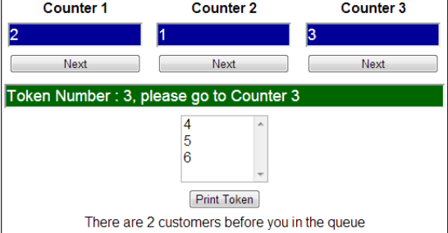
When a representative at the counter is available to server a customer, he will push the "Next“ button and the token number that is present at the beginning of the queue, will be dequeued.
So, this is one example, where a Queue collection class can be effectively used.

Slide 66
Real time example of stack collection class in c#

Slide 67
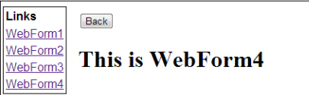
Real time example - Stack
Two common scenarios, where a stack can be used
Implementing UNDO functionality
Implementing browser back button

Slide 68
Multithreading in C#

Slide 69
Multithreading in C#
What is a Process:
Process is what the operating system uses to facilitate the execution of a program by providing the resources required. Each process has a unique process Id associated with it. You can view the process within which a program is being executed using windows task manager.

Slide 70
Multithreading in C#
What is Thread:
Thread is a light weight process. A process has at least one thread which is commonly called as main thread which actually executes the application code. A single process can have multiple threads.
Please Note: All the threading related classes are present in System. Threading namespace.

Slide 71
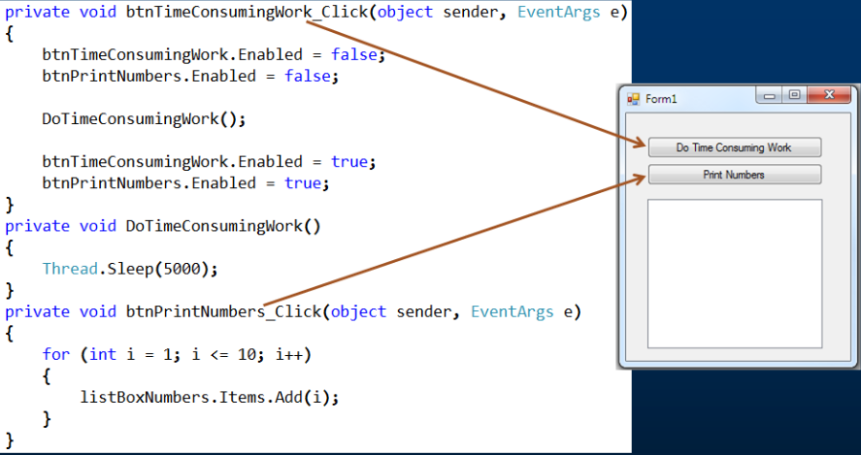
Simple multithreading example

Slide 72
Advantages and Disadvantages of multithreading

Slide 73
Advantages
Advantages of multithreading:
To maintain a responsive user interface
To make efficient use of processor time while waiting for 1/0 operations to complete
To split large, CPU-bound tasks to be processed simultaneously on a machine that has multiple processors/ cores

Slide 74
Disadvantages
Disadvantages of multithreading:
On a single processor/core machine threading can affect performance negatively as there is overhead involved with context-switching
Have to write more lines of code to accomplish the same task
Multithreaded applications are difficult to write, understand, debug and maintain

Slide 75
ThreadStart delegate

Slide 76
ThreadStart Delegate
class Program
{
public static void Main()
{
Thread T1 = new Thread(Number PrintNumbers);
T1. Start();
}
}
class Number
{
public static void PrintNumbers()
{
for (int i = 1; i <= 10; i++)
{
Console WriteLine(i);
}
}
}
To create a THREAD, create:
instance of Thread class anc
it's constructor pass the nan
of the function that we want
thread to execute.

Slide 77
ThreadStart Delegate
Thread T1 = new Thread(Number PrintNumbers);
T1.Start();
We can rewrite the above line using ThreadStart delegate as shown below
Thread T1 = new Thread(new ThreadStart(Number.PrintNumbers));
T1.Start();

Slide 78
ThreadStart Delegate
Why a delegate need to be passed as a parameter to the Thread class constructor?
The purpose of creating a Thread is to execute a function. A delegate is a type safe function pointer, meaning it points to a function that the thread has to execute. In short, all threads require an entry point to start execution. Any thread you create need an explicitly defined entry point i.e. a pointer to the function where they shou begin execution. So threads always require a delegate.

Slide 79
ThreadStart Delegate
In the code below, we are not explicitly creating the ThreadStart delegate, then ho is it working here?
Thread T1 = new Thread(Number .PrintNumbers);
T1. Start();

Slide 80
ThreadStart Delegate
We can also rewrite the same line using delegate() Keyword
Thread T1 = new Thread(delegate() { Number.PrintNumbers();
The same line rewritten using lambda expression
Thread T1 = new Thread(© => Number.PrintNumbers));
class Program{
public static void Main(){
Number number = new Number();
Thread T1 = new Thread(number .PrintNumbers);
T1. Start();
}
}
class Number (
public void PrintNumbers(){
for (int i = 1; i <= 10; i++){
Console. WriteLine(i);
}
}
}
Thread function need not be
static function always. It can
also be a non static function
case of non-static function w
have to create an instance o
the class.

Slide 81
Parameterized ThreadStart delegate

Slide 82
Parameterized ThreadStart Delegate
Please note:
Using Parameterized ThreadStart delegate and Thread Start(Object) method to pass data to the Thread function is not type safe as they operate on object datatype and any type of data can be passed.
If you try to change the data type of the target parameter of PrintNumbers() function from object to int, a compiler error will be raised as the signature of PrintNumbers() function does not match with the signature of Parameterized ThreadStart delegate.

Slide 83
Passing data to the Thread function in a type safe manner

Slide 84
Passing data to the Thread fuction
To pass data to the Thread function in a type safe manner, encapsulate the thread function and the data it needs in a helper class and use the ThreadStart delegate to execute the thread function.
class Number{
int_target;
public Number(int target){
this._target - target;
}
public void PrintNumbers(){
for (int i = 1; i <=_ target; i++){
Console.WriteLine(1);
}
}
}
class Program{
public static void Main(){
Console WriteLine("Please enter the target number");
int target = Convert. Tolnt32(Console.ReadLine());
Number number = new Number (target);
Thread T1 = new Thread(new ThreadStart(number PrintNumbers));
T1. Start();
}
}

Slide 85
Retrieving data from Thread function using callback method

Slide 86
Callback method to get data from thread
Example:
Main thread retrieves the target number from the user.
Main thread creates a child thread and pass the target number to the child thread.
The child thread computes the sum of numbers and then returns the sum to the Main thread using callback function.
The callback method prints the sum of numbers
Please enter the target number
5
Sum of numbers is 15

Slide 87
Callback method to get data from thread
Step 1:
Create a callback delegate. The actual callback method signature should match with the signature of this delegate.
public delegate void SumOfNumbersCallback(int sumOfNumbers);

Slide 88
Callback method to get data from thread
Step 2:
Create a helper class to compute the sum of numbers and to call the callback method

Slide 89
Step 2:
Class Number
{
int_target;
SumOfNumbersCallback _callbackMethod;
public Number(int target, SumOfNumbersCallback callbackMethod){
this._target = target;
this._callbackMethod = callbackMethod;
}
public void ComputeSumOfNumbers(){
int sum = 0;
for (int i = 1; i <=_ target; i++){
sum = sum + i;
}
if (_callbackMethod != null)
_callbackMethod (sum) ;
}
}

Slide 90
Callback method to get data from thread
Step 3:
This class consumes the Number class created in step 2

Slide 91
Step 3:
class Program
{
public static void PrintSumOfNumbers(int sum)
{
Console WriteLine("Sum of numbers is" + sum);
}
public static void Main()
{
Console WriteLine("Please enter the target number");
int target = Convert. ToInt32(Console.ReadLine());
SumOfNumbersCallback callbackMethod = new SumOfNumbersCallback(PrintSumOfNumbers).
Number number = new Number(target, callbackMethod);
Thread T1 = new Thread(new ThreadStart(number .ComputeSumOfNumbers) );
T1.StartO;
}
}

Slide 92
Significance of Thread.Join and Thread.IsAlive functions

Slide 93
Thread.Join & Thread.IsAlive functions
Join blocks the current thread and makes it wait until the thread on which Join method is invoked completes. Join method also has a overload where we can specify the timeout. If we don't specify the timeout the calling thread waits indefinitely, until the thread on which Join is invoked completes. This overloaded Join(int millisecondsTimeout) method returns boolean. True if the thread has terminated otherwise false.

Slide 94
Thread.Join & Thread.IsAlive functions
Join is particularly useful when we need to wait and collect result from a thread execution or if we need to do some clean-up after the thread has completed.
IsAlive returns boolean. True if the thread is still executing otherwise false.

Slide 95
Protecting shared resources from concurrent access in multithreading

Slide 96
Protecting Shared Resources
What happens if shared resources are not protected from concurrent access in multithreaded program?
The output or behavior of the program can become inconsistent if the shared resources are not protected from concurrent access in multithreaded program

Slide 97
class Program{
static int Total = 0;
public static void Main() {
AddOneMillion();
AddOneMillion();
AddOneMillion();
Console WriteLine("Total = “ + Total);
}
public static void AddOneMillion(){
for (int i = 1; i <= 1000000; i++){
Total++;
}
}
}
This program is a single-threaded program. In the Main() method, AddOneMillion() method is called 3 times, and it updates the Total field correctly as expected, and finally prints the correct total i.e. 3M.

Slide 98
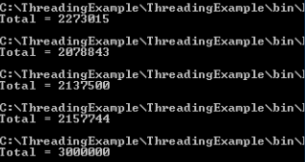
Protecting Shared Resources
class Program{
static int Total = 0;
public static void Main(){
Thread thread1 = new Thread(Program.AddOneMillion);
Thread thread2 = new Thread(Program.AddOneMillion);
Thread thread3 = new Thread(Program.AddOneMillion);
thread1. Start(); thread2.Start(); thread. Start();
thread1. Join(); thread2.Join(); thread3.Join();
Console WriteLine("Total = " + Total);
}
public static void AddOneMillion(){
for (int i = 1; i <= 1000000; i++){
Total++;
}
}
}

Slide 99
Protecting Shared Resources
Using Interlocked.Increment method: Increments a specified variable and stores the result. as an atomic operation.
public static void AddOneMillion(){
for (int i = 1; i <= 1000000; i++){
Total++;
}
}
public static void AddOneMillion(){
for (int i = 1; i <= 1000000; i++){
Intelocked.increment(ref Total);
}
}
Locking:
static object _lock = new object();{
public static void AddOneMillion(){
for (int i = 1; i <= 1000000; i+){
lock (_lock){
Total++;
}
}
}

Slide 100
Protecting Shared Resources
Which option is better?
From a performance perspective using Interlocked class is better over using locking. locks out all the other threads except a single thread to read and increment the Total variable. This will ensure that the Total variable is updated safely. The downside is that since all the other threads are locked out, there is a performance hit.
The Interlocked class can be used with addition/subtraction (increment, decrement, add,etc.) on and int or long field. The Interlocked class has methods for incrementing,decrementing, adding, and reading variables atomically.

Slide 101
Protecting Shared Resources
The following code prints the time taken in ticks.1 millisecond consists of 10000 ticks.
public static void Main(){
Stopwatch stopwatch = Stopwatch.StartNew();
Thread threadl = new Thread (Program.AddOneMillion);
Thread thread2 = new Thread (Program.AddOneMillion);
Thread thread3 = new Thread(Program.AddOneMillion);
thread1. Start(); thread2. Start(); thread3.Start();
thread1. Join(); thread2. Join; thread3. Join();
Console WriteLine("Total = " + Total);
stopwatch. Stop();
Console WriteLine("Time Taken in Ticks = " + stopwatch.ElapsedTicks);
}

Slide 102
Difference between Monitor and lock in C#

Slide 103
Monitor v/s lock
Both Monitor class and lock provides a mechanism that synchronizes access to objects. lock is the shortcut for Monitor. Enter with try and finally

Slide 104
Monitor v/s lock
static object _lock = new object);
public static void AddOneMillion()
{
for (int i = 1; i <= 1000000; i++)
{
lock (_lock)
{
Total++;
}
}
}
static object _lock = new object);
public static void AddOneMillion()
{
for (int i = 1; i <= 1000000; i++)
{
Monitor. Enter(_lock)
try
{
Total++;
}
finally
{
Monitor. Exit(_lock)
}
}
}

Slide 105
Monitor v/s lock
In C# 4,it is implement slightly differently
static object _lock = new object();
public static void AddOneMillion(){
for (int i = 1; i <= 1000000; i++){
bool lockTaken = false;
Monitor. Enter(_lock,ref lockTaken);
try{
Total++;
}
finally{
if (lockTaken)
Monitor. Exit(_lock);
}
}
}
So, in short, lock is a shortcut and it's the option for the basic usage. If you need more control to implement advanced multithreading solutions using TryEnter() Wait(). Pulse(). & PulseAll() methods. then the Montior class is your option.

Slide 106
Deadlock in a multithreaded program

Slide 107
Deadlocks
When a deadlock can occur
Let's say we have 2 threads
Thread 1
Thread 2
and 2 resources
Resource 1
Resource 2

Slide 108
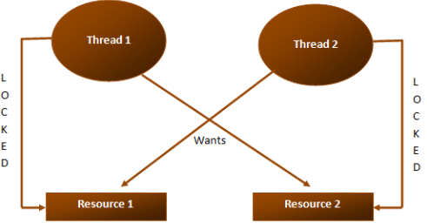
Deadlocks
Thread 1 has already acquired a lock on Resource 1 and wants to acquire a lock on Resource 2. At the same time Thread 2 has already acquired a lock on Resource 2 and wants to acquire a lock on Resource 1.
Two threads never give up their locks, hence a deadlock

Slide 109
Deadlocks
public class Account
{
double_balance; int_id;
public Account(int id, double balance)
{
this._id = id; this._balance = balance;
}
public int ID
{
get { return_id; }
}
public void Withdraw(double amount)
{
_balance -= amount;
}
public void Deposit(double amount)
{
balance += amount;
}
}

Slide 110
Deadlocks
public class AccountManager{
Account _fromAccount; Account _toAccount; double
_toAccount; double _amountToTransfer;
public AccountManager(Account fromAccount, Account toAccount, double amountToTransfer){
this._fromAccount = fromAccount;
this._toAccount = toAccount;
this._amountToTransfer = amountToTransfer;
}
public void Transfer(){
lock (_fromAccount){
Thread. Sleep (1000);
lock (_toAccount){
_fromAccount.Withdraw(_amountToTransfer);
_toAccount. Deposit (_amountToTransfer);
}
}
}
}

Slide 111
How to resolving deadlocks in a multithreaded program

Slide 112
Resolving Deadlocks
There are several techniques to avoid and resolve deadlocks. For example
Acquiring locks in a specific defined order
Mutex class
Monitor.TryEnter method
we will discuss, acquiring locks in a specific defined order to resolve a deadlock.

Slide 113
Resolving Deadlocks
public void Transfer()
{
lock (_fromAccount)
{
Thread. Sleep (1000);
lock (_toAccount)
{
_fromAccount.Withdraw(_amount
_toAccount. Deposit(_amountTo
}
}
}

Slide 114
Resolving Deadlocks
public void Transfer(){
object_lock1, _lock2;
if (_fromAccount. ID < _toAccount. ID){
_lock1 = _fromAccount; _lock2 = _toAccount;
}
else{
_lock1 = _toAccount; _lock2 = _fromAccount;
}
lock (_lock1){
Thread. Sleep(1000);
lock (_lock2){
_fromAccount.Withdraw(_amountToTransfer);
_toAccount. Deposit (_amountToTransfer);
}
}
}

Slide 115
Resolving Deadlocks
AccountManager accountManagerA = new AccountManager (accountA, accountB, 1000);
Thread T1 = new Thread(accountManagerA. Transfer);
AccountManager accountManagerB = new AccountManager(accountB, accountA, 2000);
Thread T2 = new Thread(accountManagerB. Transfer);

Slide 116
Performance implications of a multithreaded program

Slide 117
Performance of a multithreaded program
Performance of a multithreaded program when run on a program
Single core
Processor machine versus multi core
Processor machine

Slide 118
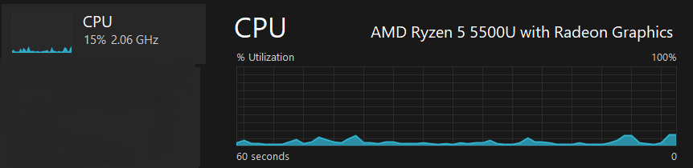
Performance implications
How to find out how many processors you have on your machine
UsingTaskManager

Slide 119
Performance implications
Use the following code in any .net application
Environment.ProcessorCount
On the windows command prompt window, type the following
echo %NUMBER_OF_PROCESSORS%

Slide 120
Performance implications
On a machine that has multiple processors, multiple threads can execute application code in parallel on different cores. For example, if there are two threads and two cores, then each thread would run on an individual core. This means, performance is better.
If two threads take 10 milli-seconds each to complete, then on a machine with 2 processors, the total time taken is 10 milli-seconds.

Slide 121
Performance implications
On a machine that has a single processor, multiple threads execute, one after the other or wait until one thread finishes. It is not possible for a single processor system to execute multiple threads in parallel. Since the operating system switches between the threads so fast, it just gives us the illusion that the threads run in parallel. On a single core/processor machine multiple threads can affect performance negatively as there is overhead involved with context-switching.

Slide 122
Performance implications
If two threads take 10 milli-seconds each to complete, then on a machine with 1 processor, the total time taken is 20 milli-seconds + (Thread context switching time, if any)

Slide 123
Anonymous methods in c#

Slide 124
Anonymous methods
What is an anonymous method?
Anonymous method is a method without a name. Introduced in C# 2, they provide us a way of creating delegate instances without having to write a separate method.

Slide 125
Anonymous methods
// Step 1: Create a method whose signature matches
// with the signature of Predicate‹Employee> delegate
private static boolFindEmployee(Employee,Emp)
{
return Emp.ID == 102;
}

Slide 126
Anonymous methods
// Step 2: Create an instance of Predicate‹Employee> delegate and pass the
// method name as an argument to the delegate constructor
Predicate‹Employee> predicateEmployee = new Predicate<Employee>(FindEmployee);

Slide 127
Anonymous methods
// Step 3: Now pass the delegate instance as the argument for Find() method
Employee employee - listEmployees.Find(x => predicateEmployee(x));
Console WriteLine("ID = (0}, Name (1}", employee. ID, employee Name);

Slide 128
// Anonymous method is being passed as an argument to the Find() method
// This anonymous method replaces the need for Step 1, 2 and 3
employee = listEmployees.Find(delegate(Employee x) { return x.ID == 102; });
Console WriteLine("ID = {0}, Name {1}", employee. ID, employee. Name);

Slide 129
Anonymous methods
Private void Form1_Load(Object sender, EventArgs e)
{
Button Buttoni = new Button();
Button1. Text = "Click Me";
Button1.Click += new EventHandler (Button1_Click);
this.Controls.Add(Button1);
}
void Button1_Click(object sender, EventArgs e){ Anonymous Method
MessageBox. Show("Button Clicked");
}
private void Forml_Load(object sender, EventArgs e)
{
Button Buttoni = new Button;
Button1. Text = "Click Me";
Button1.Click += delegate(object obj, EventArgs eventArgs)
{
MessageBox Show("Button Clicked");
};
this.Controls.Add(Button1);
}

Slide 130
Anonymous methods
With anonymous Methods delegate parameters are optional. This means the below code
Button1. Click += delegate(object obj,EventArgseventArgs)
{
MessageBox.Show("Button Clicked");
};
can be rewritten as shown below
Button1. Click += delegate
{
MessageBox.Show( "Button Clicked");
};

Slide 131
Lambda expression in c#

Slide 132
Lambda Expressions
What are Lambda expressions?
Anonymous methods and Lambda expressions are very similar. Anonymous methods were introduced in C# 2 and Lambda expressions in C# 3.

Slide 133
Lambda Expressions
To find an employee with Id - 102, using anonymous method
Employee employee = listEmployees.Find(delegate(Employee Emp)
{ return Emp.ID == 102; });
To find an employee with id - 102, using lambda expression
Employee employee = listEmployees. Find(Emp => Emp.ID == 102);

Slide 134
Lambda Expressions
You can also explicitly specify the Input type but not required
Employee employee = listEmployees.Find((Employee Emp) => Emp.ID == 102);

Slide 135
Lambda Expressions
=> Is called lambda operator and read as GOES TO. Notice that with a Lambda expression you don't have to use the delegate keyword explicitly and don't have to specify the input parameter type explicitly. The parameter type is inferred. Lambda expressions are more convenient to use than anonymous methods. Lambda expressions are particularly helpful for writing LINQ query expressions.

Slide 136
Lambda Expressions
In most of the cases Lambda expressions supersedes anonymous methods. To my knowledge, the only time I prefer to use anonymous methods over lambdas is, when we have to omit the parameter list when it's not used within the body.
Anonymous methods allow the parameter list to be omitted entirely when it's not used within the body, where as with lambda expressions this is not the case.
For example, with anonymous method notice that we have omitted the parameter list as we are not using them within the body

Slide 137
Button1.Click += delegate
{
MessageBox. Show("Button Clicked");
}
The above code can be rewritten using lambda expression as shown below. Notice that with lambda we cannot omit the parameter list.
Button1.Click += (eventSender, eventAgrs) =›
{
MessageBox.Show("Button Clicked");
}

Slide 138
Func Delegate in c#

Slide 139
Func Delegate
What is Func<T, TResult> in C#?
In simple terms, Func<T, TResult> is just a generic delegate. Depending on the requirement, the type parameters (T and TResult) can be replaced with the corresponding type arguments.
For example, Func <Employee, string> is a delegate that represents a function expecting Employee object as an input parameter and returns a string.

Slide 140
Func Delegate
Public class Employee
{
Public int ID { get; set; }
public string Name { get; set; }
}
List< Employee >listEmployees = new List< Employee>()
{
new Employee{ ID = 101, Name =“Mark”},
new Employee{ ID = 102, Name =“john”},
new Employee{ ID = 103, Name =“Mary”},
};
Func<Employee, string> selector = employee => "Name = " + employee .Name;
IEnumerable<string> names = listEmployees.Select(selector);
foreach (string name in names)
{
Console.WriteLine (name);
}
Name = Mark
Name = John
Name = Mary
// Lambda expression can also be used to achieve the same thing
IEnumerable<string> names = listEmployees.Select (employee => "Name = " + employee .Name);

Slide 141
Func Delegate
What is the difference between Func delegate and lambda expression?
They're the same, just two different ways to write the same thing. The lambda syntax is newer, more concise and easy to write.

Slide 142
Func Delegate
What if I have to pass two or more input parameters?
As of this recording there are 17 overloaded versions of Func, which enables us to pass variable number and type of input parameters. In the example below, Func<int, int, string> represents a function that expects 2 int input parameters and returns a string.

Slide 143
Func Delegate
class Program
{
public static void Main()
{
Func<int, int, string> funcDelegate = (firstNumber, secondNumber) =>
"Sum = " + (firstNumber + secondNumber). ToString();
string result = funcDelegate(10, 20);
Console. WriteLine(result);
}
}

Slide 144
Async and await in c#

Slide 145
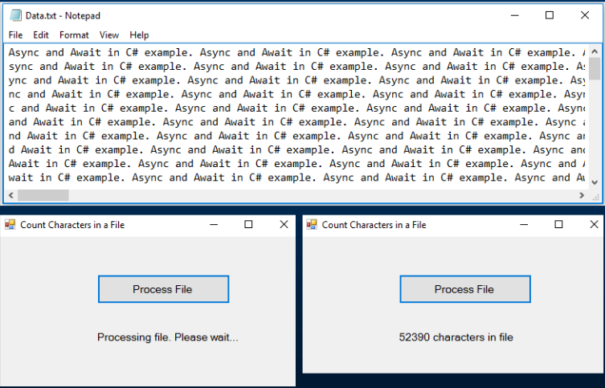
Async and await in c# example

Slide 146
Blocking example
private int CountCharacters ()
{
int count = 0;
using (StreamReader reader = new StreamReader ("C:\\Data\\Data.txt"))
{
string content = reader .ReadToEnd();
count = content. Length;
Thread. Sleep (5000);
}
return count;
}
private void btnProcessFIle_Click(object sender, EventArgs e)
{
1blCount. Text = "Processing file. Please wait...";
int count = CountCharacters);
1blCount. Text = count. ToString() + " characters in file";
}

Slide 147
Non - Blocking Example – async & await
private int CountCharacters)
{
int count = 0;
using (StreamReader reader = new StreamReader ("C: \\Data\ (Data.txt"))
{
string content = reader .ReadToEnd() ;
count = content. Length;
Thread.Sleep (5000);
}
return count;
}
private async void btnProcessFIle_Click(object sender, EventArgs e)
{
Task<int> task = new Task<int>(CountCharacters);
task. Start);
1blCount. Text = "Processing file. Please wait...";
int count = await task;
1blCount. Text = count. ToString() + " characters in file";
}

Slide 148
How to wait for a thread to finish without blocking

Slide 149
Wait for thread to finish without blocking
// Task, async & await keywords
private async void benProcessFile_Click(object sender, EventArgs e)
{
Task<int> task = new Task‹int>(CountCharacters);
task.Start();
1blCount.Text = "Processing file. Please wait...";
int count = await task;
1blCount.Text = count.ToString() + " characters in file";
}
// Using a Thread
private void btnProcessFile_Click(object sender, EventArgs e)
{
int count = 0;
Thread thread = new Thread (() =› { count = CountCharacters (); });
thread.Start;
1blCount. Text = "Processing file. Please wait....":
1blCount. Text = count.ToString()+“Characters in file":
}

Slide 150
Wait for thread to finish without blocking
// Using a Thread
private void btnProcessFile_Click(object sender, EventArgs e)
{
int count = 0;
Thread thread = new Thread(() =› { count = CountCharacters); }).
thread.Start);
1blCount. Text = "Processing file. Please wait...";
// Join() blocks the Main thread (UI Thread)
thread. Join();
1blCount. Text = count. ToString() + " characters in file";
}

Slide 151
Wait for thread to finish without blocking
// Using a Thread
private void btnProcessFile_Click(object sender, EventArgs e)
{
int count = 0;
Thread thread = new Thread =>
{
count = CountCharacters);
// This is dangerous
1blCount. Text = count.ToString() + " characters in file";
}) ;
thread. Start();
1blCount. Text = "Processing file. Please wait...";
}

Slide 152
Wait for thread to finish without blocking
// Using a Thread
private void btnProcessFile_Click(object sender, EventArgs e)
{
int count = 0;
Thread thread = new Thread(() =>
{
count = CountCharacters);
Action action = () => IblCount. Text = count.ToString() + " characters in file";
this.BeginInvoke(action);
});
thread. Start);
1blCount. Text = "Processing file. Please wait...";
}

Slide 153
Wait for thread to finish without blocking
// SetLabelTextProperty() method needs access to this variable,
// so we moved it out of btnProcessFile_Click() method
int characterCount = 0;
private void btnProcessFile_Click(object sender, EventArgs e)
{
Thread thread = new Thread(© =>
{
characterCount = CountCharacters);
// Action delegate points to SetLabelTextProperty method
// Signature of SetLabelTextProperty() method should match
// with the signature of Action delegate
Action action = new Action(SetLabelTextProperty);
this.BeginInvoke(action);
}) ;
thread. Start() ;
1blCount. Text = "Processing file. Please wait...";
}
private void SetLabelTextProperty)
{
IbiCount. Text = characterCount. ToString() + " characters in file";
}

