Slide 1

Speech Emotion Recognition
By
2211CS050058 L.Murari
Under the Guidance of
K.Rashmi
Department of IOT
School of Engineering
Malla Reddy University
Hyderabad, Telangana, INDIA

Slide 2
ABSTRACT
The Speech Emotion Recognition (SER) project focuses on developing a machine learning-based system that accurately identifies and classifies human emotions from vocal inputs. This system leverages advanced acoustic analysis and machine learning techniques to process and interpret emotional content in speech. Key features such as pitch, intensity, and speech rate are extracted from audio samples and fed into various algorithms, including Support Vector Machines (SVM), Random Forests, and Naive Bayes. The model is trained on diverse emotional datasets, ensuring versatility in handling different languages and accents. To enhance the precision of emotion detection, the project integrates feature selection methods and ensemble learning techniques to refine the model's performance.
In addition to emotion classification, the system provides graphical representations of emotional trends and generates text scripts from the audio, offering a comprehensive understanding of emotional nuances. Applications of this technology include enhancing human-computer interaction in virtual assistants, improving customer service through emotion-aware responses, and equipping mental health professionals with tools for assessing emotional states more effectively. The long-term vision encompasses real-time emotion recognition and adaptation, contributing to more intuitive and empathetic user experiences across various domains.

Slide 3
1. Introduction
1.1 Problem Definition:
In previous attempts to build a Speech Emotion Recognition (SER) system with speech-to-text functionality, several challenges were encountered that hindered the accuracy and usability of the models. One major issue was the inconsistent quality of feature extraction from audio files, leading to inaccurate emotion classification. Features such as MFCCs, chroma, and mel-spectrograms were sometimes not sufficiently robust across various speakers, languages, and recording conditions, causing the machine learning models to perform poorly, particularly with diverse accents and emotions. There were difficulties with GUI integration, where models did not seamlessly interact with the Tkinter interface, causing lag or failure to display the results. These issues highlight the need for better noise handling, improved feature robustness, and model generalization in future iterations.
Problem Description
The project aims to develop an integrated Speech Emotion Recognition (SER) and speech-to-text system using machine learning models. The goal is to accurately predict human emotions from audio inputs while simultaneously transcribing speech into text. A Tkinter-based GUI enables users to upload audio files, visualize their spectrograms, predict emotions, and obtain textual transcripts. The main objective is to build a robust and user-friendly application that can be applied in areas such as human-computer interaction, emotion analysis, and assistive technologies, with a focus on improving model accuracy, feature extraction, and handling diverse speech conditions and accents.

Slide 4
1. Introduction
1.2 Objectives of the Project
The objective of this project is to develop a reliable and adaptable Speech Emotion Recognition (SER) system that can accurately identify and classify emotions from both recorded audio and live voice inputs. This project leverages machine learning algorithms such as Support Vector Machines, Random Forest, and Naive Bayes to enhance emotion detection precision. The system is designed to handle diverse languages and accents, ensuring broad applicability and robust performance. Additionally, the project provides a dual-output approach, delivering both emotion classification and speech transcription for a comprehensive understanding of verbal and emotional contexts in communication. By incorporating live voice input functionality, the system allows for real-time emotional insights, which is particularly valuable for applications in virtual assistance, customer service, and mental health, where understanding user emotions can enrich interactions and user experiences.
1.3 Aim
The aim of this project is to design and implement a Speech Emotion Recognition (SER) system capable of accurately identifying and classifying emotions from vocal inputs, including live voice data, to facilitate more natural and responsive human-computer interactions. the system aims to enhance communication by providing both emotional classification and textual transcription, which offers insights into the emotional and verbal content of speech.

Slide 5
2. Methodology
Data Collection and Preprocessing: The project begins by gathering audio datasets that contain diverse emotional expressions, ensuring variability in accents, languages, and tonal patterns.
Feature Extraction: In this phase, critical acoustic features such as Mel Frequency Cepstral Coefficients (MFCC), chroma, and Mel spectrograms are extracted from each audio sample.
Live Voice Input Integration: A key part of the project is the real-time processing of live voice input. Using live audio capture, the system applies preprocessing and feature extraction in real time, allowing for immediate emotion classification.
Emotion Classification and Speech Transcription: The trained model is deployed to classify emotions from both recorded and live audio inputs. In addition to emotion detection, a speech-to-text module transcribes the spoken content, providing a comprehensive analysis of both emotional and verbal information from the audio.
Visualization and User Interface: Finally, graphical representations of emotional trends are generated, and a user-friendly interface is developed using Tkinter, allowing users to upload audio files, view emotion predictions, and access transcriptions.

Slide 6
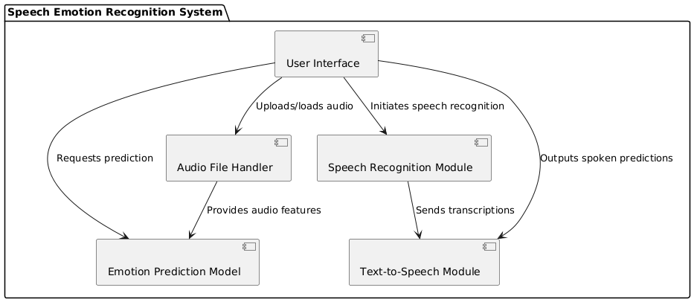
2. Methodology

Slide 7
3. Technologies
The key technologies used in the application include:
Python: The primary programming language used for implementing the entire SER system, Python's simplicity and extensive library support make it ideal for data manipulation and machine learning tasks.
Tkinter: This standard GUI toolkit for Python is employed to create the user interface of the SER system.
Librosa: This library is crucial for audio analysis and feature extraction. It provides tools to process audio files, extract relevant features like Mel Frequency Cepstral Coefficients (MFCC), chroma features, and mel spectrograms.
Scikit-learn: A comprehensive machine learning library that offers a range of algorithms for classification, regression, and clustering.
Speech Recognition Library (SpeechRecognition): This library enables the conversion of spoken language into text. It integrates with various speech recognition APIs to provide transcription capabilities, allowing the system to interpret and display spoken content alongside emotion detection.
Real-time Audio Capture Tools: Various libraries or tools that support capturing live audio inputs are integrated to enable the real-time functionality of the SER system, allowing it to process and classify emotions from ongoing speech interactions.

Slide 8
4. Requirements
4.1 Hardware Requirements
Processor : A modern multi-core processor (e.g., Intel i5 or AMD Ryzen 5) to handle data processing and machine learning model training efficiently.
Memory (RAM) : At least 4GB of RAM, but 8GB or more is recommended for smoother performance, especially when working with larger datasets.
Storage : Sufficient storage space (at least 256GB) to store the operating system, Python environment, required libraries, and datasets. An SSD is recommended for faster data access and overall performance.
Graphics : Integrated graphics should suffice, but a dedicated GPU can speed up certain machine learning tasks and enhance overall performance.

Slide 9
4. Requirements
4.2 Software Requirements
Libraries and Modules:
Librosa: For audio processing and feature extraction. This library allows for extracting features like MFCC, chroma, and mel spectrograms from audio files.
SpeechRecognition: For converting speech into text. This library interfaces with various APIs for transcription capabilities.
Matplotlib: For data visualization. It is used to create plots and graphs for analyzing model performance and emotional trends.
Tkinter: For creating the graphical user interface (GUI) of the application, allowing user interaction with the system.
Operating System : Compatible with Windows, macOS, or Linux (any OS that supports Python 3.x)
IDEs or Code Editors : Such as PyCharm, Visual Studio Code, or Jupyter Notebook for writing and testing the code.

Slide 10
5. System Analysis
5.1 Literature Survey
The literature on Speech Emotion Recognition (SER) encompasses a variety of approaches, techniques, and applications aimed at enhancing the accuracy and reliability of emotion detection from vocal inputs. Many studies highlight the importance of feature extraction methods, with research by S. K. Saha et al. (2020) focusing on acoustic features such as pitch, energy, and speech rate, which are pivotal in distinguishing between different emotional states. The use of machine learning algorithms, particularly Support Vector Machines (SVM) and Random Forests, has been prevalent in recent works due to their effectiveness in classifying emotions based on extracted features. For instance, a study by K. R. Mohan et al. (2021) demonstrated that ensemble methods significantly improved classification performance by combining predictions from multiple algorithms, thereby reducing the risk of overfitting.
El Ayadi et al. (2011) provided an extensive survey of SER techniques, focusing on both classical and advanced classification models like Gaussian Mixture Models (GMM), SVM, and Neural Networks. They analyzed various emotional datasets, highlighting the need for diverse, multilingual datasets to improve the generalizability of SER systems. Their work emphasized the importance of feature selection in improving model accuracy, contributing insights that are instrumental for systems designed to handle varied linguistic and acoustic inputs.

Slide 11
5. System Analysis
5.2 Existing System
This existing system explores emotion recognition in speech without employing spectrogram analysis or live voice input. Instead, it focuses on utilizing traditional feature extraction methods that analyze pre-recorded speech samples to identify emotional states. The system uses a Gaussian Mixture Model (GMM) for classification, a technique that allows for modeling the underlying distribution of the feature space for each emotion category.
Classification Technique: The system utilizes a Gaussian Mixture Model (GMM) for classifying emotional states, which models the underlying distribution of the feature space for each emotion category.
Traditional Feature Extraction Methods: The system employs basic temporal and spectral features, such as: Fundamental frequency (F0) Energy levels Speech rate.
Limitations in Nuanced Emotion Detection: The absence of advanced methods like spectrogram analysis restricts the system's ability to capture complex emotional expressions.
Focus on Pre-recorded Speech Samples: The system analyzes pre-recorded audio rather than live voice input, limiting its real-time application.

Slide 12
5. System Analysis
Limitations of existing system
Lack of Real-time Processing: The system is designed to analyze pre-recorded speech samples, which restricts its applicability in real-time scenarios where immediate emotion detection is required.
Traditional Feature Extraction Methods: The reliance on basic temporal and spectral features means the system may miss more subtle and complex emotional cues that advanced techniques, such as spectrogram analysis, could reveal.
Dependence on Statistical Models: The use of Gaussian Mixture Models (GMM) may not effectively capture all emotional nuances, as emotional expressions can be highly variable and complex.
Limited Scalability: The system’s reliance on traditional feature sets may hinder its scalability to more advanced or diverse datasets that require deeper analysis and feature extraction.
User Interaction Constraints: Without a GUI, users may find it challenging to interact with the system effectively, as there are no visual elements to guide them through the process of inputting data or interpreting results.

Slide 13
5. System Analysis
5.3 Proposed System
The proposed Speech Emotion Recognition (SER) system aims to create an advanced machine learning framework capable of accurately detecting and classifying emotions from live voice input.
Real-Time Emotion Recognition: The system is designed to analyze and classify emotions from live voice input, allowing for immediate feedback and interaction, which enhances the user experience.
Multiple Machine Learning Algorithms: The proposed system employs a combination of machine learning algorithms, such as Support Vector Machines (SVM), Random Forest, and Naive Bayes, to improve classification accuracy and robustness.
Transcription Capabilities: In addition to emotion classification, the system can transcribe spoken content, providing a comprehensive view of both verbal and emotional communication.
User-Friendly Interface: A well-designed graphical user interface (GUI) facilitates easy interaction with the system, making it accessible to users with varying technical expertise.

Slide 14
5. System Analysis
5.3 Proposed System
Advantages of proposed system
Instantaneous Emotion Recognition: The system's ability to analyze live voice input enables immediate detection of emotional states, allowing for timely and context-aware responses during interactions.
Improved Predictive Accuracy: The use of ensemble learning techniques combines the strengths of various models, resulting in improved predictive performance and reduced risk of overfitting, leading to better generalization on unseen data
Scalability for Future Enhancements: The architecture of the system is designed to be scalable, enabling future improvements and integrations with emerging technologies, such as deep learning methods and additional emotional categories.
Dual Output Functionality: The system not only classifies emotions but also provides graphical visualizations of emotional trends and transcriptions of the speech input.
User-Centric Design: Featuring an intuitive interface, the system caters to users of varying technical skill levels, promoting ease of use and encouraging adoption across different fields, including customer support and mental health care.

Slide 15
5. System Analysis
Key Features of proposed system
Real-Time Emotion Detection: The system can analyze live voice input to detect emotional states instantly, allowing for immediate responses in various applications
Speech Transcription: The system can transcribe spoken input into text, facilitating a comprehensive understanding of both verbal and emotional content.
Graphical Visualization: Provides visual representations of emotional trends and variations over time, allowing users to grasp emotional dynamics easily.
User-Friendly Interface: Features an intuitive graphical user interface (GUI) that simplifies interaction for users with different technical skills.
Scalability: Built to allow for future enhancements and integrations, including advanced machine learning techniques, increasing its applicability and relevance in evolving technological landscapes.

Slide 16
6.Architectural Design
Modules Design
User Interface (UI) Module: The UI module serves as the primary interface between the user and the system. Built with Tkinter for a desktop GUI, this module provides buttons for uploading audio files and capturing live audio. It displays results, including the predicted emotion and transcribed text, and visualizations such as the audio spectrogram.
Speech Recognition Module:The Speech Recognition module is dedicated to converting audio input into text. It uses the library to process the audio files and transcribe spoken words into written text. This module handles both uploaded files and live audio inputs, providing flexibility in capturing spoken data.
Model Training and Evaluation Module: The Model Training and Evaluation module is responsible for training the machine learning models used in the Emotion Recognition module. It includes scripts for loading datasets, encoding emotions, splitting data into training and testing sets, and evaluating model performance using accuracy metrics
Live Voice Input Module: The Live Voice Input module allows the application to process real-time audio input through a microphone. It captures the user’s voice, normalizes ambient noise, and forwards the live audio stream to both the Speech Recognition and Emotion Recognition modules.

Slide 17
6.Project Architecture: Architecture Diagram:

Slide 18
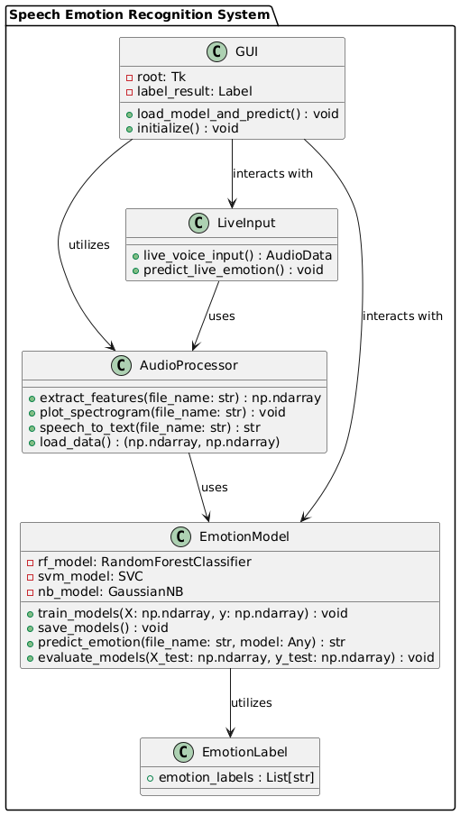
Class Diagram:

Slide 19
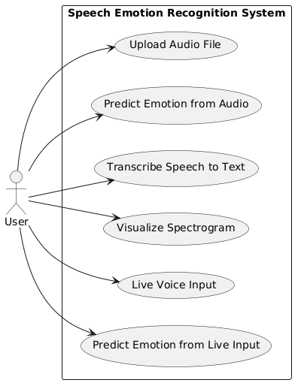
Use Case Diagram:

Slide 20
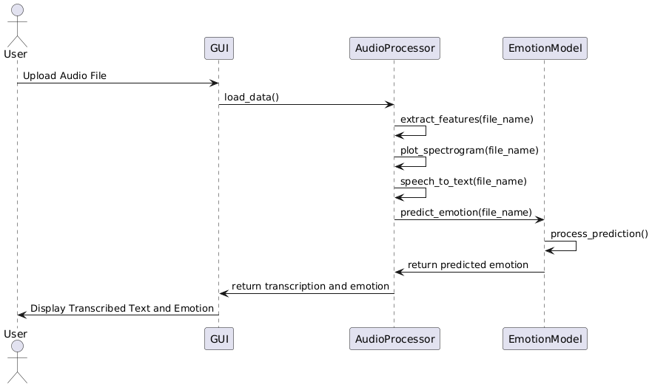
Sequence Diagram:

Slide 21
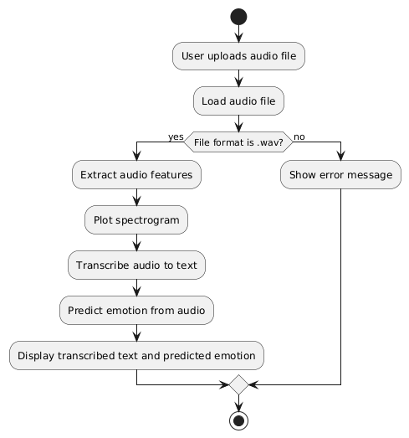
Activity Diagram:

Slide 22
Implementation & Testing
Coding Blocks:
import os
import numpy as np
import librosa
import speech_recognition as sr
from sklearn.model_selection import train_test_split
from sklearn.preprocessing import LabelEncoder
from sklearn.ensemble import RandomForestClassifier
from sklearn.svm import SVC
from sklearn.naive_bayes import GaussianNB
from sklearn.metrics import accuracy_score
from tkinter import Tk, filedialog, Label, Button
import joblib
import matplotlib.pyplot as plt
import io
# Feature Extraction
def extract_features(file_name):
audio_data, sample_rate = librosa.load(file_name, res_type='kaiser_fast')
mfccs = np.mean(librosa.feature.mfcc(y=audio_data, sr=sample_rate, n_mfcc=40).T, axis=0)
chroma = np.mean(librosa.feature.chroma_stft(y=audio_data, sr=sample_rate).T, axis=0)
mel = np.mean(librosa.feature.melspectrogram(y=audio_data, sr=sample_rate).T, axis=0)
return np.hstack([mfccs, chroma, mel])

Slide 23
# Generate and plot spectrogram
def plot_spectrogram(file_name):
audio_data, sample_rate = librosa.load(file_name, res_type='kaiser_fast')
plt.figure(figsize=(10, 4))
D = librosa.amplitude_to_db(np.abs(librosa.stft(audio_data)), ref=np.max)
plt.imshow(D, aspect='auto', cmap='inferno', origin='lower',
extent=[0, len(audio_data) / sample_rate, 0, sample_rate / 2])
plt.colorbar(format='%+2.0f dB')
plt.title('Spectrogram')
plt.xlabel('Time (s)')
plt.ylabel('Frequency (Hz)')
plt.tight_layout()
plt.show()
# Speech-to-text conversion
def speech_to_text(file_name):
recognizer = sr.Recognizer()
audio_file = sr.AudioFile(file_name)
with audio_file as source:
audio = recognizer.record(source)
try:
text = recognizer.recognize_google(audio)
return text
except sr.UnknownValueError:
return "Speech not recognized"
except sr.RequestError:
return "Speech recognition service unavailable“
# Load dataset and extract features
def load_data():
data = []

Slide 24
emotions = []
dataset_path = 'dataset/' # Ensure this path is correct
for file in os.listdir(dataset_path):
if file.endswith('.wav'):
feature_vector = extract_features(os.path.join(dataset_path, file))
data.append(feature_vector)
emotion = int(file.split('-')[2]) # Adjust based on your filename format
emotions.append(emotion)
return np.array(data), np.array(emotions)
# Emotion labels corresponding to the encoded labels
emotion_labels = ["happy", "sad", "angry", "fearful", "surprised", "neutral"]
# Load and preprocess data
X, y = load_data()
if len(X) == 0 or len(y) == 0:
raise ValueError("No data loaded. Please check your dataset directory.")
le = LabelEncoder()
y_encoded = le.fit_transform(y)
X_train, X_test, y_train, y_test = train_test_split(X, y_encoded, test_size=0.2, random_state=42)
# Train models
rf_model = RandomForestClassifier(n_estimators=100, random_state=42)
rf_model.fit(X_train, y_train)
svm_model = SVC(kernel='linear')
svm_model.fit(X_train, y_train)
nb_model = GaussianNB()
nb_model.fit(X_train, y_train)

Slide 25
# Save models
joblib.dump(rf_model, 'random_forest.pkl')
joblib.dump(svm_model, 'svm.pkl')
joblib.dump(nb_model, 'naive_bayes.pkl’)
# Evaluation
rf_pred = rf_model.predict(X_test)
svm_pred = svm_model.predict(X_test)
nb_pred = nb_model.predict(X_test)
print("Random Forest Accuracy:", accuracy_score(y_test, rf_pred))
print("SVM Accuracy:", accuracy_score(y_test, svm_pred))
print("Naive Bayes Accuracy:", accuracy_score(y_test, nb_pred))
# Predict emotion
def predict_emotion(file_name, model):
features = extract_features(file_name).reshape(1, -1)
prediction = model.predict(features)
return emotion_labels[prediction[0]] # Convert prediction index to label
# Live voice input
def live_voice_input():
recognizer = sr.Recognizer()
with sr.Microphone() as source:
recognizer.adjust_for_ambient_noise(source)
print("Please speak...")
audio = recognizer.listen(source)
print("Audio captured, processing...")
return audio

Slide 26
def predict_live_emotion():
audio_data = live_voice_input()
audio_stream = io.BytesIO(audio_data.get_wav_data())
features = extract_features(audio_stream).reshape(1, -1)
model = joblib.load('random_forest.pkl') # You can switch models
prediction = model.predict(features)
emotion = emotion_labels[prediction[0]]
# Convert speech to text
transcription = speech_to_text(io.BytesIO(audio_data.get_wav_data()))
# Update the GUI with results
label_result.config(text=f"Predicted Emotion: {emotion}\nTranscribed Text: {transcription}")
def load_model_and_predict():
file_path = filedialog.askopenfilename()
# Predict emotion
model = joblib.load('random_forest.pkl') # You can switch models
emotion = predict_emotion(file_path, model)
# Get the speech-to-text result
transcription = speech_to_text(file_path)
# Update the GUI with results
label_result.config(text=f"Predicted Emotion: {emotion}\nTranscribed Text: {transcription}")
# Plot spectrogram
plot_spectrogram(file_path)

Slide 27
# Tkinter GUI
root = Tk()
root.title('Speech Emotion Recognition & Speech-to-Text')
label_result = Label(root, text="Upload an audio file or use live voice input", font=("Helvetica", 16))
label_result.pack()
btn_upload = Button(root, text="Upload Audio", command=load_model_and_predict)
btn_upload.pack()
btn_live_voice = Button(root, text="Live Voice Input", command=predict_live_emotion)
btn_live_voice.pack()
root.mainloop()

Slide 28
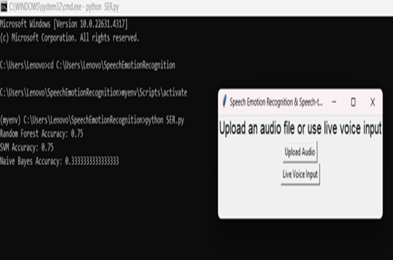
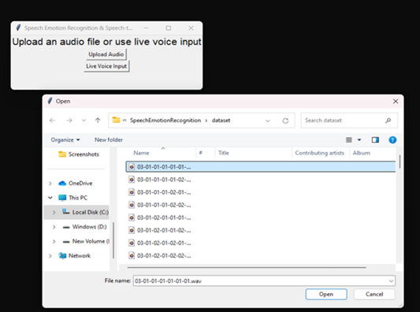
Result :
fig(1): User Interface
fig(2): Uploading audio files

Slide 29
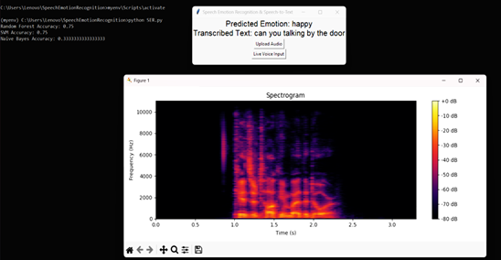
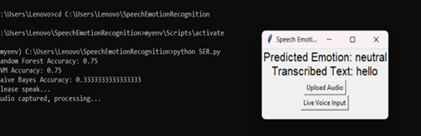
Result :
fig(3): Spectrogram for audio file
fig(4): Live voice input and result

Slide 30
Thank you

