Slide 1
PIPBOI Prototype
Barnabáš Bernášek, C4c

Slide 2

What is PIPBOI?
Pigeon
Integrated
Personal
Biometric and
Operational
Interface

Slide 3
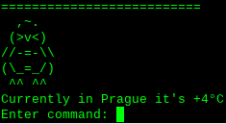
What is it used for?
Interface for your RPi
Good for Linux noobs
Tells you information

Slide 4
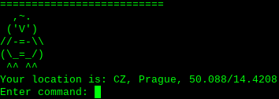
Why?
Based on Fallout’s PIPBOY
Attempt to bring functional PIPBOY to reality

Slide 5
Is there more?
Game package
Modifications
Guide on how to make your own wearable PIPBOI
Connectable sensors
Calendar, weather, sensors and more functions for everyday use

Slide 6
