Slide 1
1963 TO 2025
Tragedies That Changed America
Five acts of violence. What did each one change?
Notes:
Hello everyone. Today I will talk about five tragedies in the United States. They are acts of violence, terrorism and political violence, from 1963 to 2025. For each one, I will answer two questions: what happened, and what changed after it? This topic is about real people who died, so I will keep it factual.

Slide 2
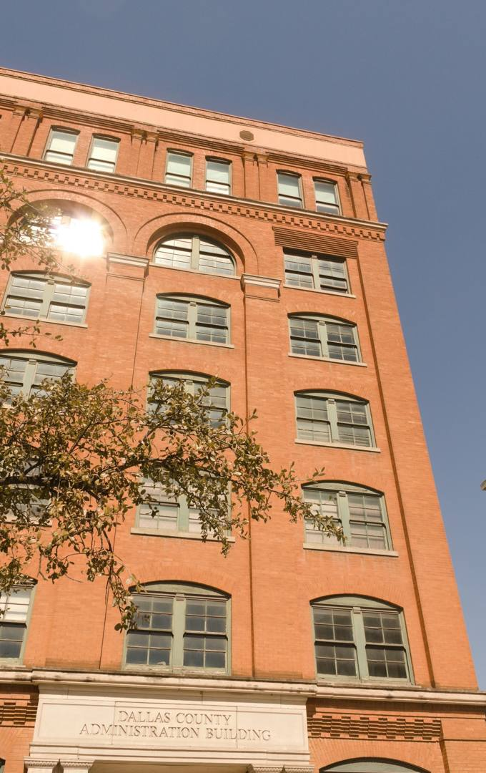
JFK assassination
1963
Dallas, Texas. President John F. Kennedy is shot and killed.
WHAT HAPPENED
He was riding in an open car. The Warren Commission said Lee Harvey Oswald acted alone.
WHAT CHANGED
The Secret Service grew and stopped using open cars. The 25th Amendment set clearer rules for replacing a vice president.
Sources: Warren Commission report; NPR; New England Journal of Public Policy
Former Texas School Book Depository, Dallas. Photo: Diego Fernández Sánchez / Unsplash
Notes:
In November 1963, President John F. Kennedy was shot in Dallas while he was riding in an open car. The Warren Commission said Lee Harvey Oswald acted alone. After this, the Secret Service changed a lot. It grew, and open cars stopped. The death also showed a problem in the law. So the 25th Amendment created clearer rules for filling the vice president’s job.

Slide 3
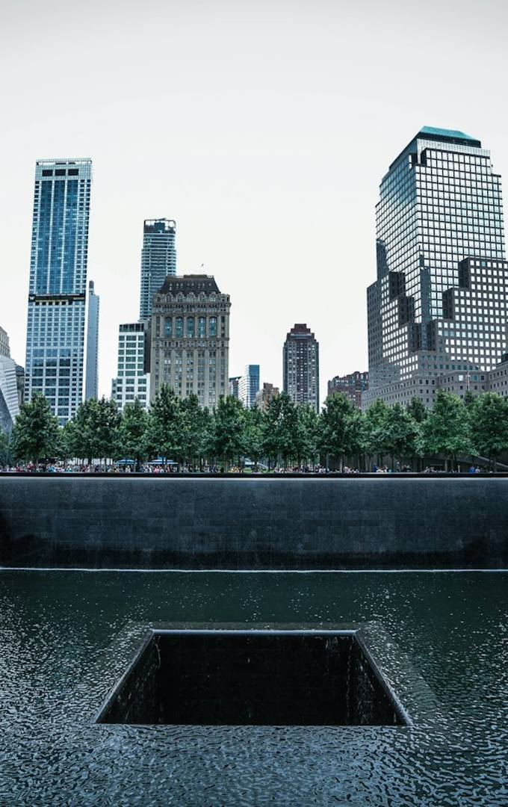
September 11 attacks
2001
2,977 people killed, including 184 at the Pentagon.
WHAT HAPPENED
Al-Qaeda hijacked four planes. They hit the Twin Towers and the Pentagon. The fourth crashed in Pennsylvania.
WHAT CHANGED
The TSA took over airport security. The Department of Homeland Security joined 22 agencies into one.
Sources: US Department of Homeland Security; Britannica; CNN
World Trade Center memorial, New York. Photo: Axel Houmadi / Unsplash
Notes:
September 11, 2001 is the biggest tragedy in this presentation. Al-Qaeda hijacked four planes. Two hit the Twin Towers in New York, one hit the Pentagon, and one crashed in Pennsylvania. In total, 2,977 people died, and 184 of them died at the Pentagon. After this, the government took control of airport security, and it created the Department of Homeland Security.

Slide 4
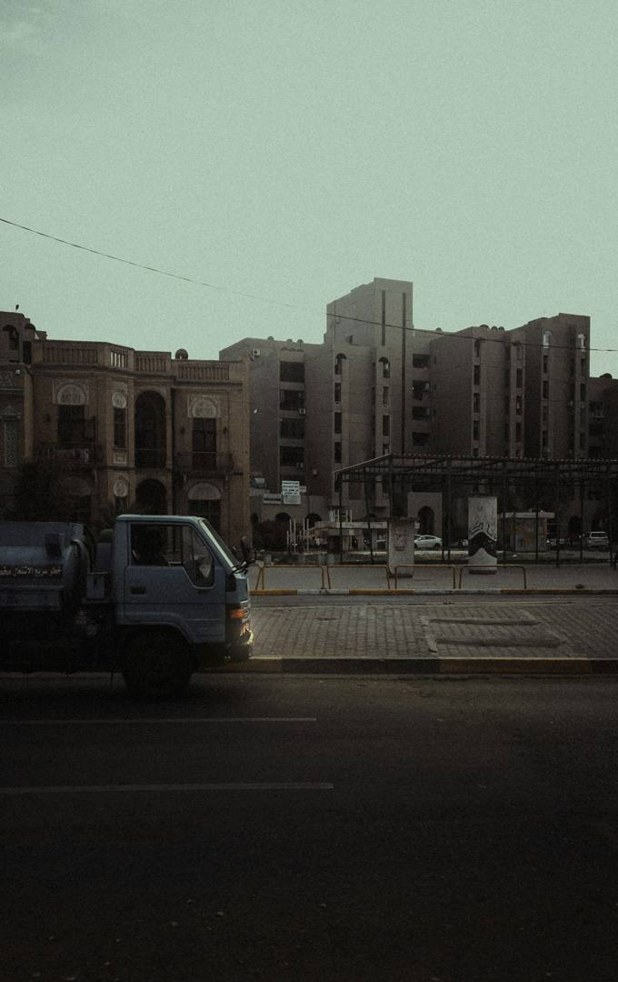
The response: Afghanistan, then Iraq
7,000+
US troops killed
432,000+
civilians killed by direct violence
$8 trillion
cost to the US
Afghanistan was the direct response. Iraq was not behind 9/11: the 9/11 Commission found no “collaborative operational relationship” with al-Qaeda.
Estimates for all post-9/11 wars. Sources: Costs of War Project, Brown University; 9/11 Commission
Haifa Street, Baghdad. Photo: gheath bader / Unsplash
Notes:
The US attacked Afghanistan in 2001, because al-Qaeda was based there. Then in 2003 it invaded Iraq. Many people think Iraq was revenge for 9/11, but this is not accurate. The main reason given was weapons of mass destruction, and none were found. The 9/11 Commission found no working relationship between Iraq and al-Qaeda for attacks on the US. These numbers are estimates for all the wars after 9/11.

Slide 5
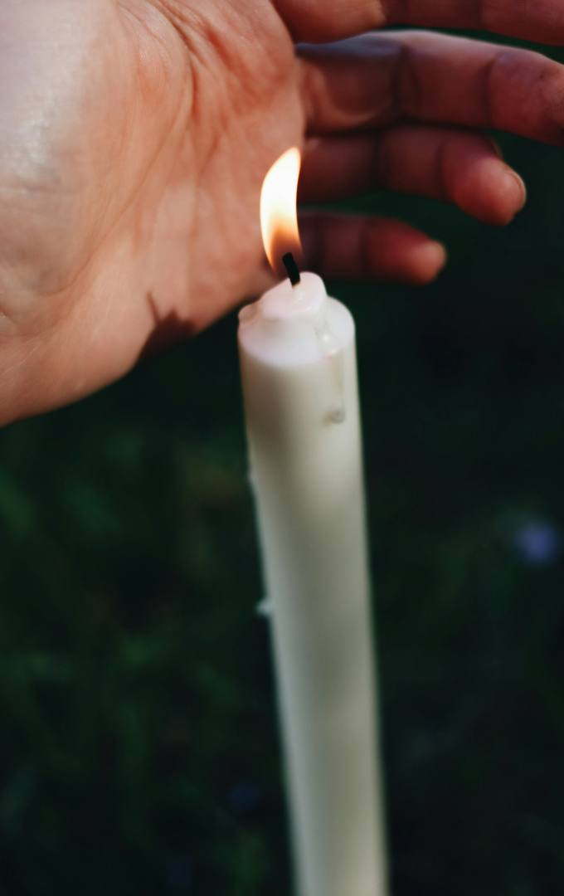
Sandy Hook shooting
2012
26 people killed: 20 children and 6 school staff.
WHAT HAPPENED
A gunman attacked Sandy Hook Elementary School in Newtown, Connecticut.
WHAT CHANGED
Connecticut passed stricter gun laws. A federal background check bill failed in 2013, with 54 votes when 60 were needed.
Sources: PBS NewsHour; Connecticut Mirror
Illustrative photo, not from Newtown. Photo: Jessica Mangano / Unsplash
Notes:
In December 2012, a gunman attacked Sandy Hook Elementary School in Connecticut. He killed 26 people, and 20 of them were young children. Many people expected big national change. Connecticut did pass stricter gun laws. But in 2013, a federal bill for wider background checks failed in the Senate. It got 54 votes, and it needed 60. A federal gun safety law only came in 2022.

Slide 6
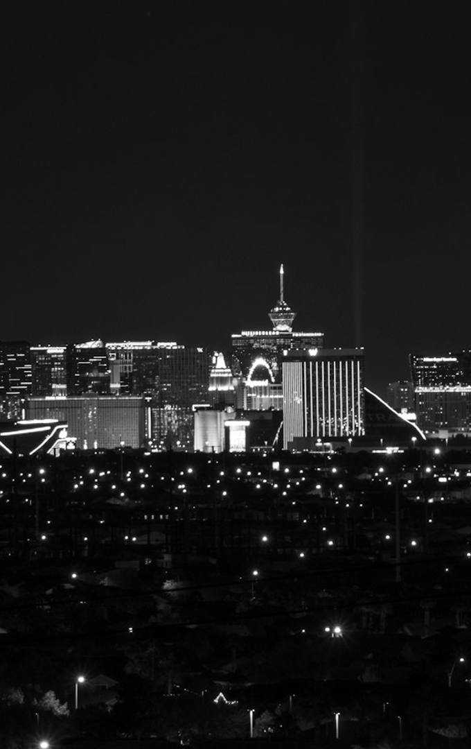
Las Vegas shooting
2017
58 people killed at a music festival.
WHAT HAPPENED
A gunman fired into a concert crowd using bump stocks, devices that make a rifle fire faster.
WHAT CHANGED
The government banned bump stocks in 2018. The Supreme Court struck down the ban in 2024, in a 6–3 decision.
Sources: JURIST; States Newsroom. Some counts say 60, including later deaths.
The Las Vegas Strip. Photo: Christian Gracia / Unsplash
Notes:
In 2017, a gunman opened fire on a country music festival in Las Vegas. He killed 58 people that night. It is called the deadliest mass shooting in modern US history. He used bump stocks, which make a rifle fire faster. The government banned them in 2018. But in 2024, the Supreme Court struck down that ban. So this change did not last.

Slide 7
Charlie Kirk assassination
2025
WHAT HAPPENED
He was speaking at a university in Utah. The accused man, Tyler Robinson, will go on trial and has not been convicted.
Conservative activist Charlie Kirk, 31, is shot and killed.
WHAT CHANGED
It is too early to know. In one survey, 45% of students felt less comfortable sharing their views in class.
Sources: Associated Press; FIRE student survey
Notes:
In September 2025, Charlie Kirk, a conservative activist, was shot while speaking at Utah Valley University. A man named Tyler Robinson is accused, and a judge sent the case to trial. He has not been convicted. It is too early to know the long-term change. In one survey, 45 percent of students felt less comfortable sharing their views in class. Political violence has also hit both sides, including a Democratic lawmaker in Minnesota and President Trump in 2024.

Slide 8
What each tragedy changed
Tragedy | Main change
JFK, 1963 | Stronger protection for presidents
9/11, 2001 | Homeland Security, TSA, long wars
Sandy Hook, 2012 | Stricter state laws, federal bill failed
Las Vegas, 2017 | Bump stock ban, later struck down
Charlie Kirk, 2025 | Too early to know
Tragedies can change a country quickly, but not always for good or forever.
Notes:
To finish, here are all five together. Some changes lasted, like stronger protection for presidents and Homeland Security. Some did not last, like the bump stock ban. And some responses caused new suffering, like the long wars after 9/11. So my conclusion is this: tragedies can change a country quickly, but not always for good or forever. Thank you for listening.

