Slide 1
Chapter 2: Complexity Analysis

Slide 2
Computational and Asymptotic Complexity
Algorithms are an essential aspect of data structures
Data structures are implemented using algorithms
Some algorithms are more efficient than others
Efficiency is preferred; we need metrics to compare them
An algorithm’s complexity is a function describing the efficiency of the algorithm in terms of the amount of data the algorithm must process
There are two main complexity measures of efficiency

Slide 3
Computational and Asymptotic Complexity (continued)
Time complexity describes the amount of time an algorithm takes in terms of the amount of input
Space complexity describes the amount of memory (space) an algorithm takes in terms of the amount of input
For both measures, we are interested in the algorithm’s asymptotic complexity
This asks: when n (number of input items) goes to infinity, what happens to the algorithm’s performance?

Slide 4
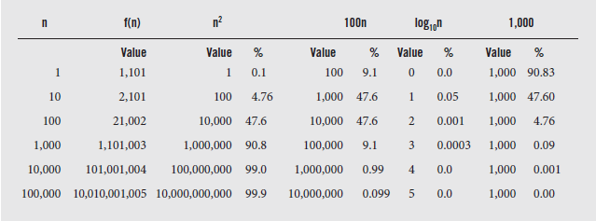
Computational and Asymptotic Complexity (continued)
To illustrate this, consider f(n) = n² + 100n + log₁₀n + 1000
As the value of n increases, the importance of each term shifts until for large n, only the n² term is significant
Fig. 2-1 The growth rate of all terms of function f (n) = n2 + 100n + log10n + 1,000.

Slide 5
Big-O Notation
The most commonly used notation for asymptotic complexity used is "big-O" notation
In the previous example we would say n² + 100n + log₁₀n + 1000 = O(n²) (read "big-oh of n squared")
Definition: Let f(n) and g(n) be functions, where n ε Z is a positive integer. We write f(n) = O(g(n)) if and only if there exists a real number c and positive integer N satisfying 0 < f(n) < cg(n) for all n > N. (And we say, "f of n is big-oh of g of n.“)
This means that functions like n² + n, 4n² - n log n + 12, n²/5 - 100n, n log n, and so forth are all O(n²)

Slide 6
Big-O Notation (continued)
Although the definition of big-O is correct, it lacks important information
While c and N exist, it does not tell us how to calculate them or what to do if multiple candidates exist (and they often do)
Consider the function f:
f (n) = 2n² + 3n + 1
and g:
g(n) = n²
Clearly f (n) is O(n²); possible candidates for c and N are shown in the next slide

Slide 7

Big-O Notation (continued)
Fig. 2.2 Different values of c and N for function f (n) = 2n² + 3n + 1 = O(n²) calculated according to the definition of big-O
These values are obtained by solving the inequality from the definition of big-O:
f(n) < cg(n)
Substituting for f(n) and g(n) from the previous slide, we have:
2n² + 3n + 1 < cn² or 2 + 3/n + 1 / n² < c
Since n > N, and N is a positive integer, we can start with N = 1 and substitute in either expression to obtain c

Slide 8
Big-O Notation (continued)
Generally, we choose an N that allows one term of f to dominate the expression
There are only two terms to consider: 2n² and 3n, since the last term is a constant
As long as n is greater than 1.5, 2n² dominates the expression
So N must be 2 or more, and c is greater than 3.75
This illustrates the central point of the definition of big-O, that f(n) < cg(n) relies on the choices of c and N as stated above
The choice of c depends on the choice of N and vice-versa

Slide 9
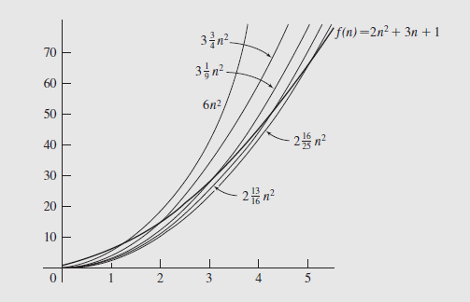
Big-O Notation (continued)
For example, if we wanted the relationship to hold for all positive N starting at 1, c would have to be 6
The graphs of f(n) and cg(n) are shown below:
Fig. 2.3 Comparison of functions for different values of c and N from Figure 2.2

Slide 10
Big-O Notation (continued)
The graph of f(n) crosses the graph of each cg(n) at N
This does not mean other values of c and N are not useful; we can choose to start with any c, provided we choose the correct N
We can also use this information to determine the big-O of a given function
Consider the function 3n² + 4n - 2
We need a c and N such that:
3n² + 4n - 2 < cn²
for all n > N

Slide 11
Big-O Notation (continued)
Dividing by n² gives us
3 + 4/n – 2/n² < c
Choosing N = 1, we need to find a c such that
3 + 4 – 2 < c
We can set c = 6, so we have
3n² + 4n - 2 < 6n²
for all n > 1
So our function is O(n²)
Big-O provides a formal method for expressing asymptotic upper bounds, bounding the growth of a function from above

Slide 12
Big-O Notation (continued)
Knowing where a function lies within the big-O hierarchy lets us compare it quickly with other functions
Thus we have an idea of which algorithm has the best time performance

Slide 13
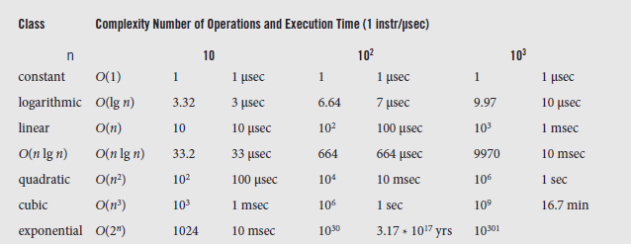
Examples of Complexities
Since we examine algorithms in terms of their time and space complexity, we can classify them this way, too
This is illustrated in the next figure
Fig. 2.4 Classes of algorithms and their execution times on a computer executing 1 million operations per second
(1 sec = 10⁶ μsec = 10³ msec)

Slide 14
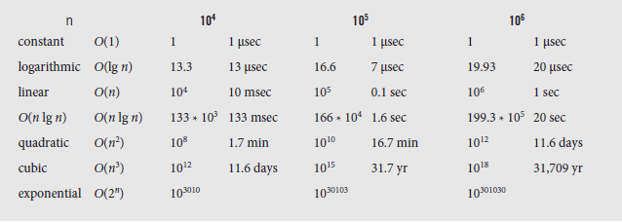
Examples of Complexities (continued)
Fig. 2.4 (concluded)
The class of an algorithm is the name used to refer to its big-O notation; it is a more convenient way to describe its behavior
For example a linear function is O(n); its time increases in direct proportion to the amount of data processed

Slide 15
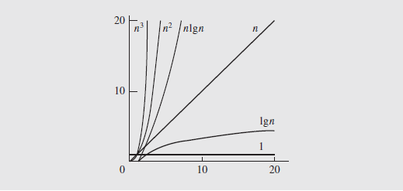
Examples of Complexities (continued)
This relationship can also be expressed graphically:
Fig. 2.5 Typical functions applied in big-O estimates.
This graph, and the previous chart, show that some algorithms have no practical application
Even with today’s supercomputers, cubic order algorithms or higher are impractical for large numbers of elements

Slide 16
Finding Asymptotic Complexity
As we have seen, asymptotic bounds are used to determine the time and space efficiency of algorithms
Generally, we are interested in time complexity, which is based on assignments and comparisons in a program
We’ll focus on assignments for the time being
Consider a simple loop:
for (i = sum = 0; i < n; i++)
sum = sum + a[i]
Two assignments are executed once (sum = 0 and i = sum) during initialization
In the loop, sum = sum + a[i] is executed n times

Slide 17
Finding Asymptotic Complexity (continued)
In addition, the i++ in the loop header is executed n times
So there are 2 + 2n assignments in this loop’s execution and it is O(n)
Typically, as loops are nested, the complexity grows by a factor of n, although this isn’t always the case
Consider
for (i = 0; i < n; i++) {
for (j = 1, sum = a[0]; j <= i; j++)
sum += a[j];
cout << ”sum for subarray 0 through “ << i
<<” is “<<sum<<end1;
}

Slide 18
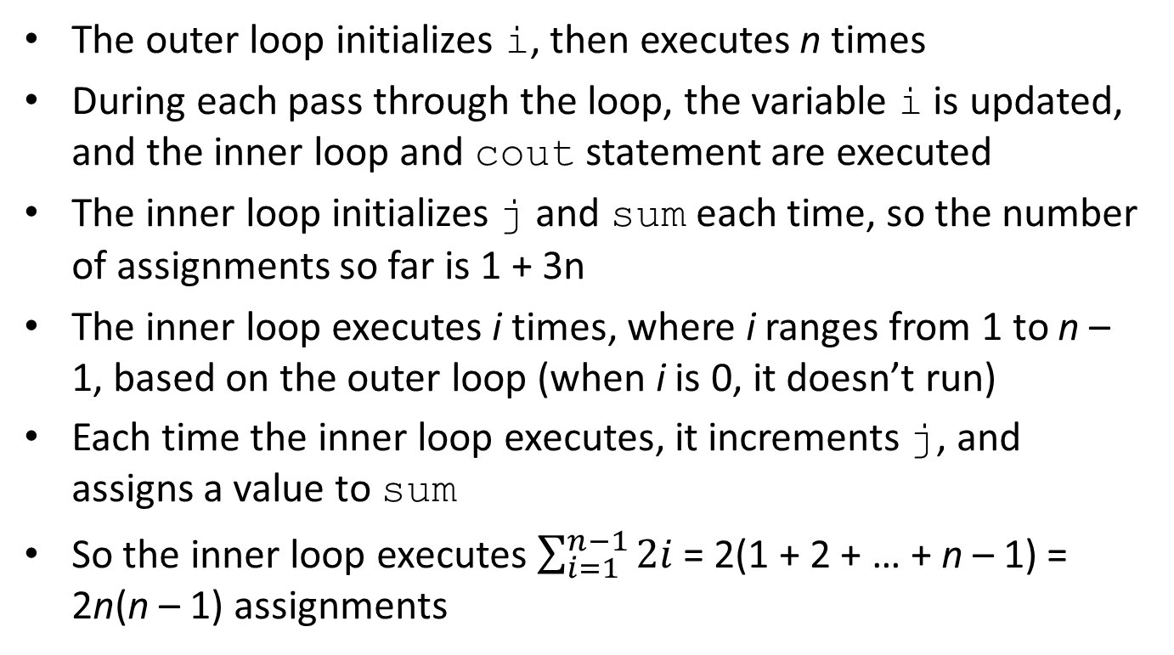
Finding Asymptotic Complexity (continued)
The outer loop initializes i, then executes n times
During each pass through the loop, the variable i is updated, and the inner loop and cout statement are executed
The inner loop initializes j and sum each time, so the number of assignments so far is 1 + 3n
The inner loop executes i times, where i ranges from 1 to n – 1, based on the outer loop (when i is 0, it doesn’t run)
Each time the inner loop executes, it increments j, and assigns a value to sum
So the inner loop executes $\sum_{i=1}^{n−1}{2i}$ = 2(1 + 2 + … + n – 1) = 2n(n – 1) assignments

Slide 19
Finding Asymptotic Complexity (continued)
The total number of assignments is then 1 + 3n + 2n(n - 1), which is O(1) + O(n) + O(n²) = O(n²)
As mentioned earlier, not all loops increase complexity, so care has to be taken to analyze the processing that takes place
However, additional complexity can be involved if the number of iterations changes during execution
This can be the case in some of the more powerful searching and sorting algorithms

