Slide 1
AuraXR
Proximity-Based Hand Animation for VR

Slide 2
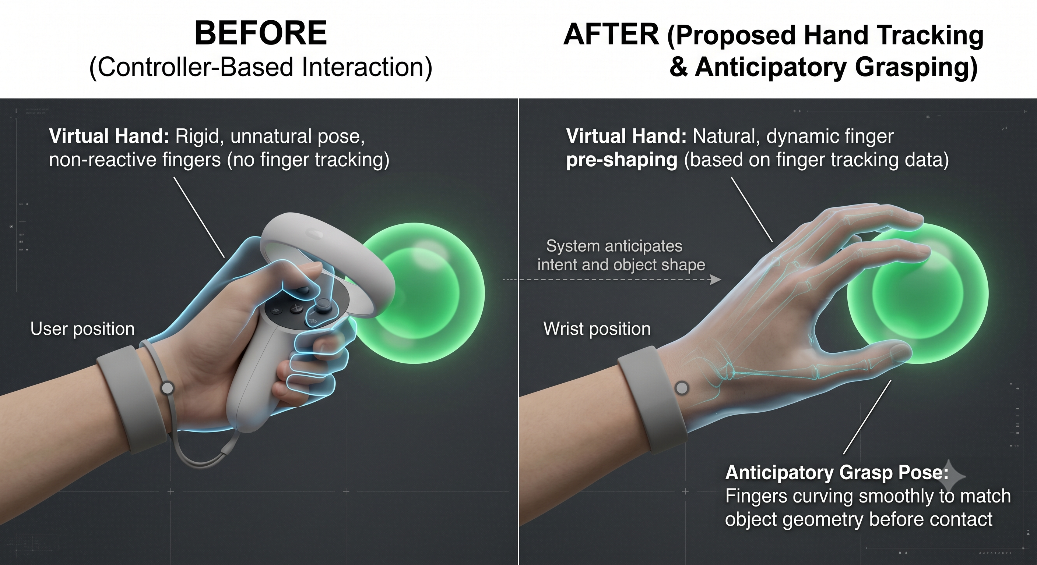
Problem
The Problem
In VR, the system only tracks controllers, not fingers. Virtual hands look stiff or fake when grabbing objects.
The Goal
The virtual hand should automatically reshape before contact, like a real hand preparing to grab.

Slide 3
Flow - 1. Data Preparation & Processing
HOT3D Dataset Download & Parsing
Extract and parse hand and object position data from HOT3D library (1.5M+ frames from Quest 3 + Aria) from ZIP formats into JSON/CSV structures.
Frame Filtering (Distance & Validity)
Filter invalid hand annotations and frames beyond 40cm distance to retain only meaningful hand-object interaction data for training.
Wrist Frame Transformation
Transform object position from world coordinate system to hand wrist reference frame to compute relative position (3D).
Feature Extraction & One-Hot Encoding
Combine hand rotation (quaternion), object relative position, grip category (Power/Precision/Palmar/Pinch), and bounding box dimensions to construct 11-dimensional input vector.
Train/Val Split & Normalization
Perform 70/15 participant-based split and normalize all features using only training set statistics (mean/std).
HDF5 Dataset Serialization (Left & Right)
Serialize processed train/val data into HDF5 format on disk to enable fast data loading for both left and right hands.

Slide 4
Flow - 2. Model Design & Improvements
V1 Baseline Model (Control Group)
Implement dual-branch architecture with spatial encoder (rel_pos + distance) and object encoder (grip_onehot + bbox) to predict 22 joint angles (~54k params).
V2 Model Development (Wrist Quaternion + Per-Finger Heads)
Augment spatial input with wrist quaternion to encode hand rotation and add 5 separate per-finger decoder heads (~210k params).
V5 & V6 Model Variants
Test different hidden dimensions, embedding sizes, dropout rates, and layer normalization positions to determine optimal architecture.
Loss Function Design (Weighted MAE)
Apply 6x weight to grip frames and 2x weight to approach frames to strengthen learning on rare and critical pose predictions.
Optimizer & Learning Rate Schedule
Use Adam optimizer with 1e-3 initial learning rate, 20-epoch linear warmup, and cosine decay schedule.

Slide 5
Flow - 3. Training & Validation
Model Training (500 Epochs)
Load entire dataset onto GPU and train model using batch training (~3 min on M2 Max).
Real-Time Monitoring & Early Stopping
Monitor training loss, validation loss, and per-phase MAE to prevent overfitting.
Checkpoint Management
Save best model (lowest val loss) and training metadata (normalization stats, model parameters).

Slide 6
Flow - 4. Model Evaluation
Per-Joint MAE Calculation
Measure mean absolute error (in degrees) for each of 22 joints on validation set to identify poorly performing joints.
Per-Phase Analysis (Pre-Shape vs Grip)
Separately evaluate 10-40cm pre-shape frames and <10cm grip frames to visualize phase-specific performance.
Per-Grip-Category Breakdown
Report separate MAE for all 4 grip categories (Power cup, Precision pen, Palmar plate, Pinch mouse).
Left & Right Hand Model Independent Evaluation
Compare performance of left and right hand models separately to detect asymmetric learning issues.
Error Distribution Analysis
Visualize how prediction error varies with distance and object size to understand model weaknesses.

Slide 7
Flow - 5. Export & Optimization
ONNX Conversion (PyTorch → ONNX)
Convert trained model to ONNX format to enable cross-platform compatibility.
ONNX Inference Validation
Run ONNX model with ONNX Runtime and verify bitwise matching with PyTorch outputs.
Quantization & Model Compression
Convert Float32 → Int8 or Float16 to reduce model size by 4x and improve Quest 3 inference speed.

Slide 8
Flow - 6. Unity Integration & C# Wrapper (Not Enough)
ONNX Runtime C# Binding
Initialize model inference in Unity via ONNX Runtime C# API.
AuraXRMetaLoader (Model Metadata Loading)
Load normalization statistics and model metadata from JSON to apply feature preprocessing correctly.
AuraXRFeatureAssembler (Input Feature Construction)
Compute wrist frame transformation, relative object position, and grip category from controller position to construct model input.
AuraXRInferenceManager (Real-Time Inference Loop)
Run inference every frame with features as input to obtain 22 joint angles and update hand animation.

Slide 9
Flow - 7. Hand Rendering & Animation
HandSkeletonAnchor & HandRigController
Transform 22 joint angles into 3D hand mesh positions using forward kinematics (IK/FK) to animate smooth hand rig.
Visibility & Proximity Management
Control hand visibility based on controller-object distance and manage occlusion.

Slide 10
Flow - 8. Quest 3 Runtime Optimization (Current Phase)
Streaming Inference (Throttling)
Run inference at intervals rather than every frame and interpolate intermediate frames.
Device-Specific Profiling
Measure inference latency and power consumption on Quest 3 Qualcomm Snapdragon processor.

Slide 11
Flow - 9. Experiments & Results
Left vs Right Hand Comparison
Report performance differences between two models and analyze asymmetry.
Object Size Impact (Object Size Scaling)
Examine how model error varies between small (pinch grip) and large (power grip) objects.
Distance-Dependent Performance (Distance Bins)
Report MAE across 5cm intervals (0-5cm, 5-10cm, ..., 35-40cm) to identify best-performing distance ranges.
Grip Transition Smoothness Test
Evaluate pose prediction smoothness during pre-shape → grip phase transition both visually and quantitatively.
User Study Subjective Feedback
Collect feedback from VR users on immersion, naturalness, and accuracy and report survey results.

Slide 12
Flow - 10. Paper Writing Sections
Abstract & Introduction (Problem Definition)
Present VR hand animation gap as motivation and introduce proximity-based prediction approach.
Related Work
Summarize MANO, UmeTrack, HOT3D, previous hand pose estimation, and grasp prediction research.
Dataset Analysis & Preprocessing
Explain HOT3D library characteristics, filtering strategies, and feature engineering details.
Model Architecture & Ablations
Document design choices in detail: V1 baseline, V2 improvements, per-finger heads, quaternion encoding.
Experiments & Results
Present training curves, validation/test performance tables, and per-phase/per-grip breakdowns.
Ablation Studies
Measure individual contributions of components: wrist quaternion, per-finger heads, loss weighting.
Error Analysis & Failure Cases
Identify worst-performing joints, grip categories, and distance ranges.
Runtime Performance & Deployment
Present ONNX export, quantization, and Quest 3 latency/power metrics.
Qualitative Results & Visualization
Include video recordings of hand pose predictions, 3D mesh visualizations, and comparison slides.
Discussion & Future Work
Discuss significance of findings, limitations, and future improvements (multi-object, dynamic scenes, etc.).
Conclusion & Impact
Summarize how AuraXR contributes to VR/AR immersion.

Slide 13
Key insight
A real hand does not wait until it touches an object, it starts shaping in the air.
Reaching for a cup, your fingers spread and curl before contact. This is called anticipatory grasp.
The shape depends on where the object is (relative to the hand) and what kind of object it is ,not on where
the hand is in the room.

Slide 14
Architecture
Simplified Model Pipeline
1. Input Dimensions (15 total) — 8 Spatial (hand) + 7 Object (shape).
2. Shared Trunk — fuses both inputs into one path.
3. Specialized Decoder (5 Heads) — one head per finger; each predicts 4 joints.
4. Output Joints (22 total) — 20 finger joints (5×4) + 2 placeholders.
Why This Design Wins
Wrist Quaternion — tracks rotation, not just position. +20% accuracy.
Per-Finger Isolation — errors in one finger do not affect others.
Ultra-Lightweight — only ~210k params; runs in <1ms on Quest 3 GPU.

Slide 15
Technical Deep-Dive & Training
Smart Data Balancing
A Weighted Huber Loss focuses training on critical moments.
GRIP FRAMES (<10cm)
6.0× weight — only 2.2% of data but the critical touch moment.
APPROACH FRAMES (>45cm)
2.0× weight — prepares finger shapes early.
NORMAL FRAMES (10–45cm)
1.0× weight — standard baseline.
Expected Training Metrics
FINGER ERROR (MAE)
? highly accurate angle match
GRIP DETECT (F1)
? at critical touch limits
TRAINING SPEED
500 epochs / 5 min
on M2 Max — ultra-fast iteration

Slide 16
Deployment & Live Performance
Live Engine Flow
Tracking — Quest 3 tracks hand and object in real time.
Assembly — 15-number input vector.
Inference — Unity Sentis runs ONNX on-device.
Update — virtual hand updates with no visible lag.
Dataset & Roadmap
Built on HOT3D — ~200k frames, 4 grip types, 20+ household objects.
Post-POC Goals
· Finger-by-finger confidence tracking.
· Dual-hand interactions.
· Super-light 110k-param option.
Device Performance
QUEST 3 GPU
? ms
1000 FPS — zero lag
QUEST 3 CPU
? ms
200 FPS — fallback mode

Slide 17
Approach
The hand reacts based on the distance to the nearest object — four stages:
Far (> 40 cm) — model is off; hand stays in a normal resting pose.
Getting close (10–40 cm) — hand starts to open and prepare for the object type.
Very close (< 10 cm) — hand moves into a full grip; fingers point to the object.
Touch + grip button — the pose locks and the object sticks to the hand.

Slide 18
HOT3D Dataset Overview
What is HOT3D?
A large-scale dataset by Meta Reality Labs, tracking human hand interactions with 33 daily objects in 3D from a first-person perspective.
Why HOT3D
Realistic & Compatible — captures natural everyday interactions; directly compatible with Quest 3.
Rich Content — RGB (1280×1024), depth, IMU, plus precise hand (UmeTrack) and object (6DoF) poses per frame.
Feature | Value
Total Frames | 1.5 Million+
Total Sequences | 800+
Unique Objects | 33 (household items)
Unique People | 19
Devices | Meta Quest 3 + Project Aria
Viewpoint | Egocentric (first-person)
Hand Models | UmeTrack (22 joints) + MANO (parametric)

Slide 19
What is UmeTrack?
Criteria | UmeTrack | MANO
Format & Size | Only 22 joint angles | 61 parameters (Pose + Shape)
VR Compatibility | ✅ Ready for direct use | ❌ Requires conversion
Speed / Performance | ✅ Extremely lightweight (<2ms on Quest 3) | ⚠️ Computationally heavier
Definition & Structure:
UmeTrack is a data format that represents hand movements using 22 joint angles (in degrees).
22 Angles: (5 Fingers × 4 angles) + 2 angles for the wrist.
All angles are normalized to the [-1, 1] range for optimized model processing.
Why UmeTrack (Instead of MANO)?
Position and rotation data obtained from the controller is converted into 22 UmeTrack angles via the AuraXR model. These angles are applied directly to the Unity hand rig, eliminating the need for inverse kinematics (IK).

Slide 20
Evaluation plan
Two evaluation streams
Quantitative — model results (MAE, grip detection accuracy, per-phase performance).
Qualitative — user feedback on immersion, naturalness, and accuracy.
What is our plan?

Slide 21
Questions to be decided
1. Grip Frame Imbalance
Grip frames are only 2.2% of training data. The model may be biased toward pre-shape poses and underperform at the critical touch moment. Weighted loss partially addresses this but doesn't solve the root imbalance.
2. Multi-Object Ambiguity
The system tracks only the nearest object. If two objects are equidistant, the active object selection is arbitrary. No blending or priority logic exists.
3. No Joint Angle Limits
The model outputs raw angles with no anatomical constraints. It can predict physically impossible poses — fingers bending backward, hyperextension — especially for unseen object sizes or rotations.
4. Extreme Wrist Rotations
Training data covers everyday interactions. Edge-case rotations (e.g., full pronation, overhead reach) are underrepresented. Model behavior outside the training distribution is unknown.
5. Dual-Hand Interaction
Left and right models are fully independent. When both hands interact with the same object, they produce conflicting joint angles with no coordination layer.
6. Release Animation
The system handles approach → grip well. The grip → release transition has no dedicated logic — the hand snaps back to default pose, which breaks immersion.
7. No Qualitative Validation
The 12° MAE is a quantitative metric. There is no user study yet to confirm whether this accuracy level actually feels natural in VR. The perceptual threshold is unknown.
8. Grip Category Dependency
Pose prediction depends entirely on the assigned grip category tag. If the object is mistagged in Unity, the model silently produces a wrong pose with no fallback.
9. Dataset-to-VR Transfer Gap
HOT3D was recorded in a controlled lab setting, not a VR environment. Users in VR move differently — faster, more exaggerated motions — and this distribution shift is not measured.
10. Quest 3 Latency — Unmeasured
The <1ms GPU figure is theoretical. Actual on-device inference latency under real VR workload (rendering, physics, tracking running simultaneously) has not been profiled.

Slide 22
Article Phase
How can I walk in this phase?

Slide 23
Risks
TBD

Slide 24
Discussion / the ask
VR controller wrist addition
User Experience plan
Benchmark target
Computer engineering benchmark - user experience benchmark
Good documentation about what I Done
MLAgent on Unity

