Slide 1
NLP Solutions on Articles
BBM467 Data Intensive Applications
Data Science Capstone Project
Murat Çelik - 21827263
Notes:
Hello, I am Murat Çelik, a Computer Engineering student at Hacettepe University. Today we will talk about Natural Language Processing solutions in healthcare. First of all, the necessary information will be given and then the demo will be shown.

Slide 2
INTRODUCTION

Slide 3
Natural Language Processing - NLP
Decision-making mechanism
Mining studies in clinical documents
Diagnosis of disease by searching many sources
Identification of disease by automatic labeling of patient complaints
Answering patients’ questions via chatbot
Notes:
In recent years, artificial intelligence studies in the field of health have intensified. Especially in Natural Language Processing. There are many studies on health in this area. Such as..

Slide 4
Problem

Slide 5
Target Group and Dataset
simplified and practical website for people who:
cannot find time
miss important parts on a article
cannot improve themselves in research
1198 plain health articles published by MedicalNewsToday
4000-10000 characters
Notes:
The focus in this project is to apply NLP solutions on health articles. The main purpose is to create a more simplified and practical website for people who cannot find time, miss important parts, and cannot improve themselves in research.
MedicalNewsToday articles published in Kaggle were used as dataset. Each article is between 4000-10000 characters.

Slide 6
Method
Title Generation
Summarization
Keyword Extraction
Question Answer
Notes:
4 different NLP solutions were used. These are ..

Slide 7
Title Generation
The first thing that reader notice is the title
Fabiochiu - t5-small-mediumtitle-generation
ROUGE-L score : 26.9%
Notes:
Title Generation algorithms are important because it is difficult to analyze the overall text and find the title that is closest to the meaning. Here all articles are titled and saved. Fabiochiu's model was used. This model scored a 26% result on the Rouge-L metric.

Slide 8
Summarization
Long text => Short text
Extractive vs Generative Model
BART Model
Notes:
Summarizing is important for the reader to decode the text faster. Summarization is of two types. One is Extractive and the other is Generative. It is a BART-based model and has an extractive algorithm.

Slide 9
Keyword Extraction
Categorization
KeyBERT
BERT Model
Lemmatization
Every article has five keyword
Notes:
With article categorization, it is aimed to provide an easy and accessible experience to the reader. In this way, articles on similar topics can be accessed more quickly. Help was taken from the KeyBERT library. It has an algorithm established with the BERT model. Lemmatization was also. 5 keywords were determined for each article.

Slide 10
Question Answer
Main Scenario
Extractive QA vs Open Generative QA vs Closed Generative QA
Every answer is scored by model. The higher score is the best answer. (exact-match and f1)
The answer to the question is sought both in an article and an answer can be searched according to a keyword.
Notes:
The main scenario of our project is based on question and answer. Questions can be answered in 3 ways. Extractive QA vs Open Generative QA vs Closed Generative QA
. Extractive-QA algorithm is used in this model. Possible answers are identified and all are scored. The highest of these scores is returned as the answer.

Slide 11
DEMO
Notes:
Let’s look the demo

Slide 12
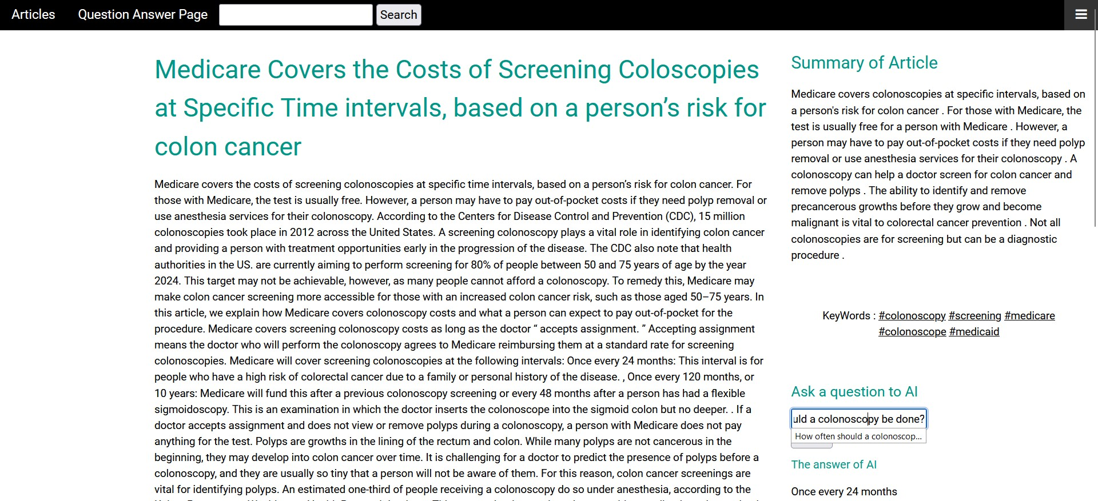
Notes:
These are snapshots of demo

Slide 13
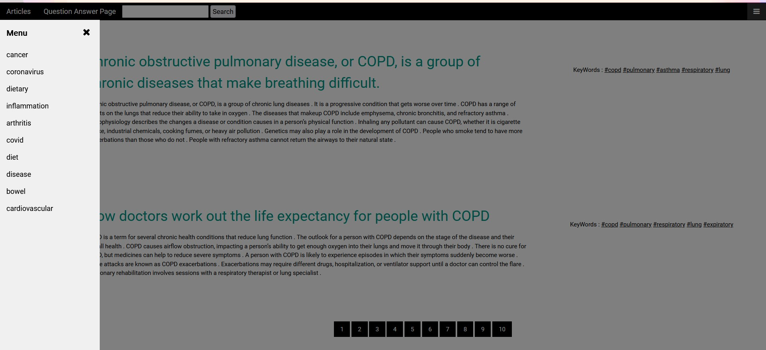

Slide 14
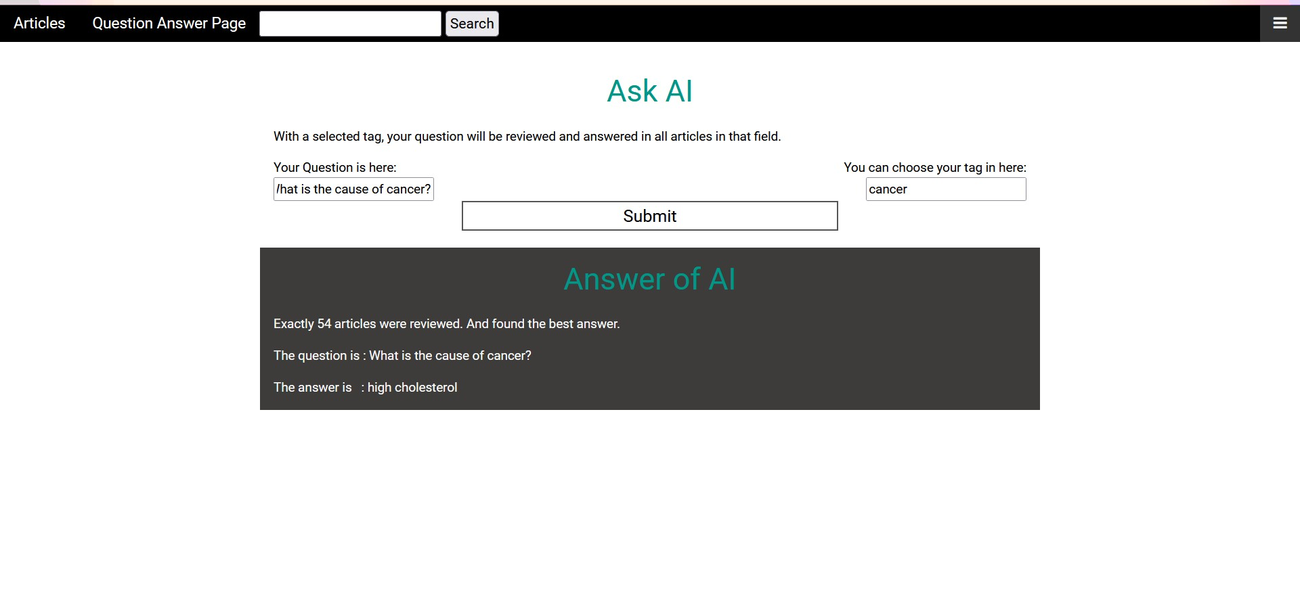

Slide 15
Conclusion
Notes:
The use of artificial intelligence algorithms, whose success is increasing day by day, in such areas is important for both healthcare professionals and people. An easy, accessible and useful platform solution is essential. In the future, the study can be expanded by adding additional algorithms to the platform.

Slide 16
References
[1] Jacob Devlin, Ming-Wei Chang, Kenton Lee, and Kristina Toutanova. 2018. BERT: Pre-training of Deep Bidirectional Transformers for Language Understanding. (2018). https://doi.org/10.48550/ARXIV.1810.04805
[2] Mike Lewis, Yinhan Liu, Naman Goyal, Marjan Ghazvininejad, Abdelrahman Mo- hamed, Omer Levy, Ves Stoyanov, and Luke Zettlemoyer. 2019. BART: Denoising Sequence-to-Sequence Pre-training for Natural Language Generation, Translation, and Comprehension. (2019). https://doi.org/10.48550/ARXIV.1910.13461
[3] Piotr Pęzik, Agnieszka Mikołajczyk-Bareła, Adam Wawrzyński, Bartłomiej Nitoń, and Maciej Ogrodniczuk. 2022. Keyword Extraction from Short Texts with a Text-To-Text Transfer Transformer. https://doi.org/10.48550/ARXIV.2209.14008
[4] Ana Sabina Uban and Cornelia Caragea. 2021. Generating Summaries for Scientific Paper Review. (2021). https://doi.org/10.48550/ARXIV.2109.14059
[5] Zhen Wang. 2022. Modern Question Answering Datasets and Benchmarks: A Survey. (2022). https://doi.org/10.4855/ARXIV.2206.15030
[6] Binggui Zhou, Guanghua Yang, Zheng Shi, and Shaodan Ma. 2021. Natural Lan- guage Processing for Smart Healthcare. (2021). https://doi.org/10.48550/ARXIV.2110.15803
[7] Fengbin Zhu, Wenqiang Lei, Chao Wang, Jianming Zheng, Soujanya Poria, and Tat-Seng Chua. 2021. Retrieving and Reading: A Comprehensive Survey on Open- domain Question Answering. https://doi.org/10.48550/ARXIV.2101.00774

