Slide 1
Web penetration testing by Murat Zhumagali
Hello, everyone! In this presentation I am trying to show SQL injection and XSS stored attacks.

Slide 2
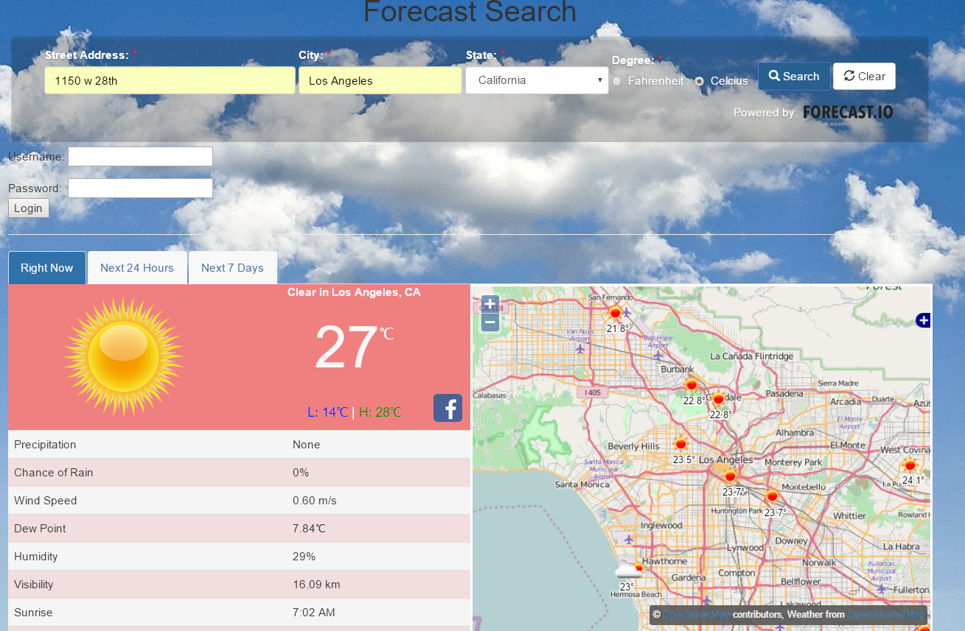
I developed weather forecast web application which has 3 tabs and Map view. We need to enter all info about location and we will get tabs which show current, next24 hours and next 7 days weather.

Slide 3
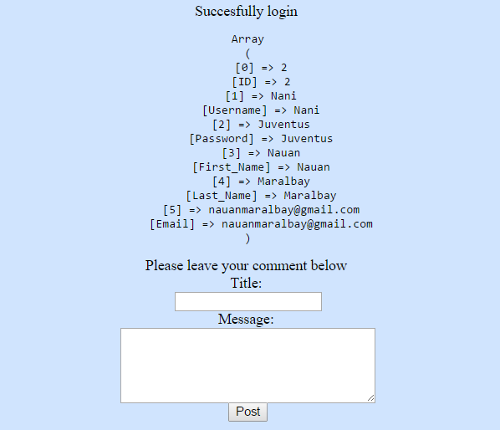
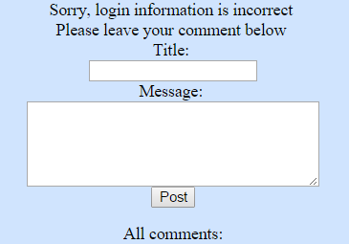
I have 2 users in my database. 1) username=Murka and password=RealMadrid 2) username=Nani and password=Juventus If we enter correct information we get the following screen. Successfully login and all info about the user.
If the input doesn’t match. We get the screen where it says ‘’Sorry, login information is incorrect.

Slide 4
Bypassing authentication with SQL injection
SQL injection consists Sql query via data or user input. With SQL injection hacker can steal data, manipulate data, or even worse drop data. I am using simple SQL injection to bypass authentication.
In general, if the username and password match, we are ok and simple query written in Mysql might look like this select * from users where Username='$Username' AND Password='$Password‘.
But if we put in the username ‘ or 1=1# we can bypass it. 1=1 is always true. # is comment in Sql which means everything after # is not going to be considered. So, we can put in password field anything or leave it as blank.
select * from users where Username=‘‘ or 1=1# ‘ AND Password=‘$Password’.
This is true because 1=1 is always true. So, we get the all information about first user and we can do whatever we want with that. See next page.

Slide 5
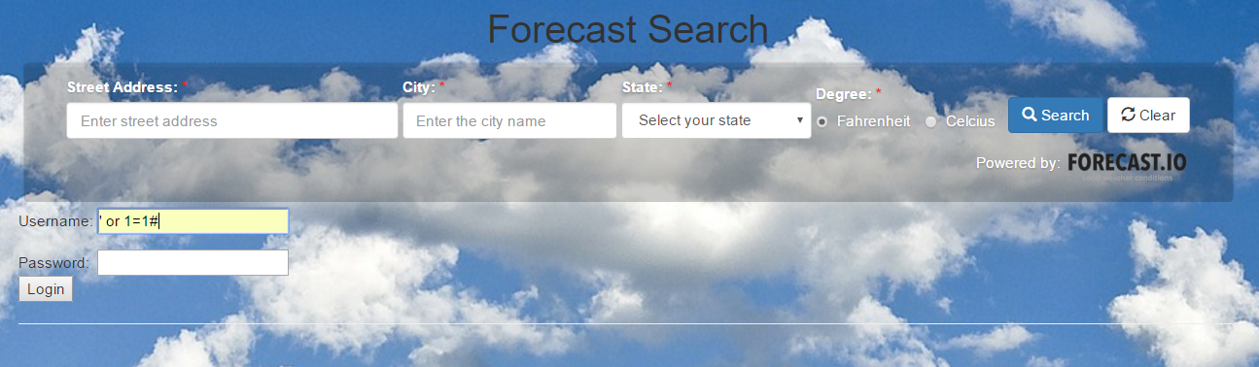
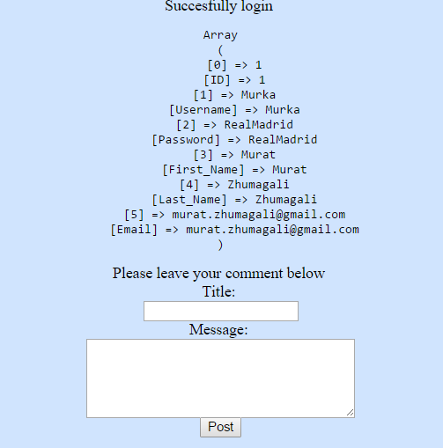

Slide 6
SQL injection prevention
We can prevent this type of attacks with:
input sanitization mysqli_real_escape_string(var) or addlashes
prepared statements
stored procedures
In this project I am using input sanitization and prepared statements:
$Username=mysqli_real_escape_string($mysqli, $_POST['username']); $Password=mysqli_real_escape_string($mysqli, $_POST['password']);
$Username=addslashes($Username); $Password=addslashes($Password);
Prepared statements:
$sql="select First_name, Last_name, Email from users where Username=? AND Password=?";
$stmt=$mysqli->prepare($sql);
$stmt->bind_param('ss', $Username, $Password); // Second approach is using a Mysqli prepared statements
$stmt->execute();
$stmt->bind_result($First_name, $Last_name, $Email);
if ($stmt->fetch()){
echo "Succesfully login <br>";
echo "First_name ----> ".$First_name."<br>";
echo "Last_name ----> ".$Last_name."<br>";
echo "Email ----> ".$Email."<br>";
}else{
echo "Sorry, login information is incorrect <br>";
}

Slide 7
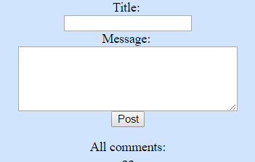
Next attack is Cross site scripting(XSS)
An attacker can inject untrusted Javascript into your app without validation.
Types:
Reflected, easiest to exploit;
Stored, also called as persistent XSS;
DOM, hardest to find.
I am going to show Stored XSS. In a stored XSS, an attacker is able to inject a persistent script in the target website which will execute when anyone visits it. Mostly script can be injected in a comment fields. So, I have comment field.

Slide 8
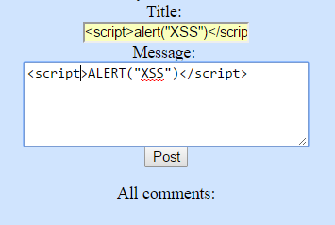
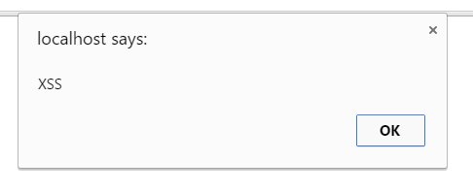
XSS example
As we can see it works, we have pop alert window with message, now let’s try to get cookie.

Slide 9
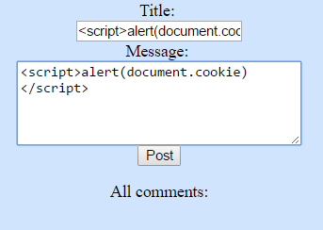
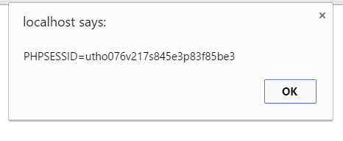
See, we have cookie of the current user, we can play with that. If the user has any open session like social networks or bank sites, he/she might be in a trouble.

Slide 10
XSS prevention
There are many ways of preventing it like:
htmlspecialchars;
Htmlentities;
strip_tags;
str_replace and preg_replace.
I am using string and char sanitizer.
$title=filter_input(INPUT_POST, "title", FILTER_SANITIZE_STRING);
$text=filter_input(INPUT_POST, "mes", FILTER_SANITIZE_SPECIAL_CHARS);
In a nearly future I will try to implement reflected XSS and Csrf attack.

Slide 11
Thank You!

