Slide 1
Details on Covid 25

Slide 2
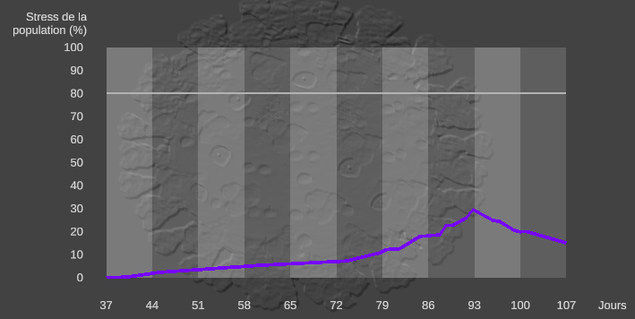
Revolution System
Computed at a national level
Some measures increase population stress (not enough mask for all the population)
Some measures can increase or decrease population stress depending on crisis evolution
Close schools while there is no lot of cases increases population stress
Close schools while there is lot of cases decreases population stress
…
If player lose control, population stress increases
If stress exceeds 80% of the population more than 15 days, the player loose the game… but s/he can choose to keep in charge!

Slide 3
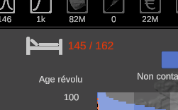
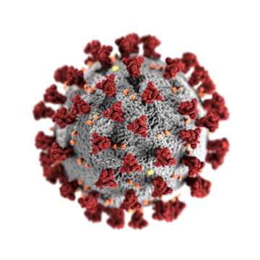

Beds System
Amount of beds is computed locally for each territory
If player ask to increase the amount of beds, it takes time…
| |
0 21 days
Virus properties
Death probability per day
Amount of beds needed = Number of patients in critic zone * virus serious case ratio

Slide 4
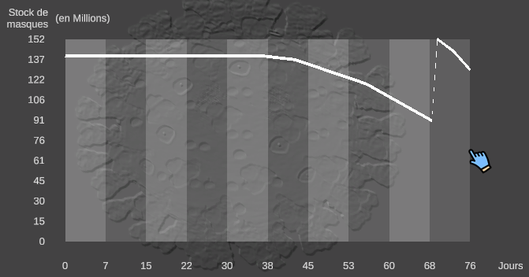
Mask system
Computed at a national level
Stock depends on
National production
International purchases
Number of infected people
Requisition for the medical profession
Self production
…

Slide 5
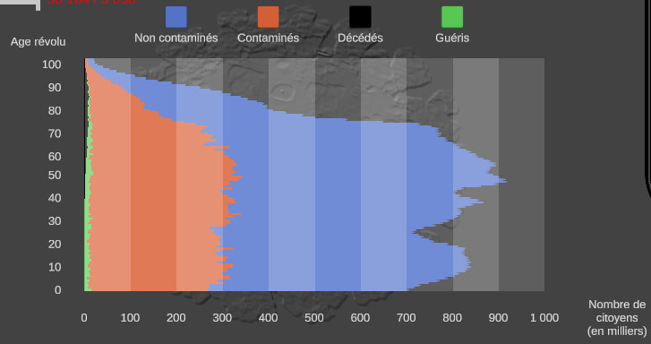
Infection System
Computed locally for each territory
Compute probability of new patient coming from a foreign country (depends on closing frontiers)
Compute probability of new patient coming from other territories (depends on restriction in each territory)
Compute contamination inside territory

Slide 6
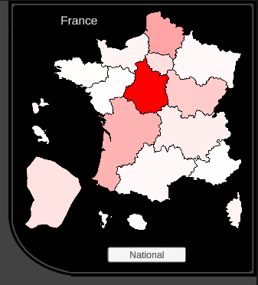
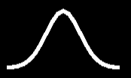
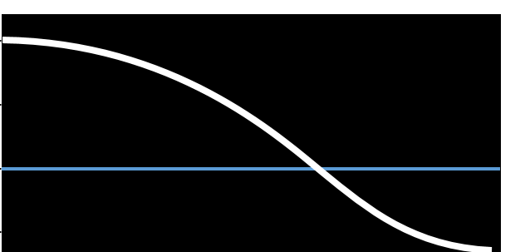
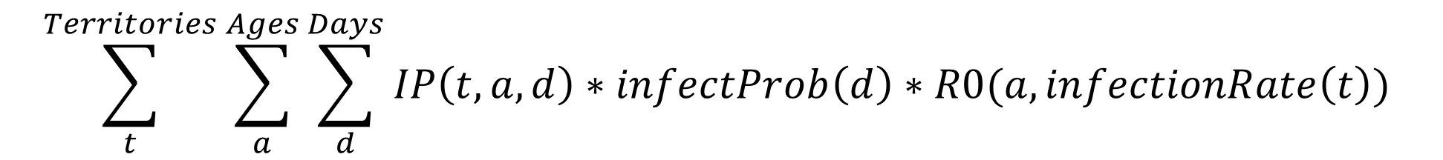
Infection System
R0
3 -
2 -
1 -
0 -
| |
0 21 days
| | |
0% 60% 100%
Amount of infected people
Contagion probability per day
R0 as a function of infection rate
$$\sum_{t}^{Territories}{\sum_{a}^{Ages}{\sum_{d}^{Days}{IP\left(t, a, d\right)∗infectProb\left(d\right)∗R0(a, infectionRate\left(t\right)) }}}$$
Apply penalties/bonuses depending on player’s decisions and masks stock

Slide 7
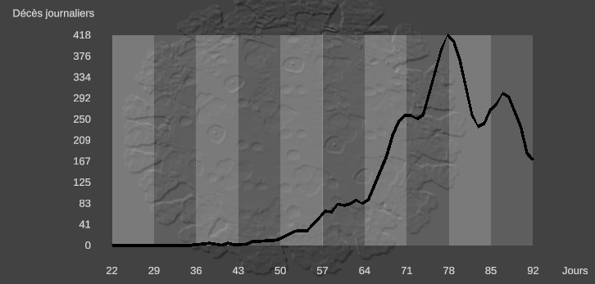

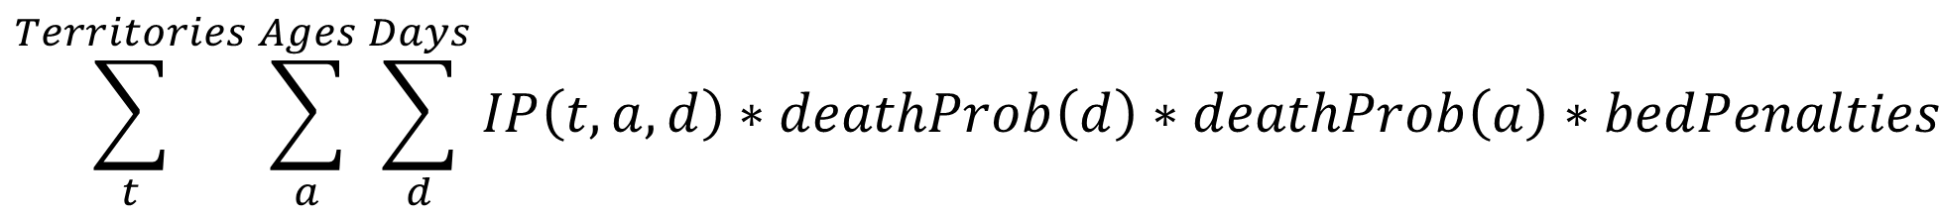
Dead System
Computed locally for each territory
| |
0 21 days
| |
0 100 y.o.
Amount of infected people
Death probability per day
Death probability per age
$$\sum_{t}^{Territories}{\sum_{a}^{Ages}{\sum_{d}^{Days}{IP\left(t, a, d\right)∗deathProb\left(d\right)∗deathProb\left(a\right)∗bedPenalties }}}$$

Slide 8
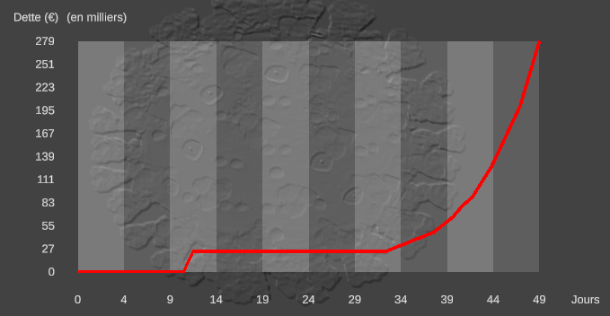
Debt System
Computed at a national level
Cumulate expenses depending on player choices
Close frontier => reduce tourism
Close shop + Cancel corporate tax => reduce income for state
Number of emergency beds used => 1 day of emergency bed costs 4 600€ for social security
Purchase of vaccine doses and masks
…

Slide 9
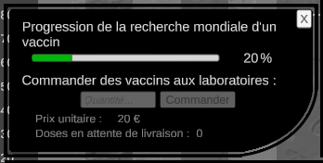
Vaccine System
Computed at an international level
When a vaccine is discovered, the player can purchase doses
When doses are delivered, population is vaccined
The oldest first
It take time…

Slide 10
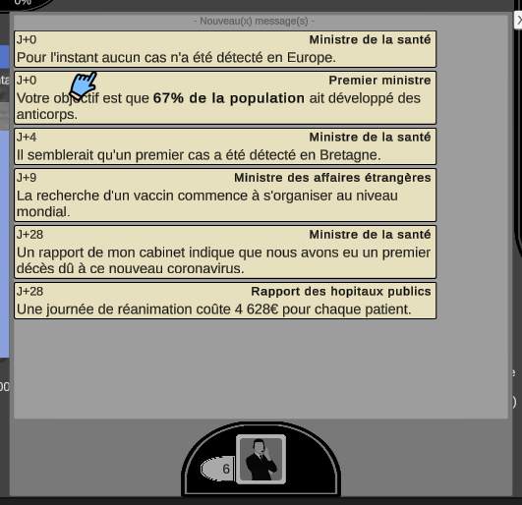
Advisor System
If data exceed thresholds, new message is pushed on advisor panel
Exemple:
If debt exceeds 1Md€ => "Can we support these measures for a long time?”
If the number of daily death exceeds 750 => “You should take measures to contain the pandemic.”
If the number of emergency beds needed exceeds available beds => “There are too many patients compared to the number of intensive care beds.”
…

