Slide 1
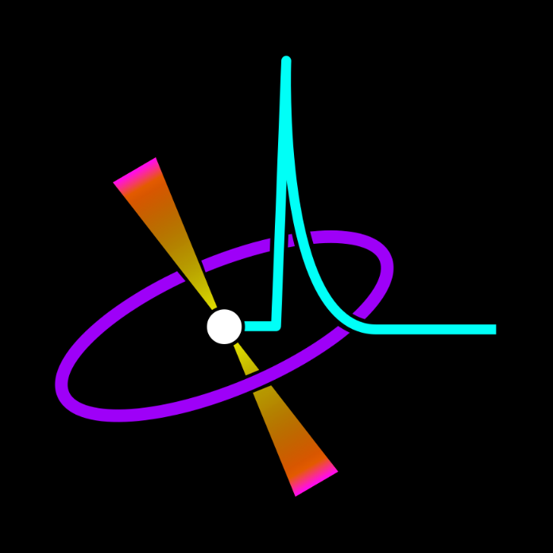
Burst Chaser
Carter Murawski

Slide 2
A citizen science project to classify Gamma Ray Bursts.

Slide 3
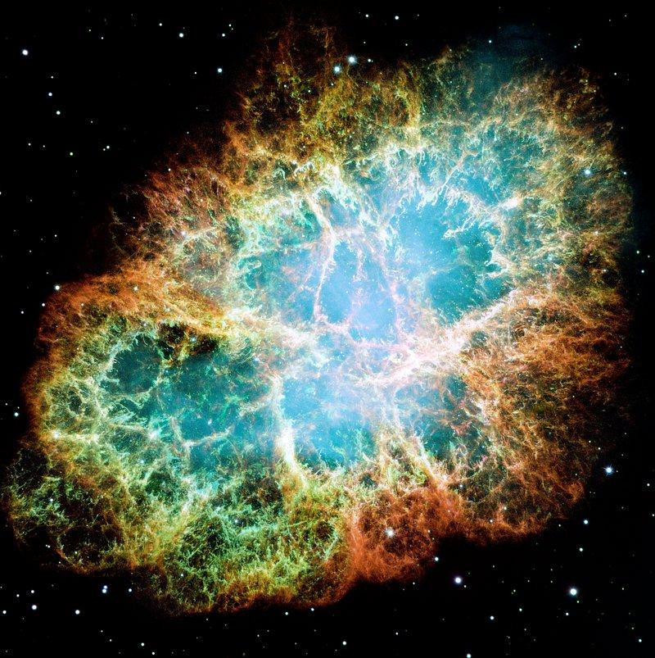
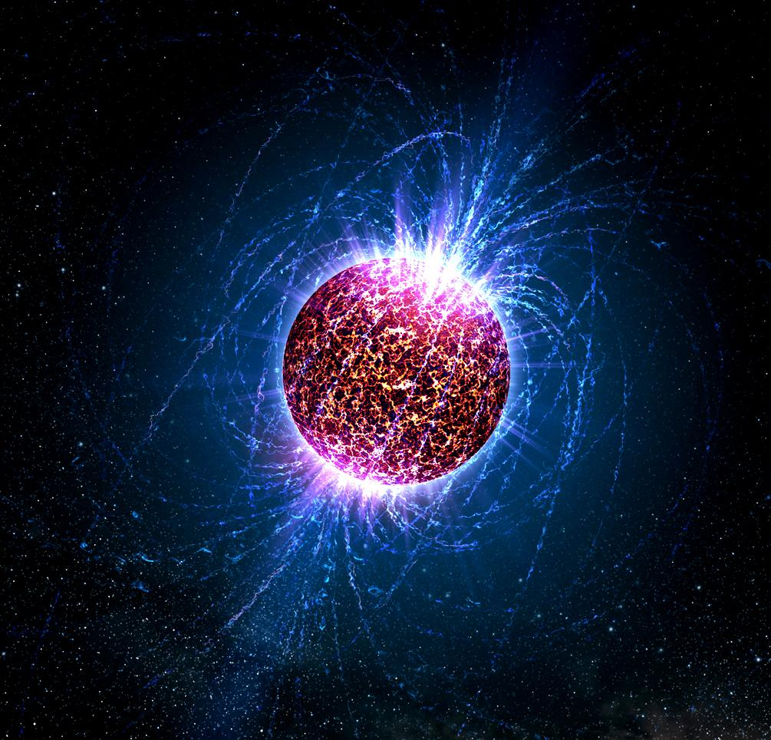
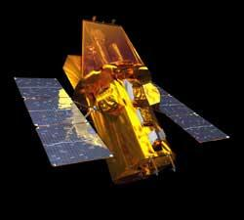
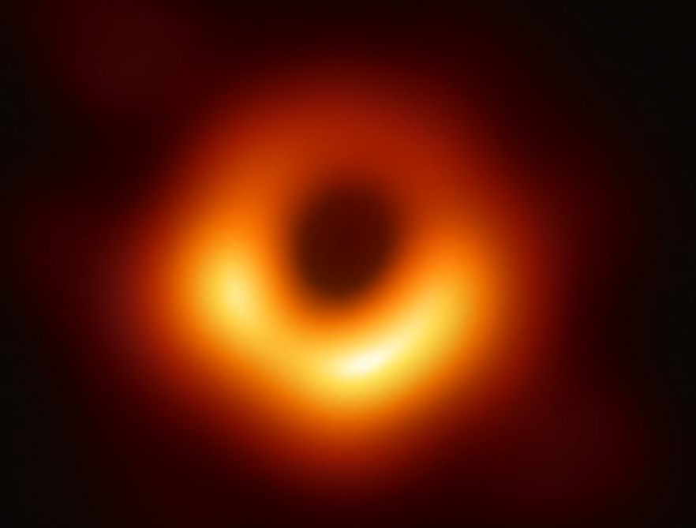
What is a Gamma Ray Burst?
Space Explosions
Supernova
Neutron Star
Black Hole

Slide 4
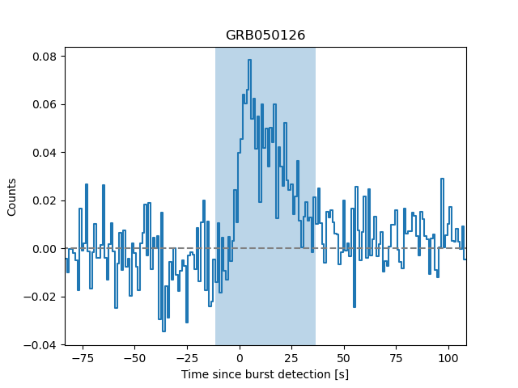
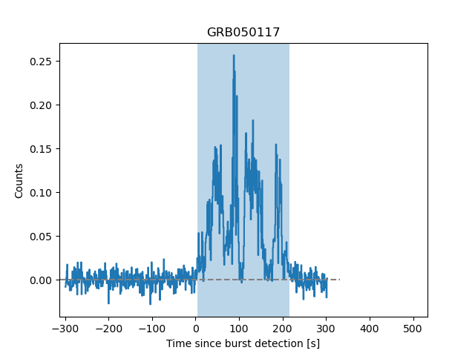
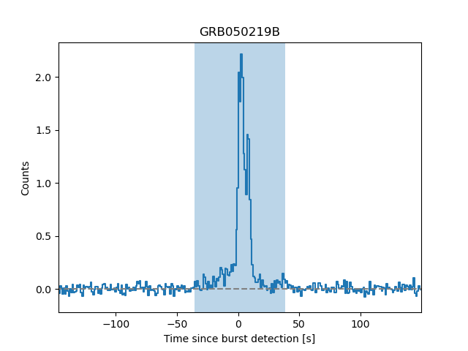
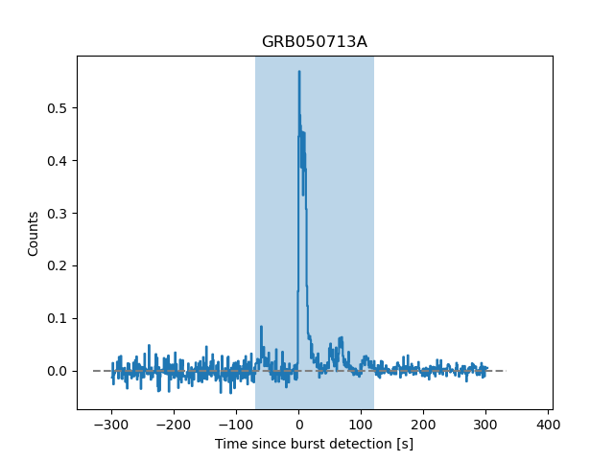
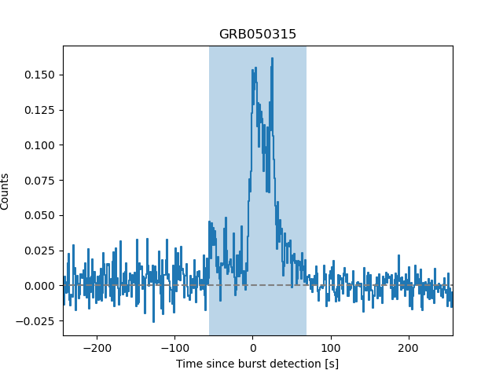
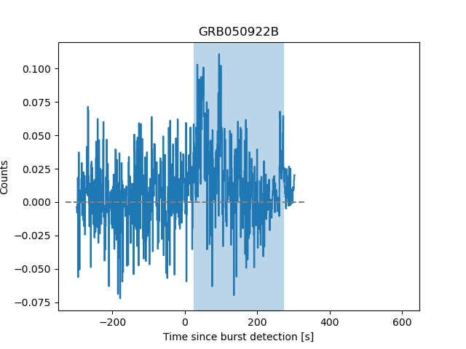
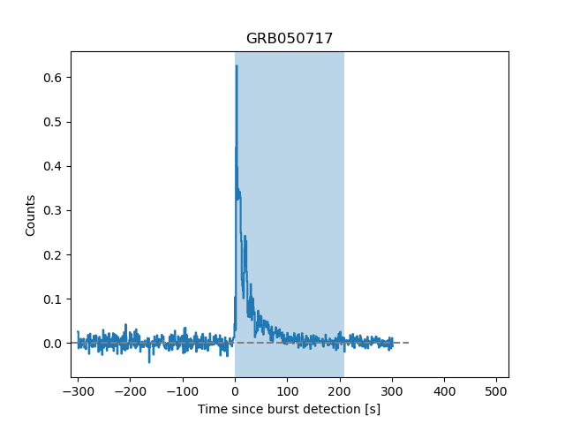
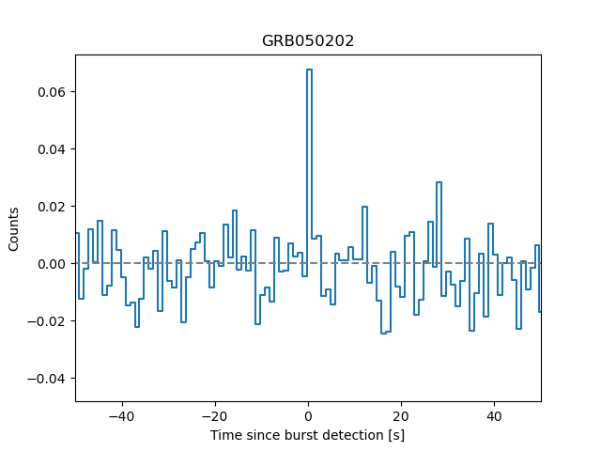
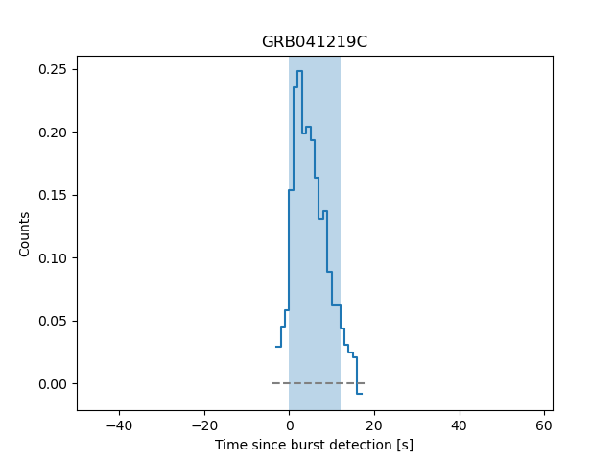

Slide 5
SIMPLE
EXTENDED
OTHER
TOO NOISY

Slide 6
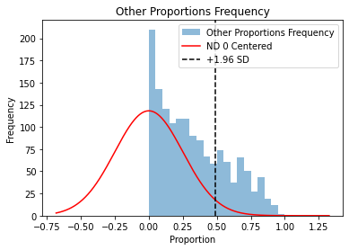
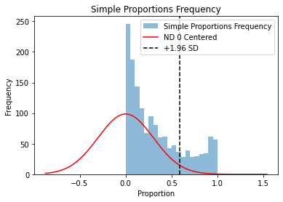
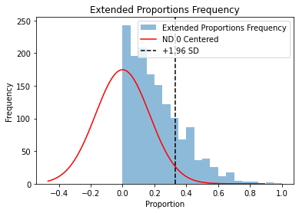
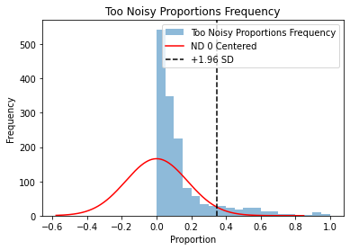
Preprocessing Data
Get Accurate Verified Classifications
Human Error
Image Flattening

Slide 7
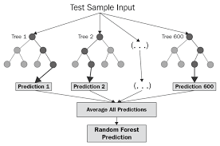
Choosing a Classifier
Random Forest
Why
Classifying in group
Looking for features

Slide 8
Refining Data
Pixel Size of Images (15,32,64)
Training Test Split
Confidence Interval Going in

Slide 9
Results
Training Data Accuracy 86%
Golden Sample Accuracy 68%
10,15,8,1
Classified extended

Slide 10
For the Future
Pros
Cons
For large amounts of data you don’t have to classify forever.
Gets rid of human biases if trained well.
Proves alternative approach to numbers could work
May need very clear images
Is the graph picking up features of the graph or just the way its drawn

