Slide 1
Classifying Light Curves With Machine Learning
Carter Murawski

Slide 2
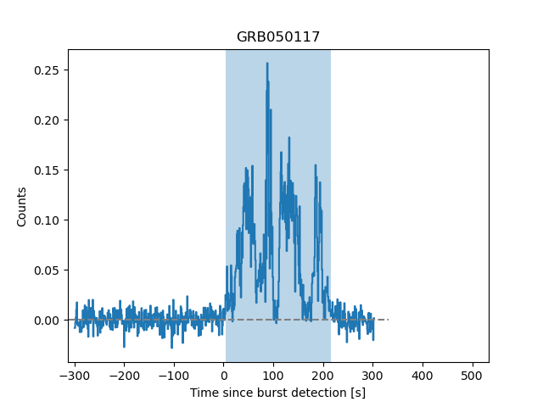
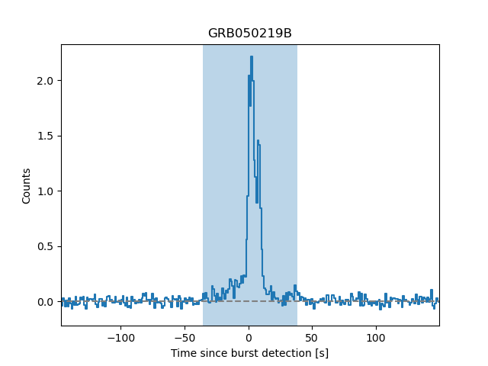
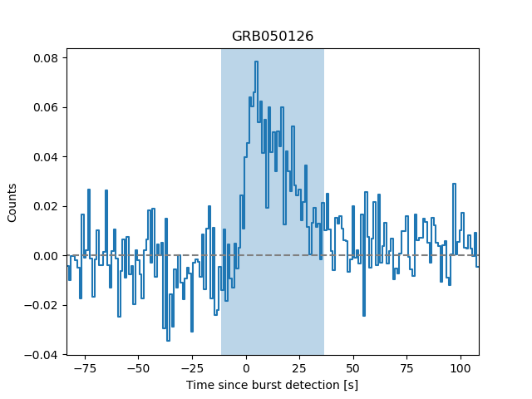
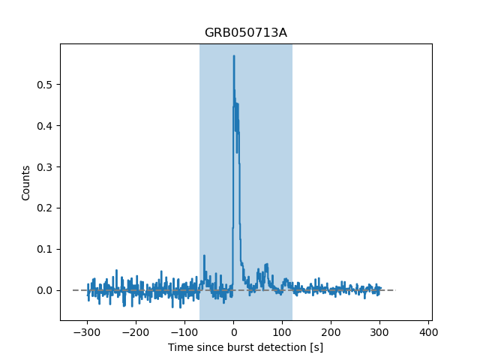

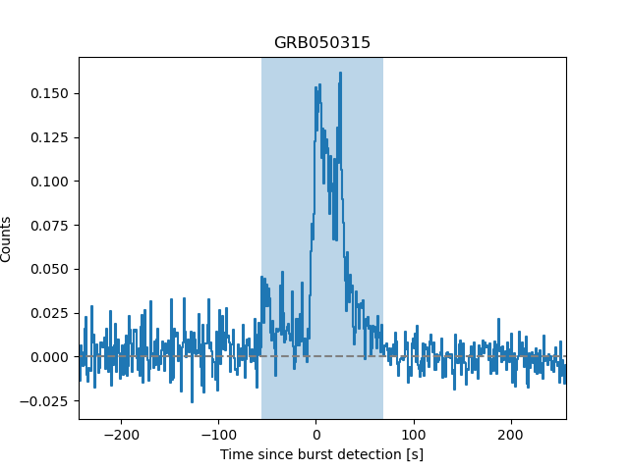
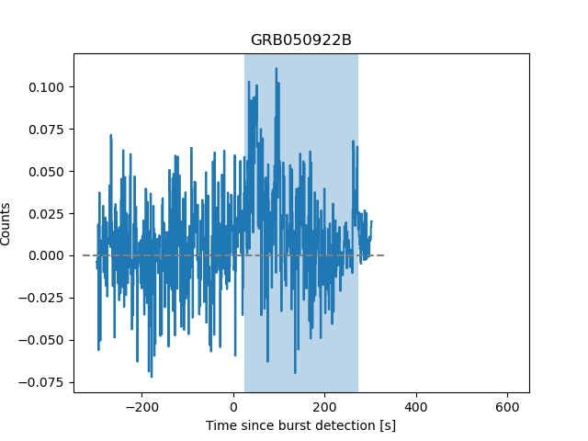
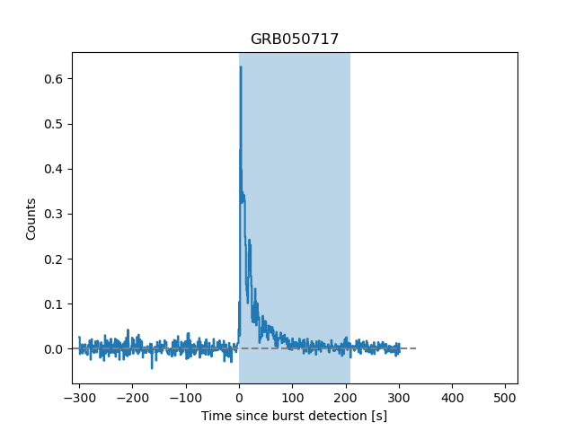
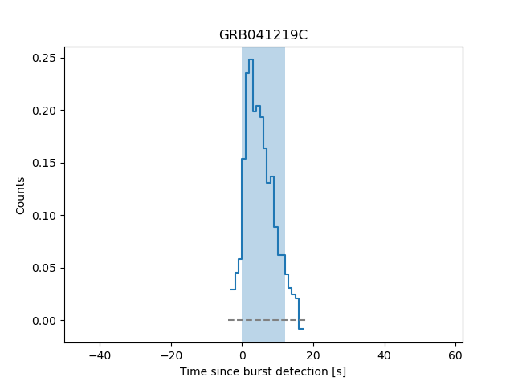
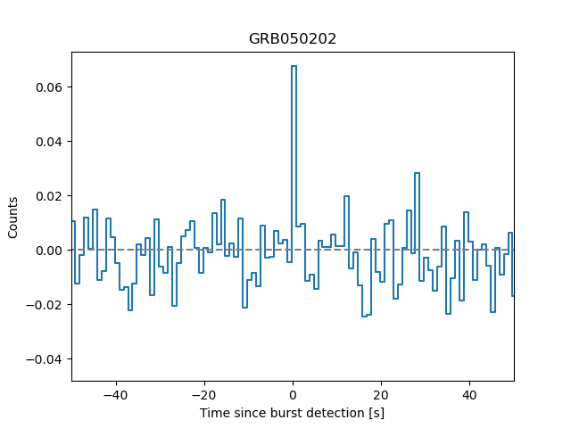
First Things First…
Burst Chaser Project
Citizen Science
Classify
Comments
Tags

Slide 4
SIMPLE
EXTENDED
OTHER
TOO NOISY
Notes:
So we need to give all these things labels that can be taught to other people

Slide 5




Choosing The Data Type

Slide 6
How it Works?

Slide 7
How it Works?
0 | 0 | 1 | 0 | 0 | 0
0 | 1 | 1 | 0 | 1 | 0
0 | 1 | 1 | 1 | 1 | 0
1 | 1 | 1 | 1 | 1 | 0

Slide 8
How it Works?
0 | 0 | 1 | 0 | 0 | 0
0 | 1 | 1 | 0 | 1 | 0
0 | 1 | 1 | 1 | 1 | 0
1 | 1 | 1 | 1 | 1 | 0

Slide 9
How it Works?
0 | 0 | 1 | 0 | 0 | 0

Slide 10
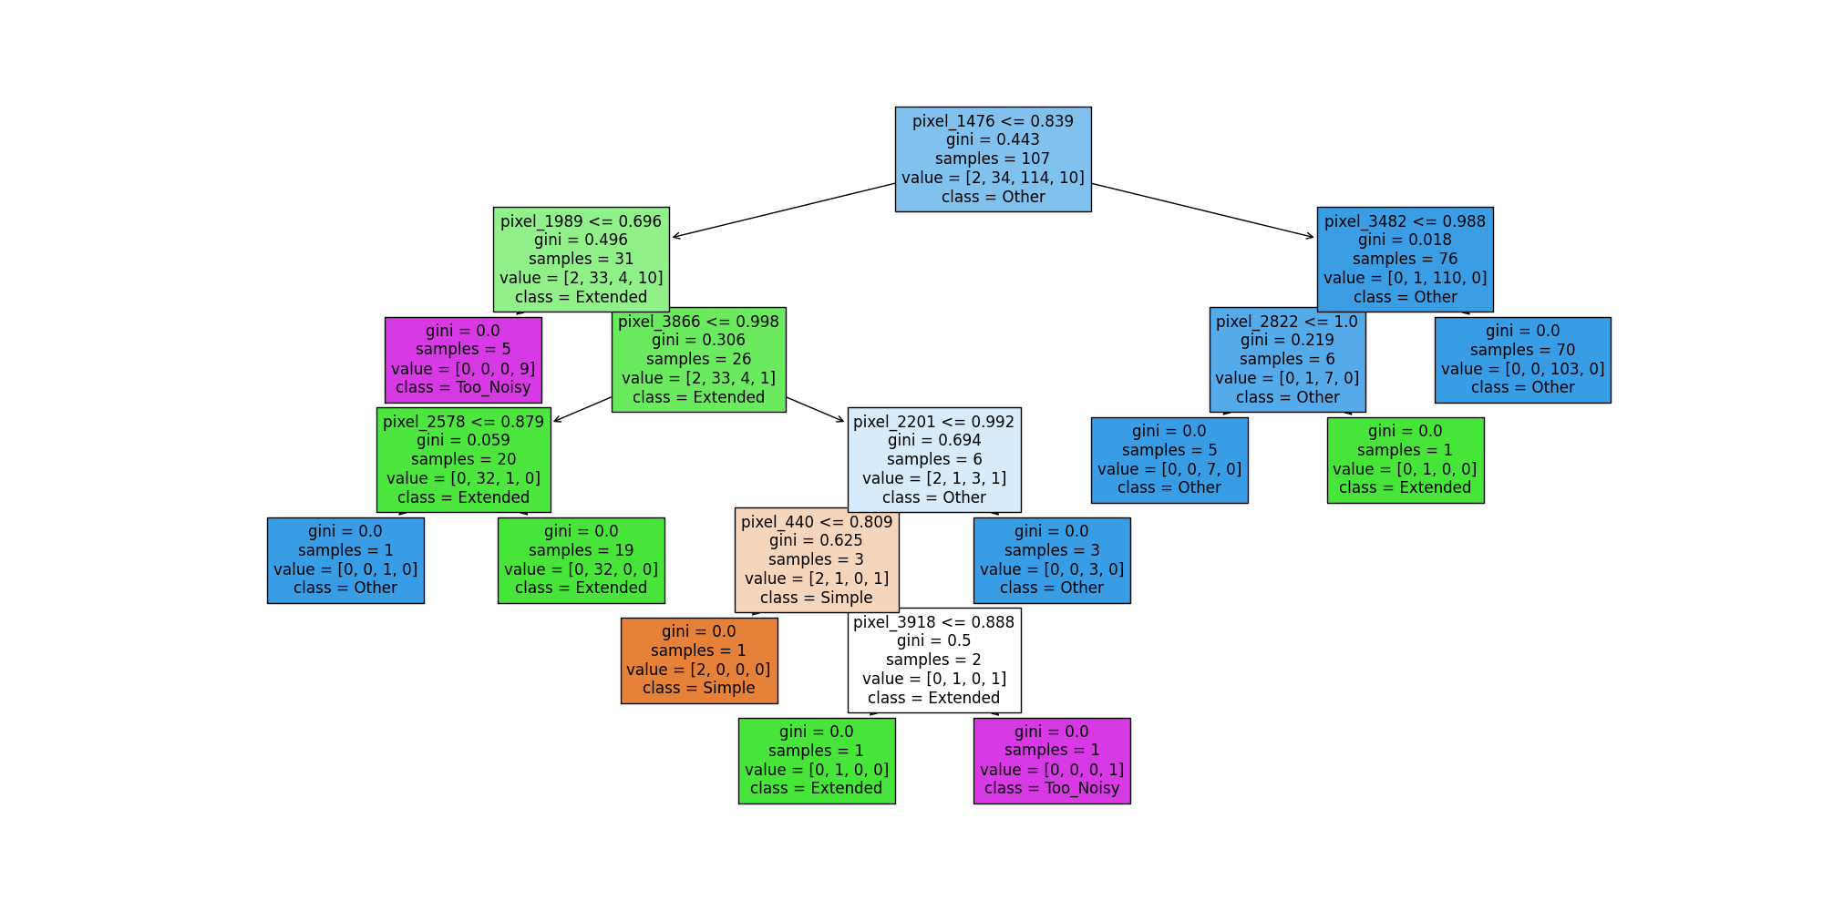

Slide 11
In Order to Use Machine Learing We Need Data. That’s why we use Citizen Science. After Deciding how reliable it was. We can then use the data tor train models.
The Proccess, Why I chose Image Processing, and Why I chose the Random Forest Classifier
The resultse were good show examples
Interesting things that were found that you reall don’t need that much its more about quality

Slide 12
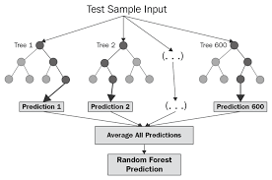
Choosing a Classifier
Random Forest
Why
Classifying in group
Looking for features

Slide 13
Ra

Slide 14
Refining Data
Pixel Size of Images (15,32,64)
Training Test Split
Confidence Interval Going in

Slide 15
Results
Training Data Accuracy 86%
Golden Sample Accuracy 68%
10,15,8,1
Classified extended

Slide 16
For the Future
Pros
Cons
For large amounts of data you don’t have to classify forever.
Gets rid of human biases if trained well.
Proves alternative approach to numbers could work
May need very clear images
Is the graph picking up features of the graph or just the way its drawn

