Slide 1
Secure Seat
Presented by Christopher Wolf

Slide 2
Project Overview
Secure Seat is a device that automatically locks a user’s desktop when they step away from their desk.
This device is intended to increase security without affecting usability.
This is accomplished using:
-Raspberry Pi Zero W with Raspbian OS (utilizing the USB On The Go port)
-A circuit utilizing a FlexiForce pressure sensor and MCP3008 Analog to Digital converter chip
-A Python script that emulates keyboard strokes using HID commands

Slide 3
Problem Description
Unlocked desktops are an issue that plague all businesses. Even when all employees try to be compliant with security policies they can be distracted and forget.
Stakeholders needs:
Employees- Will no longer be reprimanded for forgetting to lock their desktop
Businesses/Government Organizations- Peace of mind that one potential security hole is patched
IT Professionals- Will be able to focus on more important problems. No longer needs to lecture Debra every week when she leaves her computer unlocked with sensitive data displayed on the screen.

Slide 4
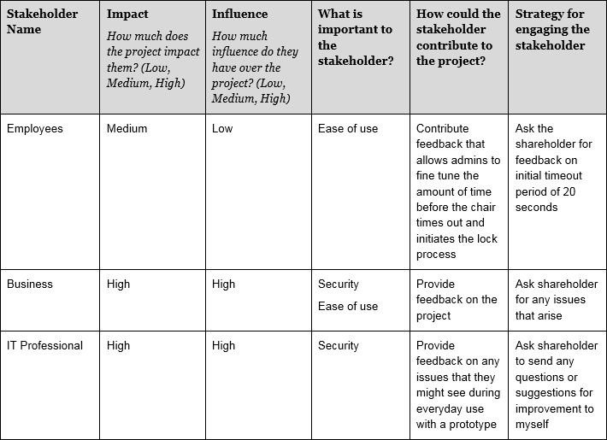
Stakeholder Analysis

Slide 5
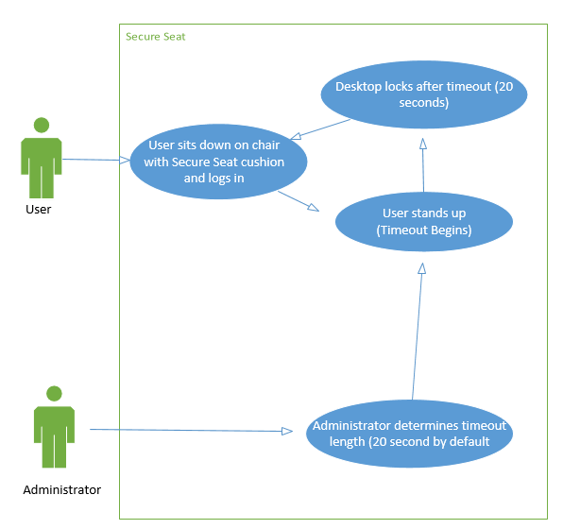
Use Case Diagram

Slide 6
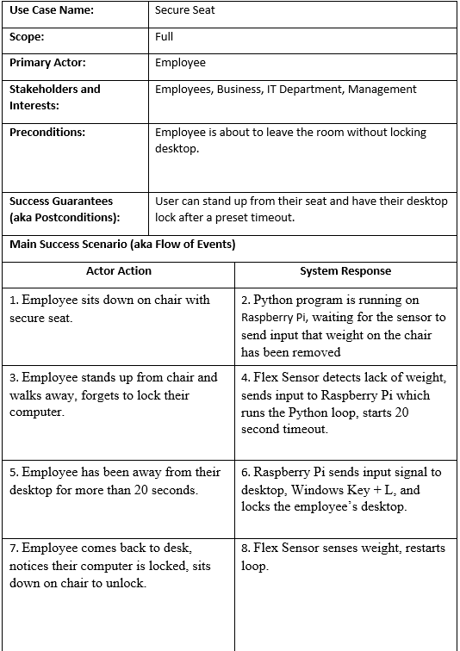

Slide 7
Use Case description
User:
User logs into computer, then stands up from their seat and walks away.
FlexiForce sensor detects nobody is in chair, signal is sent to python script running on python zero to countdown 20 seconds
Once 20 seconds has elapsed Python script then sends a HID value “\x8\0\xf\0\0\0\0\0” that locks the users computer (Windows Key + L)
Now that desktop is locked the python script and sensor are reset until a user sits down and resets that process.
Administrator:
Can manually edit the config file that pulls the timeout value for the python script. This allows the administrator to adjust how long before the seat locks the desktop.

Slide 8
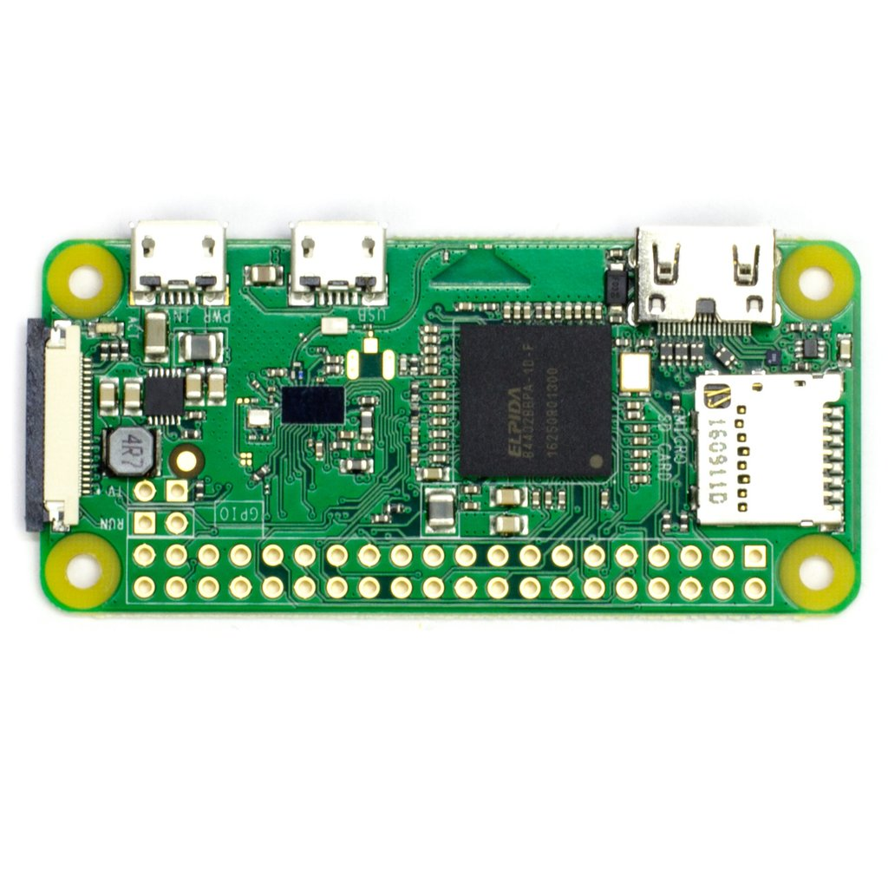
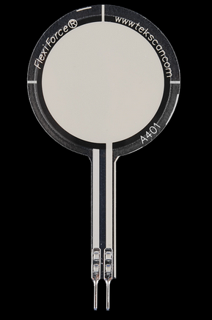
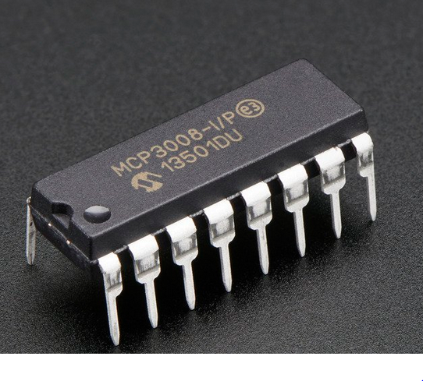
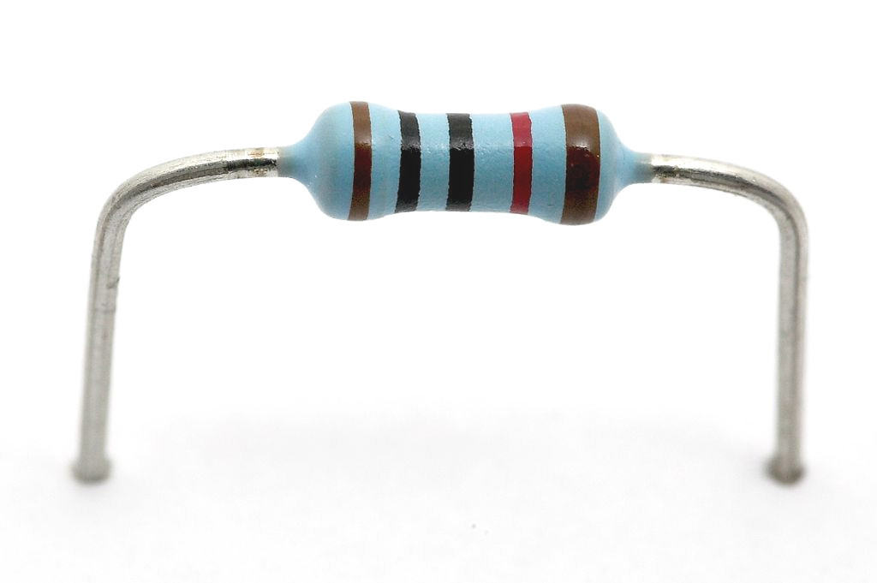
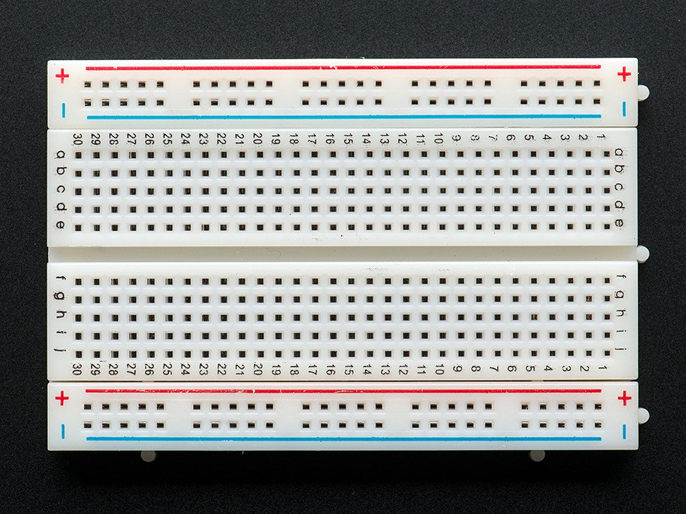
Prototype Design Specifications (Hardware)
Raspberry Pi Zero W
FlexiForce Pressure Sensor
MCP 3008
50-100k Ω resistor
Bread Board to build circuit

Slide 9
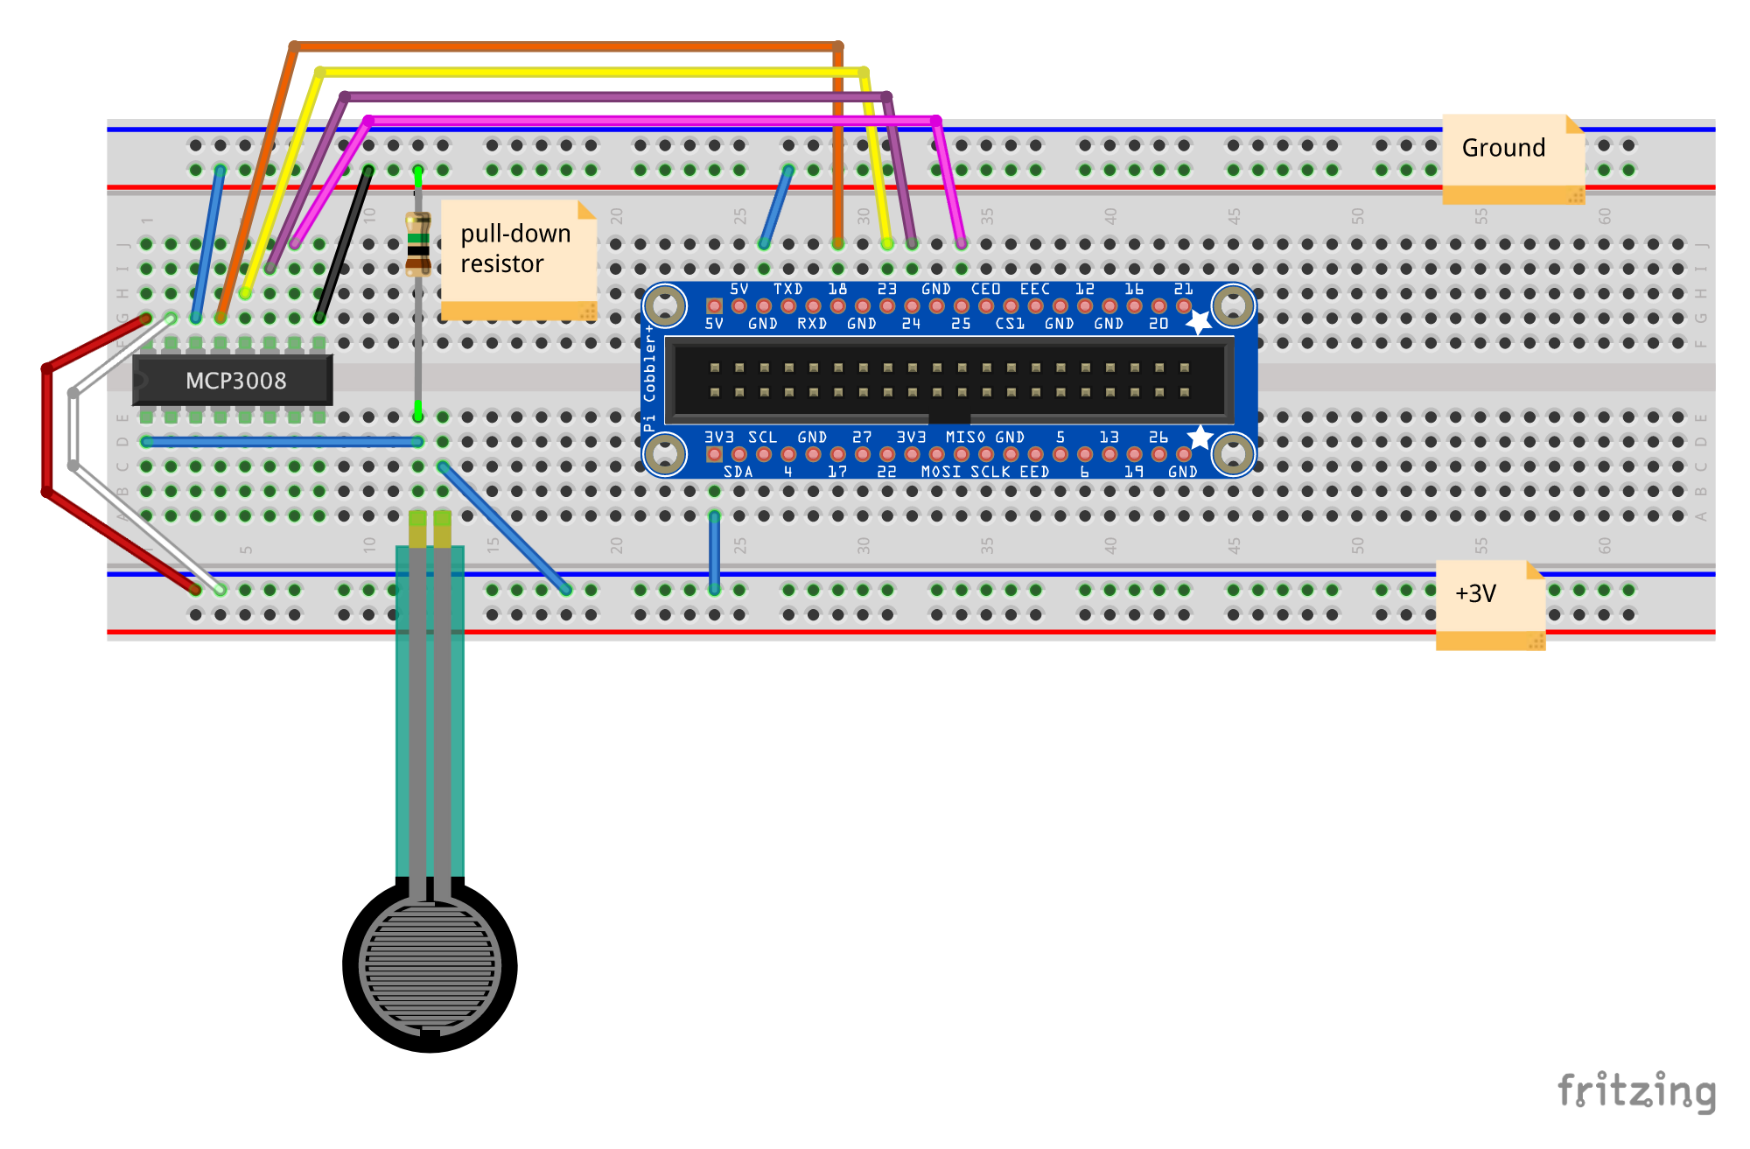
Prototype Design Specifications

Slide 10
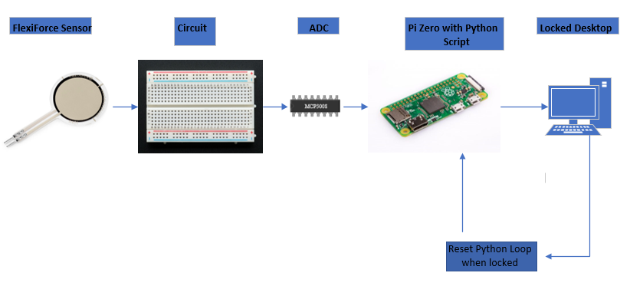
Prototype Design Specifications

Slide 11
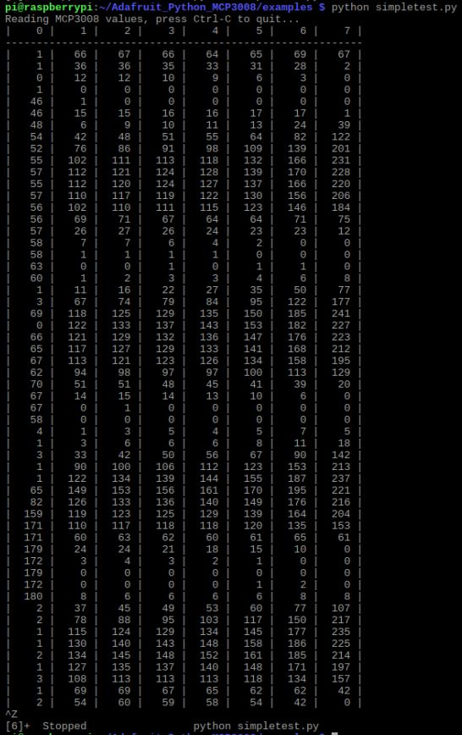
Pressure Sensor Performance Metrics
Sensor is too small to use with a cushion so it had to be scaled down.
Test script showing readings with and without rock placed on top of pressure sensor.
This is how I determined the threshold for whether or not someone is considered “sitting” on the “cushion”. If reading for Channel 0 < 20 then start timeout on python script.

Slide 12
USB HID protocol
[modifier, reserved, Key1, Key2, Key3, Key4, Key6, Key7]
Lowercase a = [0, 0, 4, 0, 0, 0, 0, 0]
Uppercase A = [2, 0, 4, 0, 0, 0, 0, 0]
Windows Key + L = “\x8\0\xf\0\0\0\0\0”
Notes:
Uses gadgetFS to create a keyboard gadget, must have enabled kernel (kernel connects the hardware to the application)

Slide 13
Performance evaluation
Expected Function:
Sensor must be contained inside of a cushion
Interfaces with the Windows PC wirelessly
Ability to change timeout settings easily
Does not affect usability of employee workstations
Reality:
This was not possible with the pressure sensors I was able to find and purchase online. Very small pressure sensors or giant industrial truck scales.
The only way I could send commands from a python script on a Raspberry Pi to a Windows PC was utilizing it’s USB On The Go port. This allows the pi to send HID keystrokes to the Windows PC, emulating a keyboard.
Timeout settings are changed directly on the raspberry pi utilizing a TimeoutConfig.txt file.
As long as the timeout settings are correct for the individual they should only notice their desktop automatically locking in case they forget to do it themselves.

Slide 14
Usability Considerations
IT staff will have to work with users in order to fine tune the timeout setting until they find what works best.
Administrators can modify the timeout value by logging into the Pi and modifying TimeoutConfig.txt.
The timeout should not activate unless a user is away from their computer. The timeout is implemented to stop the program from locking a users computer when they slightly shift weight off the sensor or stand up for a brief period to grab something nearby.

Slide 15
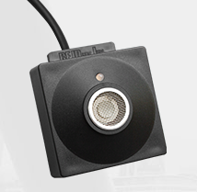
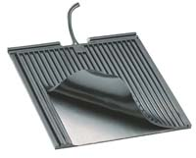
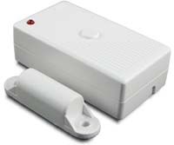
Alternatives to this device:
pcProx Sonar: $80
Automatically locks user PC using proximity sensor
ProxMat: $375
“The pressure sensitive ProxMat detects the user, when they step off the ProxMat the workstation is secured without the need of any user involvement.”
DocLok: Price Unknown
Automatically locks workstation when RF magnet detects an exam room being opened.

Slide 16
Device Feasibility
Economic:
I’m able to create another device prototype for $60, with roughly 4 hours of manpower.
This is more feasible for smaller businesses, on a larger scale it wouldn’t be practical.
Organizational:
Secure seat isn’t feasible in an organization until technical improvements to the device are made.
Technical:
The prototype needs improvements to meet organizational feasibility. I would add a case and longer wires. Having to use USB OTG is also an issue because that’s one long wire that a user could trip over. A revised prototype also needs a larger pressure sensor and cushion.
These changes would increase the overall cost of the device.

Slide 17
Costs Component Price:
Development Time (given $25/hour rate)
~6 hours per week, 15 weeks during the semester
$2250
Prototype Hardware Total:
$60 (One time cost per device)
Overall cost:
~$200 (Purchased wrong parts, bulk components, more expensive version)
Flexiforce Pressure Sensor:
$25
MCP3008:
$4
Raspberry Pi Zero W starter kit:
$26
This is where I would cut the cost of my device first, it’s $10 without the starter kit.

Slide 18
Benefits
Secure Seat is an affordable way for security to be increased without usability being affected.
Secure Seat is more valuable in a workplace that requires increased security. An office that must follow HIPAA policy would appreciate this device.

Slide 19
Lessons Learned
Simple projects can grow outside of the original scope quickly.
Spent weeks researching a method or technology only to realize it wouldn’t work on my project.
Gained knowledge and experience with:
HID Emulation and keystroke codes
Circuitry
Analog to digital conversion
First time using a soldering iron
Python scripting

Slide 20
Courses that helped to support this project:
CIS 115, ITE 285, ITE 370 (Visual Basic courses):
Helped with understanding the syntax of Python and how to plan out the logic/pseudo code for my project.
ITE 272 (Systems Architecture)
Helped me understand how to use Linux.
ITE 475 (IT Project Management)
Experience from this class helped me create my project timeline.

Slide 21

A place to learn and work on hobby projects.
The members are composed of friendly people experienced with electronics and woodworking.
Tools available for members use include: 3D printers, Laser engraver/cutter, Electronics workstations (Soldering stations, multi-meters, spare components),and Power tools
If there’s something you’re interested in working on but don’t know where to start this is a great place to jump in and get experience.

