Slide 2
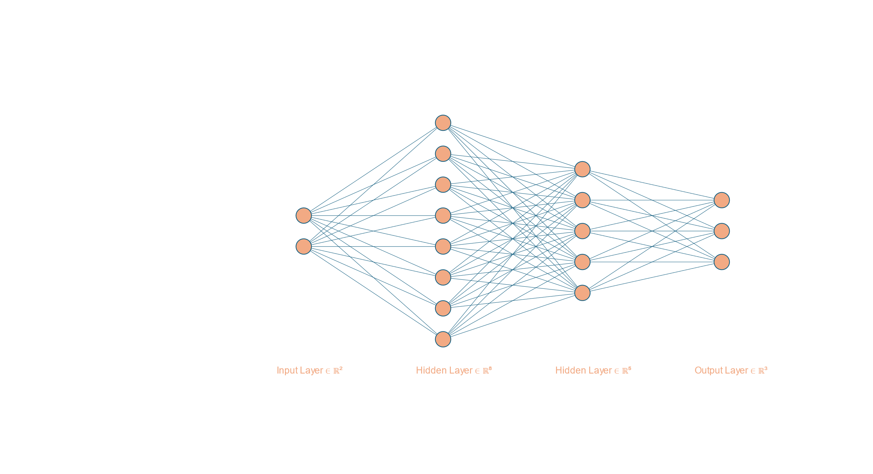

$$σ=ReLu or Tan or Sigmoid$$

Slide 3
Accuracy

Slide 4
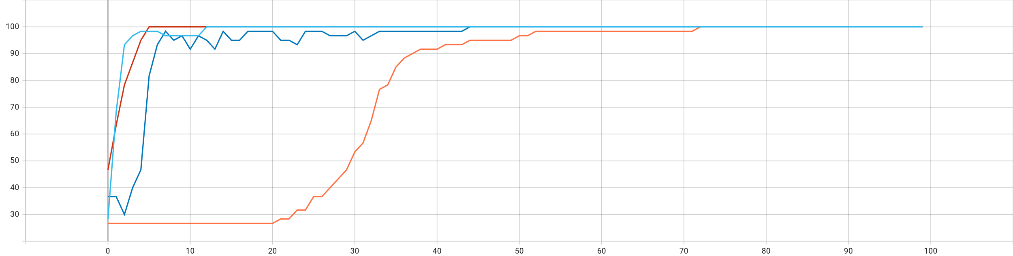
1 layered-Sigmoid
2 layered-Sigmoid
2 layered-ReLu
2 layered-Tanh
1 layered-Sigmoid
2 layered-Sigmoid
2 layered-ReLu
2 layered-Tanh

Slide 5
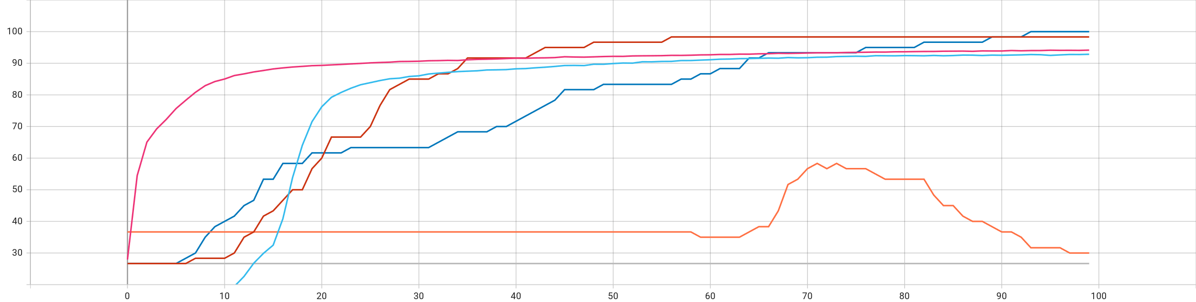
1 layered-Sigmoid
2 layered-Sigmoid
2 layered-ReLu
2 layered-Tanh

Slide 6
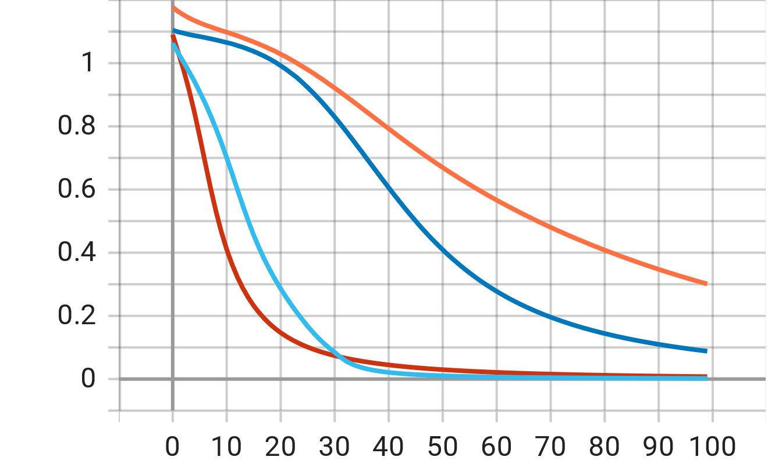
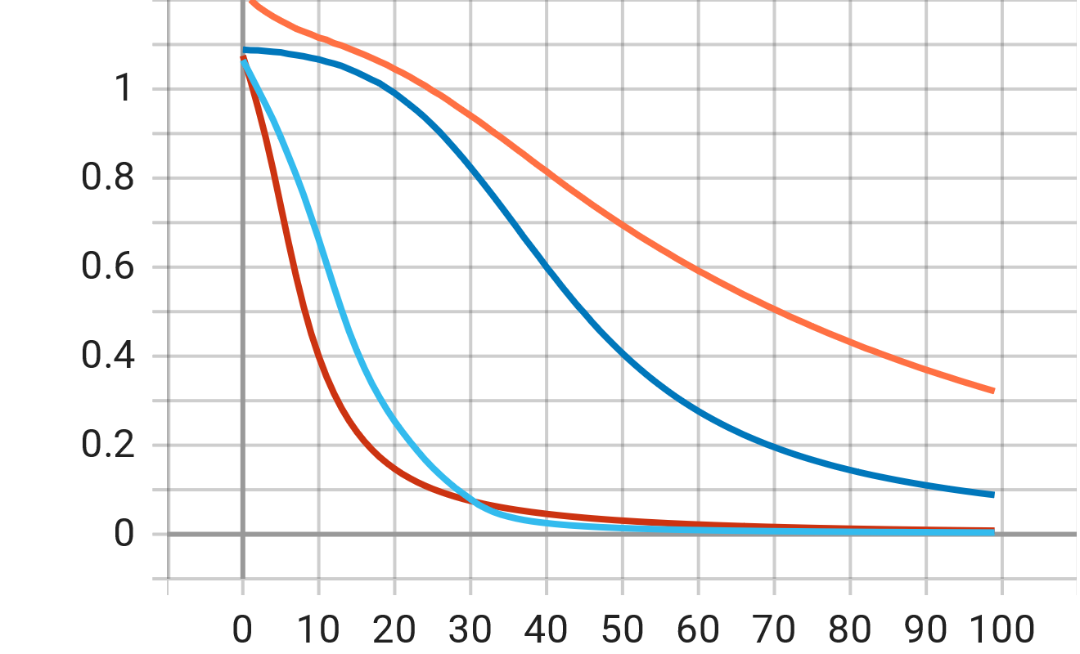
Loss
Adam
1 layered-Sigmoid
1 layered-Sigmoid
2 layered-Sigmoid
2 layered-Sigmoid
2 layered-ReLu
2 layered-ReLu
2 layered-Tanh
2 layered-Tanh
Training loss
Validation loss

Slide 7
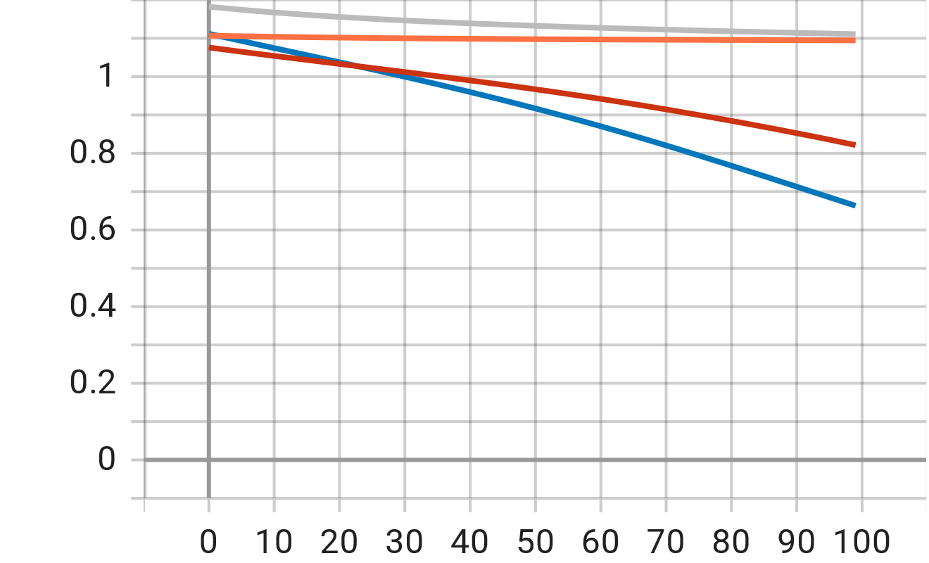
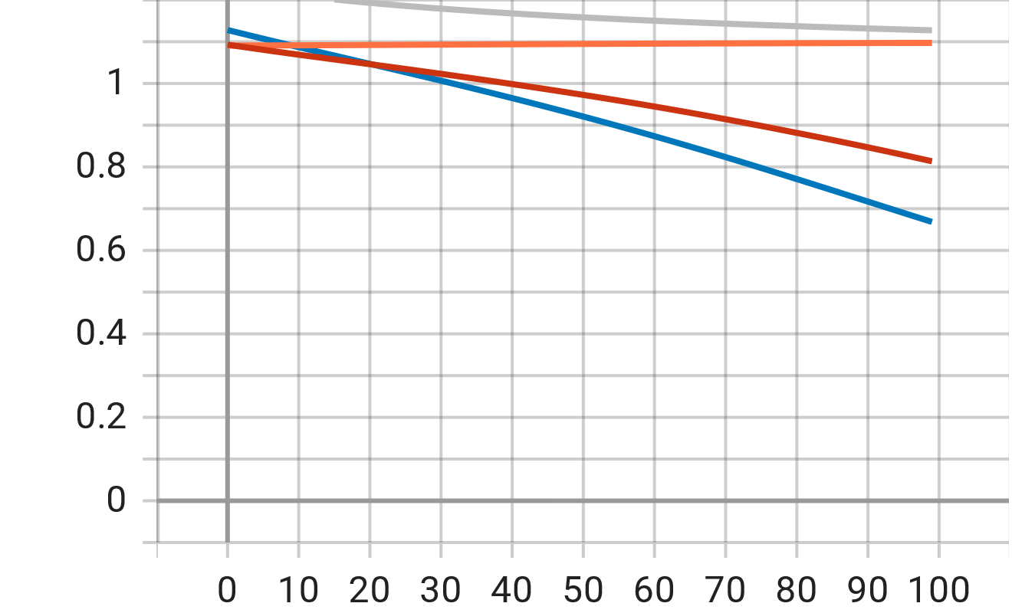
Sgd
1 layered-Sigmoid
2 layered-Sigmoid
2 layered-ReLu
2 layered-Tanh
Training loss
Validation loss

Slide 8
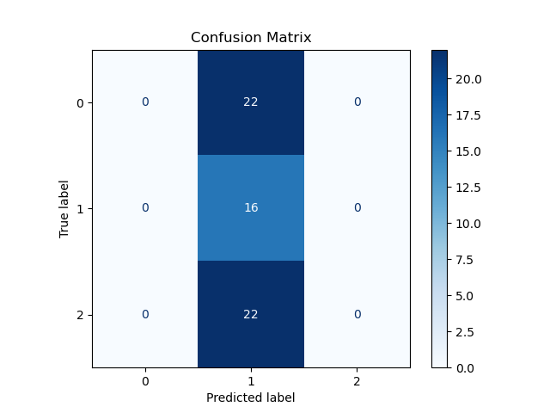
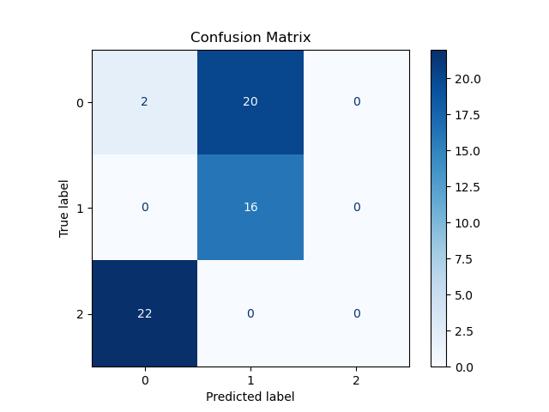
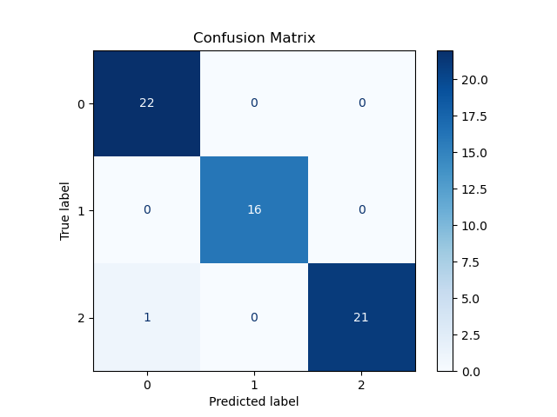
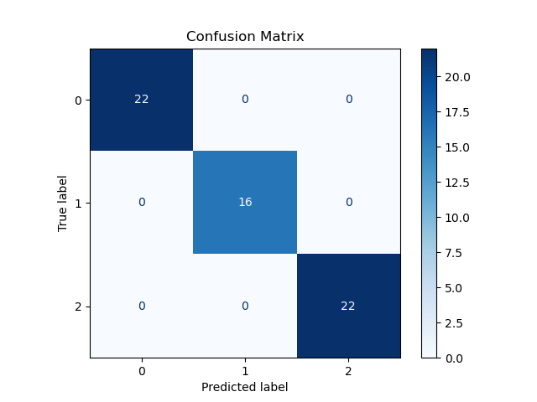
Sgd
Sigmoid 1 layer
Sigmoid 2 layer
ReLu
Tanh

