Slide 2
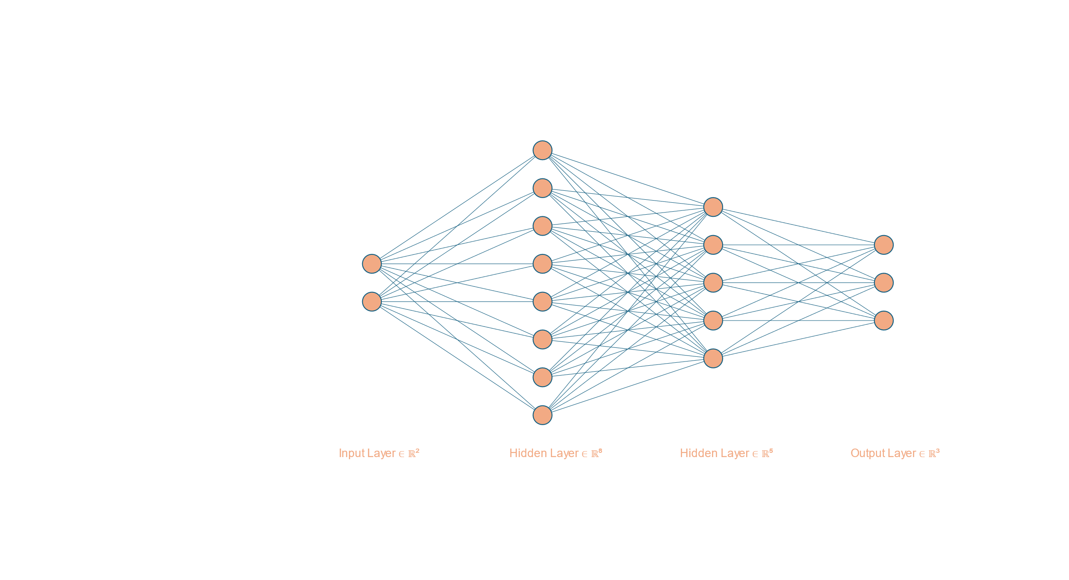

$$σ=ReLu or Tan or Sigmoid$$

Slide 3
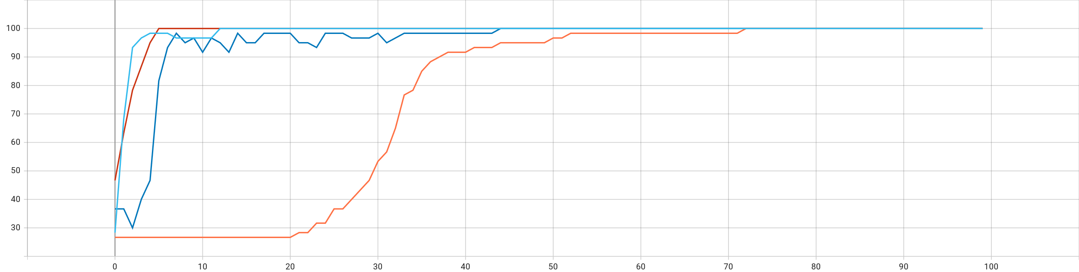
1 layered-Sigmoid
2 layered-Sigmoid
2 layered-ReLu
2 layered-Tanh

