Slide 2
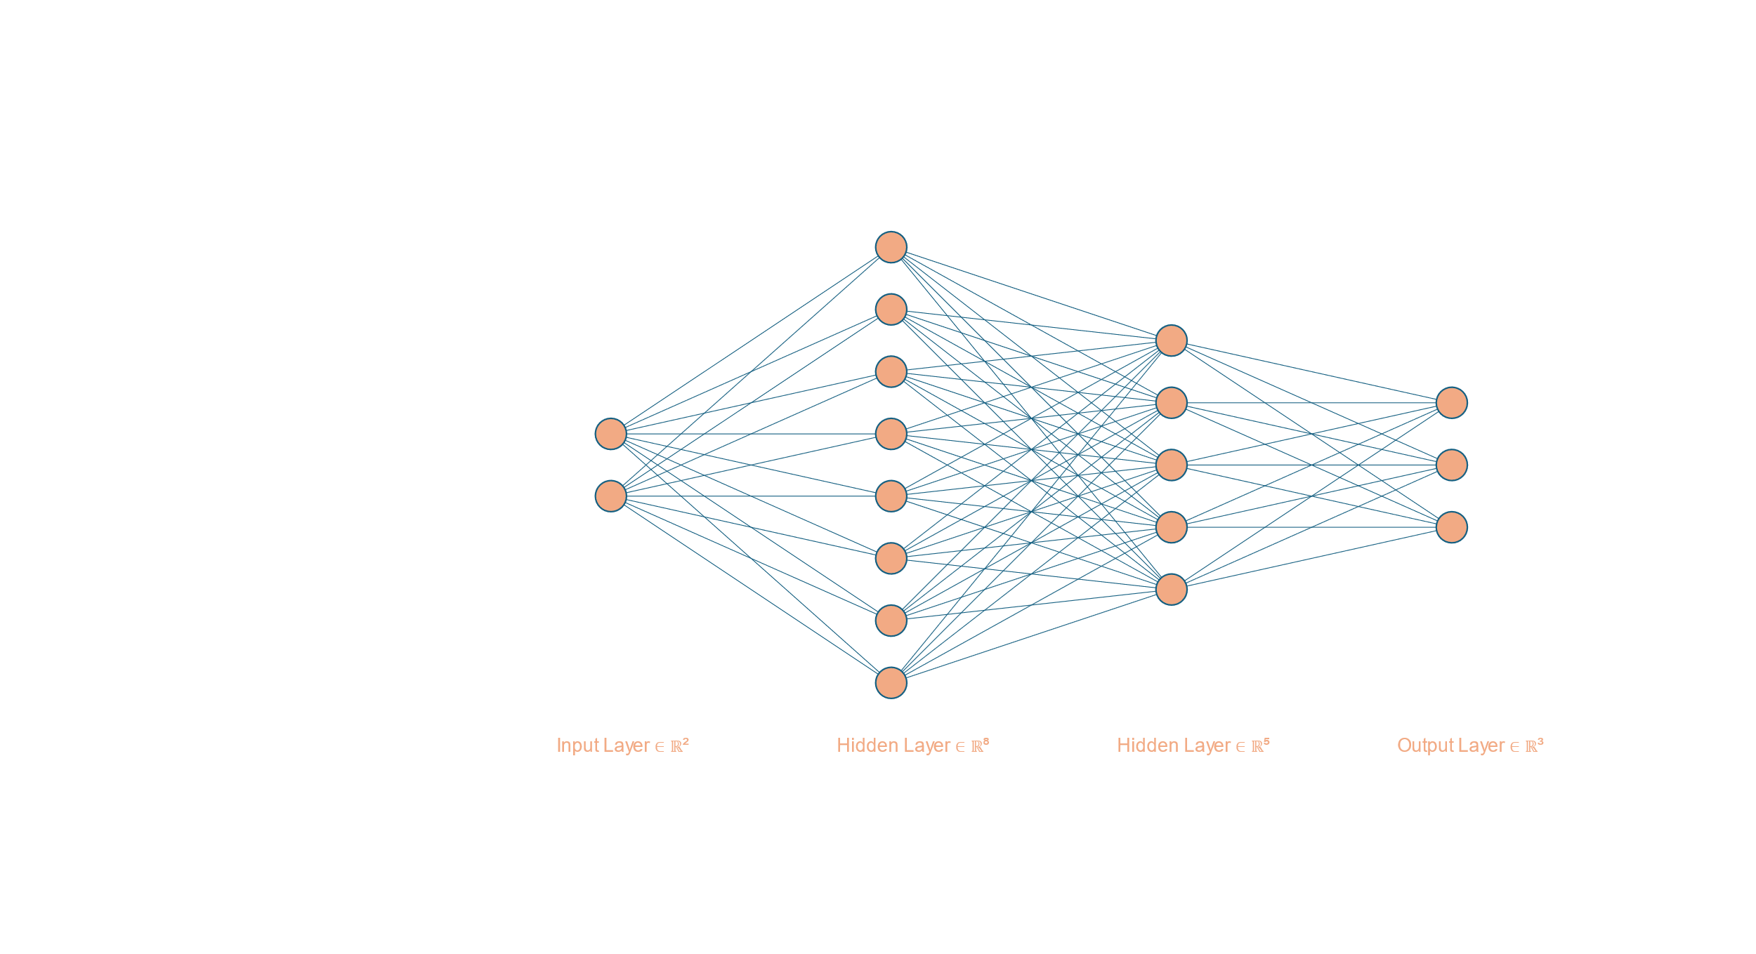

$$σ=ReLu or Tan or Sigmoid$$

Slide 3
Accuracy

Slide 4
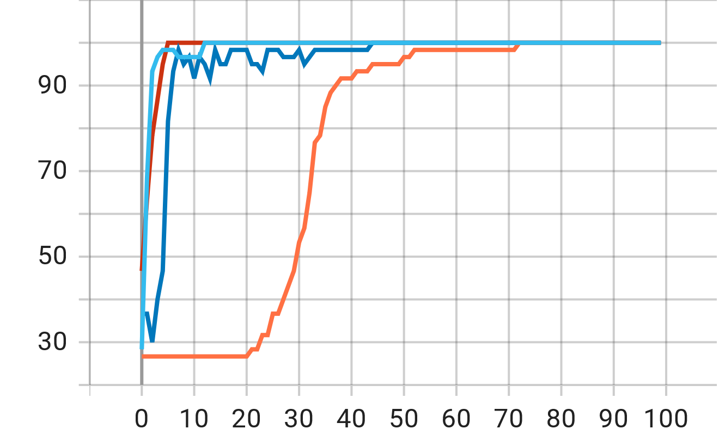
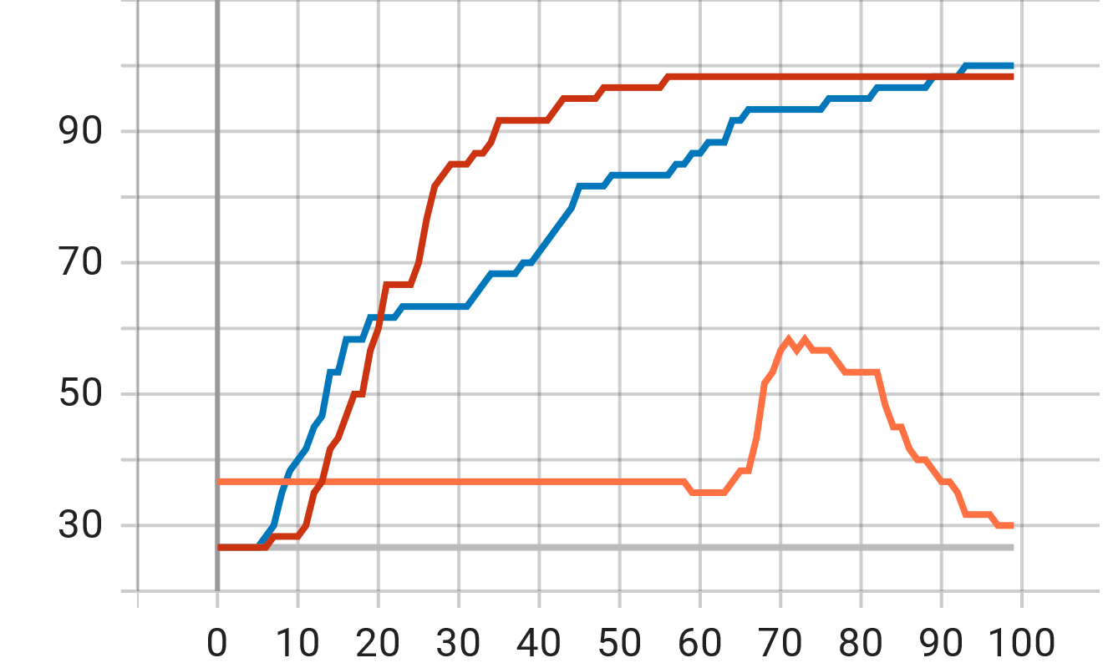
1 layered-Sigmoid
2 layered-Sigmoid
2 layered-ReLu
2 layered-Tanh
1 layered-Sigmoid
1 layered-Sigmoid
1 layered-Sigmoid
2 layered-Sigmoid
2 layered-Sigmoid
2 layered-Sigmoid
2 layered-ReLu
2 layered-ReLu
2 layered-ReLu
2 layered-Tanh
2 layered-Tanh
2 layered-Tanh
Adam
SGD

Slide 5
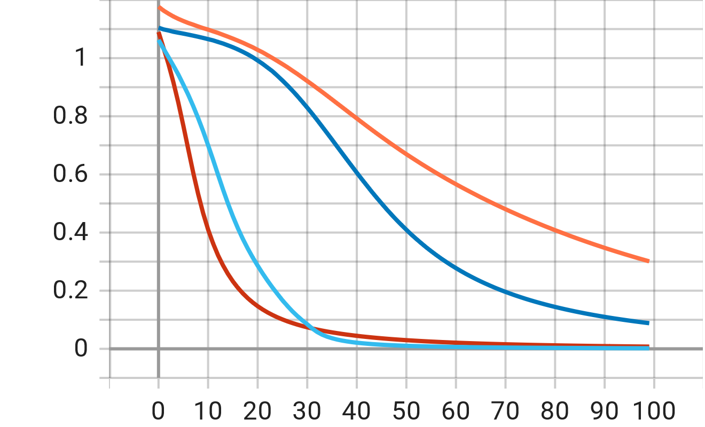
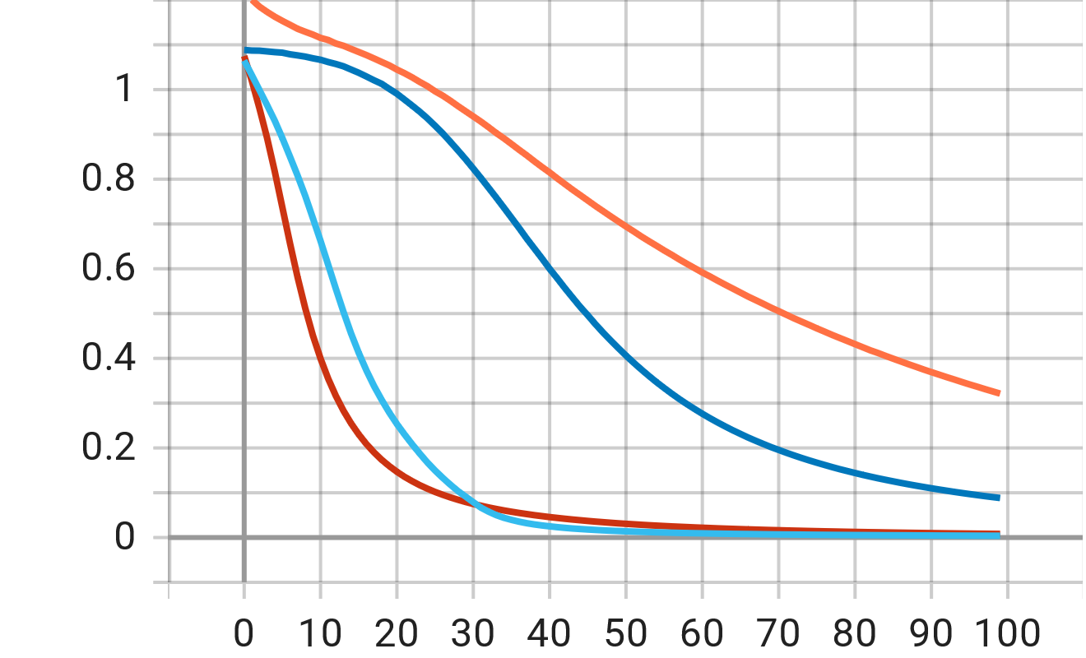
Loss
Adam
1 layered-Sigmoid
2 layered-Sigmoid
2 layered-ReLu
2 layered-Tanh
Training loss
Validation loss

Slide 6
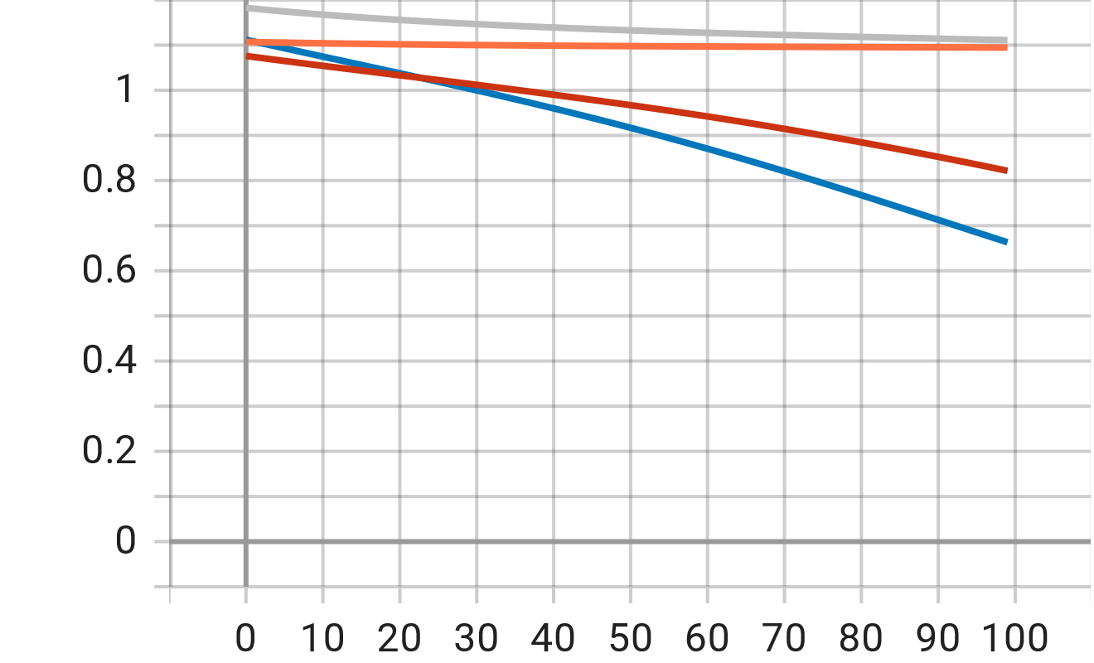
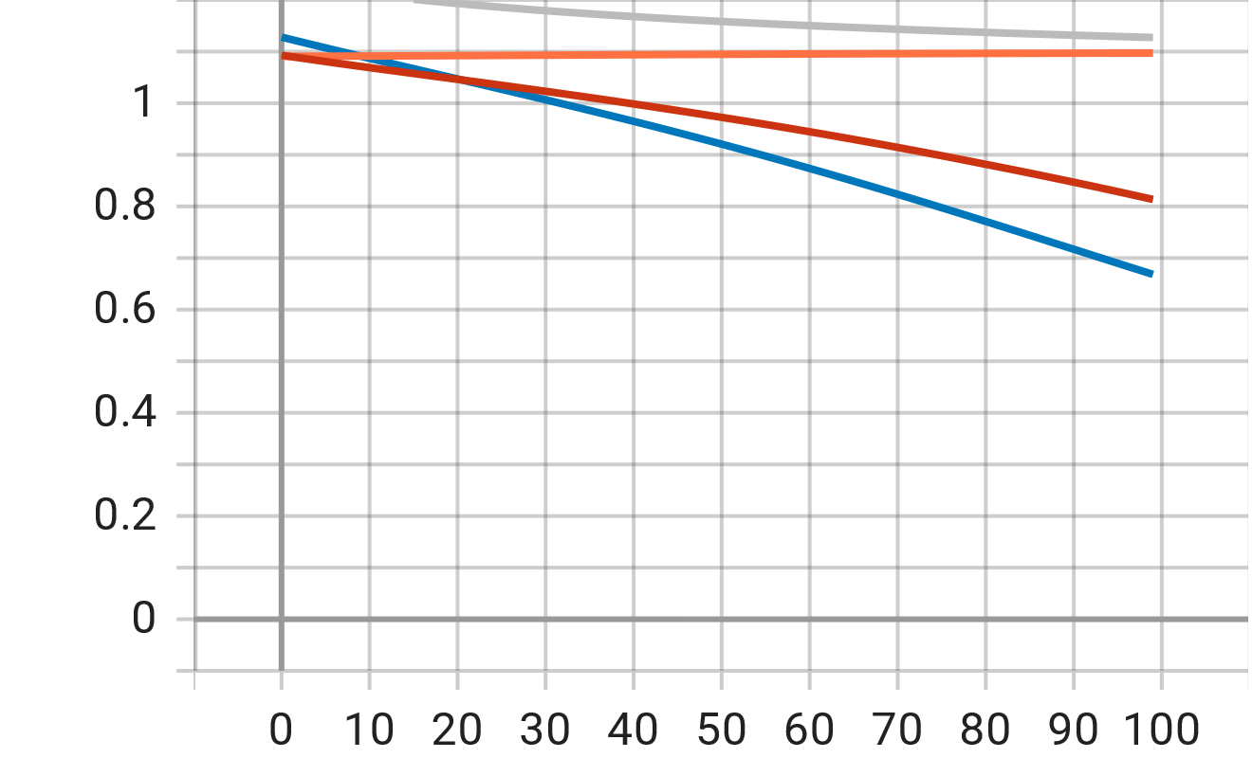
Loss
SGD
Training loss
Validation loss

