Slide 1
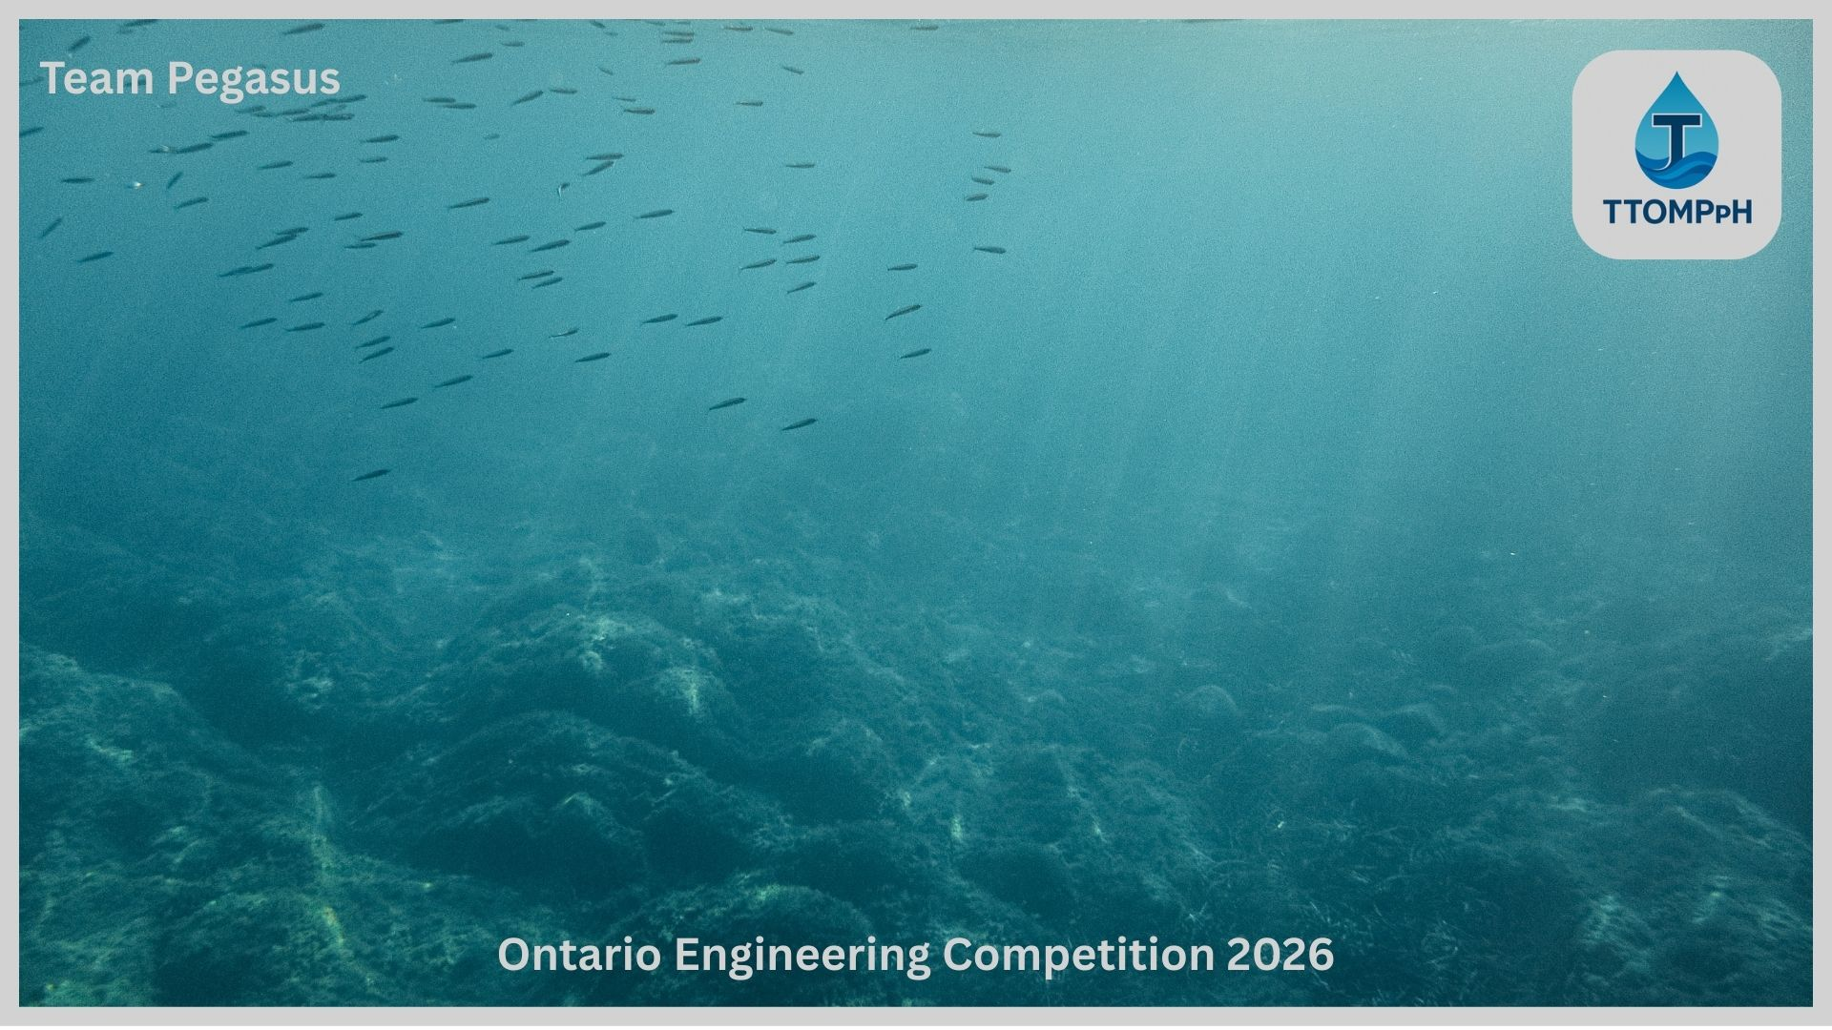
TTOMPH – Pioneering The Way For Microplastic Detection
Jan Wodnicki, Alex Hazen, and Oluwamurede Adetiba

Slide 2
What are 'Microplastics' ?
Plastic particles 5 mm or smaller
Found in water, food, air, soil, and everyday products
Primary microplastics: manufactured microbeads and fibers
Secondary microplastics: fragments from broken-down plastics
Small enough to enter bodies and ecosystems
Notes:
(Jan)

Slide 3
Ecological Impacts of MPs
Ingested by marine organisms
Bioaccumulate inside the food chain
Disrupt zooplankton, harming marine food webs
MPs are found everywhere
Notes:
(Alex)
Microplastics are now found throughout the ocean, from surface waters to deep-sea sediments
Because of their small size, they’re easily mistaken for food by marine organisms
Zooplankton, fish, and invertebrates ingest microplastics either directly or indirectly
These particles move up the food chain as predators consume contaminated prey
Ingestion of microplastics disrupt feeding, growth, and reproduction of marine life
Overall, microplastics weaken marine food webs and reduce ecosystem health

Slide 4
Aquaculture Industry
Global aquaculture production hit 130.9 million tonnes in 2022
This makes aquaculture over 50 % of aquatic animal production
System that can improve yield rates, can have real impact on the global scale
2022 production includes about 94.4 million tonnes of aquatic animals
Notes:
(Jan)
"The aquaculture industry has a massive global presence
Read FACTS
Having a reliable system MP detection system, that helps boost offspring fertility rates has the potential to become the new status quo rapidly

Slide 5
MP Detection Methods
FTIR, Raman and SEM-EDS
Expensive ($10,000 or more)
Lab-based (slow results)
Difficult to use
Notes:
(Alex)
FTIR, Raman, and SEM-EDS
Advanced material characterization techniques
Used to identify chemical composition and structure
FTIR (Fourier Transform Infrared Spectroscopy) Identifies chemical bonds and functional groups by measuring how a material absorbs infrared light.
Raman Spectroscopy Determines molecular structure by analyzing how laser light scatters when it interacts with a material.
SEM-EDS (Scanning Electron Microscopy with Energy-Dispersive X-ray Spectroscopy) SEM provides high-resolution images of a sample’s surface, while EDS identifies its elemental composition.
Expensive
Instruments cost $10,000+ (often much higher)
High maintenance and operating costs in specialized facilities
Lab-Based (Slow Results)
Difficult to Use
Requires technical training to operate
Complex setup and calibration
Data interpretation needs expert knowledge

Slide 6
Our Solution – TTOMPpH
Real-time Microplastics Detection
Cost Effective Design
App Connectivity
Portability
Field Ready
Notes:
(Alex)
Notes to mention and expand on
Real-time:
505nm laser (ideal for accurate detection)
slow flowing sample (maintains accuracy in isolated sensor area)
Cost Effective:
esp32 microcontroller (strong processing power for fair price)
Semi module (can opt out of not needed sensors for specific application)
App
Portability
Small,
Field Ready
Floating, sealed electronics

Slide 7
Our Solution – TTOMPpH: Prototype
Copper Construction
Prototype Demonstration
Modular Construction
Simple Maintenance
App based intuitive data access
Notes:
(Alex)
Copper
Readily available material
Modular construction
Can be adjusted for specific use case/location
Maintenance
Removable laser module
Hose barb fitting for standardization to pipe fittings

Slide 8
Our Solution – TTOMPpH: Live-monitoring App
Centralized Data Access
Intuitive User Interface
Real-Time Data Reporting
Easy, On the Go access
Notes:
(Jan)
Our application will provides users with an intuitive, easy data access through WiFi
It consolidates all the TTOMPH system data readings in real-time,
to allow marine animal farmers with all the relevant information to optimize the farming process

Slide 9
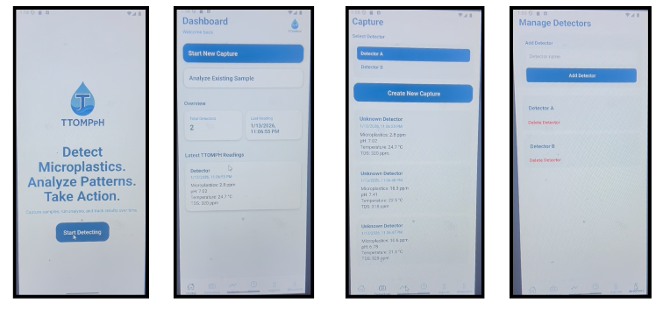
Our Solution – TTOMPpH: Live-monitoring App
Notes:
(Jan)
Here are some screenshots of the current state of our GUI.
The start detecting button prompts users to the menu page that allows users to choose between the three screens:
Dashboard, Capture and Manage Detectors
The dashboard screen allows the user to start new data captures
Captures are divided by detector to help facilitate scalabilty, as diferent water tanks may have different needs
Lastly we have a manage detection page to help us connect the detectors via WiFi
Ideally we are looking to have our app posted on the appstore and google playstore

Slide 10
Social & Economic Feasibility
New government regulations for tracking MPs
Human health impacts from high MP levels
Low-cost (relative to lab-based solutions)
Real-time tracking
Multi-sensor capabilities
Notes:
(Jan)
Our solution is cheaper than the current lab based methods
Currently, we'd have no competitors as no one inside the aquaculture industry has applied a MPs detection to their water quality systems making our design and idea more appealing for fish farmers
New EU MP regulations are demonstrating a global trend of rising public awareness in MPs
This could lead to a forced compliance to track MPs, which are system does

Slide 11
Future of TTOMPpH
Proof of Concept
Manufacturing Plan and Feature Refinement
Problem Statement
Prototype
Implementation of O2 Sensor and Machine Learning
Ideation/feasibility comparison
Testing and Validation
Design Iteration and Feature Enhancement
Notes:
(Alex)
Proof of concept (3d printed prototype)
Prototype (copper, current)
Manufacturing plan (aluminum/stainless steel machined)
O2 + ML (O2 is standalone and expensive so can be implemented last, ML to optimize turbidity + MP detection)

Slide 12
THANK YOU FOR LISTENING!

