Slide 1
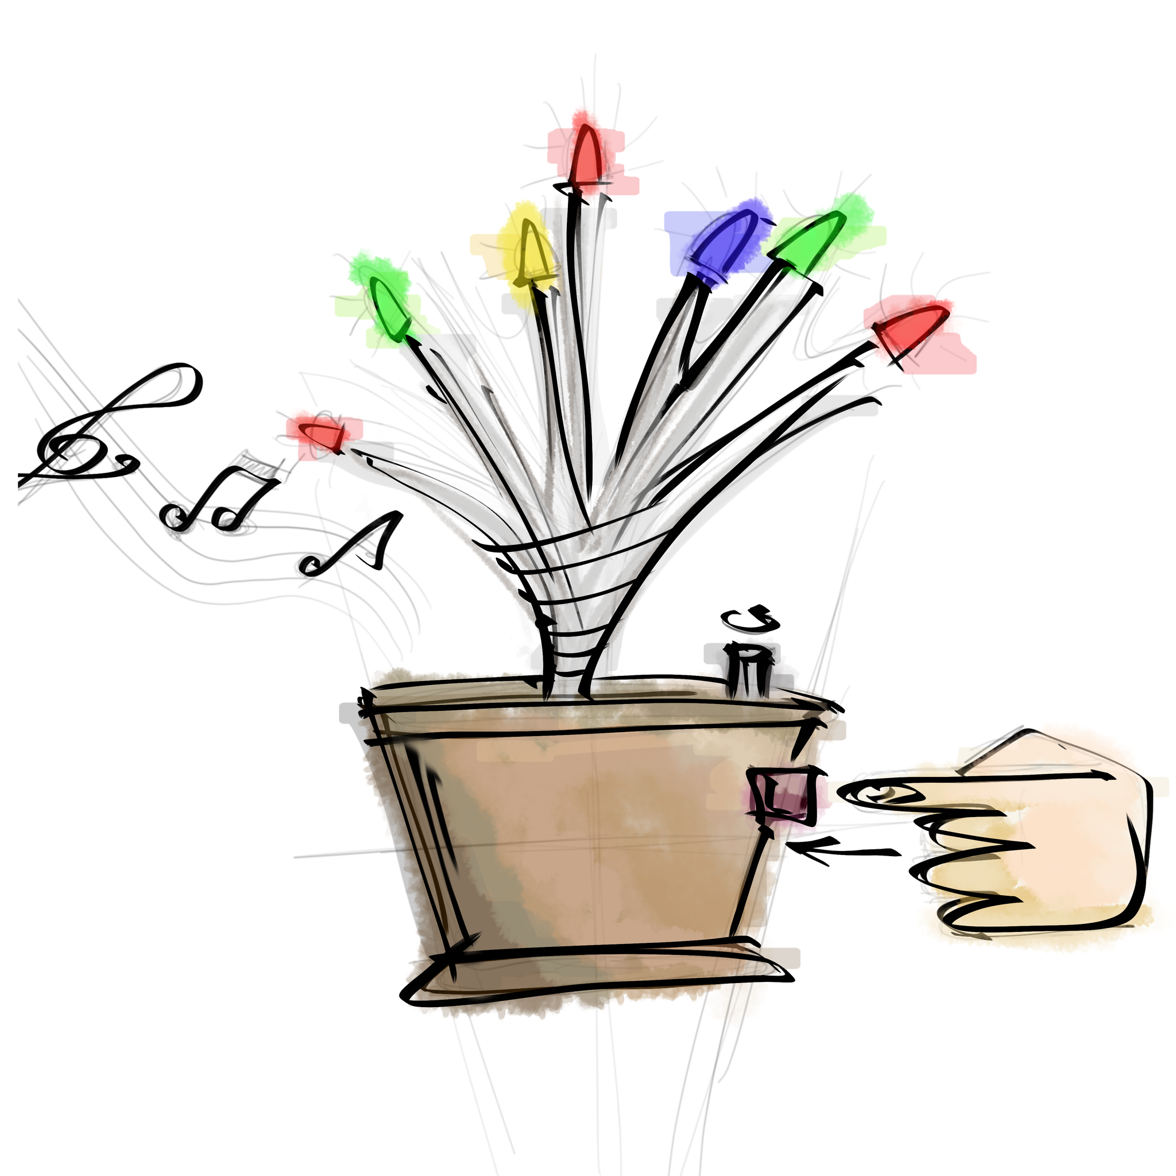
Musical Tree
Mureşan Bianca-Maria
January 2019

Slide 2
Description
The project is about making an electronic tree that come out of a pot with 20 branches and at the end of every branches there is a color LED (four colors in total). On the pot there is a button and for each press the current melody will change (three melodies in total). Also there will be a potentiometer for volume adjustment.
Input and output data
Input data:
button state (Low/High).
Output data:
the three melodies (the frequencies on buzzer);
the light on the branches (tthe voltage on the LEDs).

Slide 3
Physical Design
The component objects:
an Arduino board (ATmega328P);
a buzzer and a potentiometer;
a button;
5 LEDs of 4 colors each (red, blue, green and yellow);
a breadboard, resistors and wires.
Pot Design
To make the tree according to the description, on the bottom of the pot is glued the Arduino board and on the pot side there are two holes, one for power source and one to connecting the button. Over Arduino board is placed the breadboard of which it is connected the buzzer and over it there is a cover for the protections of the interior circuits. Also, on the cover is placed the potentiometer.

Slide 4
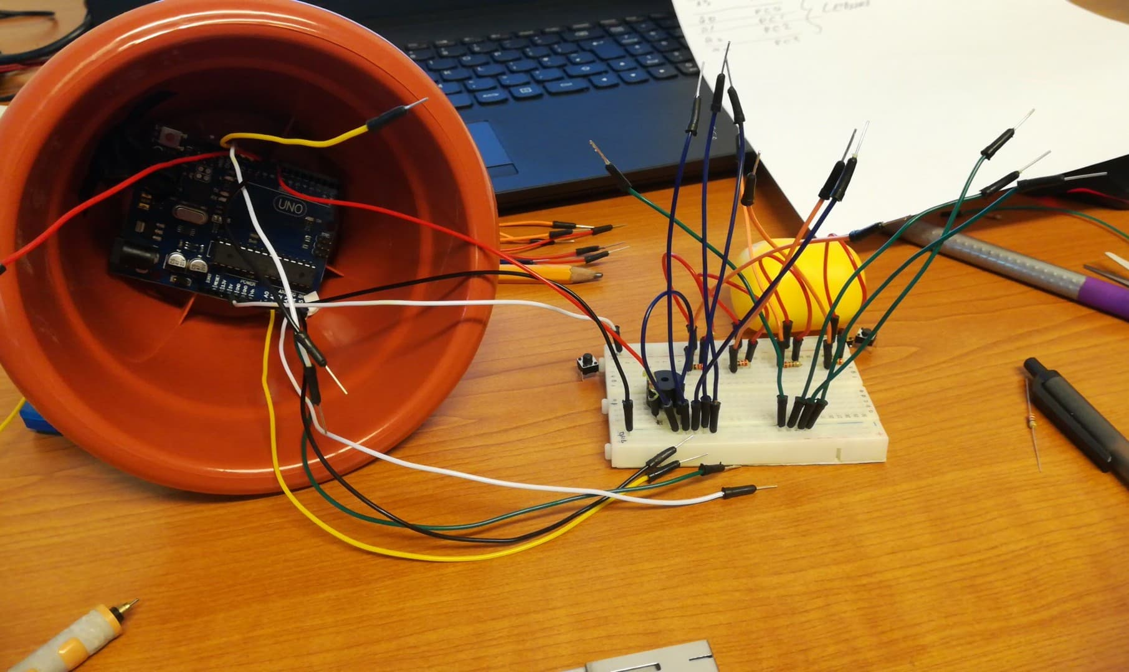
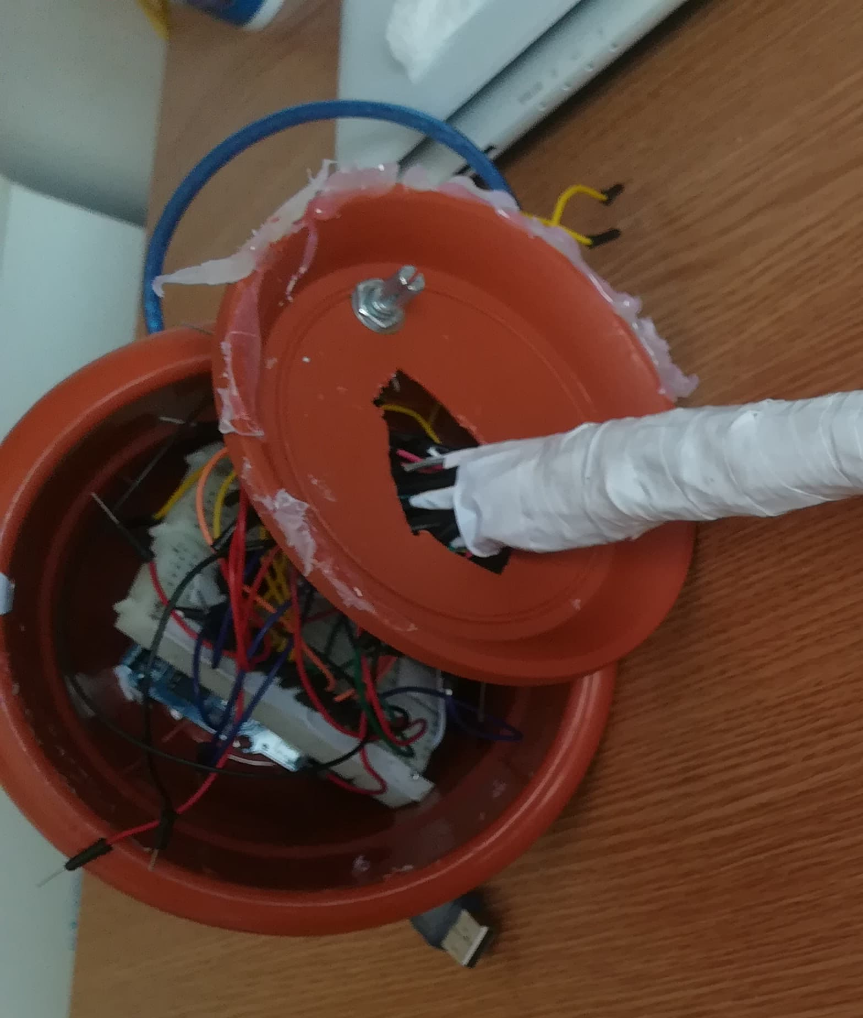
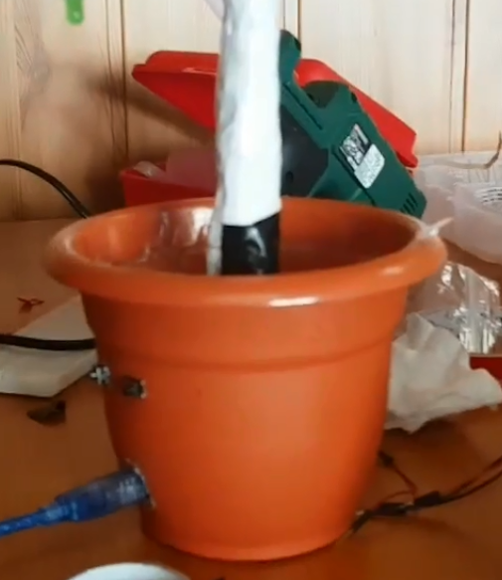
Arduino Board
Buzzer
Potentiometer
Breadboard
Cover
Button
Power Source

Slide 5
Button Design
Buzzer Design
The melodies notes are played with the help of the buzzer and the potentiometer. The buzzer play the note frequencies and the potentiometer adjust the volume. A buzzer pin is connected at the GND and the other is connected at the potentiometer. The other two potentiometer pins are connected at the GND and at the PB1 pin on the Arduino board.
The button is placed on the pot side, above the power source hole. The pot is drilled in four points in which are introduced the button's pins. Two of these pins are connected at GND and Vcc on the breadboard and the third pin is connected at the PD2 on the Arduino board to verify its state (Low/High).

Slide 6
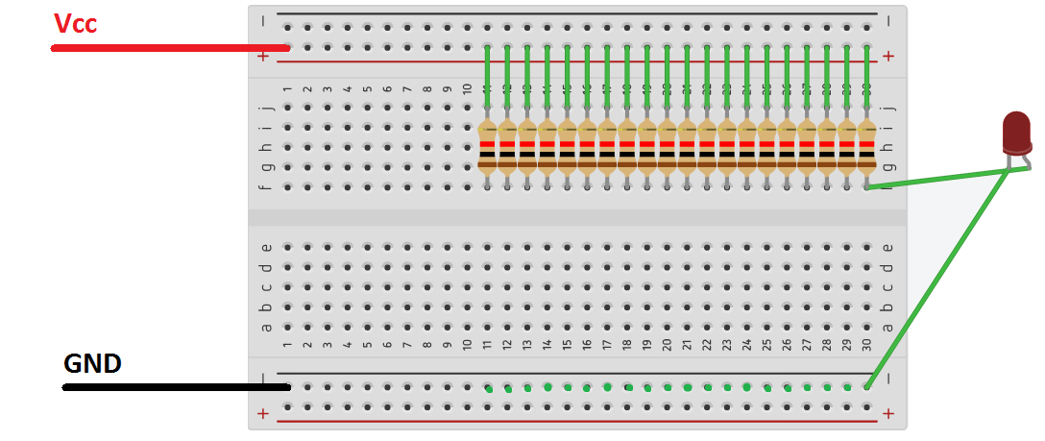
LEDs Design
First version:LEDs and resistors in parallel, connected at Vcc
We assume that each resistor is connected to a LED, like the last resistor from the picture above. The voltage from resistor-LED assembly(or circuit-nush cum suna mai bine) in series is equal with Vcc (5V) and the voltage on the LEDs varies depending on the resistors value.
In this version, the LEDs are always ON as long as the circuit is powered and we can't control them as we wish.

Slide 7
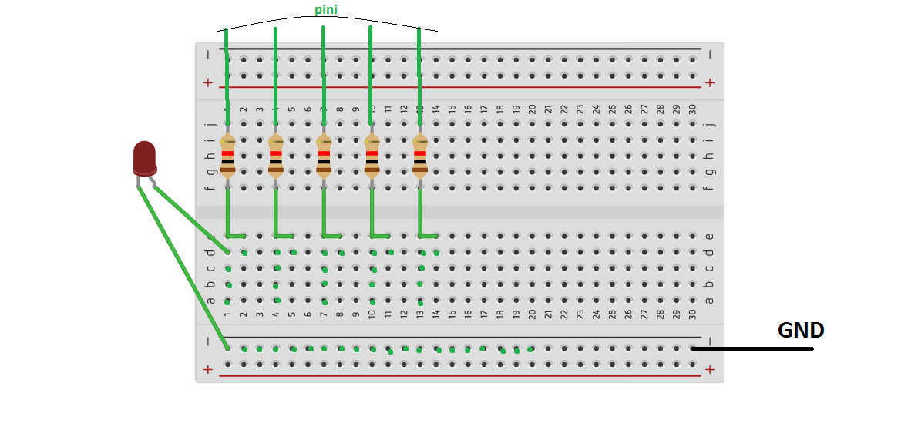
Second version: LEDs and resistors in parallel, connected at a control pin
We assume that we have four different control signal for four pins on the Arduino board to controlling five resistor-LED assembly in series, like in the picture above. Each of these four circuits of five resistor-LED assembly in series represents a color(red, green, yellow and blue). The resistor-LED assembly in series voltage (or The voltage of resistor-LED assembly in series) is equal with the control signal voltage when is ON (5V) and the LEDs voltage varies depending on resistor values.
This version allow us to control each color set, but we have to little current on a command pin (max 40mA).

Slide 8
This current is then split on the five resistor-LED assembly in series, so we have maxim 8mA on a branch, but we need minimum 10mA to turn on a LED..
Third version: All in series
This version assume that we have three command pins for three brenches thus: two LEDs and one resistor in series on two branches and one LED with one resistor on the third branch for each color, except the blue LEDs. The blue LEDs consume to much power and we can't connect them in series if we want them to shine at the full potential. In conclusion, we need five command pins for five LED-resistor assembly in series. To find out the value for each resistors I used the Ohm's law and I searched for the voltage for turning on each LED depending on its color.
Therefore, we need three pins for red, yellow, green sets and five pins for blue sets, in total fourteen pins to control the LEDs outputs.
That being said, this version will remain the final version.

Slide 9
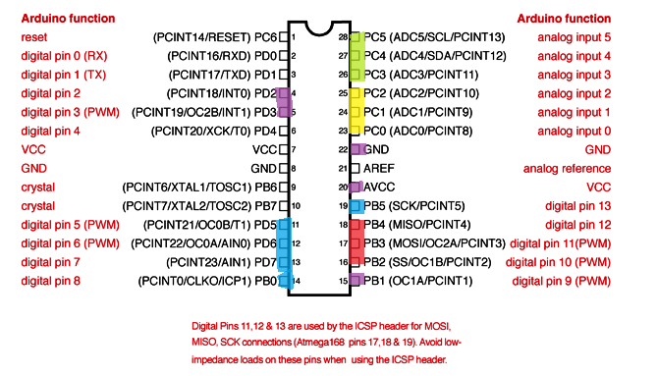
Pins choosing
The blue, red, yellow and green colored pins are the pins chosen for LEDs outputs and the purple ones are chosen for:
PB1 - the buzzer command signal. For this specific command pin we need to create PWM signal as output to play the frequency and the tempo of melodies notes. So we need a pin with OCR1A or OCR2B (from PD3 pin).
PD2 - this pin is reading the signal input from the button.

Slide 10
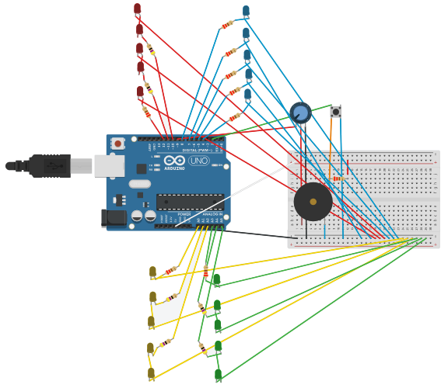
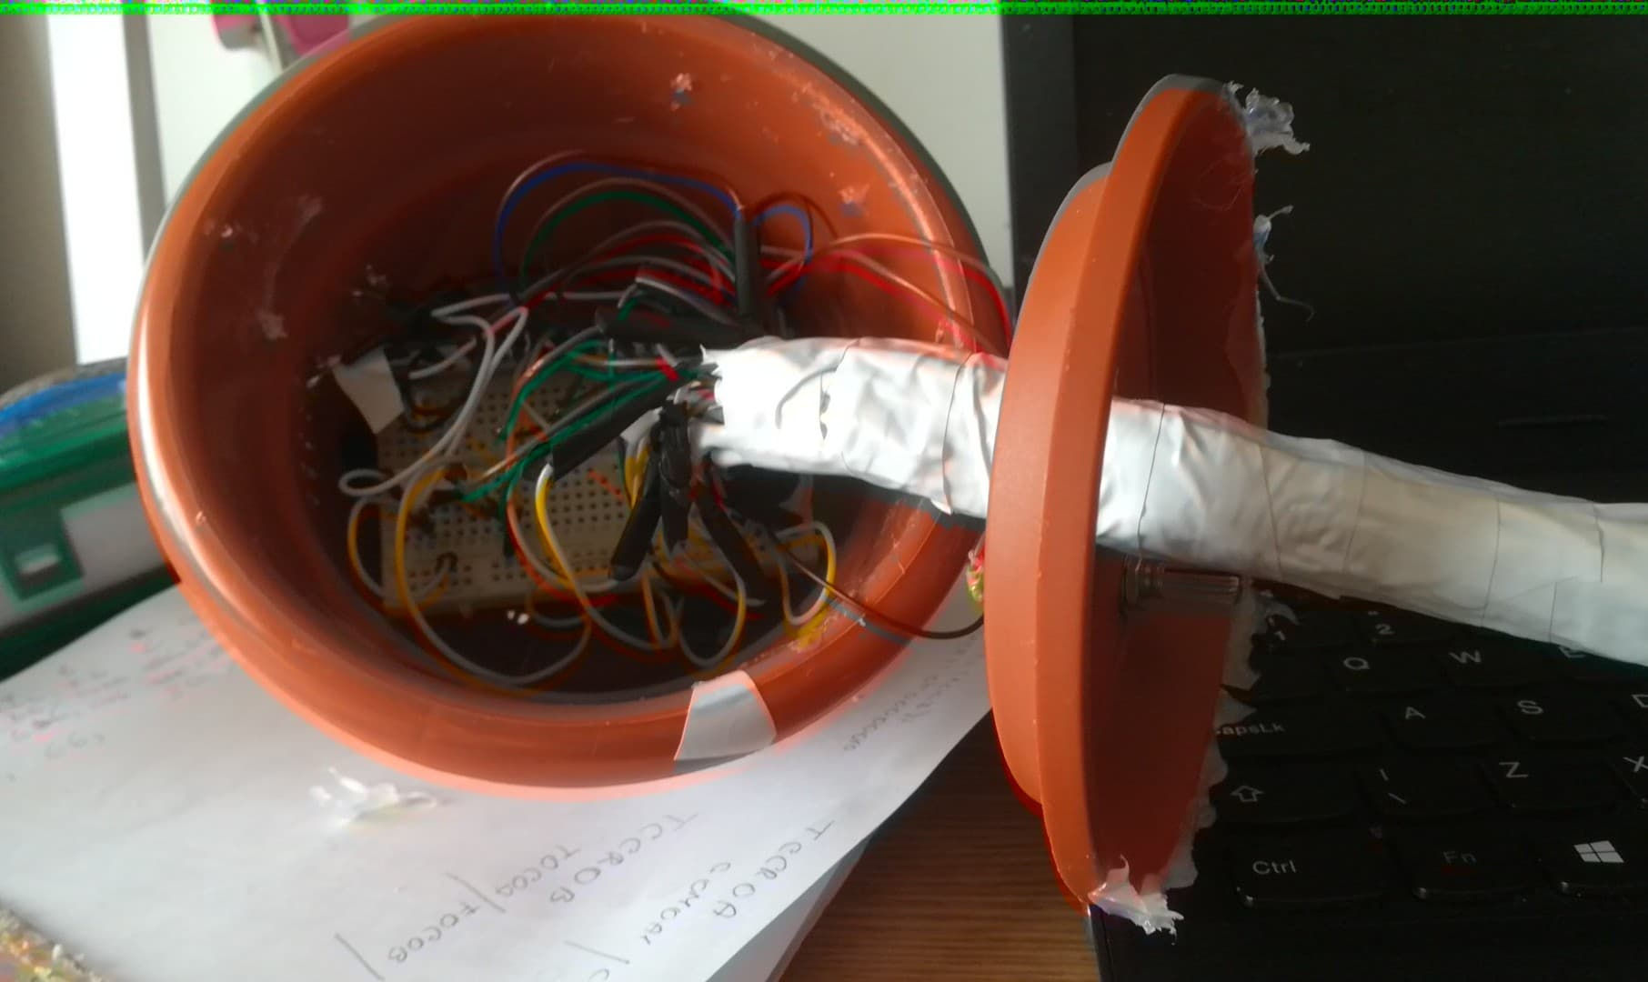
Physical Final Design

Slide 11
The code
Timer0 initialization::
void timer0_init() {
SREG = 1<<7;
TCCR0A = 0b00000010;
TCCR0B = 0b00000011;
TCNT0 = 0;
OCR0A = 250;
TIMSK0 |= 0b00000010;
}
// Global Interrupt Enable
//normal port operation,
// OC0A si OC0B disconnect,
//CTC with OCRA,
//64 prescaler
//timer0 counting register
//16.000.000/64=250.000/250=1.000Hz
//=>T=1ms
//Enables internal
//output comparison interrupts
// for OCR0A
Interrupts initialization:
void interrupt_init(){
EIMSK=0b00000011;
EICRA=0b00001010;
}
//acvtivate the external interrupts
//positive edge INT0 and INT1
//(PD2)

Slide 12
Buzzer initialization:
void buzzer_init(){
DDRB |= 0b00000010;
TCCR1A = 0b01000000;
TCCR1B = 0b00001010;
TCCR1C = 0b00000000;
}
//PB1 is set as an output
//for the buzzer's PWM signal
// the setings for the timer as //CTC, clk/8 prescaler,
//toogle OC1A compare //match
Button initialization:
void button_int(){
DDRD &=~ 0b00000100;
}
//PD2 - switch the melody
LEDs initialization:
void LEDs_init(){
DDRC |= 0b00000111; DDRC |= 0b00111000;
DDRB |= 0b00111101; DDRD |= 0b11100000;
}
//yellow output
//green output
//red output
//iblue output

Slide 13
Main:
Global Variables:
1. All the notes frequencies that we use (ex: float C4 = 261.63;);
2. The tempo for melodies (int sec;);
3. The arrays which contains all the notes in order and the arrays which contains timing for each note depending on the tempo;
4. The milliseconds(long int ms = 0;), the counter for traversing (??) the melodies arrays (int i =0;) and the TOP variable used for frequency(long int TOP;);
5. The counter for switching the melodies arrays (int contor= -1;).
Interrupts:
int main(){
timer0_init();
buzzer_init();
button_int();
LEDs_init();
interrupt_init();
while(1){
}
}
ISR(INT0_vect){
contor++;
i=0;
ms=0;
if(contor==3)
contor=0;
}
//Its activating at button press (PD2) and the program is stopping and running the interrupt.

Slide 14
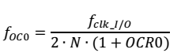
PWM signal:
To generate an output signal in CTC mode, the OC0 pin has to be set as digital output. The output mode for OC0 can be set to toggle every time its find a equality between TCNT0 and OCR0.The signal frequency is defined by the following equation:
where the fclk_I/O is the internal sistem clock frequency, N is the prescaler value(1, 8, 64, 256, 1024) and ORC0 is the register value.
In our case the equation above becomes :
TOP = 1000000/frequency
OCR1A = (TOP+1)/2

